Slide 1

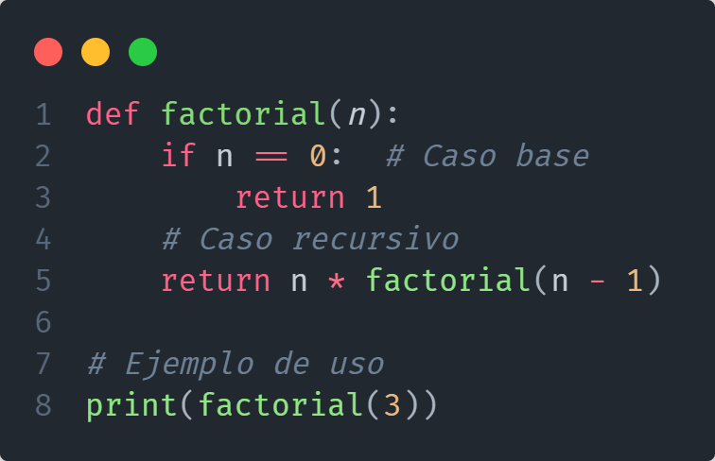



Slide 3
factorial(3)

Slide 4

factorial(3)

Slide 5

factorial(3)

Slide 6
factorial(3)

Slide 7
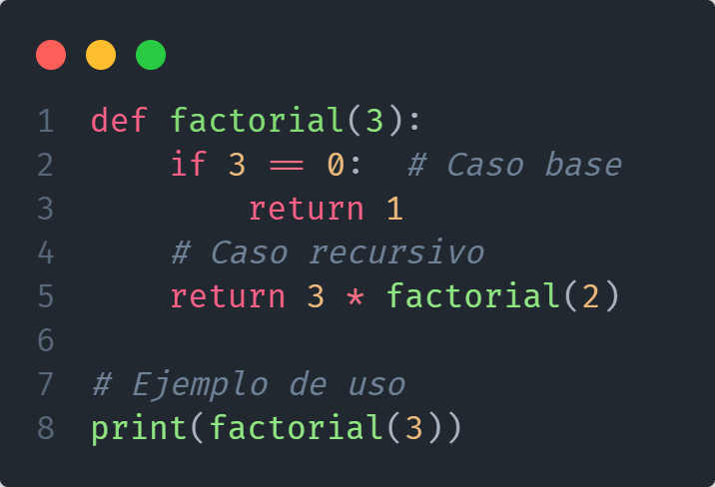
factorial(3)

Slide 8
factorial(2)
factorial(3)

Slide 9
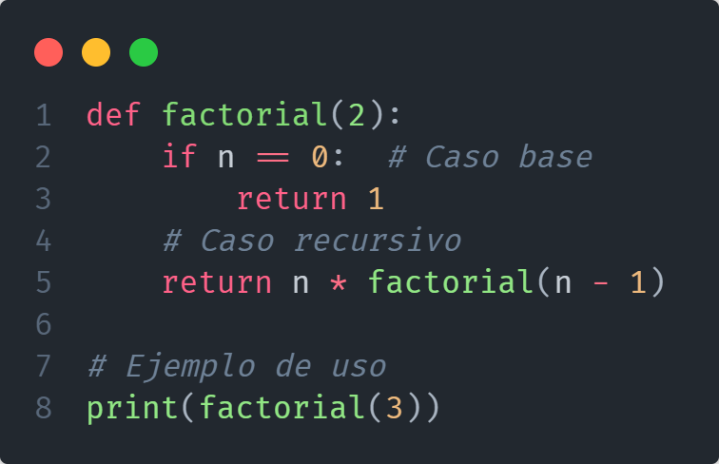
factorial(2)
factorial(3)

Slide 10

factorial(2)
factorial(3)

Slide 11
factorial(2)
factorial(3)

Slide 12
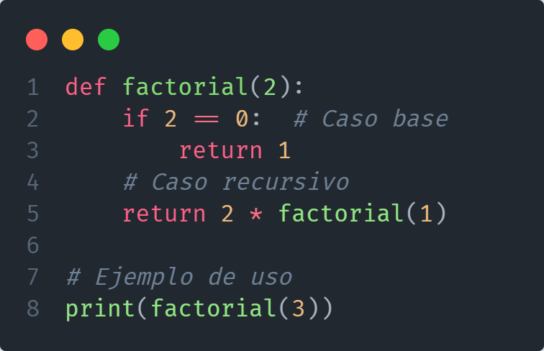
factorial(2)
factorial(3)

Slide 13
factorial(1)
factorial(2)
factorial(3)

Slide 14

factorial(1)
factorial(2)
factorial(3)

Slide 15

factorial(1)
factorial(2)
factorial(3)

Slide 16
factorial(1)
factorial(2)
factorial(3)

Slide 17
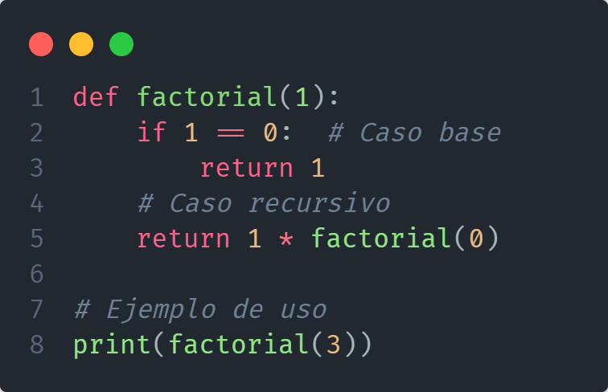
factorial(1)
factorial(2)
factorial(3)

Slide 18
factorial(0)
factorial(1)
factorial(2)
factorial(3)

Slide 19

factorial(0)
factorial(1)
factorial(2)
factorial(3)

Slide 20
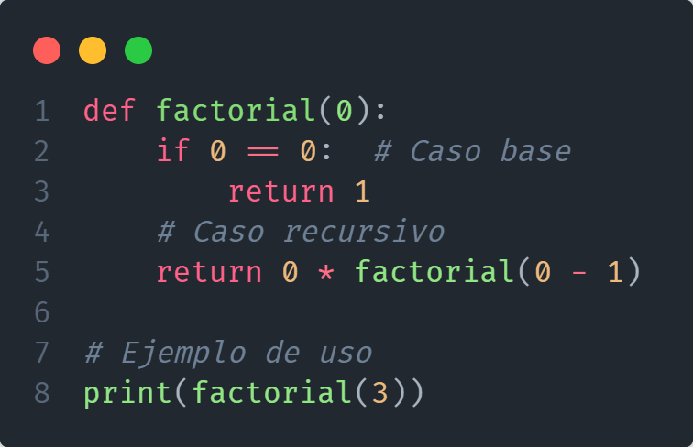
factorial(0)
factorial(1)
factorial(2)
factorial(3)

Slide 21
factorial(0)
factorial(1)
factorial(2)
factorial(3)

Slide 22
factorial(0)
factorial(1)
factorial(2)
factorial(3)

Slide 23
factorial(0) = 1
factorial(1)
factorial(2)
factorial(3)

Slide 24
factorial(0) = 1
factorial(1)
factorial(2)
factorial(3)

Slide 25
factorial(0) = 1
factorial(1)
factorial(2)
factorial(3)

Slide 26
factorial(0) = 1
factorial(1)
factorial(2)
factorial(3)

Slide 27
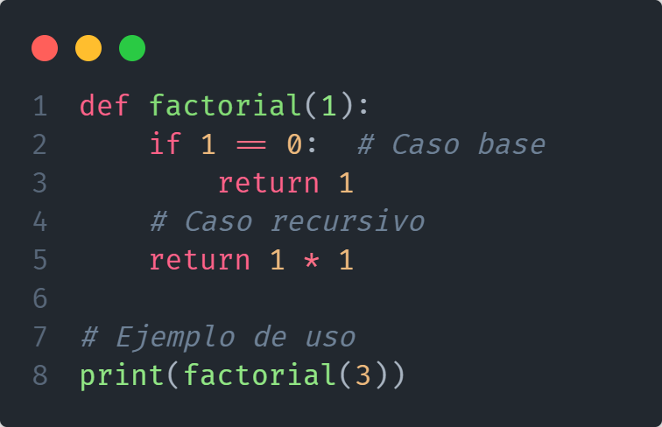
factorial(1)
factorial(2)
factorial(3)

Slide 28
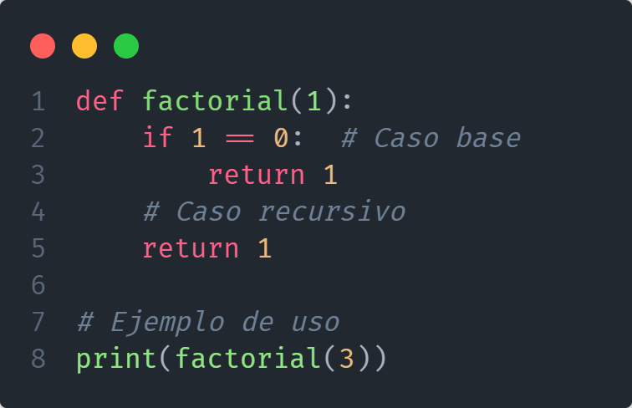
factorial(1)
factorial(2)
factorial(3)

Slide 29
factorial(1) = 1
factorial(2)
factorial(3)

Slide 30
factorial(1) = 1
factorial(2)
factorial(3)

Slide 31
factorial(1) = 1
factorial(2)
factorial(3)

Slide 32
factorial(1) = 1
factorial(2)
factorial(3)

Slide 33
factorial(1) = 1
factorial(2)
factorial(3)

Slide 34

factorial(2)
factorial(3)

Slide 35

factorial(2)
factorial(3)

Slide 36
factorial(2) = 2
factorial(3)

Slide 37

factorial(2) = 2
factorial(3)

Slide 38
factorial(2) = 2
factorial(3)

Slide 39
factorial(2) = 2
factorial(3)

Slide 40
factorial(2) = 2
factorial(3)

Slide 41

factorial(3)

Slide 42

factorial(3)

Slide 43
factorial(3) = 6

Slide 44
factorial(3) = 6

Slide 45
factorial(3) = 6

Slide 46
factorial(3) = 6

Slide 47
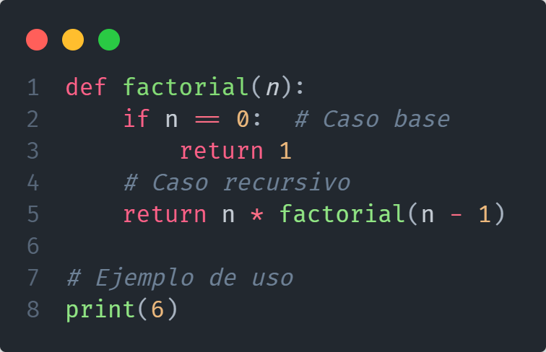

Slide 48

Salida en la terminal

