Slide 1
Topic Overview
Implicit Parallelism: Trends in Microprocessor Architectures
Limitations of Memory System Performance
Dichotomy of Parallel Computing Platforms
Communication Model of Parallel Platforms
Physical Organization of Parallel Platforms
Communication Costs in Parallel Machines
Messaging Cost Models and Routing Mechanisms
Mapping Techniques
Case Studies

Slide 2
Scope of Parallelism
Instruction Level Parallelism
Super-scalar execution
Prefetching
Latency, Memory bandwidth
Pipelining, caching
It is important to understand each of these performance bottlenecks.

Slide 3
Implicit Parallelism: Trends in Microprocessor Architectures
Microprocessor clock speeds have posted impressive gains over the past two decades (two to three orders of magnitude).
However, memory wall
Current processors use these resources in multiple functional units and execute multiple instructions in the same cycle.

Slide 4
Pipelining and Superscalar Execution
Pipelining overlaps various stages of instruction execution to achieve performance.
At a high level of abstraction, an instruction can be executed while the next one is being decoded and the next one is being fetched.
This is akin to an assembly line for manufacture of cars.

Slide 5
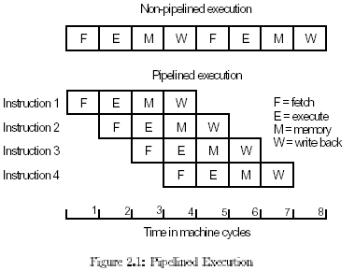
Pipelining
Sequential: each h/w stage idle 75% of the time. time_{ex} = 4 * i
Parallel: each h/w stage working after filling the pipeline. time_{ex} = 3 + i

Slide 6
Pipelining
Executing the mov instruction, while fetching the sub instruction
.global main
main:
save %sp, -96, %sp
mov 9, %l0 !initialize x
sub %l0, 1, %o0 !(x - 1) into %o0
call .mul
sub %l0, 7, %o1 !(x - 7) into %o1
call .div
sub %l0, 11, %o1 !(x - 11) into %o1, the divisor
mov %o0, %l1 !store it in y
ret ! end the program
restore
EXECUTE →
FETCH →

Slide 7
Pipelining
Now executing the sub instruction, while fetching the call instruction
.global main
main:
save %sp, -96, %sp
mov 9, %l0 !initialize x
sub %l0, 1, %o0 !(x - 1) into %o0
call .mul
sub %l0, 7, %o1 !(x - 7) into %o1
call .div
sub %l0, 11, %o1 !(x - 11) into %o1, the divisor
mov %o0, %l1 !store it in y
ret ! end the program
restore
EXECUTE →
FETCH →

Slide 8
Pipelining
Now executing the call instruction, while fetching the sub instruction
.global main
main:
save %sp, -96, %sp
mov 9, %l0 !initialize x
sub %l0, 1, %o0 !(x - 1) into %o0
call .mul
sub %l0, 7, %o1 !(x - 7) into %o1
call .div
sub %l0, 11, %o1 !(x - 11) into %o1, the divisor
mov %o0, %l1 !store it in y
ret ! end the program
restore
EXECUTE →
FETCH →

Slide 9
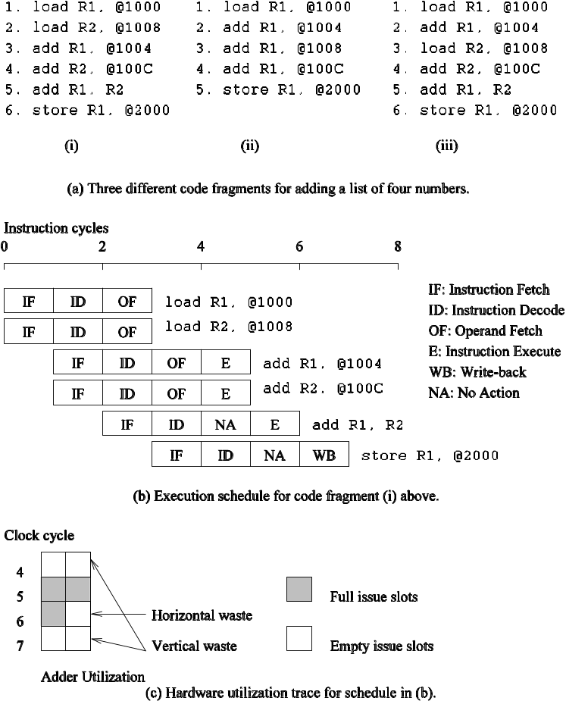
Superscalar Execution: An Example
Example of a two-way superscalar execution of instructions.

Slide 10
Superscalar Execution: An Example
In the above example, there is some wastage of resources due to data dependencies.
The example also illustrates that different instruction mixes with identical semantics can take significantly different execution time.

Slide 11
Superscalar Execution
Scheduling of instructions is determined by a number of factors:
  True Data Dependency: The result of one operation is an input to the next.
  Resource Dependency: Two operations require the same resource.
  Branch Dependency: Scheduling instructions across conditional branch statements cannot be done deterministically a-priori.
  The scheduler, a piece of hardware looks at a large number of instructions in an instruction queue and selects appropriate number of instructions to execute concurrently based on these factors.

Slide 12
Superscalar Execution:
Issue Mechanisms
In the simpler model, instructions can be issued only in the order in which they are encountered. That is, if the second instruction cannot be issued because it has a data dependency with the first, only one instruction is issued in the cycle. This is called in-order issue.
In a more aggressive model, instructions can be issued out-of-order. In this case, if the second instruction has data dependencies with the first, but the third instruction does not, the first and third instructions can be co-scheduled. This is also called dynamic issue.
Performance of in-order issue is generally limited.

Slide 13
Limitations of
Memory System Performance
Memory system, and not processor speed, is often the bottleneck for many applications.
Memory system performance is largely captured by two parameters, latency and bandwidth.
Latency is the time from the issue of a memory request to the time the data is available at the processor.
Bandwidth is the rate at which data can be pumped to the processor by the memory system.

Slide 14
Memory System Performance: Bandwidth and Latency
It is very important to understand the difference between latency and bandwidth.
Consider the example of a fire-hose. If the water comes out of the hose two seconds after the hydrant is turned on, the latency of the system is two seconds.
Once the water starts flowing, if the hydrant delivers water at the rate of 5 gallons/second, the bandwidth of the system is 5 gallons/second.
If you want immediate response from the hydrant, it is important to reduce latency.
If you want to fight big fires, you want high bandwidth.

Slide 15
Memory Latency: An Example
Consider a processor operating at 1 GHz (1 ns clock) connected to a DRAM with a latency of 100 ns (no caches). Assume that the processor has two multiply-add units and is capable of executing four instructions in each cycle of 1 ns. The following observations follow:
  The peak processor rating is 4 GFLOPS.
  Since the memory latency is equal to 100 cycles and block size is one word, every time a memory request is made, the processor must wait 100 cycles before it can process the data.

Slide 16
Memory Latency: An Example
On the above architecture, consider the problem of computing a dot-product of two vectors.
  A dot-product computation performs one multiply-add on a single pair of vector elements, i.e., each floating point operation requires one data fetch.
  It follows that the peak speed of this computation is limited to one floating point operation every 100 ns, or a speed of 10 MFLOPS, a very small fraction of the peak processor rating!

Slide 17
Improving Effective Memory
Latency Using Caches
Caches are small and fast memory elements between the processor and DRAM.
This memory acts as a low-latency high-bandwidth storage.
If a piece of data is repeatedly used, the effective latency of this memory system can be reduced by the cache.
The fraction of data references satisfied by the cache is called the cache hit ratio of the computation on the system.
Cache hit ratio achieved by a code on a memory system often determines its performance.

Slide 18
Impact of Caches: Example
Consider the architecture from the previous example. In this case, we introduce a cache of size 32 KB with a latency of 1 ns or one cycle. We use this setup to multiply two matrices A and B of dimensions 32 × 32. We have carefully chosen these numbers so that the cache is large enough to store matrices A and B, as well as the result matrix C.

Slide 19
Impact of Caches: Example (continued)
The following observations can be made about the problem:
  Fetching the two matrices into the cache corresponds to fetching 2K words, which takes approximately 200 µs.
  Multiplying two n × n matrices takes 2n³ operations. For our problem, this corresponds to 64K operations, which can be performed in 16K cycles (or 16 µs) at four instructions per cycle.
  The total time for the computation is therefore approximately the sum of time for load/store operations and the time for the computation itself, i.e., 200 + 16 µs.
  This corresponds to a peak computation rate of 64K/216 or 303 MFLOPS.

Slide 20
Impact of Caches
Repeated references to the same data item correspond to temporal locality.
In our example, we had O(n²) data accesses and O(n³) computation. This asymptotic difference makes the above example particularly desirable for caches.
• Data reuse is critical for cache performance.

Slide 21
Impact of Memory Bandwidth
Memory bandwidth is determined by the bandwidth of the memory bus as well as the memory units.
• Memory bandwidth can be improved by increasing the size of memory blocks.
The underlying system takes l time units (where l is the latency of the system) to deliver b units of data (where b is the block size).

Slide 22
Impact of Memory Bandwidth: Example
Consider the same setup as before, except in this case, the block size is 4 words instead of 1 word. We repeat the dot-product computation in this scenario:
  Assuming that the vectors are laid out linearly in memory, eight FLOPs (four multiply-adds) can be performed in 200 cycles.
  This is because a single memory access fetches four consecutive words in the vector.
  Therefore, two accesses can fetch four elements of each of the vectors. This corresponds to a FLOP every 25 ns, for a peak speed of 40 MFLOPS.

Slide 23
Impact of Memory Bandwidth
The above examples clearly illustrate how increased bandwidth results in higher peak computation rates.
The data layouts were assumed to be such that consecutive data words in memory were used by successive instructions (spatial locality of reference).
If we take a data-layout centric view, computations must be reordered to enhance spatial locality of reference.

Slide 24
Impact of Memory Bandwidth: Example
Consider the following code fragment:
for (i = 0; i < 1000; i++)
column_sum[i] = 0.0;
for (j = 0; j < 1000; j++)
column_sum[i] += b[j][i];
The code fragment sums columns of the matrix b into a vector column_sum.

Slide 25
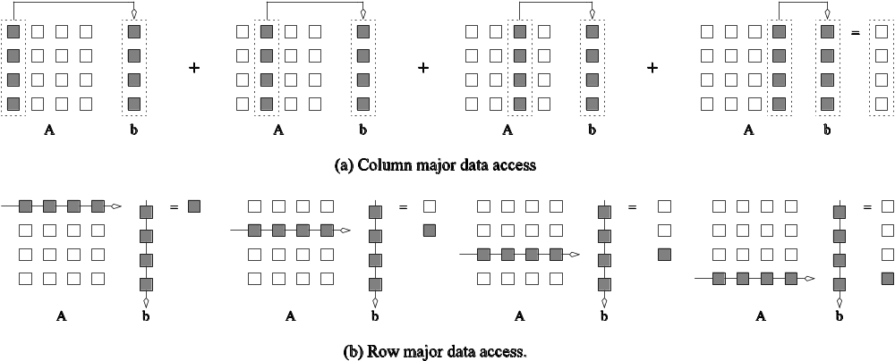
Impact of Memory Bandwidth: Example
The vector column_sum is small and easily fits into the cache
The matrix b is accessed in a column order.
The strided access results in very poor performance.
Multiplying a matrix with a vector: (a) multiplying column-by-column, keeping a running sum; (b) computing each element of the result as a dot product of a row of the matrix with the vector.

Slide 26
Impact of Memory Bandwidth: Example
We can fix the above code as follows:
for (i = 0; i < 1000; i++)
column_sum[i] = 0.0;
for (j = 0; j < 1000; j++)
for (i = 0; i < 1000; i++)
column_sum[i] += b[j][i];
In this case, the matrix is traversed in a row-order and performance can be expected to be significantly better.

Slide 27
Memory System Performance: Summary
The series of examples presented in this section illustrate the following concepts:
  Exploiting spatial and temporal locality in applications is critical for amortizing memory latency and increasing effective memory bandwidth.
  The ratio of the number of operations to number of memory accesses is a good indicator of anticipated tolerance to memory bandwidth.
  Memory layouts and organizing computation appropriately can make a significant impact on the spatial and temporal locality.

Slide 28
Alternate Approaches for
Hiding Memory Latency
Consider the problem of browsing the web on a very slow network connection. We deal with the problem in one of three possible ways:
  we anticipate which pages we are going to browse ahead of time and issue requests for them in advance;
  we open multiple browsers and access different pages in each browser, thus while we are waiting for one page to load, we could be reading others; or
  we access a whole bunch of pages in one go - amortizing the latency across various accesses.
The first approach is called prefetching, the second multithreading, and the third one corresponds to spatial locality in accessing memory words.

Slide 29
Multithreading for Latency Hiding
A thread is a single stream of control in the flow of a program.
We illustrate threads with a simple example:
for (i = 0; i < n; i++)
c[i] = dot_product(get_row(a, i), b);
Each dot-product is independent of the other, and therefore represents a concurrent unit of execution. We can safely rewrite the above code segment as:
for (i = 0; i < n; i++)
c[i] = create_thread(dot_product,get_row(a, i), b);

Slide 30
Multithreading for Latency Hiding: Example
In the code, the first instance of this function accesses a pair of vector elements and waits for them.
In the meantime, the second instance of this function can access two other vector elements in the next cycle, and so on.
After l units of time, where l is the latency of the memory system, the first function instance gets the requested data from memory and can perform the required computation.
In the next cycle, the data items for the next function instance arrive, and so on. In this way, in every clock cycle, we can perform a computation.

Slide 31
Tradeoffs of Multithreading
Multithreading and prefetching are critically impacted by the memory bandwidth. Consider the following example:
  Consider a computation running on a machine with a 1 GHz clock, 4-word cache line, single cycle access to the cache, and 100 ns latency to DRAM. The computation has a cache hit ratio at 1 KB of 25% and at 32 KB of 90%. Consider two cases: first, a single threaded execution in which the entire cache is available to the serial context, and second, a multithreaded execution with 32 threads where each thread has a cache residency of 1 KB.
  If the computation makes one data request in every cycle of 1 ns, you may notice that the first scenario requires 400MB/s of memory bandwidth and the second, 3GB/s.

Slide 32
Tradeoffs of Multithreading and Prefetching
Bandwidth requirements of a multithreaded system may increase very significantly because of the smaller cache residency of each thread.
Multithreaded systems become bandwidth bound instead of latency bound.
Multithreading and prefetching only address the latency problem and may often exacerbate the bandwidth problem.
Multithreading and prefetching also require significantly more hardware resources in the form of storage.

Slide 33
Explicitly Parallel Platforms

Slide 34
Dichotomy of Parallel Computing Platforms
An explicitly parallel program must specify concurrency and interaction between concurrent subtasks.
The former is sometimes also referred to as the control structure and the latter as the communication model.

Slide 35
Control Structure of Parallel Programs
Parallelism can be expressed at various levels of granularity - from instruction level to processes.
Between these extremes exist a range of models, along with corresponding architectural support.

Slide 36
Control Structure of Parallel Programs
Processing units in parallel computers either operate under the centralized control of a single control unit or work independently.
If there is a single control unit that dispatches the same instruction to various processors (that work on different data), the model is referred to as single instruction stream, multiple data stream (SIMD).
If each processor has its own control control unit, each processor can execute different instructions on different data items. This model is called multiple instruction stream, multiple data stream (MIMD).

Slide 37
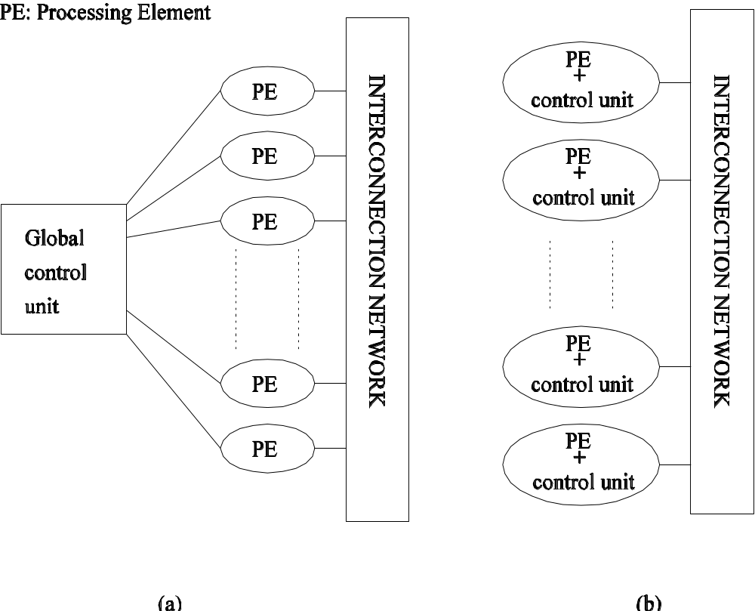
SIMD and MIMD Processors
A typical SIMD architecture (a) and a typical MIMD architecture (b).

Slide 38
SIMD Processors
Some of the earliest parallel computers such as the Illiac IV, MPP, DAP, CM-2, and MasPar MP-1 belonged to this class of machines.
Variants of this concept have found use in co-processing units such as the MMX units in Intel processors and DSP chips such as the Sharc.
SIMD relies on the regular structure of computations (such as those in image processing).
It is often necessary to selectively turn off operations on certain data items. For this reason, most SIMD programming paradigms allow for an ``activity mask'', which determines if a processor should participate in a computation or not.

Slide 39
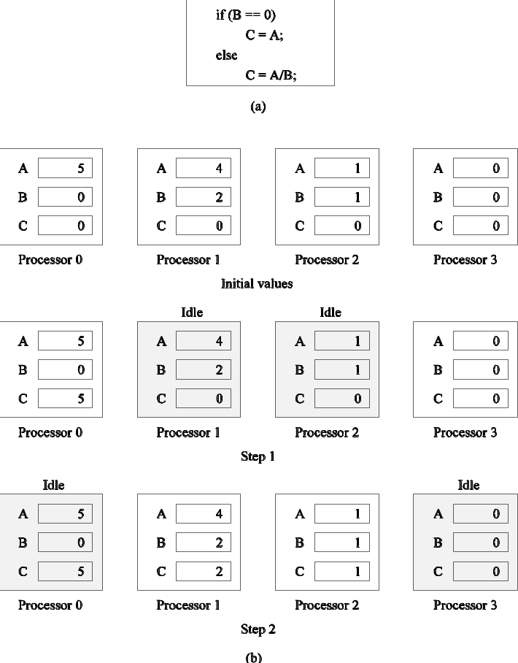
Conditional Execution in SIMD Processors
Executing a conditional statement on an SIMD computer with four processors: (a) the conditional statement; (b) the execution of the statement in two steps.

Slide 40
MIMD Processors
In contrast to SIMD processors, MIMD processors can execute different programs on different processors.
A variant of this, called single program multiple data streams (SPMD) executes the same program on different processors.
It is easy to see that SPMD and MIMD are closely related in terms of programming flexibility and underlying architectural support.
Examples of such platforms include current generation Sun Ultra Servers, SGI Origin Servers, multiprocessor PCs, workstation clusters, and the IBM SP.

Slide 41
SIMD-MIMD Comparison
SIMD computers require less hardware than MIMD computers (single control unit).
However, since SIMD processors ae specially designed, they tend to be expensive and have long design cycles.
Not all applications are naturally suited to SIMD processors.
In contrast, platforms supporting the SPMD paradigm can be built from inexpensive off-the-shelf components with relatively little effort in a short amount of time.

Slide 42
Communication Model of Parallel Platforms
There are two primary forms of data exchange between parallel tasks - accessing a shared data space and exchanging messages.
Platforms that provide a shared data space are called shared-address-space machines or multiprocessors.
Platforms that support messaging are also called message passing platforms or multicomputers.

Slide 43
Shared-Address-Space Platforms
Part (or all) of the memory is accessible to all processors.
Processors interact by modifying data objects stored in this shared-address-space.
If the time taken by a processor to access any memory word in the system global or local is identical, the platform is classified as a uniform memory access (UMA), else, a non-uniform memory access (NUMA) machine.

Slide 44
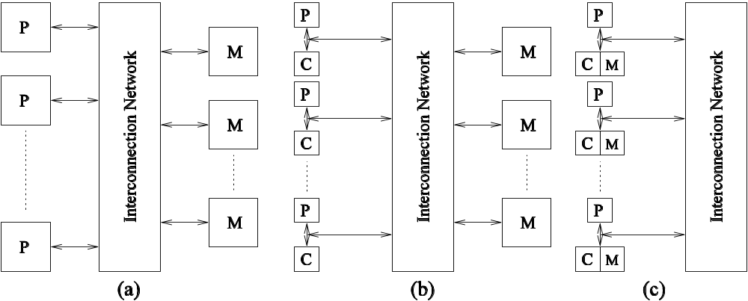
NUMA and UMA Shared-Address-Space Platforms
Typical shared-address-space architectures: (a) Uniform-memory access shared-address-space computer; (b) Uniform-memory-access shared-address-space computer with caches and memories; (c) Non-uniform-memory-access shared-address-space computer with local memory only.

Slide 45
Message-Passing Platforms
These platforms comprise of a set of processors and their own (exclusive) memory.
Instances of such a view come naturally from clustered workstations and non-shared-address-space multicomputers.
These platforms are programmed using (variants of) send and receive primitives.
Libraries such as MPI provide such primitives.

Slide 46
Physical Organization of Parallel Platforms
We begin this discussion with an ideal parallel machine called Parallel Random Access Machine, or PRAM.

Slide 47
Architecture of an
Ideal Parallel Computer
A natural extension of the Random Access Machine (RAM) serial architecture is the Parallel Random Access Machine, or PRAM.
PRAMs consist of p processors and a global memory of unbounded size that is uniformly accessible to all processors.
Processors share a common clock but may execute different instructions in each cycle.

Slide 48
Architecture of an
Ideal Parallel Computer
Depending on how simultaneous memory accesses are handled, PRAMs can be divided into four subclasses.
  Exclusive-read, exclusive-write (EREW) PRAM.
  Concurrent-read, exclusive-write (CREW) PRAM.
  Exclusive-read, concurrent-write (ERCW) PRAM.
  Concurrent-read, concurrent-write (CRCW) PRAM.

Slide 49
Architecture of an
Ideal Parallel Computer
What does concurrent write mean, anyway?
  Common: write only if all values are identical.
  Arbitrary: write the data from a randomly selected processor.
  Priority: follow a predetermined priority order.
  Sum: Write the sum of all data items.

Slide 50
OR problem
Input: bits b1, b2, ..., bn
Output: Logical OR of the bits
EREW algorithm T(n,p) = n/p + log p
CRCW common
T(n,n) = O(1)
Each processor Pi sets answer to 0
If bi == 1, Pi sets answer to 1

Slide 51
Min Problem
Input: Integers x₁, x₂, ..., x_{n}
Output: smallest x_{i}
EREW same as earlier.
CRCW Common algorithm with T(n, p = n²) = 1
If x[i] <= x[j], then M[i,j] = 1 else M[i,j]=0
And[i]=1
If T[i,j]=0, then And[i]=0
If And[i] = 1, then Answer = i

Slide 52
Min Problem
 | 5 | 2 | 3 | 9 | And
5 | 1 | 0 | 0 | 1 | 1
2 | 1 | 1 | 1 | 1 | 1
3 | 1 | 0 | 1 | 1 | 1
9 | 0 | 0 | 0 | 1 | 1

Slide 53
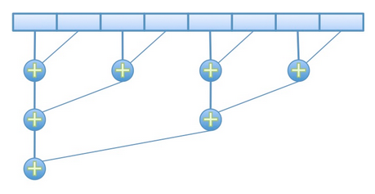
Parallel summation
0 1 2 3 4 5 6 7

Slide 54
Sum n elements
EREW algo. using n/2 processors
P₀, P₁, ... P_{n/2-1}
A[0...(n-1)] : array of n elements
for all P_{i} where 0 <= i < n/2 do
for j ← 0 to log n-1 do
if i % 2^{j} == 0
A[2i] = A[2i] + A[2i+2^{j}]

Slide 55
Sum n elements
EREW algo. using n/2 processors
P₀, P₁, ... P_{n/2-1}
A[0...(n-1)] : array of n elements
for all P_{i} where 0 <= i < n/2 do
for j ← 0 to logn -1 do
if i % 2^{j} == 0
A[2i] = A[2i] + A[2i+2^{j}]
Time complexity : O(logn) using n/2 processors

Slide 56
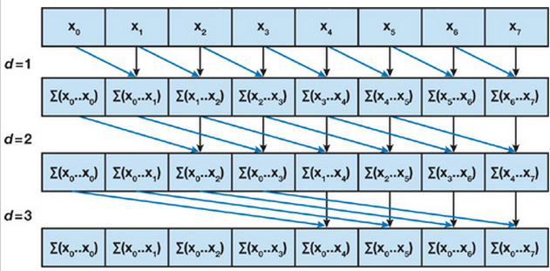
Parallel Prefix sum

Slide 57
Prefix sum (CREW)
Array A[n] and n processors
for all Pi, i : 0 to n
for j ←0 to logn-1
if (i-2^{j} >=0)
A[i] = A[i] + A[i-2^{j}]

Slide 58
Prefix sum (CREW)
Array A[n] and n processors
for all Pi, i : 0 to n
for j <- 0 to logn -1
if (i-2^{j} >=0)
A[i] = A[i] + A[i-2^{j}]
Time complexity : O(logn) using n processors

Slide 59
List Ranking
Input: A list of n numbers
Output: Ranking of numbers
Repeat for log (n) steps in parallel
{
count[i] = count[i] + count[pointer[i]]
pointer[i] = pointer[pointer[i]]
}

Slide 60
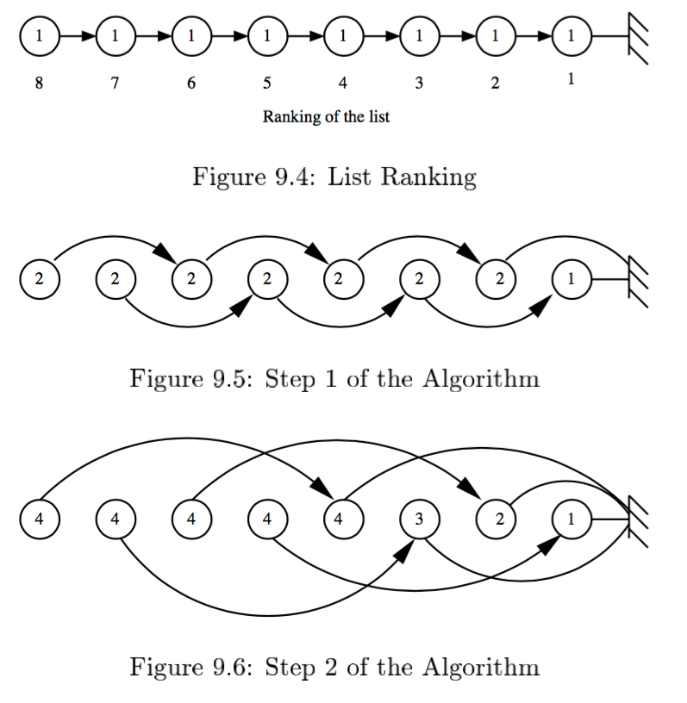
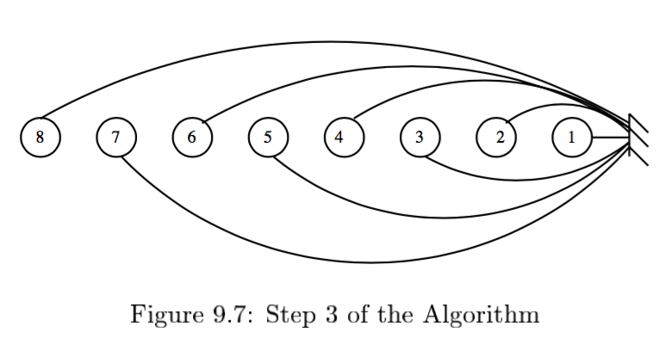

Slide 61
Physical Complexity of an
Ideal Parallel Computer
Processors and memories are connected via switches.
Since these switches must operate in O(1) time at the level of words, for a system of p processors and m words, the switch complexity is O(mp).
Clearly, for meaningful values of p and m, a true PRAM is not realizable.

Slide 62
Interconnection Networks for Parallel Computers
Interconnection networks carry data between processors and to memory.
Interconnects are made of switches and links (wires, fiber).
Interconnects are classified as static or dynamic.
Static networks consist of point-to-point communication links among processing nodes and are also referred to as direct networks.
Dynamic networks are built using switches and communication links. Dynamic networks are also referred to as indirect networks.

Slide 63
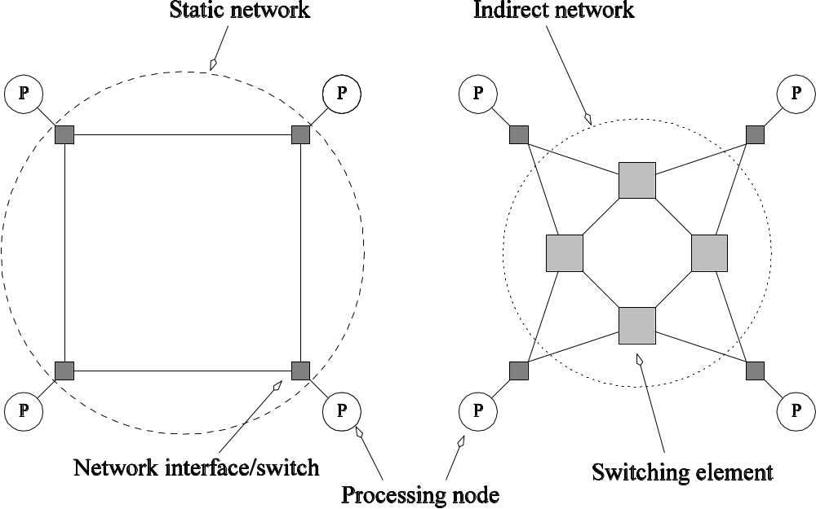
Static and Dynamic
Interconnection Networks
Classification of interconnection networks: (a) a static network; and (b) a dynamic network.

Slide 64
Interconnection Networks
Switches map a fixed number of inputs to outputs.
The total number of ports on a switch is the degree of the switch.

Slide 65
Network Topologies
A variety of network topologies have been proposed and implemented.
These topologies tradeoff performance for cost.
Commercial machines often implement hybrids of multiple topologies for reasons of packaging, cost, and available components.

Slide 66
Network Topologies: Buses
Some of the simplest and earliest parallel machines used buses.
All processors access a common bus for exchanging data.
The distance between any two nodes is O(1) in a bus. The bus also provides a convenient broadcast media.
However, the bandwidth of the shared bus is a major bottleneck.
Typical bus based machines are limited to dozens of nodes. Sun Enterprise servers and Intel Pentium based shared-bus multiprocessors are examples of such architectures.

Slide 67
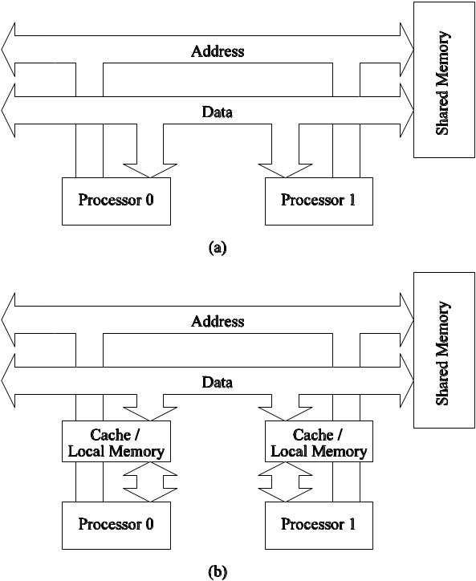
Network Topologies: Buses
Bus-based interconnects (a) with no local caches; (b) with local memory/caches.
Since much of the data accessed by processors is local to the processor, a local memory can improve the performance of bus-based machines.

Slide 68
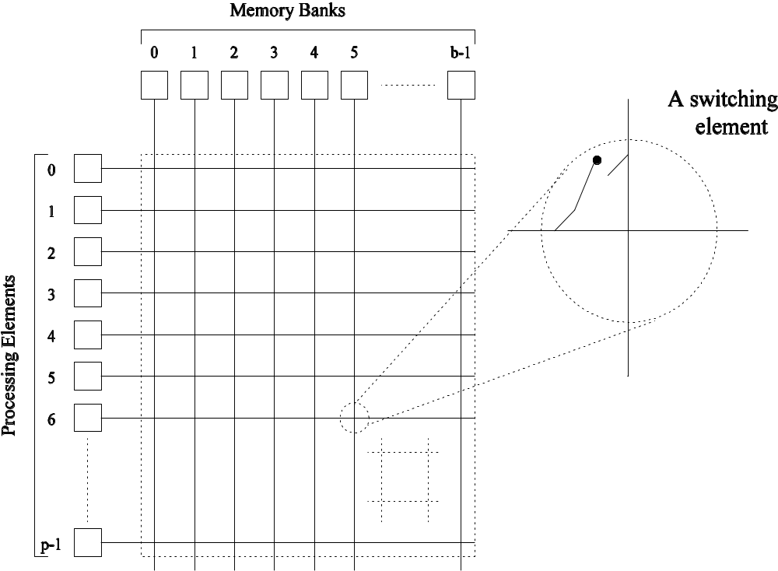
Network Topologies: Crossbars
A crossbar network uses an p×m grid of switches to connect p inputs to m outputs in a non-blocking manner.
A completely non-blocking crossbar network connecting p processors to b memory banks.

Slide 69
Network Topologies: Crossbars
The cost of a crossbar of p processors grows as O(p²).
This is generally difficult to scale for large values of p.
Examples of machines that employ crossbars include the Sun Ultra HPC 10000 and the Fujitsu VPP500.

Slide 70
Network Topologies:
Crossbars have excellent performance scalability but poor cost scalability.
Buses have excellent cost scalability, but poor performance scalability.

Slide 71
Network Topologies:
Completely Connected Network
Each processor is connected to every other processor.
The number of links in the network scales as O(p²).
While the performance scales very well, the hardware complexity is not realizable for large values of p.
In this sense, these networks are static counterparts of crossbars.

Slide 72
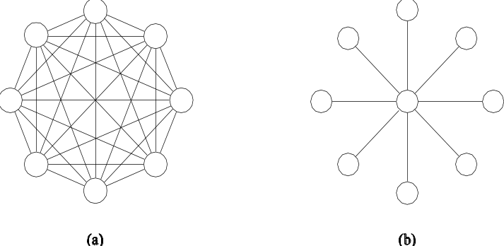
Network Topologies: Completely Connected and Star Connected Networks
Example of an 8-node completely connected network.
(a) A completely-connected network of eight nodes;
(b) a star connected network of nine nodes.

Slide 73
Network Topologies:
Star Connected Network
Every node is connected only to a common node at the center.
Distance between any pair of nodes is O(1). However, the central node becomes a bottleneck.
In this sense, star connected networks are static counterparts of buses.

Slide 74
Network Topologies:
Linear Arrays, Meshes, and k-d Meshes
In a linear array, each node has two neighbors, one to its left and one to its right. If the nodes at either end are connected, we refer to it as a 1-D torus or a ring.
A generalization to 2 dimensions has nodes with 4 neighbors, to the north, south, east, and west.
A special case of a d-dimensional mesh is a hypercube. Here, d = log p, where p is the total number of nodes.

Slide 75
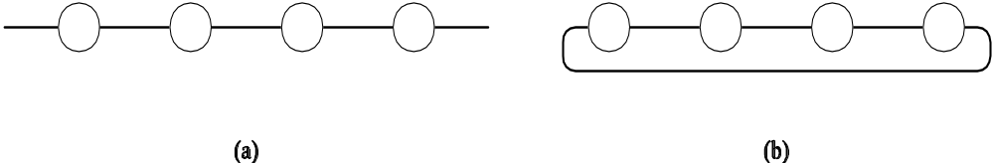
Network Topologies: Linear Arrays
Linear arrays: (a) with no wraparound links; (b) with wraparound link.

Slide 76
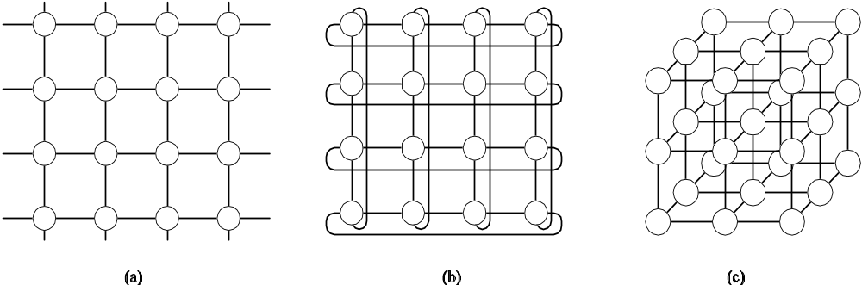
Network Topologies:
Two- and Three Dimensional Meshes
Two and three dimensional meshes: (a) 2-D mesh with no wraparound; (b) 2-D mesh with wraparound link (2-D torus); and (c) a 3-D mesh with no wraparound.

Slide 77
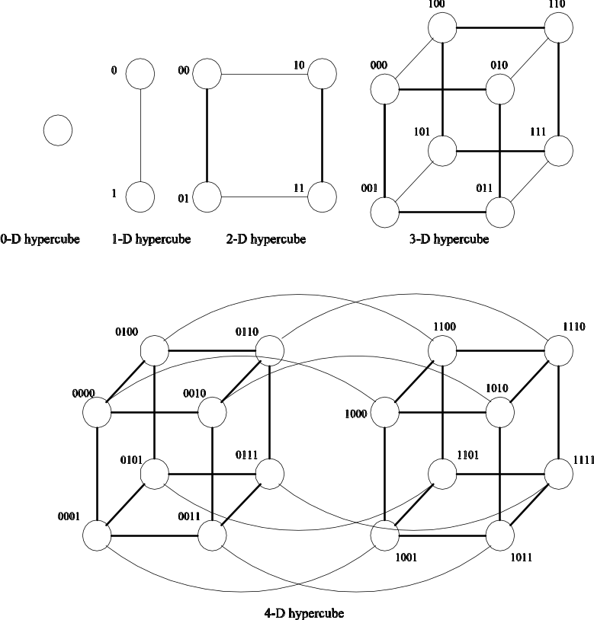
Network Topologies:
Hypercubes and their Construction
Construction of hypercubes from hypercubes of lower dimension.

Slide 78
Network Topologies:
Properties of Hypercubes
The distance between any two nodes is at most log p.
Each node has log p neighbors.
The distance between two nodes is given by the number of bit positions at which the two nodes differ.

Slide 79
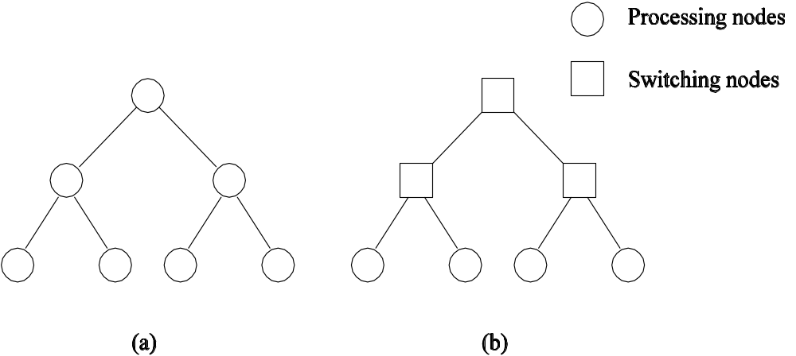
Network Topologies: Tree-Based Networks
Complete binary tree networks: (a) a static tree network; and (b) a dynamic tree network.

Slide 80
Network Topologies: Tree Properties
The distance between any two nodes is no more than 2logp.
Links higher up the tree potentially carry more traffic than those at the lower levels.
For this reason, a variant called a fat-tree, fattens the links as we go up the tree.
Trees can be laid out in 2D with no wire crossings. This is an attractive property of trees.

Slide 81
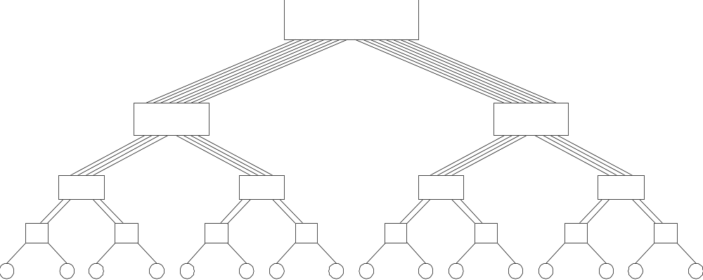
Network Topologies: Fat Trees
A fat tree network of 16 processing nodes.

Slide 82

Evaluating
Static Interconnection Networks
Diameter: The distance between the farthest two nodes in the network. The diameter of a linear array is p − 1, that of a mesh is 2( − 1), that of a tree and hypercube is log p, and that of a completely connected network is O(1).
Bisection Width: The minimum number of wires you must cut to divide the network into two equal parts. The bisection width of a linear array and tree is 1, that of a mesh is , that of a hypercube is p/2 and that of a completely connected network is p²/4.
Cost: The number of links or switches (whichever is asymptotically higher) is a meaningful measure of the cost. However, a number of other factors, such as the ability to layout the network, the length of wires, etc., also factor in to the cost.

Slide 83

















Evaluating
Static Interconnection Networks
Network | Diameter | BisectionWidth | Arc Connectivity | Cost (No. of links)
Completely-connected
Star
Complete binary tree
Linear array
2-D mesh, no wraparound
2-D wraparound mesh
Hypercube
Wraparound k-ary d-cube

Slide 84
Communication Costs in Parallel Machines
Along with idling and contention, communication is a major overhead in parallel programs.
The cost of communication is dependent on a variety of features including the programming model semantics, the network topology, data handling and routing, and associated software protocols.

Slide 85
Message Passing Costs in
Parallel Computers
The total time to transfer a message over a network comprises of the following:
  Startup time (t_{s}): Time spent at sending and receiving nodes (executing the routing algorithm, programming routers, etc.).
  Per-hop time (t_{h}): This time is a function of number of hops and includes factors such as switch latencies, network delays, etc.
  Per-word transfer time (t_{w}): This time includes all overheads that are determined by the length of the message. This includes bandwidth of links, error checking and correction, etc.

Slide 86


Store-and-Forward Routing
A message traversing multiple hops is completely received at an intermediate hop before being forwarded to the next hop.
The total communication cost for a message of size m words to traverse l communication links is
In most platforms, t_{h} is small and the above expression can be approximated by

Slide 87
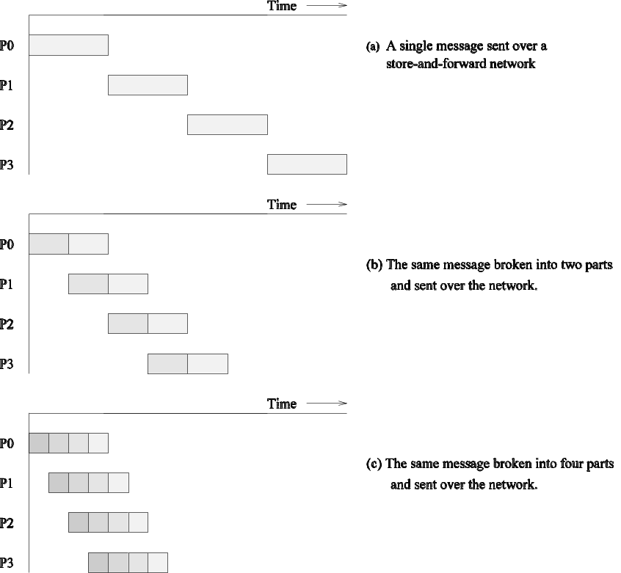
Routing Techniques
Passing a message from node P₀ to P₃ (a) through a store-and-forward communication network; (b) and (c) extending the concept to cut-through routing. The shaded regions represent the time that the message is in transit. The startup time associated with this message transfer is assumed to be zero.

Slide 88

Packet Routing
Store-and-forward makes poor use of communication resources.
Packet routing breaks messages into packets and pipelines them through the network.
Since packets may take different paths, each packet must carry routing information, error checking, sequencing, and other related header information.
The total communication time for packet routing is approximated by:
The factor t_{w} accounts for overheads in packet headers.

Slide 89
Cut-Through Routing
Takes the concept of packet routing to an extreme by further dividing messages into basic units called flits.
Since flits are typically small, the header information must be minimized.
This is done by forcing all flits to take the same path, in sequence.
A tracer message first programs all intermediate routers. All flits then take the same route.
Error checks are performed on the entire message, as opposed to flits.
No sequence numbers are needed.

Slide 90
Cut-Through Routing
The total communication time for cut-through routing is approximated by:
This is identical to packet routing, however, t_{w} is typically much smaller.

Slide 91


Simplified Cost Model for Communicating Messages
The cost of communicating a message between two nodes l hops away using cut-through routing is given by
In this expression, t_{h} is typically smaller than t_{s} and t_{w}. For this reason, the second term in the RHS does not show, particularly, when m is large.
Furthermore, it is often not possible to control routing and placement of tasks.
For these reasons, we can approximate the cost of message transfer by

Slide 92
Routing Mechanisms for Interconnection Networks
How does one compute the route that a message takes from source to destination?
  Routing must prevent deadlocks - for this reason, we use dimension-ordered or e-cube routing.
  Routing must avoid hot-spots - for this reason, two-step routing is often used. In this case, a message from source s to destination d is first sent to a randomly chosen intermediate processor i and then forwarded to destination d.

Slide 93
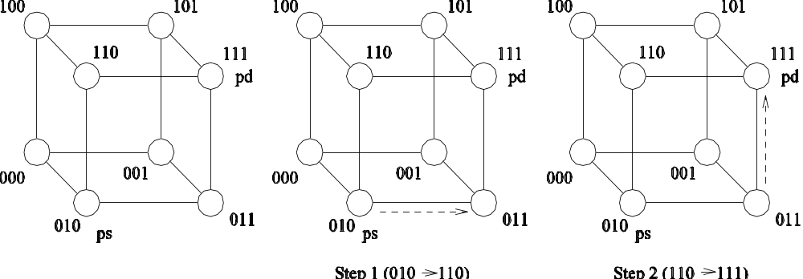
Routing Mechanisms for Interconnection Networks
Routing a message from node P_{s} (010) to node P_{d} (111) in a three-dimensional hypercube using E-cube routing.

