Slide 1
Bill Splitter & Expense Tracker Software

Slide 2
introduction
Managing shared expenses can be a challenge in both personal and professional settings. Whether among roommates, during group travel, or at team lunches, tracking who paid what and calculating how much each person owes can become confusing.
The Bill Splitter & Expense Tracker Software is designed to streamline this process. It automates the splitting of bills among multiple individuals and keeps transparent records of balances — who owes whom and how much. This ensures smooth and fair settlements, avoiding misunderstandings.

Slide 3
Literature
Several apps and systems exist for expense tracking, such as:
Splitwise: A popular app for splitting bills with friends and tracking debts.
Venmo and Paypal: While mainly payment platforms, they offer basic expense-splitting functionality.
Google Sheets and Templates: Manually created trackers for managing group expenses.
However, many of these tools either require an internet connection, are not open-source, or are not customizable to specific needs. Our software aims to offer a lightweight, offline, and easily extendable alternative.

Slide 4
Previous Work
Existing solutions focus heavily on mobile apps with rich UI but often neglect customizable backend logic or offline capabilities. Some users prefer simple desktop or terminal applications without the need for signing in or internet access.
Earlier prototypes and GitHub projects demonstrate basic bill splitting but lack user-friendly summaries, balancing logic, or group tracking

Slide 5
Proposed Model
Our system is a command-line Python application that allows users to:
Add members to a group
Log expenses with amount, payer, and participants
Automatically split expenses equally
Display balances showing who owes whom
Export data for record-keeping (future enhancement)

Slide 6
Key Features
Minimalist and intuitive UI
Supports any group size
Transparent balance display
Option for future enhancements like database/GUIs

Slide 7
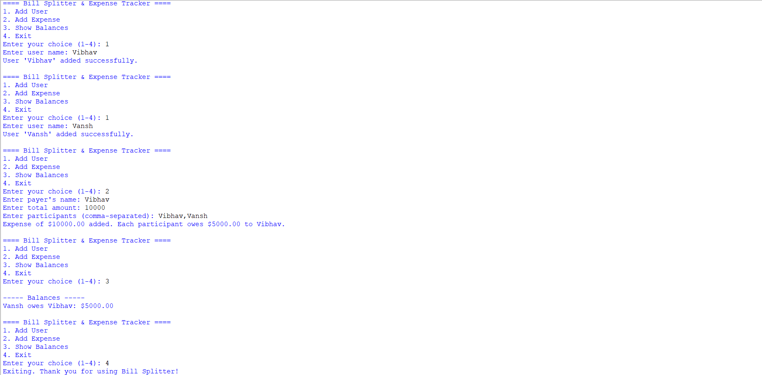
screenshot

Slide 8
Conclusion
This project simplifies the tedious task of splitting bills and tracking group expenses. With a lightweight implementation and future extensibility, it serves as a foundational financial tool for casual and professional scenarios alike.

Slide 9
THAnk you -Vansh kumar sharma -vibhav keshar sahu

