Slide 1
Land Registration System using Aadhar Card
Theme: Blockchain

Slide 2
Why We Have a Land Titling Problem
A registration in India is a mere record of the sales transaction that allows only ‘presumptive’ ownership and is liable to be challenged in courts.
Why cannot a ‘confirmed ownership’ be conferred, one may ask? Because nobody can be certain as to how many ‘hands’ a piece of land has passed through. Put simply,
It’s an information problem, which makes verification of ownership and assignment of a unique identification prohibitively expensive.

Slide 3
So What We Need
Therefore, two remedies are needed: first, titling of a land unit needs to be confirmed with one owner. Second, there needs to be a clear trail and record of all transactions done regarding the unit
The current government has recently renewed the push for making all land records and titling digital through E-PANJIYAN. While a digital footprint is certainly an improvement over a physical ledger of records, certain vulnerabilities will persist such as conflicting claims on ownership; bribery and corruption in altering registered data; bureaucracies around third-party vetting; and cyber-attacks and data theft.

Slide 4
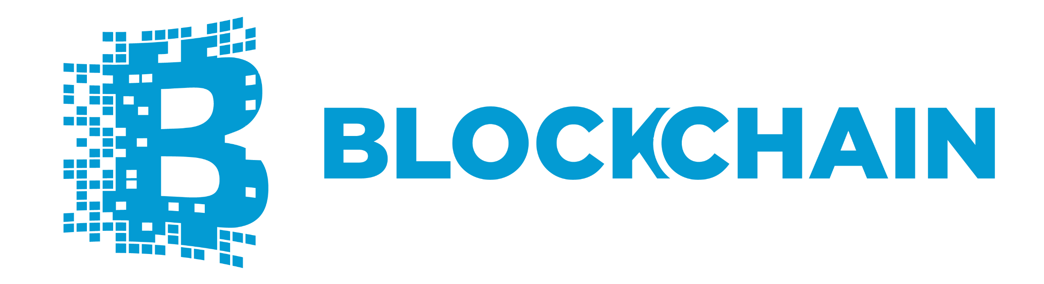
Our solution is…

Slide 5
Introduction
The goal of the project is to renovate the Land registry system of Rajasthan , with even moving ahead from the traditional digital system to a decentralized ownership registration system which also proves the viability and usability of blockchain technology for such a system in real life situations. The system will be based on unique biometric identifications(AADHAR) with immutable land ownership registrations on the blockchain.

Slide 6
The Problems That Blockchain Will Solve
#1 Digital Units Shouldn’t Be Easy To Replicate:- It is essential that confidential documents like land registry papers which is of immense value should be extremely hard to replicate. It shouldn’t be possible for someone to have two copies of the same registry but with different details
#2 Digital Files Should Be Tamper Proof:- Back in the day all these files used to be physically stored in registers, this obviously brought in a host of problems.
Anyone can steal the registers.
It is very simple to bribe someone to tamper with the records.
Registers are susceptible to wear and tear
Even when the system was made digital, certain problems still persisted.
The system could always be hacked.
The bribe angle still remained. Anyone could bribe an official and make them change the records
#3 Digital Processes Should Be Tamper Proof:- Every official institution has a process for each and every activity but they may not be strictly adhered to. This could happen for a General human negligence or Malicious intent .As you can see, these problems are both human related so
The blockchain pretty much solved this problem a long time back through “consensus mechanism”. As a blockchain is a distributed system with a large number of actors. In order to make any decision, all these people need to come to a majority consensus

Slide 7
Example for the use cases
State= Rajasthan. Rajasthan is realistic and probably suitable.
Immovable property = parcel, small piece of land in Rajasthan, identified with a unique code
Roles:
Govt.= GARP(Growth At A Reasonable Price)
Citizens: Initial owner

Slide 8
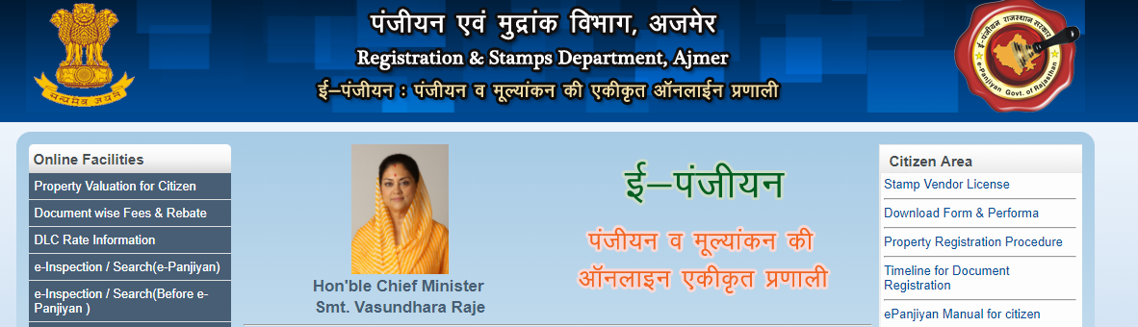
Verification
Database
In an initial stage, the database of “E-PANJIAN” remains intact. Updates to the land registry are retrieved from the Blockchain and are then also checked by Registration Department. Registration in the Blockchain is digital and based on the legal requirements, which minimizes errors in the information.

Slide 9
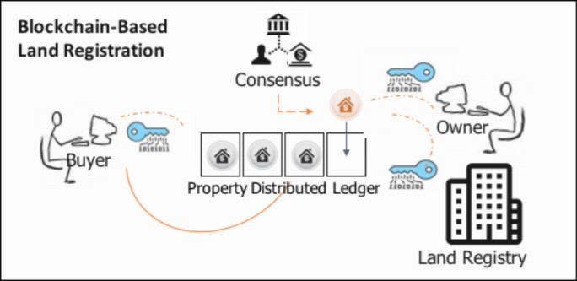

Slide 10
Thank You
By : Team ChainWay
Ajay Saxena
Devesh Saini
Digvijay Singh

