Slide 1
Deep learning based Kidney Stone detection Using Ultrasound images
Under the Guidance of
S.Koteswara Rao
190040127-D.Gowtham Reddy
190040601-P.Tarun Kumar
190040623-G.Harsha Vardhan Reddy

Slide 2

TODAY’S AGENDA:
Introduction
Problem Statement
Aim
Proposed Methodology
Conclusion

Slide 3
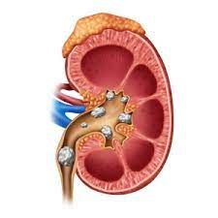
INTRODUCTION:
The Kidney stones are a hard collection of salt and minerals, often calcium and uric acid that form in the kidneys.
There are few kinds of kidney stones that are usually formed in our body:
1)Calcium Stones
2)Struvite Stones
3)Uric acid Stones
4)Cystine Stones
Some risk that affect our body due to kidney stones are Dehydration, Obesity problem
and certain diet problems etc..

Slide 4

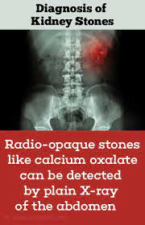
The diagnosis of kidney stones can be done with the Urinalysis, Blood Test, Imaging Tests like X-ray scanning,
CT Scanning and Ultrasound imaging etc..
The majority of persons with kidney stones do not recognize them at first, and their organs gradually deteriorate.

Slide 5
PROBLEM STATEMENT:
The kidney malfunctioning can be life intimidating. Hence early detection of kidney stone is essential. Precise
identification of kidney stone is vital in order to ensure surgical operations success.
The detection of kidney stones directly from the ultrasound images is hard.
The ultrasound images of kidney comprise speckle noise and are of low contrast which makes the identification
of kidney abnormalities a difficult task.
This effects the proper diagnosis of the patient. To overcome this problem, a reaction diffusion level set segmentation
is proposed to identify location of the stone.

Slide 6
AIM
Our main of the project is to recognize the kidney stones in the ultrasound images.
We detect the kidney stones in ultrasound images using median filters to improve the detection
rate in terms of accuracy and sensitivity.
Materials and Methods: The accuracy and sensitivity of median filter was compared with rank filter.
The median filter is used to detect the kidney stone in ultrasound images.
A certain sample size is taken with the some p-value and has been used to improve detection rate of kidney stones in
terms of accuracy and sensitivity using Matlab simulation tool.

Slide 7
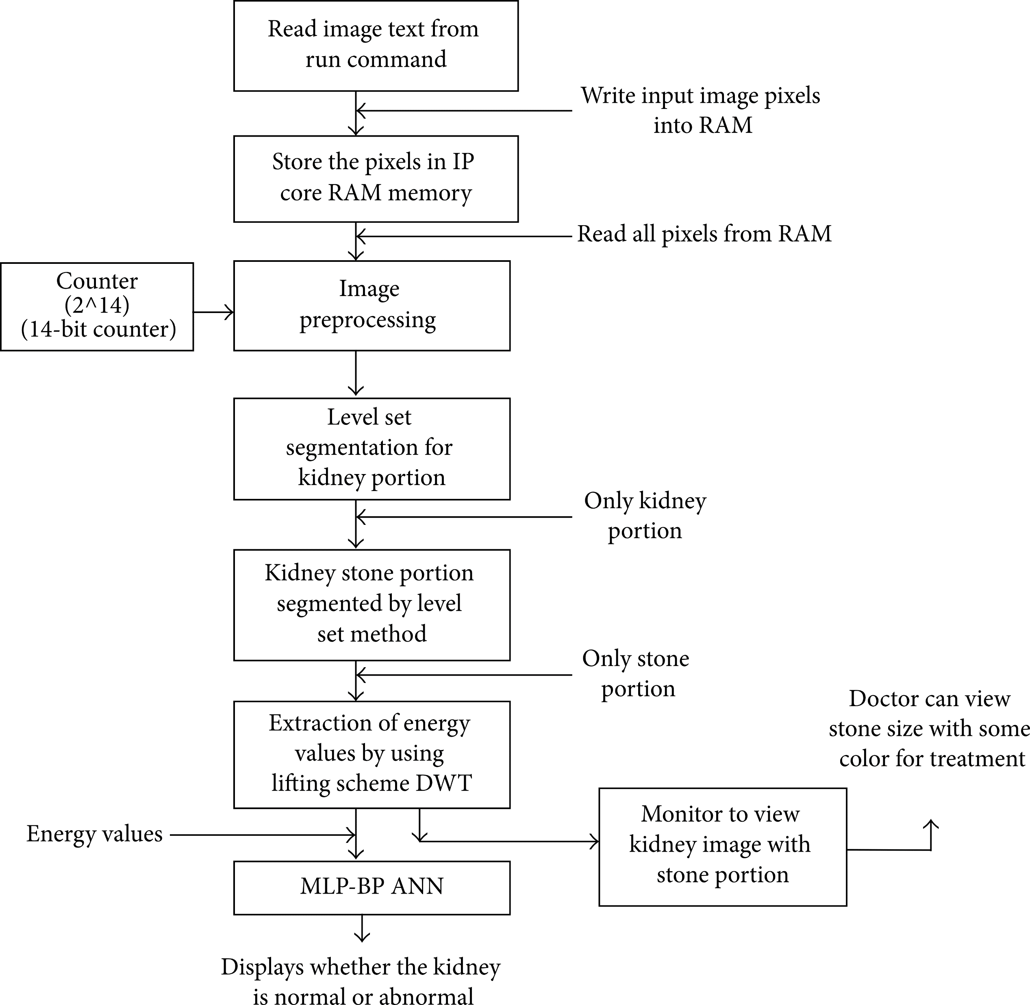
PROPOSED METHODOLOGY:

Slide 8
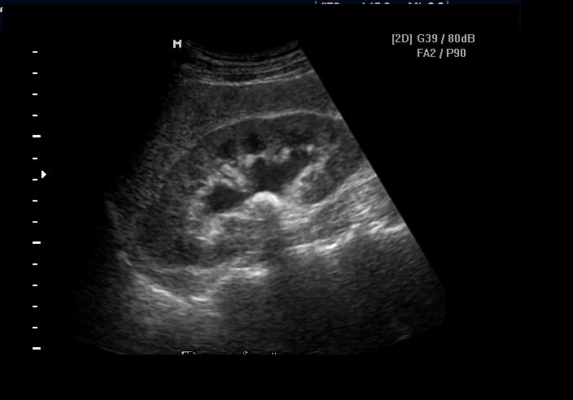
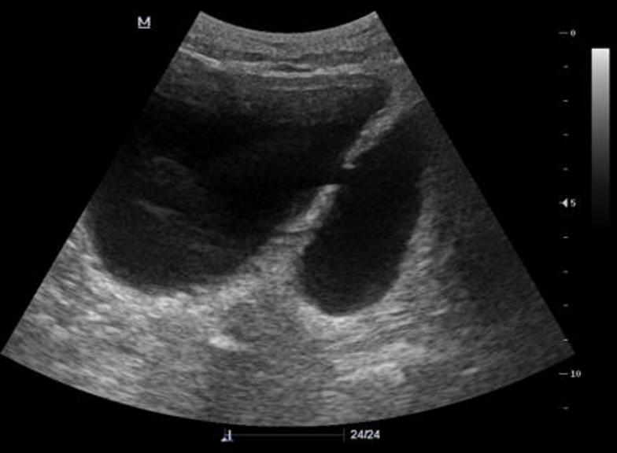
Firstly we take the input of kidney image which is an ultrasound image.
The system will detect the image and store them as pixels in it’s memory.
Now the system automates to use the image processing technique called Level set Segmentation and divides the
kidney portion and stone portion.
In this technique, a median filter and a rank filter is used to detect the kidneys.
By using DWT technique the extraction of energy levels are done then by back propagation algorithm it displays
whether the kidney is normal or abnormal
Image with stone
Image without stone

Slide 9
CONCLUSION:
In this paper ,we have discussed various techniques for detecting the kidney stones and improved a technique which
uses level set segmentation method.
We have detected whether the patient is effected with the presence of stones in the kidney.
This paper introduces the proper diagnosis technique for the medical field in detection of stones in kidneys.

