Slide 1


Alexa Smart clock by powered raspberry pi 3
Jacob lattie
Peter Nguyen
Dylan Verstandig
Notes:
Peter
Introduce Us and the project
Explain our reasoning for making this project: ex:
"We wanted to make an alarm clock that behaves like a regular alarm clock but also have the features that are found on Alexa enabled devices."
"Our two main tasks were making a gui that updates in real time based on Alexa voice commands, and creating custom skills relating to alarm clock features"

Slide 2
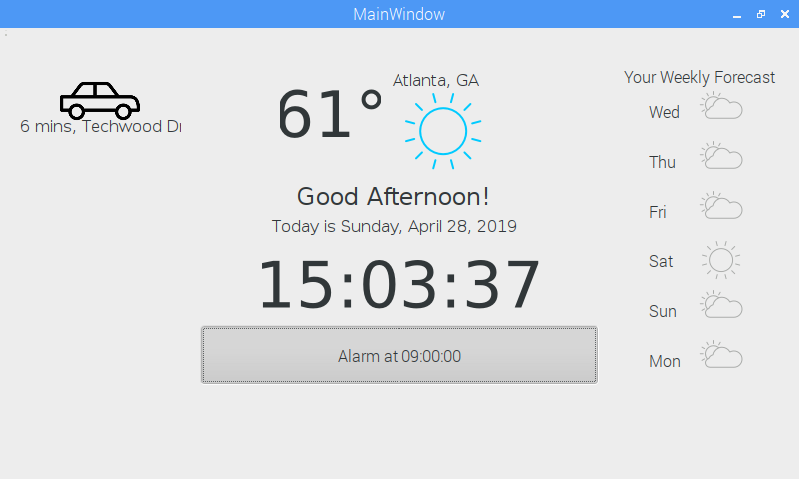
Graphical User Interface Features
Show minimal view of weekly forecast
Display the time expected and best road to take for daily commute
Show current time and date
Dynamically set and stop alarm from Alexa voice commands or button toggle
Present daily temperature and weather forecast
Notes:
Jacob
Shown is the User Interface for our Alarm Clock device.
Explain each of the features:
- Still maintain basic clock features such as time and date
- Display CURRENT weather and forecast
- Display weekly weather forecast (useful for future rain)
- Alarm time and pushbutton (touch screen) functionality to stop it
- Car icon shows commute time and best road to travel

Slide 3
Smart Alarm Clock Features
Alexa Enabled Device
Ask for Weather
Play Radio
Ask for the news
Raspberry Pi Custom Alexa Skills
Set an alarm
“Alexa, ask raspberry pi to set an alarm for 9:00 am”
“Alexa, ask raspberry pi to stop my alarm”
Ask for Daily Commute
“Alexa, ask raspberry pi for my daily rundown”
Invocation Name
Intent Name
- Slot Value
Notes:
Dylan

Slide 4





High Level Diagram for Skills
AVS Running on Pi Forwards request to Amazon Cloud
User Speaks
Response is played and GUI is updated with real time traffic
Raspberry Pi 3 Running Alexa
Response is sent back to Alexa device in JSON format
Alexa Skills
Request is sent to and from lambda
AWS Lambda sends request to Google maps API for real time traffic
Sends back traffic response
AWS Lambda
Notes:
Dylan

Slide 5
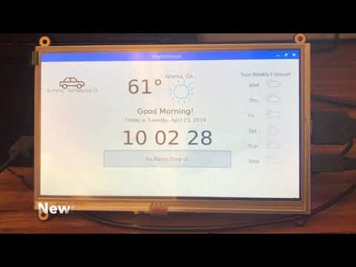
Video Demonstration (1:22)
https://www.youtube.com/watch?time_continue=1&v=yNKB0Weq6vo
Notes:
Jacob
Explain that this video shows the functionality of both our custom Alexa skills and the more broad skills of an Alexa enabled device

Slide 6

Documentation / Version Control
Github and Github Pages
https://dverstandig.github.io/4180-Smart-Alarm-Clock/
Notes:
Peter
Version Control and Webpage

Slide 7
Questions?
Notes:
Peter

