Slide 1

Warehouse Operational Efficiency
Analyzing
Warehouse
Operational
Efficiency
Performance Analysis Using Data Analytics and Predictive Modelling
Deepesh Kumar Gautam
USN: 233VBBR00561
BBA (DSA) | SupplyFlow FMCG Solutions [Capstone Project]
April 2026
Under the guidance of
Rishabh Pandey
Faculty – Jain Online

Slide 2
THE BUSINESS PROBLEM
Why does the same company have warehouses that are worlds apart in performance?
📉
❓
🎯
Performance Gap
No Root Cause
The Mission
25,000 warehouses. A coefficient of variation of 52%. Some ship 40,000+ tons. Others struggle past 5,000.
Management relied on static KPIs. They knew what was failing. They didn't know why — or which sites were next.
Build a data-driven framework to rank every warehouse, identify key drivers, and give management a tool to act.
SupplyFlow FMCG Solutions | SupplyFlow_FMCG_Solutions.xlsx | 25,000 records across 24 operational variables
2 / 11

Slide 3
THE DATASET
What we had to work with
25,000
24
5
0
Warehouse Records
Operational Variables
Geographic Zones
Duplicate Records
Variable Categories
🏭 Infrastructure
👥 Workforce
🗺️ Geography
flood, electric, temp
workers, manager ID
zone, hub distance, location
📦 Operations
🏪 Network
🎯 Target Variable
breakdowns, refills, checks
retail shops, distributors
product_wg_ton (tons shipped)
⚠ Critical Decision: storage_issue_reported_l3m was excluded. Pearson r = 0.987 with target — a co-indicator of load, not a causal driver. Inclusion would assign 98% importance to one variable, making the model unactionable.
3 / 11

Slide 4
RESEARCH METHODOLOGY
A rigorous, end-to-end analytical pipeline
01
Data Quality
02
EDA
03
Preprocessing
Dtype checks
Missing value audit
0 duplicates confirmed
Univariate
Bivariate scatter
Correlation analysis
Imputation
IQR capping
Log transforms
Encoding
04
Feature Selection
05
Model Building
06
Efficiency Score
RF importance
20 → 12 features
Co-indicator removed
5 models trained
Same train/test split
4 metrics each
Weighted index
0–100 ranking
High / Med / Low tiers
Data: Secondary | Source: SupplyFlow FMCG Solutions dataset | 25,000 records | Tool: Python 3.10, Scikit-learn, Kaggle Notebook. GitHub.
4 / 11

Slide 5
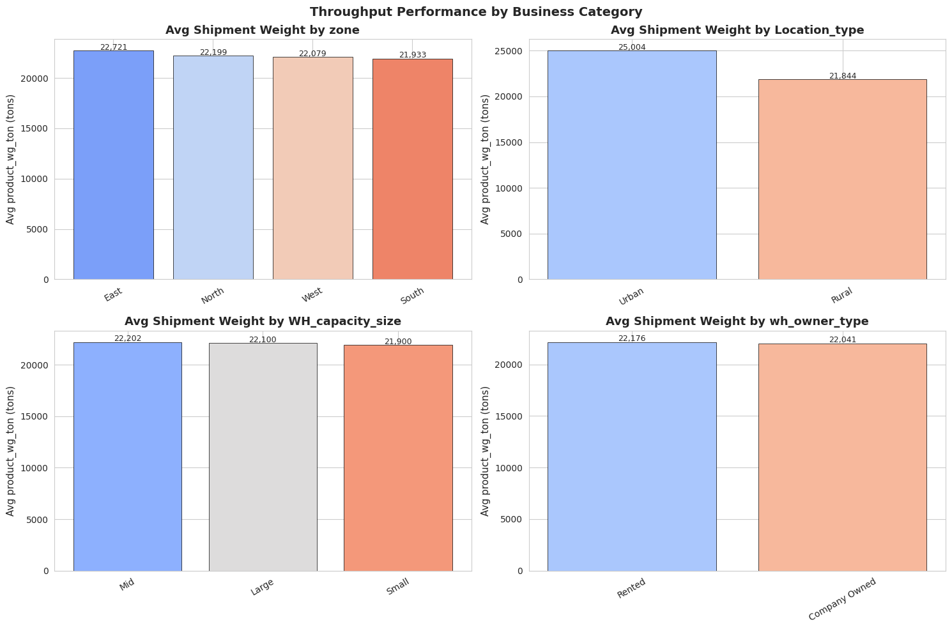
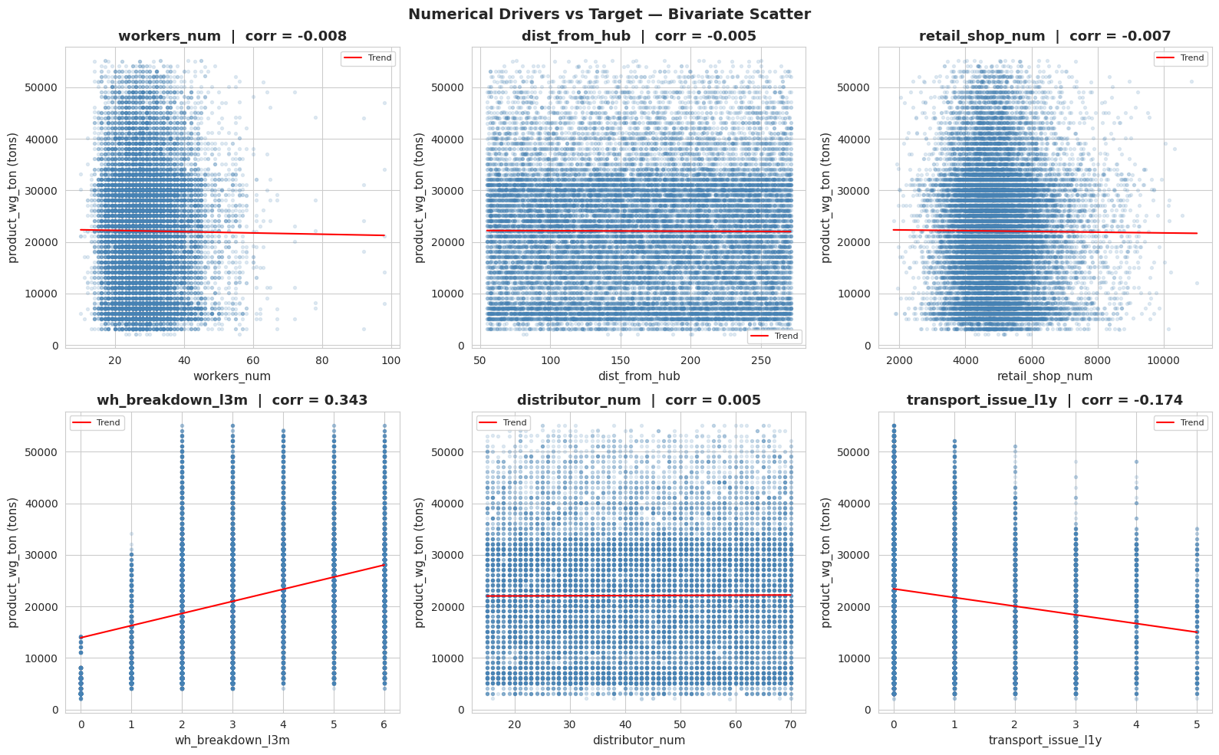
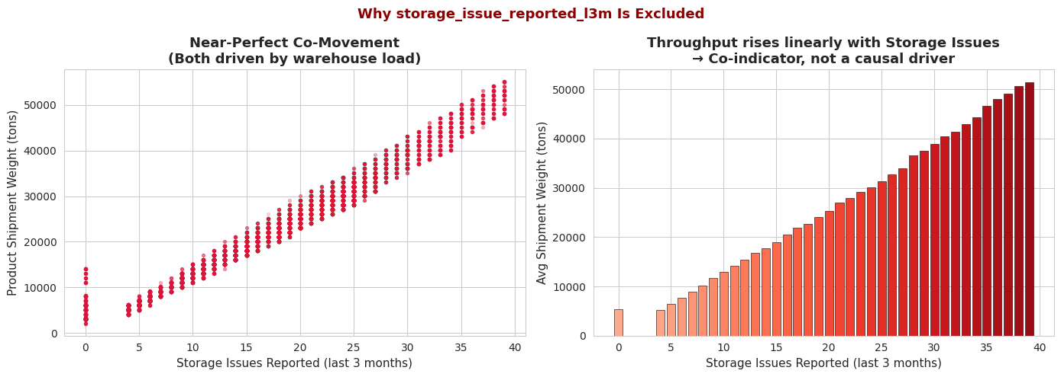
EXPLORATORY DATA ANALYSIS
Three findings that shaped every modelling decision
📊 Figure 4 — Avg Shipment by Zone, Capacity, Ownership
Finding 1 — Performance is Geographic & Structural
CV = 52% — extreme inequality across the network
North & West zones outperform East & South
Grade A certified warehouses: higher throughput, lower variance
📊 Figure 6 — Scatter: Numerical Drivers vs Target
📊 Figure 10 — storage_issue Co-Indicator Evidence
5 / 11

Slide 6
MODEL BUILDING & COMPARISON
Five models. One winner — chosen by the data, not assumption.
Model
R²
RMSE
MAPE
CV R²
Linear Regression
0.4496
8,582
51.21%
0.4433
Baseline
Lasso Regression
0.4496
8,582
51.21%
0.4433
L1 Validation
Decision Tree
0.0269
11,411
51.56%
0.0563
Overfit Demo
Random Forest
0.5430
7,819
39.21%
0.5367
Strong
Gradient Boosting
0.5527
7,736
39.32%
0.5467
Best Baseline ★
Decision Tree R² = 0.027 on test set despite perfect training fit — textbook overfitting. Ensemble methods overcome this. Gradient Boosting selected for tuning alongside Random Forest.
6 / 11

Slide 7
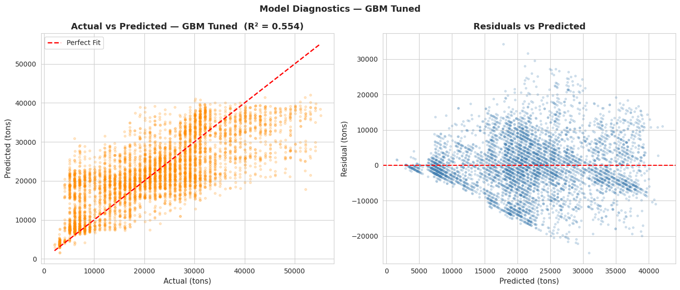
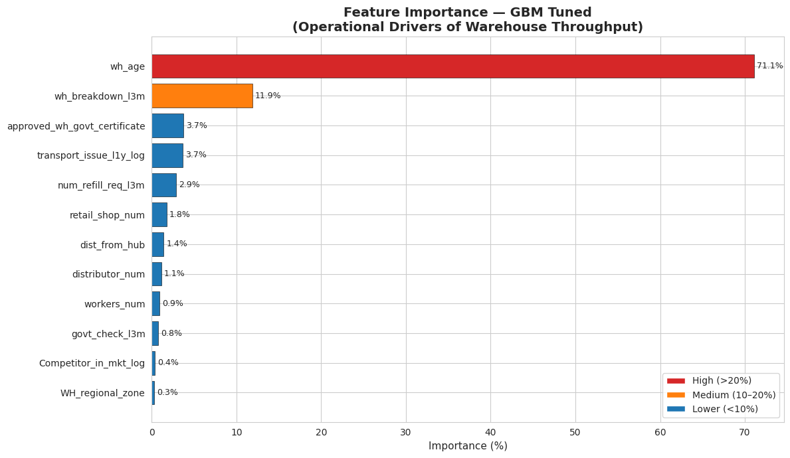
FINAL MODEL — TUNED GRADIENT BOOSTING
After hyperparameter tuning: the most stable model across all 7 candidates
0.554
7,725
39.41%
0.5461
R² Score
55.4% variance explained
RMSE (tons)
avg prediction error
MAPE
avg % error vs actual
CV R² (5-fold)
± 0.0096 — stable
📊 Figure 15 — Actual vs Predicted
📊 Figure 17 — Feature Importance (GBM Tuned)
Tuning: RandomizedSearchCV — 20 iterations, 5-fold CV | Best GBM params: subsample=0.8, n_estimators=100, max_depth=6, learning_rate=0.05 | CV Std = 0.0096 (lowest of all 7 models — most consistent)
7 / 11

Slide 8
WAREHOUSE EFFICIENCY COMPOSITE SCORE — THE UNIQUE DELIVERABLE (Part 1)
Turning a model into a management tool: ranking 25,000 warehouses 0–100
1
2
3
4
Normalise
Direction
Weight
Score
All 12 features scaled 0–1 using MinMaxScaler
+1 (higher=better) or –1 (higher=worse) per feature
Multiply by GBM importance score
Sum & rescale → 0–100 Efficiency Score per warehouse
🟢 High
🟡 Medium
🔴 Low
Score: 67–100
3,286
Score: 34–66
17,028
Score: 0–33
4,685
13.1% of network
68.1% of network
18.7% of network
Strong network, low disruption, established sites
Core network — stable, opportunity for optimisation
Priority targets — newer sites, high breakdowns, West & North zones
Note : Key figure form Code file is part 2
8 / 11

Slide 9
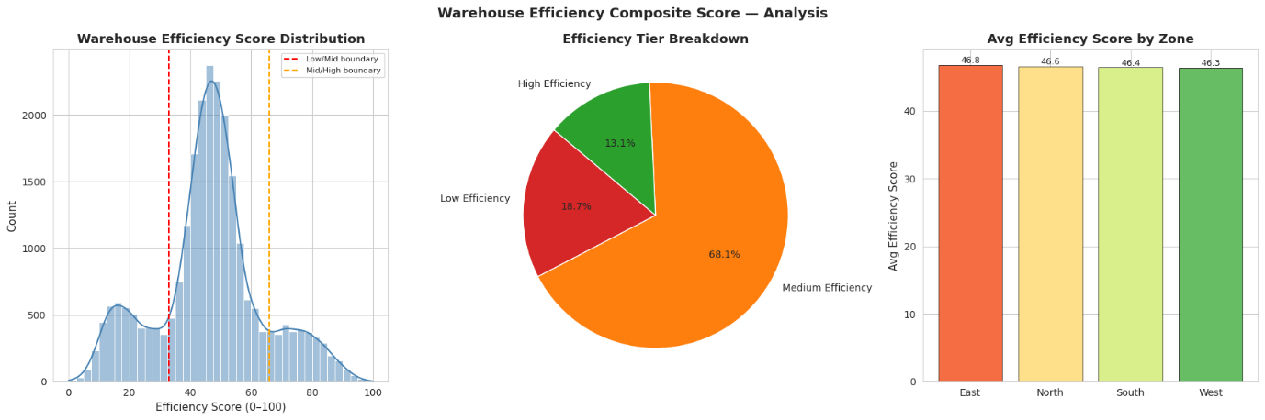
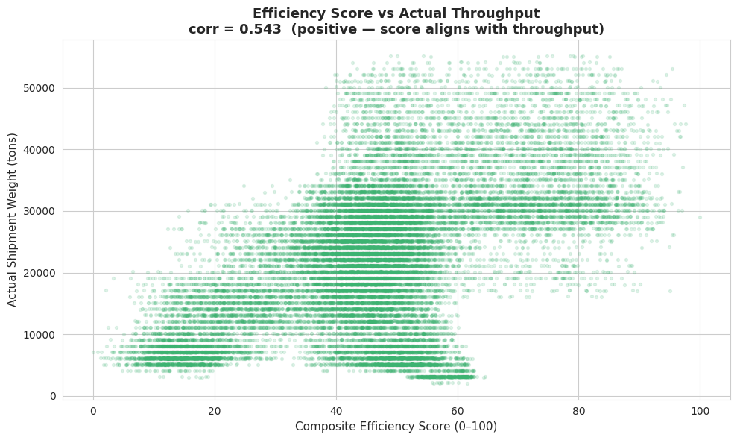
WAREHOUSE EFFICIENCY COMPOSITE SCORE — THE UNIQUE DELIVERABLE (Part 2)
📊 Figure 18 — Efficiency Score Distribution, Tier Breakdown, Zone Average
📊Figure 19 — Score vs Throughput (r = 0.543 — validated)
9 / 11

Slide 10
STRATEGIC RECOMMENDATIONS — CONSULTING FRAMEWORK
Five recommendations. Three impact dimensions. All data-validated.
01
Revenue
wh_age = 71%
02
Cost
wh_breakdown = 11.9%
03
Revenue
Network rank 3rd/8th
Accelerated Establishment Programme
Preventive Maintenance Programme
Distributor & Retail Expansion
Structured 12-month support for warehouses <5 years old: distributor managers, retail onboarding targets, throughput milestones.
Maintenance calendar for bottom-500 disruption sites: electrical audits, contingency staffing, flood-prep. Target: reduce breakdowns from 5→2 per quarter.
5 new distributors + 200 retail accounts per underperforming West & North warehouse within 12 months.
04
CX
dist_from_hub rank 7th
05
OpsReady
Cert grade rank 3rd
Predictive Restocking for Remote Sites
Certification Improvement Programme
Deploy GBM model to generate per-warehouse restocking forecasts. Calibrate safety stock by predicted throughput for hubs >200km.
Audit + remediation for Grade B/C warehouses. 90-day certification improvement timeline. Dual benefit: throughput + compliance.
10 / 11

Slide 11
What This Project
Taught Me
Future Scope
1. Real-time efficiency dashboard integrating live WMS data feeds
🧠
Data decisions matter more than algorithms
2. Cost-efficiency index: expenditure per ton shipped
Removing a 0.987-correlated co-indicator was more impactful than any model choice.
3. Unsupervised clustering for warehouse peer-group benchmarking
📐
Honest metrics build trust
4. Deep learning for temporal demand pattern capture
R² = 0.554 on clean data tells the truth. A 0.99 built on circular logic tells a story that collapses under scrutiny.
Thank You
🎯
Analytics is a business tool
Deepesh Kumar Gautam | 233VBBR00561
SupplyFlow FMCG Solutions — Warehouse Operational Efficiency
Project Link: https://github.com/Dvipg/Supply-Flow--Analyzing-Warehouse-Operational-Efficiency
Every technical choice — feature direction, tier thresholds, GBM tuning — existed to answer a business question, not to impress an algorithm.
11 / 11

