Slide 1
Intro2cs
Tirgul 3

Slide 2
What will we cover today?
Short recap
Loops
Range
Nested Loops
Lists
Debugging and Testing!

Slide 3
EX3, and general Submissions
Submit only the files specified in the exercise description
Not the entire project directory, not the virtual environment
Why didn’t I get the presubmission feedback?
Ex3 – loops
You will practice today’s materiel
Ex3 quiz
Part of the exercise, not of the MAGEN quizzes
Make sure you submit it on time

Slide 4
Syntax – reminder
Each indentation is considered a new “group” (scope)
A new scope is defined by every function/class declaration and are not visible on the global scope (we’ll talk about classes in the coming weeks).

Slide 5
Truth values
An object is False if-and-only-if it holds one of the following values:
None
False
Zero (of any numeric type, e.g., 0, 0.0)
Empty sequence
Which means everything else is True!
bool(“False”) == ???

Slide 6
Boolean Casting
Casting “empty” values to bool is always False:
bool (0) == False
bool (0.0) == False
bool ("") == False
bool ([]) == False

Slide 7


What will we cover today?
Short recap
Loops
Range
Nested Loops
Lists
Debugging and Testing!

Slide 8
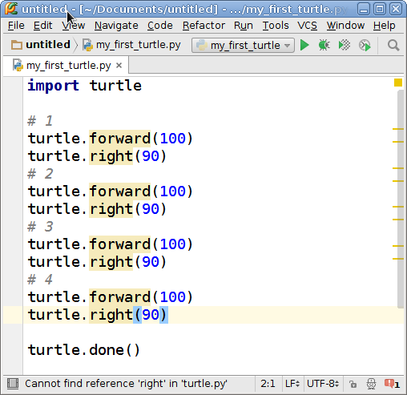
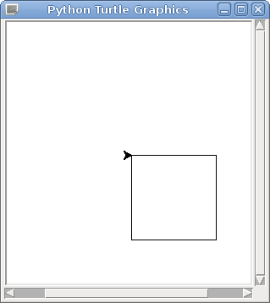
Reminder – Tirgul 1

Slide 9
Loops - Motivation
Often, we want to execute a statement multiple times repetitively
Write a program that receives 2 numbers from the user and sums them up.
Write a program that receives 3 numbers from the user and sums them up.
What if we wanted a program that sums 100 numbers?

Slide 10
What is a loop?
A loop is a programming structure that contains an executable block of code that can be repeated several times.
There are two types of loops:
while loop
for loop
Notes:
Print every item in the list

Slide 11
The while loop
Basic Syntax:
i = 0 while i < 3:
print('Hello World’) i += 1
Hello World
Hello World
Hello World

Slide 12
The for loop
Basic Syntax:
for i in range(3):
print('Hello World’)
Hello World
Hello World
Hello World

Slide 13
What will we cover today?
Short recap
Loops
Range
Nested Loops
Lists
Debugging and Testing!

Slide 14
Python’s Range
range is a built-in construct
Used to generate an ordered sequence of integers following a simple “rule’”
range([start], end, [step])

Slide 15
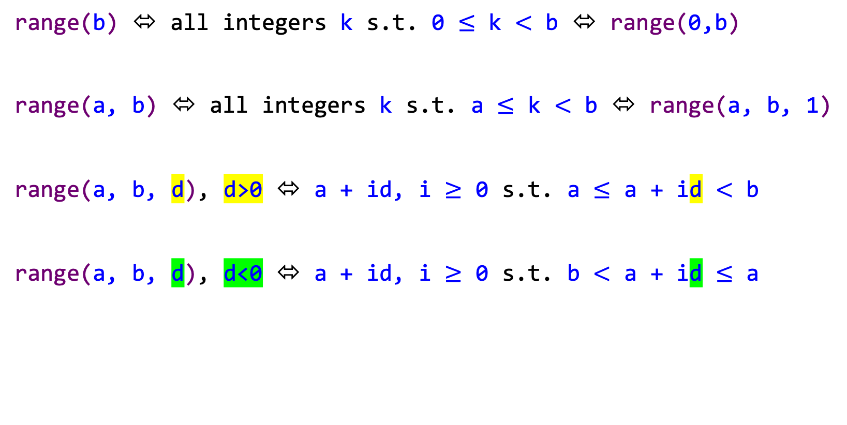
Python’s Range
range([start],end[,step])
range(b) ⬄ all integers k s.t. 0 $≤$ k $<$ b ⬄ range(0,b)
range(a, b) ⬄ all integers k s.t. a $≤$ k $<$ b ⬄ range(a, b, 1)
range(a, b, d), d>0 ⬄ a + id, i $≥$ 0 s.t. a $≤$ a + id $<$ b
range(a, b, d), d<0 ⬄ a + id, i $≥$ 0 s.t. b $<$ a + id $≤$ a

Slide 16
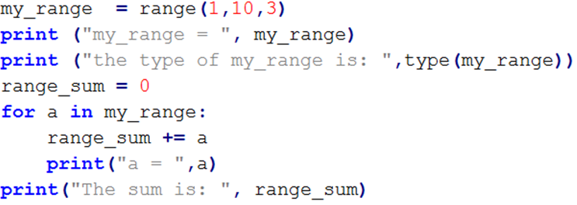
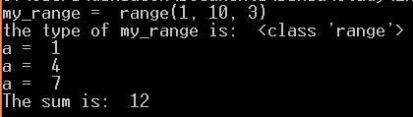
Summing a range
What will be printed?
Notes:
use each item’s value

Slide 17
How many iterations?
How many iterations the following loops will run?
for i in range (5)
for i in range (0, 5)
for i in range (0, 5, 2)
for i in range (0, 50, 20)
for i in range (0, 5, 8)
for i in range (15, 3, -4)
5 iterations
5 iterations
3 iterations
3 iterations
1 iterations
3 iterations
Notes:
5 (0, 1, 2, 3, 4)
5 (0, 1, 2, 3, 4)
3 (0, 2, 4)
3 (0, 20, 40)
1 (0)
3 (15, 11, 7)

Slide 18
How many iterations?
What will these code snippets print?
for num in range(5, 0, -1): print(num)
for num in range(5, 0, -3): print(num)
for num in range(5, 6, -1): print(num)
[5, 4, 3, 2, 1]
[5, 2]
[ ]
Notes:
Answers : [5,4,3,2,1], [5,2], []

Slide 19
Iterating over a string with for loop
line = 'The quick brown fox jumps over the lazy dog’
num_of_spaces = 0
for char in line:
if char == ' ':
num_of_spaces += 1
if num_of_spaces:
print('There are ', num_of_spaces,
' spaces in the sentence')
>>> There are 8 spaces in the sentence

Slide 20
Generate a random number
import random
for i in range(10):
print(random.randint(1, 50), end=’, ’)
>>> 28, 19, 43, 11, 36, 32, 50, 20, 45, 22,
More about the functions in the random module

Slide 21
Generate a random number
import random
for i in range(10):
if random.randint(1, 50) == 41:
print(’41 was randomized’)
How many times will it be printed?
What should we do if we want it to be printed at most one time?

Slide 22
Breaking loops
We might want to dynamically stop a loop:
On user input
When finding an error
On specific event we were looking for
Use the break statement, which tells the program:
terminates the current loop
continue the regular flow of the program.

Slide 23
break
import random
for i in range(10):
if random.randint(1, 50) == 41:
print(’41 was randomized’)
break
Possible outputs?
>>> 41 was randomized
>>>

Slide 24
continue
continue – allows us to terminate only the current iteration
syntax:
for <condition1>:
if <condition2>:
continue
<statements>

Slide 25
continue
With continue it is possible to:
skip the rest of the commands in the current iteration
start from the begining of the loop again

Slide 26
continue
for i in range(5):
x = random.randint(-5, 5)
if x == 0:
continue
print('The inverse of', x, 'is:', 1/x)
The inverse of 5 is: 0.2
The inverse of -4 is: -0.25
The inverse of 1 is: 1.0

Slide 27
else clause (of ‘for’ statement)
Loop statements may have an else clause
It is executed when the for loop is completed and not terminated by a break statement
Allows us to now how the loop was completed

Slide 28
Example of ‘else’ statement
has_even_number = False for i in range(10): val = random.randint(1, 50) if val % 2 == 0: has_even_number = True break if has_even_number: print(’An even number was found’) else: print(’No even number found')
Using a flag:
Notes:
Notice where the else is indented

Slide 29
Example of ‘else’ statement
for i in range(10): val = random.randint(1, 50) if val % 2 == 0: print('An even number was found’) break else: print(’No even number found')
Using else:
Notes:
Notice where the else is indented

Slide 30
What will we cover today?
Short recap
Loops
Range
Nested Loops
Lists
Debugging and Testing!

Slide 31
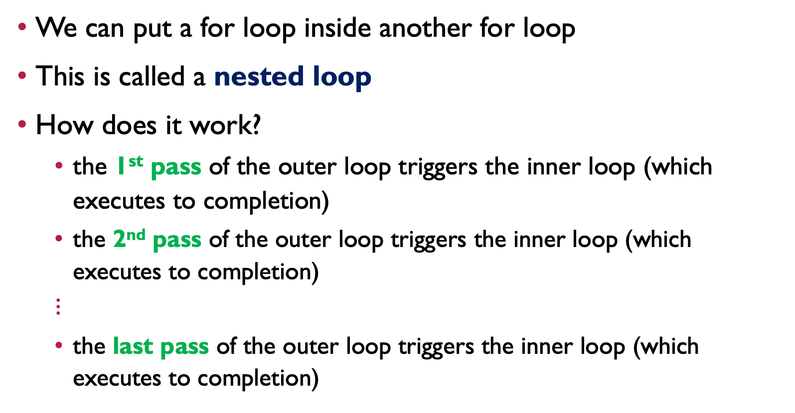
Nested for loops
We can put a for loop inside another for loop
This is called a nested loop
How does it work?
the 1st pass of the outer loop triggers the inner loop (which executes to completion)
the 2nd pass of the outer loop triggers the inner loop (which executes to completion)
$$⋮$$
the last pass of the outer loop triggers the inner loop (which executes to completion)

Slide 32
Nested loops, why is it useful?
How to print 8 rows of 5 ‘*’ each?
for i in range( 8 ):
for k in range( 5 ):
print( '*', end='' )
print()
Even simpler!
for i in range( 8 ):
print( '*’ * 5 )
*****
*****
*****
*****
*****
*****
*****
*****

Slide 33
Multiplication table
How do you print the multiplication table? (Up to 100)
1 2 3 4 5 6 7 8 9 10 2 4 6 8 10 12 14 16 18 20 3 6 9 12 15 18 21 24 27 30 4 8 12 16 20 24 28 32 36 40 5 10 15 20 25 30 35 40 45 50 6 12 18 24 30 36 42 48 54 60 7 14 21 28 35 42 49 56 63 70 8 16 24 32 40 48 56 64 72 80 9 18 27 36 45 54 63 72 81 90 10 20 30 40 50 60 70 80 90 100

Slide 34
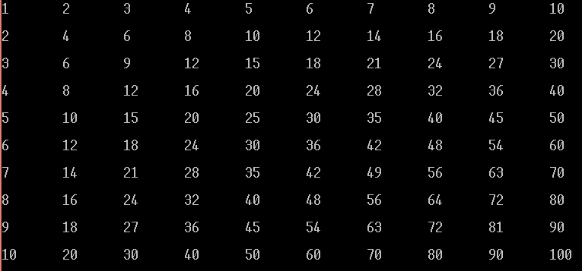
Multiplication table
for i in range(1, 11):
for j in range(1, 11):
print(i * j, end='\t')
print()

Slide 35
nested loops
How can we print the following series using nested loops?
1
1 2
1 2 3
1 2 3 4
1 2 3 4 5

Slide 36
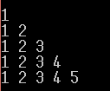
Print range of ranges
for i in range(1, 6):
for j in range(1, i+1):
print(j, end=" ")
print()

Slide 37
What will we cover today?
Short recap
Loops
Range
Nested Loops
Lists
Debugging and Testing!

Slide 38
Python Lists
The list is the most versatile data structure in Python
Can be written as a list of comma-separated values (items) between square brackets: []
Python’s list can include elements of different types. Be careful

Slide 39
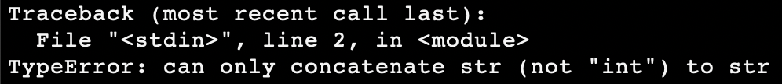
Lists can hold different types
lst = [1, 3, ’hi’, ‘bye’]
for i in range(len(lst)):
lst[i] = lst[i] + 1

Slide 40
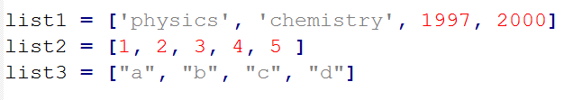
Creating a list (1)
Creating a list is as simple as putting different comma-separated values between square brackets.
For example:
Like string indices, list indices start at 0
Lists can be sliced, concatenated and so on.

Slide 41



Creating a list (1)
Another way to create a list is by using the list(seq) function which converts a sequence into a list.

Slide 42
Lists as Sequences
Lists are a specific kind of sequence
A sequence consists of finite number of elements
The elements are arranged in some order, and have an index accordingly
The first index is 0, the second index is 1, and so on
Loops iterate over the elements of a sequence according to their order

Slide 43
Lists as Sequences (2)
There are certain things you can do with all sequence types:
indexing – seq[i]
slicing – seq[i:j]
adding* – seq1 + seq2
multiplying* – n * seq
checking for membership – value in seq
In addition, Python has built-in functions for finding:
the length of a sequence – len()
its largest and smallest elements in a sequence – min(), max()
Notes:
*range does not support those!

Slide 44
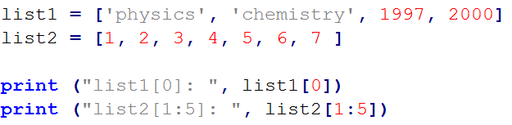

Accessing Values in Lists
To access values in lists, use the square brackets []
To obtain multiple values use slicing

Slide 45
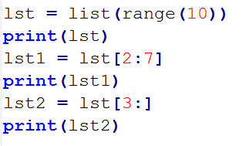

List Slicing (1)
Slicing will create a new list with a subset of the original list.
Works very similar to range
lst1 = lst[start:end] # items from start through end-1
lst2 = lst[start:] # items from start through the rest of it

Slide 46
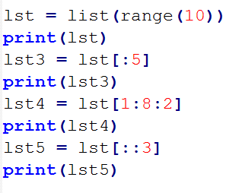

List Slicing (2)
More examples:
lst3 = lst[:end] # items from the beginning through end-1
lst4 = lst[start:end:step] # items from start through end-1 by step
lst5 = lst[::step] # from the beginning to the end by step

Slide 47
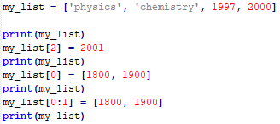

Updating Lists (1)
You can update elements of a list
Done by giving the :
slice on the left-hand side
the assignment (=) operator
the new values on the right-hand side

Slide 48
Updating Lists (2)
You can also add elements to a list by using the append() method
list.append(x) – Add one element to the end of the list
equivalent to a[len(a):] = [x]
append() takes exactly one argument!

Slide 49
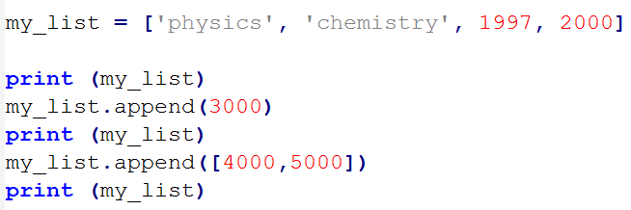

Updating Lists (2) – EXAmple

Slide 50
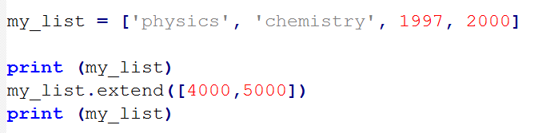

Updating Lists (3)
You can also extend a list by using the extend() method
list.extend(L) – This extends the list by appending all the elements in the given list
equivalent to a[len(a):] = L

Slide 51
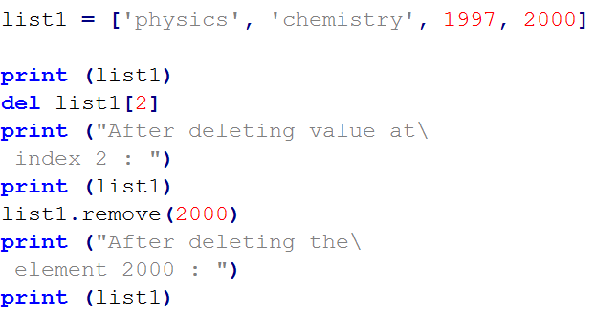
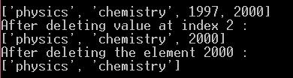
Delete List Elements
To remove a list element, we can use either:
del if we know the index of the element(s) we are deleting
list.remove() if we only know the value
Only the first matching element will be removed

Slide 52
Iterating over a list (1)
lst = [1, 3, ’hi’, ‘bye’]
for item in lst:
print(item)
1
3
hi
bye
Equivalent to:
for i in range(len(lst)):
print(lst[i])

Slide 53
Iterating over a list (2)
Notice the difference!
lst = [1, 3, ’hi’, ‘bye’]
for i in lst:
i = i * 2
print(lst)
[1, 3, ‘hi’, ‘bye’]
lst = [1, 3, ’hi’, ‘bye’]
for i in range(len(lst)):
lst[i] = lst[i] * 2
print(lst)
[2, 6, ‘hihi’, ‘byebye’]

Slide 54
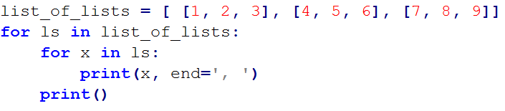

Iterating over a list of lists
What will be printed?

Slide 55
Basic List Operations
Lists respond to the + and * operators
Like in strings - they mean concatenation and repetition
In fact, lists respond to all the general sequence operations we used on strings.
Python Expression | Results | Description
len([1, 2, 3]) | 3 | Length
[1, 2, 3] + [4, 5, 6] | [1, 2, 3, 4, 5, 6] | Concatenation
[’Hi!’] * 4 | [‘Hi!’, ‘Hi!’, ‘Hi!’, ‘Hi!’] | Repetition
3 in [1, 2, 3] | True | Membership
for x in [1, 2]: print(x) | 1 2 | Iteration

Slide 56
Built-in List Functions
len(list)
Gives the total length of the list
max(list)
Returns item from the list with max value
min(list)
Returns item from the list with min value
list(seq)
Converts a sequence into list

Slide 57
Built-in Methods of List (1)
list.append(obj)
Appends object obj to list
list.count(obj)
Returns count of how many times obj occurs in list
list.extend(seq)
Appends the contents of seq to list
list.index(obj)
Returns the lowest index in list that obj appears
list.insert(index, obj)
Inserts object obj into list at offset index

Slide 58
Built-in Methods of List (2)
list.pop(obj=list[-1])
Removes and returns last object or obj from list
list.remove(obj)
Remove the first item from the list whose value is x. It is an error if there is no such item.
list.reverse()
Reverses objects of list in place
list.sort([func])
Sorts objects of list, use func to compare, if given
More about list methods

Slide 59
Example (1)
>>> a = [66.25, 333, 333, 1, 1234.5]
>>> print(a.count(333), a.count(66.25), a.count('x'))
2 1 0
>>> a.insert(2, -1)
>>> a.append(333)
>>> a
[66.25, 333, -1, 333, 1, 1234.5, 333]
>>> a.index(333)
1

Slide 60
example (2)
>>> a.remove(333)
>>> a
[66.25, -1, 333, 1, 1234.5, 333]
>>> a.reverse()
>>> a
[333, 1234.5, 1, 333, -1, 66.25]
>>> a.sort()
>>> a
[-1, 1, 66.25, 333, 333, 1234.5]
>>> a.pop()
1234.5
>>> a
[-1, 1, 66.25, 333, 333]

Slide 61
What will we cover today?
Short recap
Loops
Range
Nested Loops
Lists
Debugging and Testing!

Slide 62
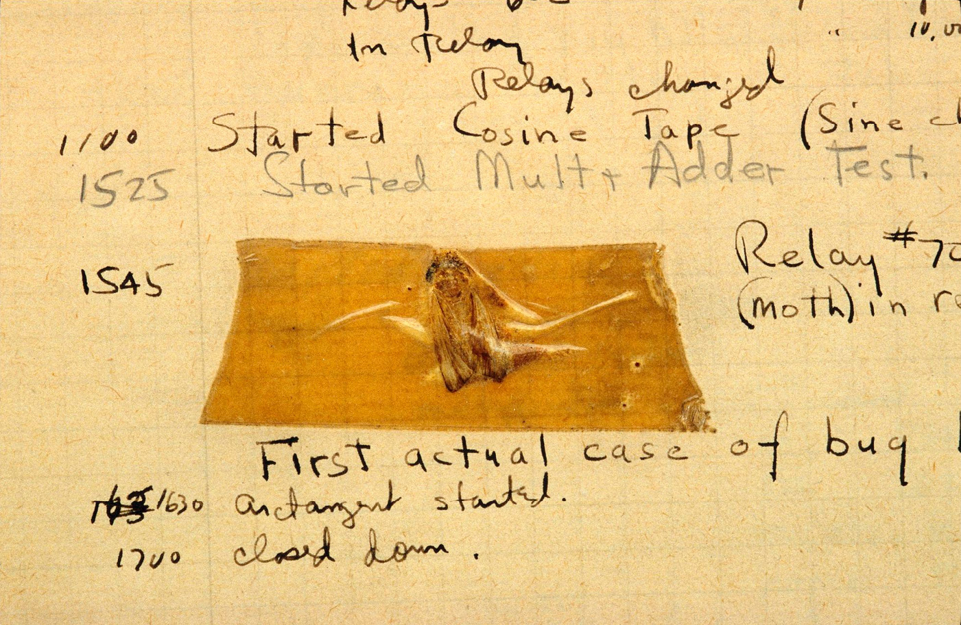
Debugging 101
One of the most important tasks as a programmer is to have the ability of debugging

Slide 63
Debugging 101
Learning how to debug takes time!
One of the approaches for debugging is using printouts: we print some message that signifies the progress in our program
Fast and provides with visual aid

Slide 64
Debugging Example
You are given a list of numbers
You need to ask the user for a number to add to every item in the list
def addition_function( numbers ):
for num in numbers:
my_num = int( input( ”Enter an integer:“ ) )
numbers.append( num + my_num )
return numbers

Slide 65
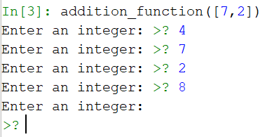
Debugging Example
If we got as input the list: [7,2]
def addition_function( numbers ):
for num in numbers:
my_num = int( input( ”Enter an integer:“ ) )
numbers.append( num + my_num )
return numbers

Slide 66
Debugging Example
What went wrong? Let's print and see!
def addition_function( numbers ):
print(“numbers= “, numbers)
for num in numbers:
print(“num= “, num)
my_num = int( input( ”Enter an integer:“ ) )
numbers.append( num + my_num )
print(“numbers= “, numbers)
return numbers

Slide 67
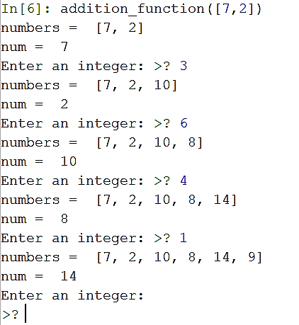
Debugging Example
def addition_function( numbers ):
print(“numbers= “, numbers)
for num in numbers:
print(“num= “, num)
my_num = int( input( ”Enter an integer:“ ) )
numbers.append( num + my_num )
print(“numbers= “, numbers)
return numbers
Found the problem!
We appended to the list we are going over

Slide 68
Unit Testing 101
Unit Tests - Code that tests code
Just like when we test your submissions!
Independent tests
As simple as possible
Helps finding bugs
Test every function
Test various “if” branches
Test edge cases
Helps keeping track of changes in the code

Slide 69
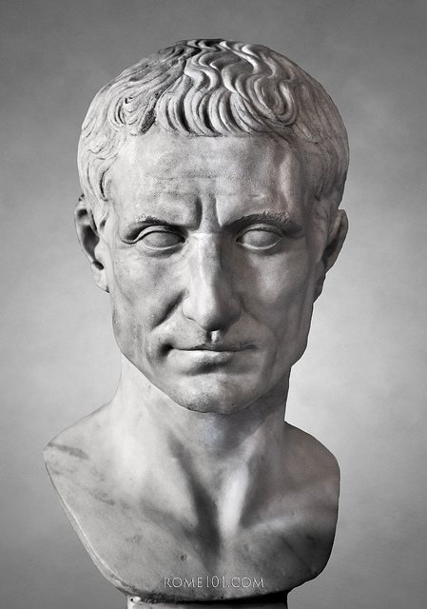
Example 2
An encryption program!
We will design the Caesar Code encryption
There is a key (number)
Every letter in a message is shifted by that key
For example – using key=2 : a b c d e f … x y z c d e f g h … z a b

Slide 70
Example 2
So first we would need to convert characters into integers, this could be done using the ord() function!
This function gives us the ASCII value of every letter
The inverse of this function is the chr() function
We would use these two functions:
encrypt(msg, key) – adds key to every letter of msg
decrypt(msg, key) – reduces key from every letter of msg
As there are 26 letters in the English alphabet, to transform each letter, we use the mapping:
ENCRYPT(LETTER, KEY) = (Value(LETTER) + KEY) mod 26
DECRYPT(LETTER, KEY) = (Value(LETTER) - KEY) mod 26

Slide 71
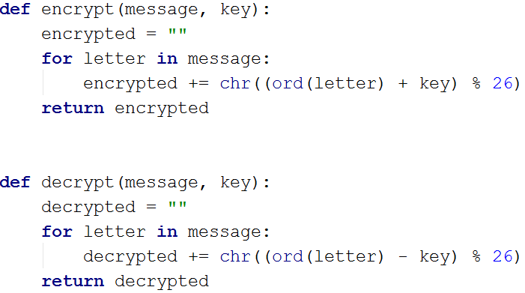
Example 2

Slide 72
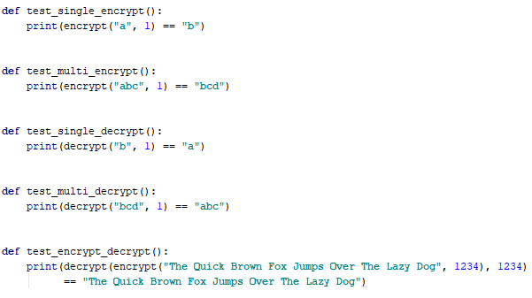
Example 2 – Unit Testing
We will write simple unit tests for our code:

Slide 73
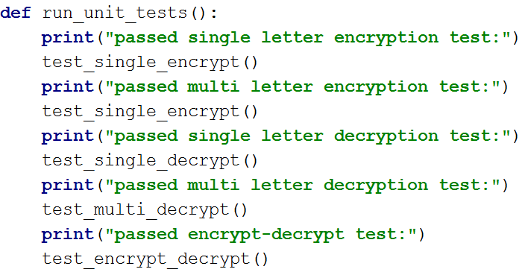
Example 2 – Unit Testing
And something to run the tests..

Slide 74
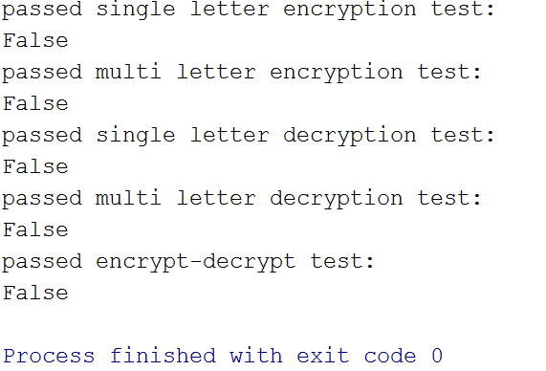
Example 2 – Unit Testing
Now we can test our code:

Slide 75
Example 2 – Unit Testing
What went wrong?? Lets debug!
OK so something is wrong, lets check the ord() function and see if we’ve missed something:

Slide 76
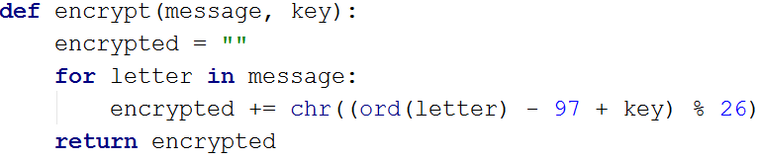
Example 2 – Unit Testing
Oh right! The values of letters in ASCII starts at 97… Lets fix that!
This transforms the value of the letter ‘a’ to 0

Slide 77
Example 2 – Unit Testing
Let’s test our code again:

Slide 78
Example 2 – Unit Testing
Back to debugging!
OK so something is still wrong, lets check the full expression:

Slide 79
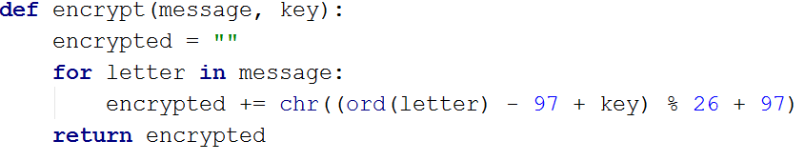
Example 2 – Unit Testing
Oh right! If we remove 97, we also must add it back… Lets fix that!
This transforms the value of every letter back to ASCII
This transforms the value of the letter ‘a’ to 0

Slide 80
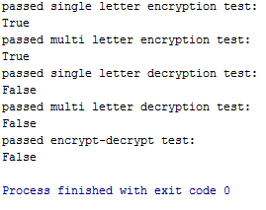
Example 2 – Unit Testing
Are we done? Let’s run tests (again)!

Slide 81
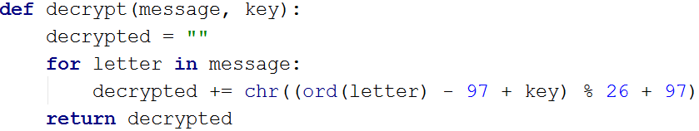
Example 2 – Unit Testing
Great! Lets copy the whole procedure to the decrypt function

Slide 82
Example 2 – Unit Testing
And again…

Slide 83
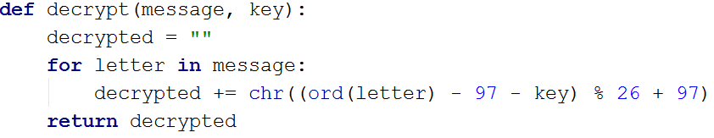
Debugging Example - 2
Wait, so what went wrong?
Oh, when copying the line we forgot to change it to ( - key )
DECRYPT(LETTER, KEY) = (Value(LETTER) - KEY) mod 26

Slide 84
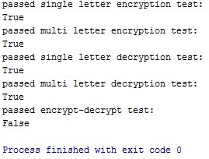
Example 2 – Unit Testing
One more time:

Slide 85
Debugging Example - 2
Now what?
Ah! Our algorithm only works for lower case letters, But the tests uses capital letters and spaces.
So this test is more like a bonus test ☺

Slide 86
Debugging Examples
So what did we have here?
Unit tests are a great way to monitor your program!
Using the print function could help you find where your bugs are
Always remember to check your assumptions!
Beware of copy-paste errors!

Slide 87
Extra Slides

Slide 88
Loop Example: Square Printing
Supposed you are asked to print a square with only the char ‘#’ and of some length, how would you do that?
A solution is to use a for loop (with range):
print('#'*size)
for i in range(0,size-2):
print('#'+' '*(size-2)+'#')
print('#'*size)
##########
# #
# #
# #
# #
# #
# #
# #
# #
##########
Notes:
Another solution using one liner:
print('#'*s+'\n'+('#'+' '*(s-2)+'#\n')*(s-2)+'#'*s)

Slide 89
Loop Example: Iterating average
We want to get 10 numbers from the user, and after each one print the current average
NUMBER_OF_ITERATIONS = 10
avg = 0
for counter in range(1, NUMBER_OF_ITERATIONS+1):
num = float(input('Enter a number: '))
avg += (num - avg) / counter
print('The current average is:', avg)

Slide 90
Loop Example: Iterating average
NUMBER_OF_ITERATIONS = 10
avg = 0
for counter in range(1, NUMBER_OF_ITERATIONS+1):
num = float(input('Enter a number: '))
avg += (num - avg) / counter
print('The current average is:', avg)
Example of execution:
Please enter a number: 10
The current average is: 10.0
Please enter a number: 0
The current average is: 5.0
Please enter a number: 9
The current average is: 6.333
Please enter a number: 1
The current average is: 5.0
Please enter a number: 8
The current average is: 5.6
Please enter a number: 2
The current average is: 5.0
Please enter a number: 7
The current average is: 5.285
Please enter a number: 3
The current average is: 5.0
Please enter a number: 6
The current average is: 5.111
Please enter a number: 4
The current average is: 5.0

Slide 91
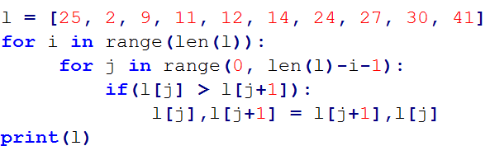
Nested Loop Example: Bubble Sort
What are we trying to do here?
What will be printed?
We performed a sort of the list, by a method called “Bubble Sort”

