Slide 1
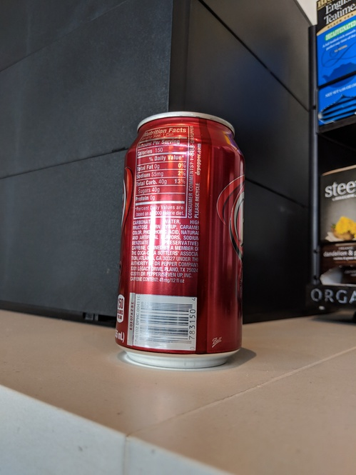
0.85
0.9
0.9
0.9
0.7
0.7

Slide 2
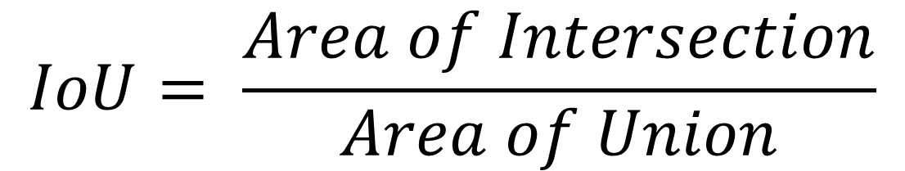
$$IoU= \frac{Area of Intersection}{Area of Union}$$
Intersection

Slide 3
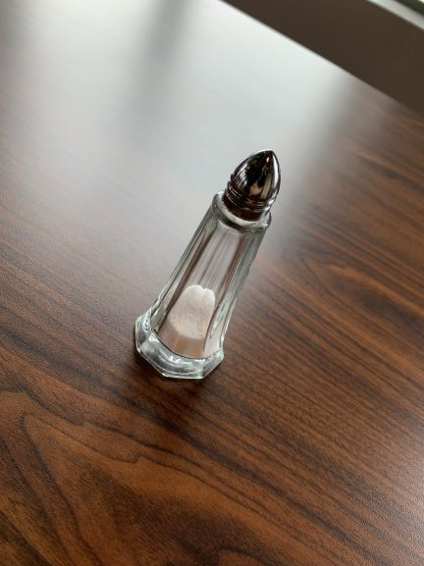
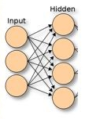
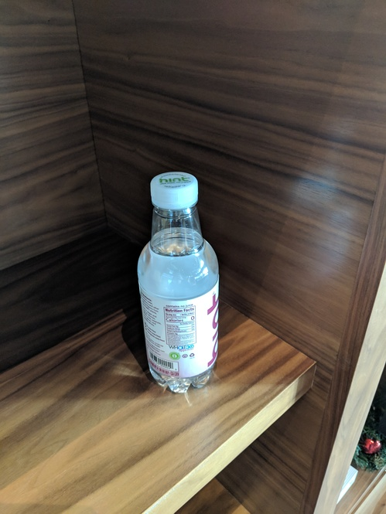
1. Training
Label = ‘water_bottle’
Score = 0.732
2. Prediction
2. Prediction (score)
Training set T
Model
3. Negative mining (add to T)
3. Negative mining (annotation)
Negative candidates set U

Slide 4
Images in U with detected objects
(2a) Score on U
(2b) Scoring results on U
Negative candidates U
(1) Train model on T
Bottle
Detection DNN
(3) Add most incorrect images from U to training set T
Training set T

