Slide 1
Main CV scenarios

Slide 2
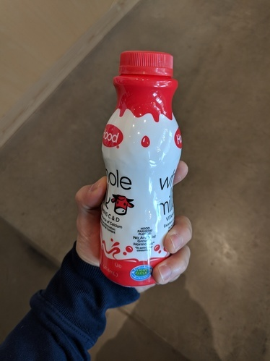
Airplane: no
Bottle: yes
Can: no
Input

Slide 3
Found 1 object:
Class: bottle Position: (100,50, 200, 80)
Input

Slide 4
Found 2 key-points:
Bottle-lid: at position (150,50)
Bottle-bottom: at position (150,80)

Slide 5
Input
Segmentation mask

Slide 6
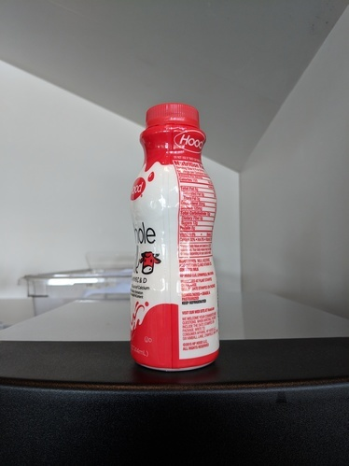
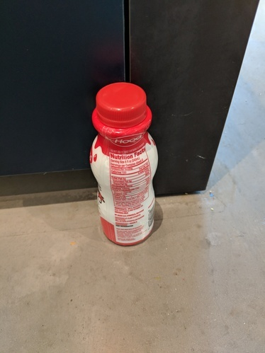
Input
Most similar images

Slide 7
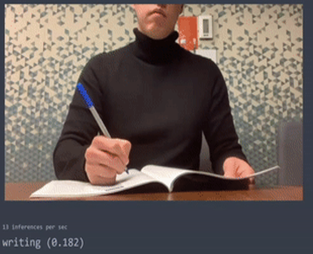
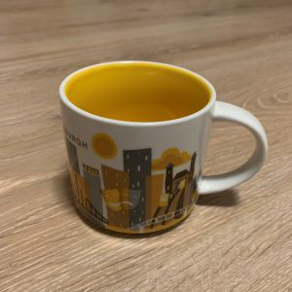
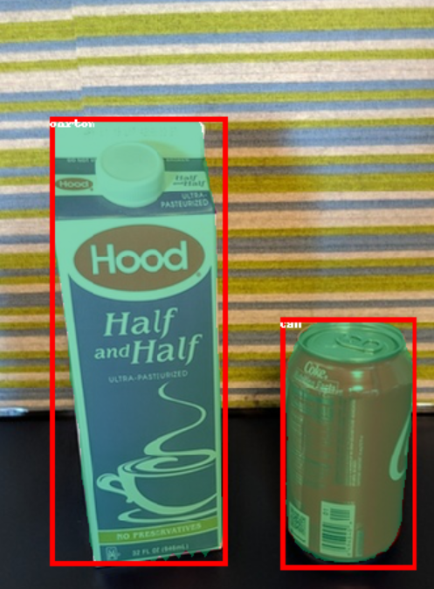
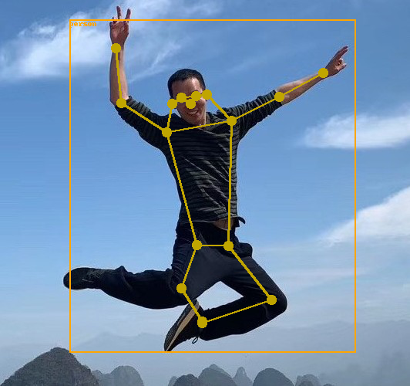
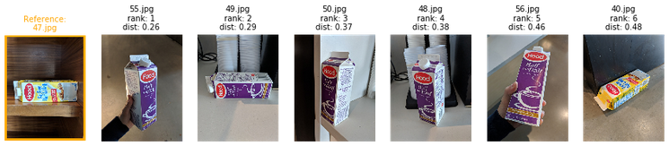
Label: cup Confidence: 99%

Slide 8
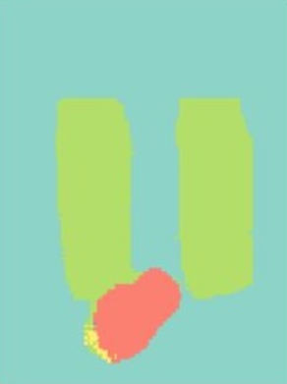
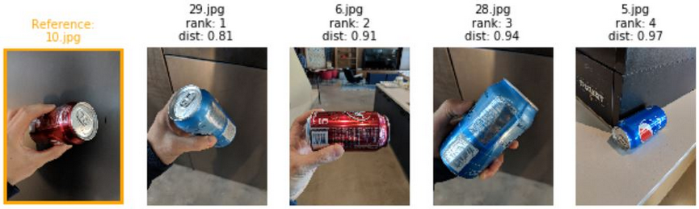
Label: cup Confidence: 99%

Slide 9
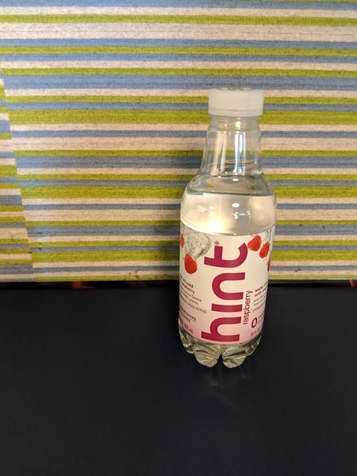
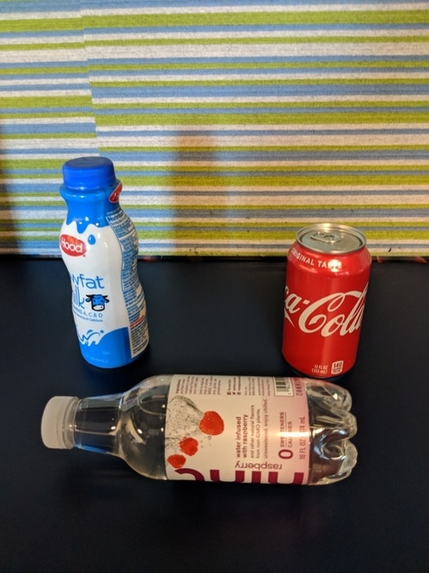
Label: bottle Confidence: 99%
Labels: bottle, can, milk_bottle Confidence: 93%, 99%, 96%

