Slide 1
Image similarity intro

Slide 2
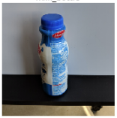
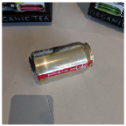
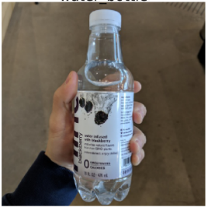
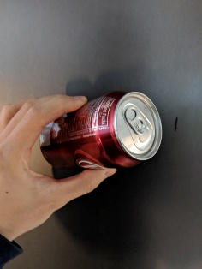
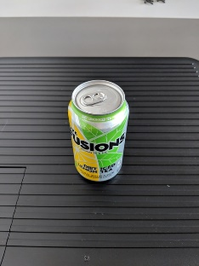
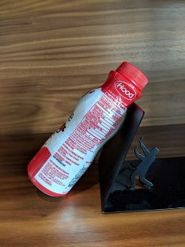
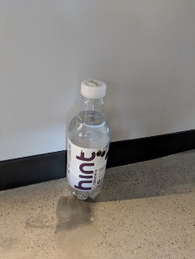
Pre-trained CNN
(e.g. ResNet50)
Fine-tuned model
Training set
u: Image embedding, i.e. vector of 512 floats
Fine-tuned model
Class
uref
dist(uref, u1)
.
.
.
.
u1
Reference
Rank 1
Rank 2
Rank 3
dist(uref, u2)
u2
dist(uref, uk)
Rank
uk
dist(uref, uk+1)
uk+1
Positive ex.
Fine-tuned model
Class
dist(uref, un)
un
Comparative set

Slide 3


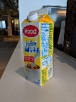
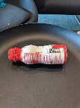
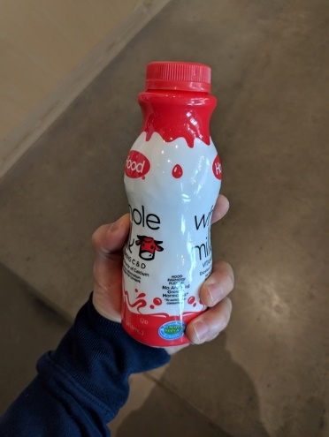
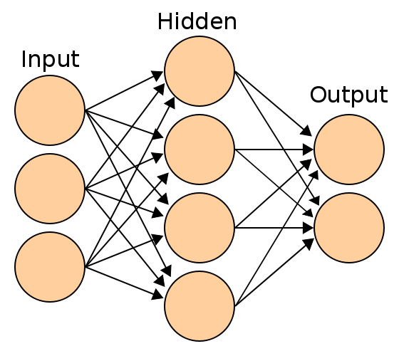
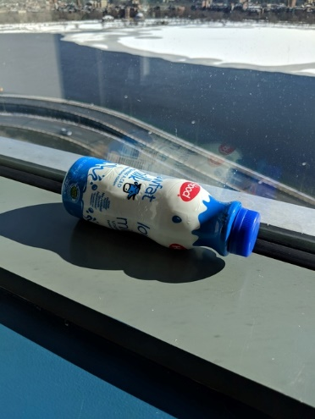



DNN
Fine-tuning
$$\vec{u}$$
512 floats
Single DNN
L2-distance ($\vec{u}$, $\vec{v}$)
$$\vec{v}$$
512 floats
Images to be compared
DNN Featurization
L2-normalization
Distance computation

Slide 4
Ranking example

Slide 5
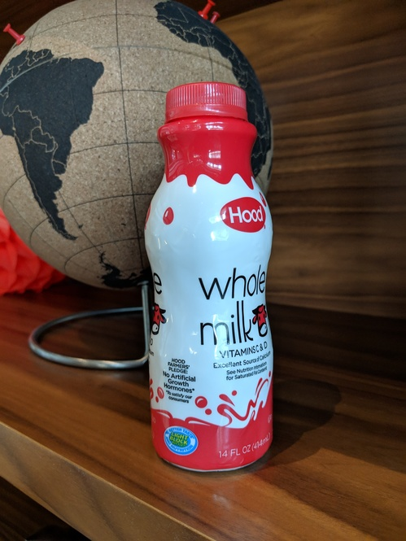

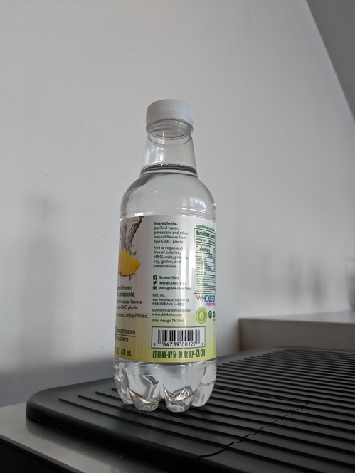
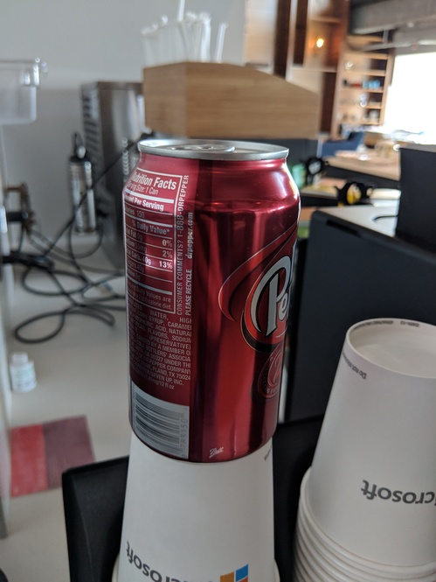
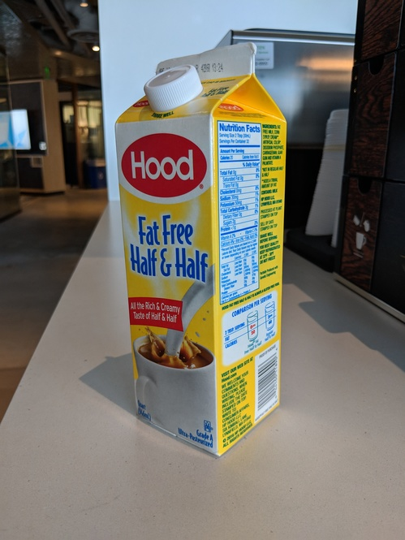
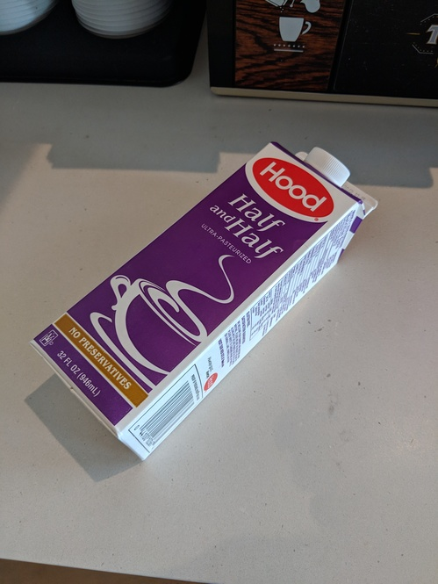
Rank 1
Rank 2
Rank 3
Rank 4
Rank 100
Query image
Sorted distractor images by their computed similarity to the query image. Note that the image with the same label (milk bottle) is at rank 3.

