Slide 1
Choosing a location for a japanese restaurant
IBM Capstone

Slide 2
Introduction
In 2017, the city had an estimated population density of 28,491 inhabitants per square mile (11,000/km2), rendering it the nation's most densely populated of all municipalities (of more than 100,000), with several small cities (of fewer than 100,000) in adjacent Hudson County, New Jersey having greater density, as per the 2010 census. Geographically co-extensive with New York County, the borough of Manhattan's 2017 population density of 72,918 inhabitants per square mile (28,154/km2) makes it the highest of any county in the United States and higher than the density of any individual American city.

Slide 3
Business Problem
New York City's food culture includes an array of international cuisines influenced by the city's immigrant history. Central and Eastern European immigrants, especially Jewish immigrants from those regions, brought bagels, cheesecake, hot dogs, knishes, and delicatessens (or delis) to the city. Italian immigrants brought New York-style pizza and Italian cuisine into the city, while Jewish immigrants and Irish immigrants brought pastrami and corned beef, respectively. Chinese and other Asian restaurants, sandwich joints, trattorias, diners, and coffeehouses are ubiquitous throughout the city.
In this context, we would like to find the best location for a Japanese restaurant.

Slide 4
Business Problem
Goal: Find the best location in New York Manhattan
The location of the restaurant is critical and has to factor various parameter (of which location against the competition)
Target Audience
I would like to open a restaurant in Manhattan. The target audience is any entrepreneur that would like to open such a business

Slide 5
Data
To find the best location for a Japanese restaurant, we will use the following sources of information:
From Foursquare Venues: Category 4bf58dd8d48988d111941735 (Japanese restaurant) available at https://developer.foursquare.com/docs/resources/categories
Newyork has a total of 5 boroughs and 306 neighborhoods (with latitude and longitude coordinates) available at https://geo.nyu.edu/catalog/nyu_2451_34572

Slide 6
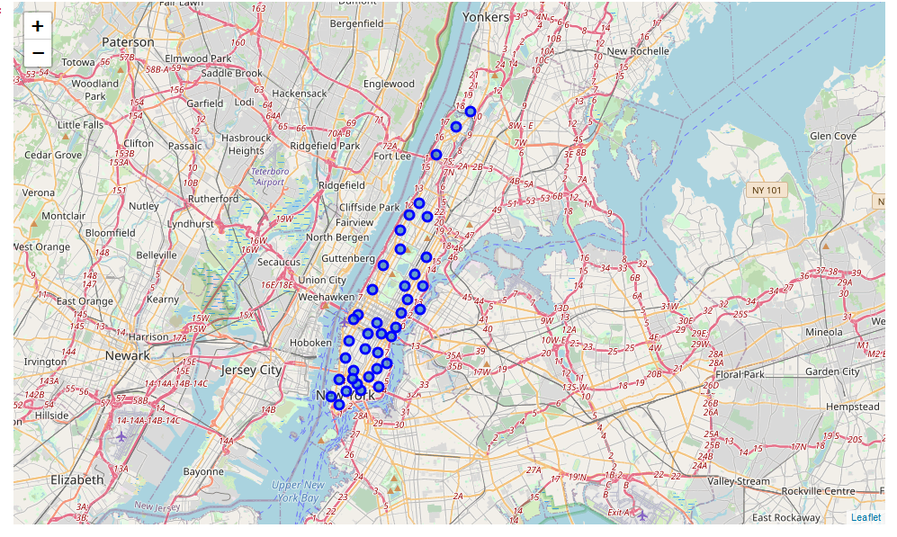
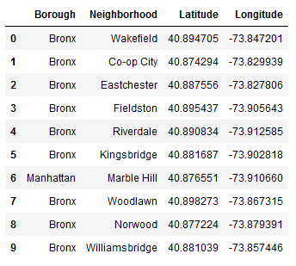
Methodolgy
Week 3 methodology

Slide 7
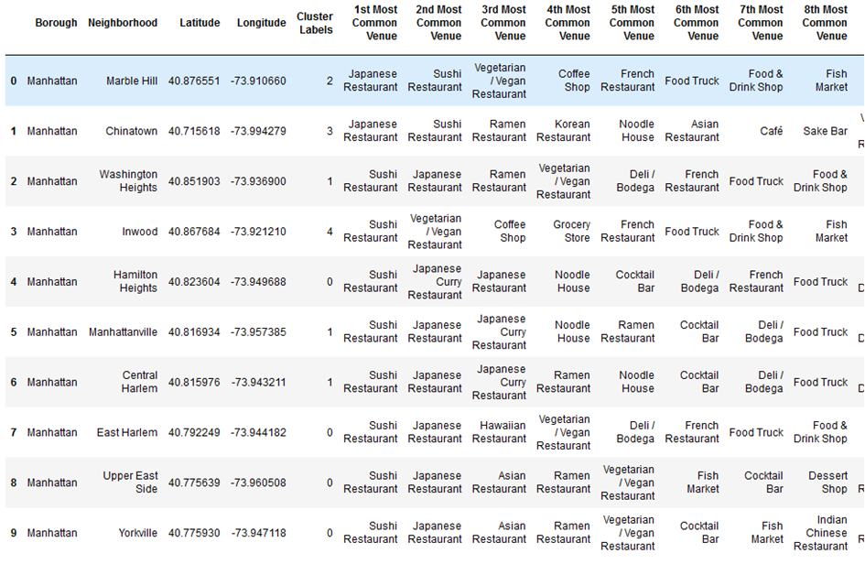
Methodolgy
The neighborhoods are grouped into clusters (K-means clustering algorithm is used).

Slide 8
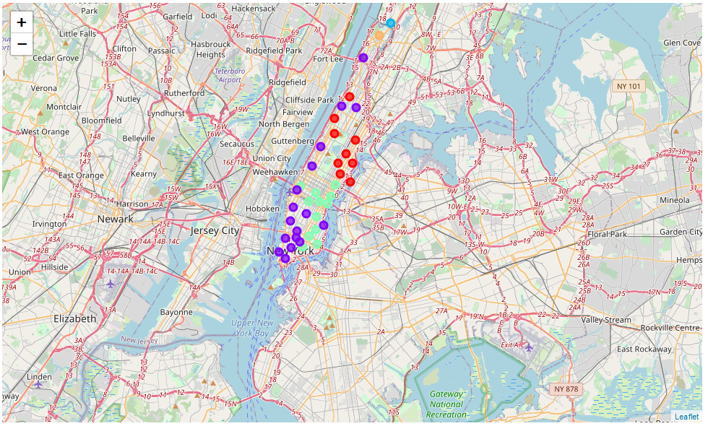
Methodolgy
Folium

Slide 9
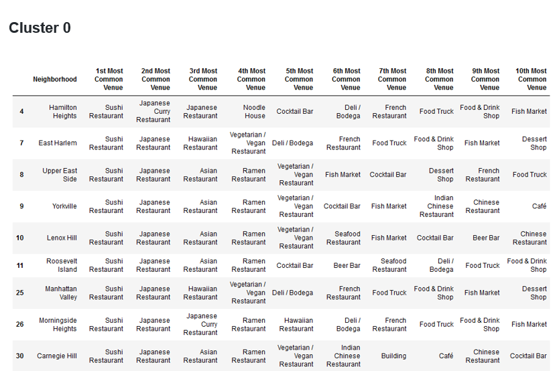
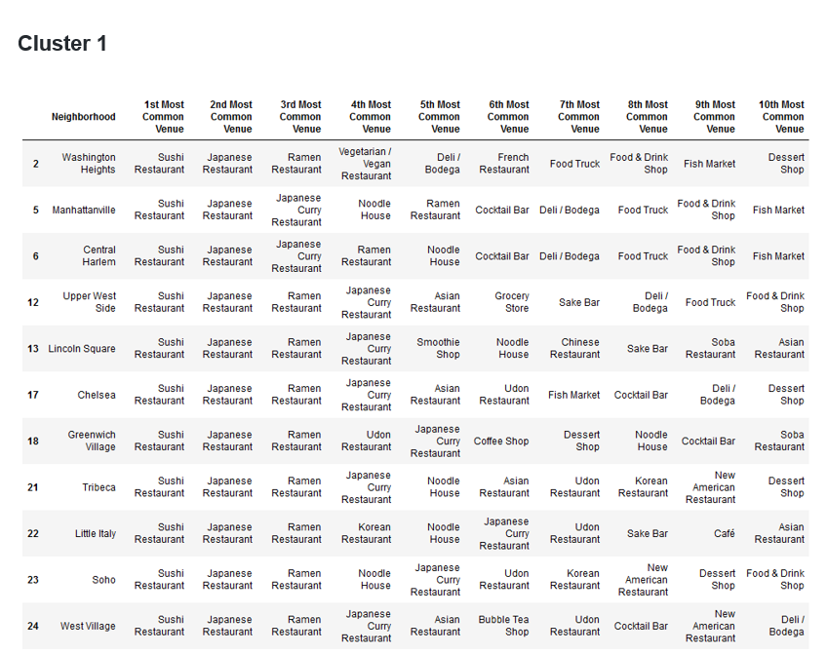
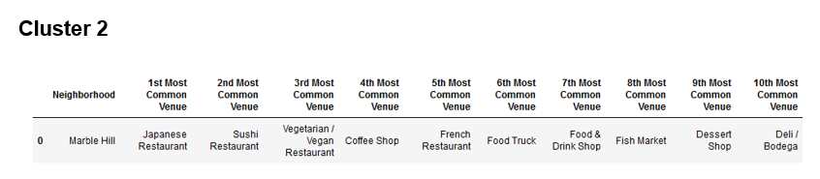
Results

Slide 10
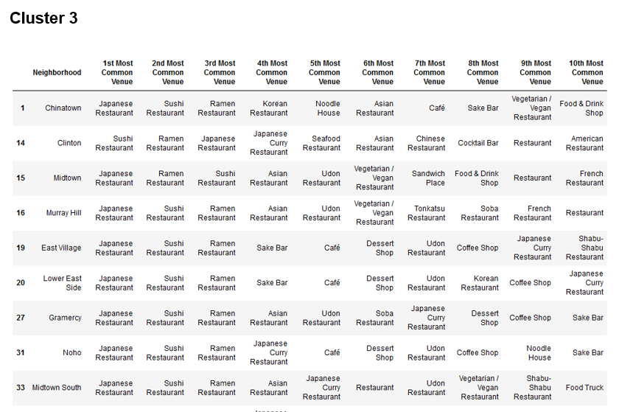
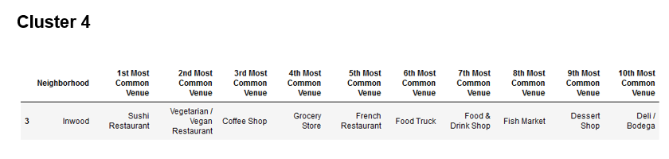
Results

Slide 11
Discussion
The result is based on extracted Foursquare data only. A lot more factors are to be taken into account when choosing a location (traffic, rent prices,…)

Slide 12
Conclusion
The best locations were found (cluster 2 and 4) based on the available data and the methodology described above but they are not the only factors to be taken into account when opening a Japanese restaurant

