Slide 1
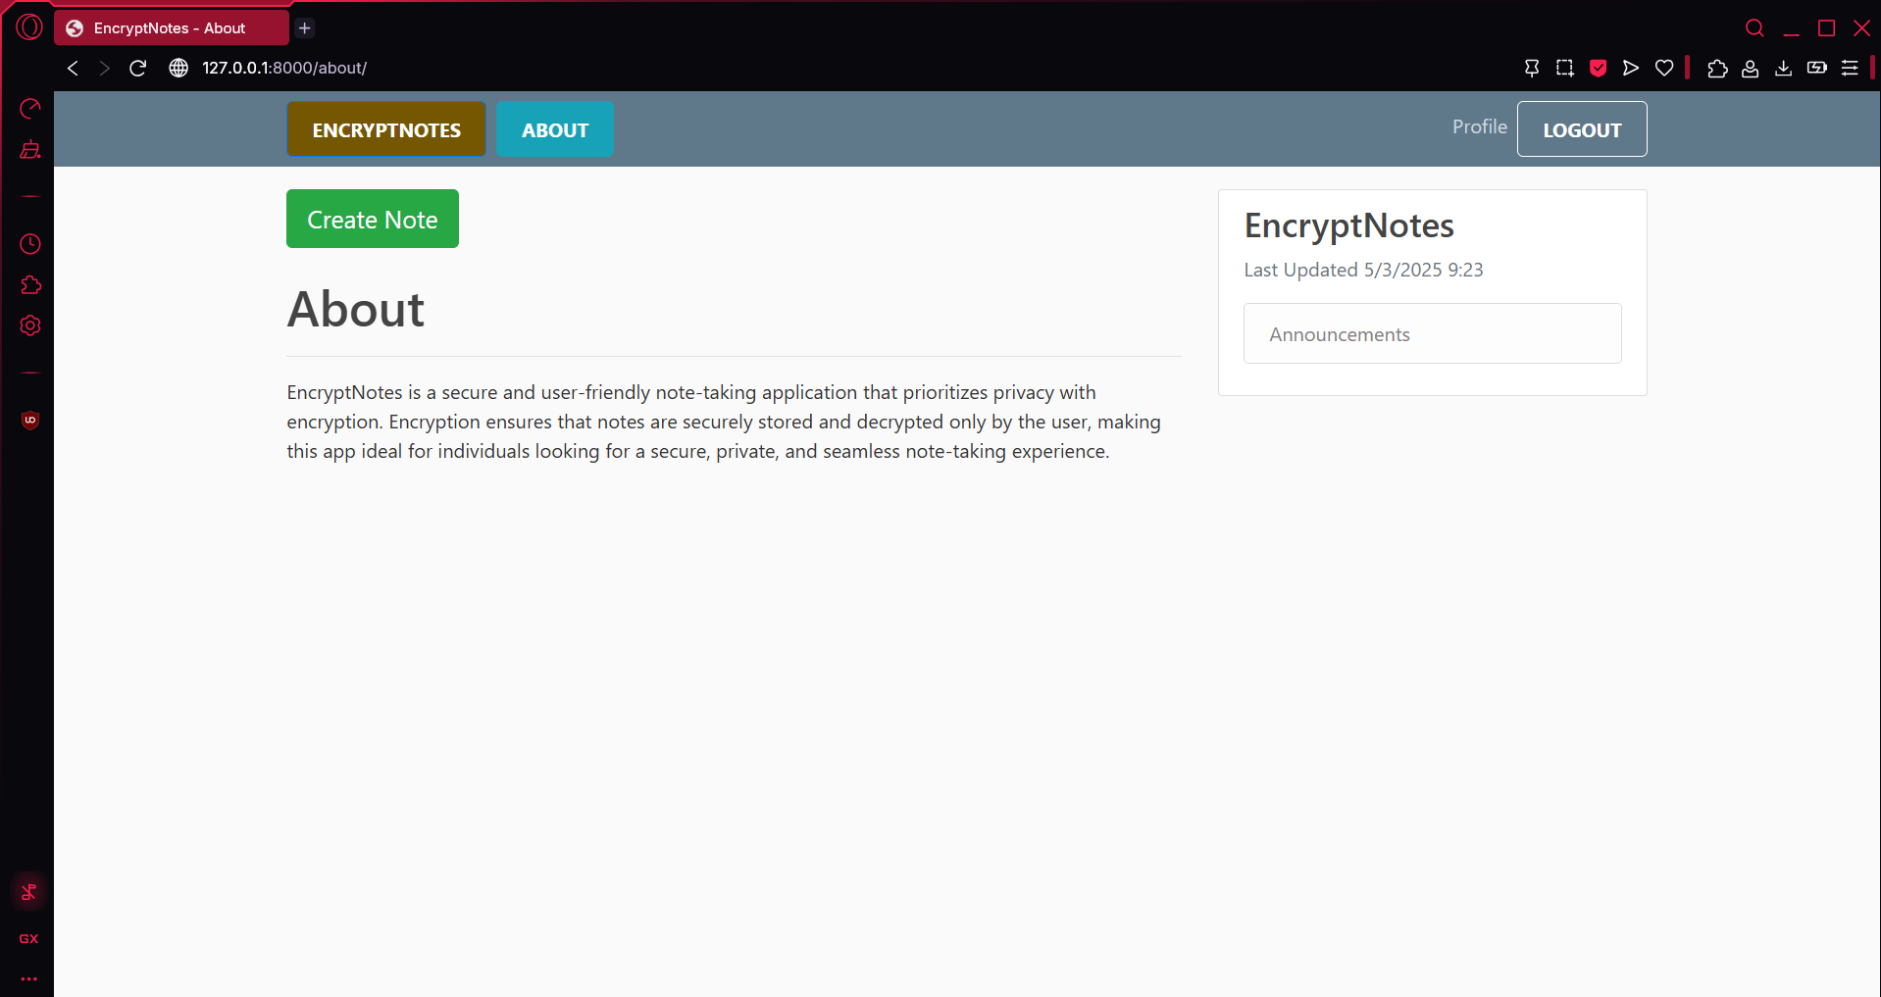
EnCryptNotes Secure and Intelligent Note Management
CPT-200 Team 2 - Phase 4

Slide 2

What is it?
Secure, AI-powered Note App
Accessed from Web Browser
Privacy & Efficiency Top priorities

Slide 3

Why EncryptNotes?
Easily accessible
No downloads
Unlike Other apps –
Ours doesn’t Lack of security
Ours doesn’t have Poor organization
Ours has automatic categorization

Slide 4
Key Features
End to End Encryption
AI-Powered Categorization
User-Controlled Security Setting
Note Editing and Management
User Account Controls

Slide 5
Technical Overview
Application
Powered by Python and Django
User Authentication
Secure authentication with Django
Encryption
Data encrypted before saving to database
Decrypted upon access from database
MySQL Database

Slide 6
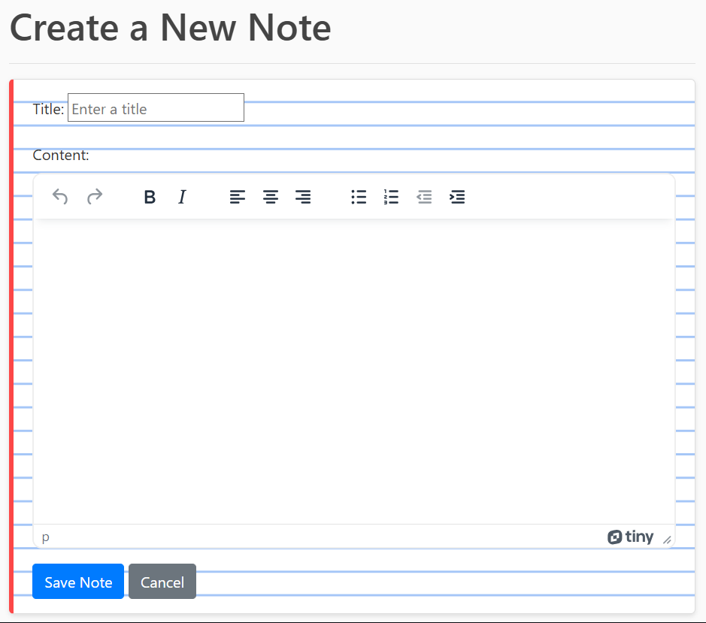
Unique Features
Powerful TinyMCE Editor utilized to create, edit, and view
AI powered note categorization with Google AI

Slide 7
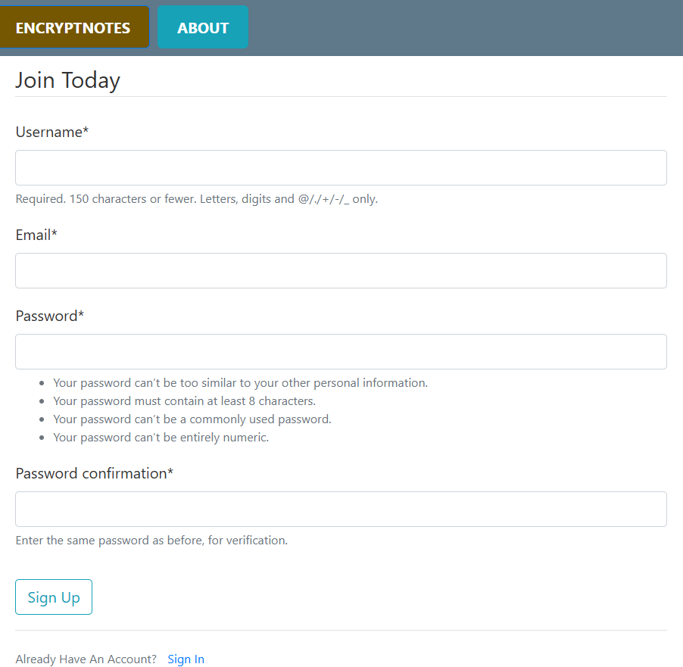
Sign Up Page
Minimum password requirements for enhanced security

Slide 8

Who would use it?
Students – Secure College Notes
Business Professionals – Secure Work Notes
Other Privacy Focused Individual Users

