Slide 1
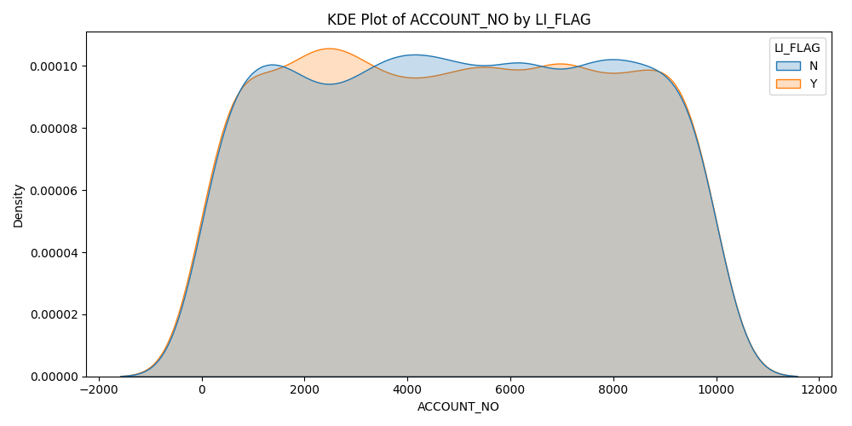
Kde Plot Of Account_No By Li_Flag

Slide 2
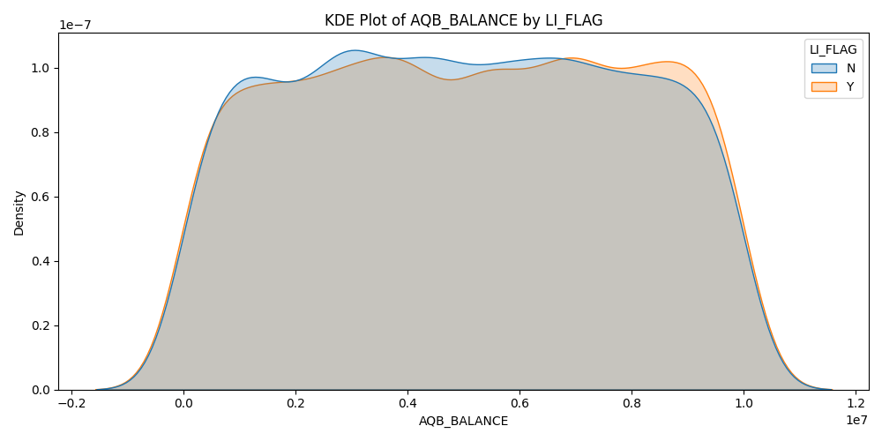
Kde Plot Of Aqb_Balance By Li_Flag

Slide 3
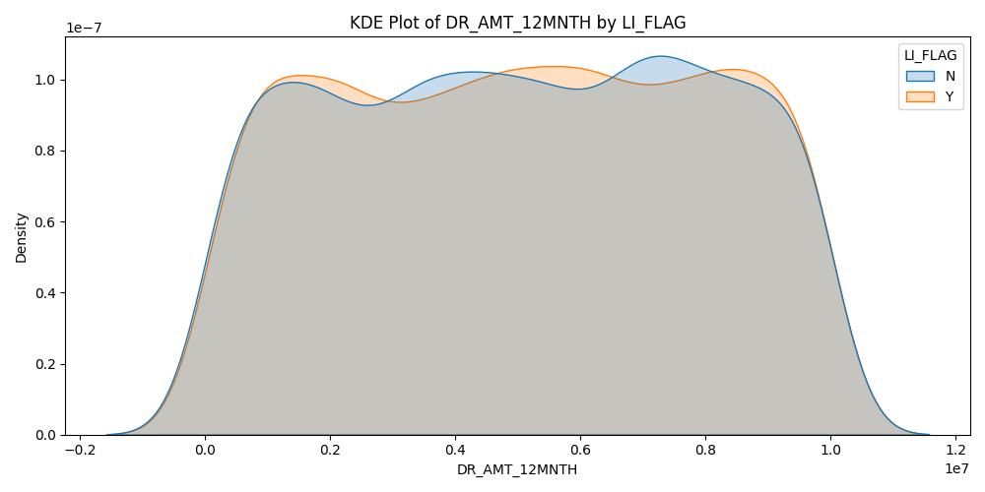
Kde Plot Of Dr_Amt_12Mnth By Li_Flag

Slide 4
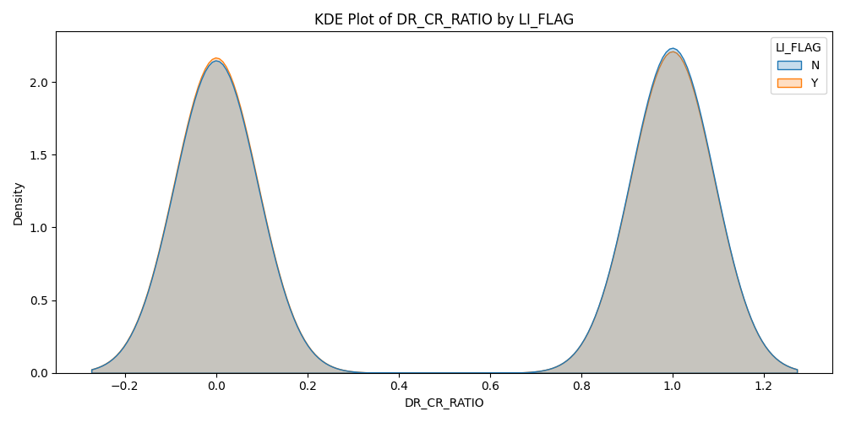
Kde Plot Of Dr_Cr_Ratio By Li_Flag

Slide 5
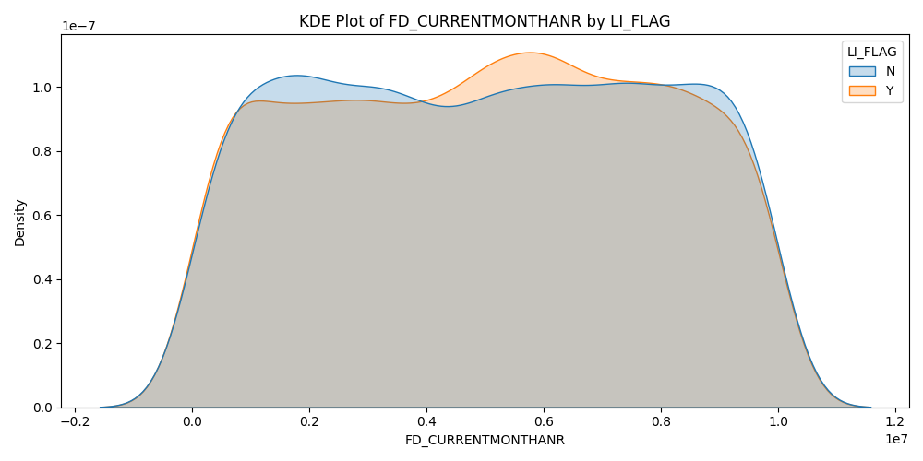
Kde Plot Of Fd_Currentmonthanr By Li_Flag

Slide 6
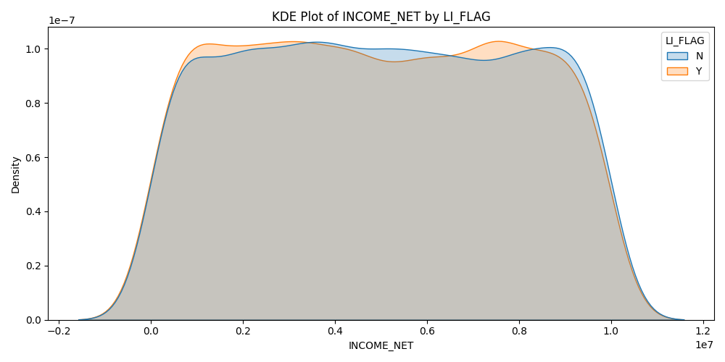
Kde Plot Of Income_Net By Li_Flag

Slide 7
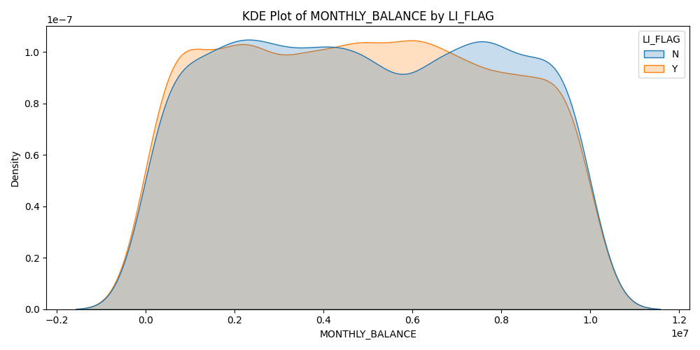
Kde Plot Of Monthly_Balance By Li_Flag

Slide 8
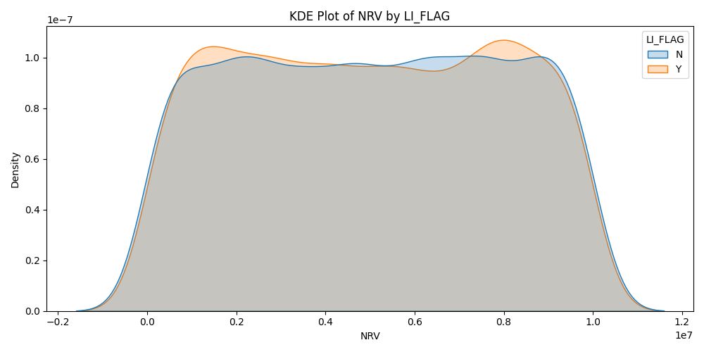
Kde Plot Of Nrv By Li_Flag

Slide 9
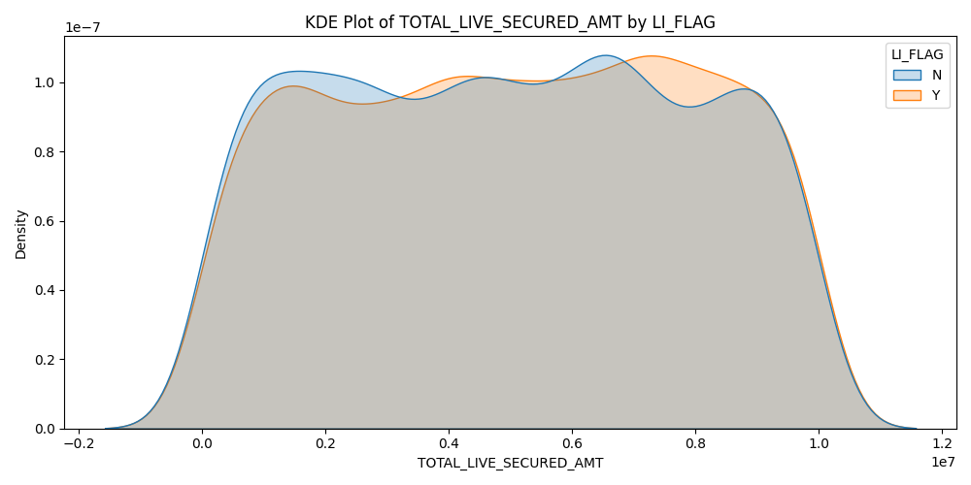
Kde Plot Of Total_Live_Secured_Amt By Li_Flag

Slide 10
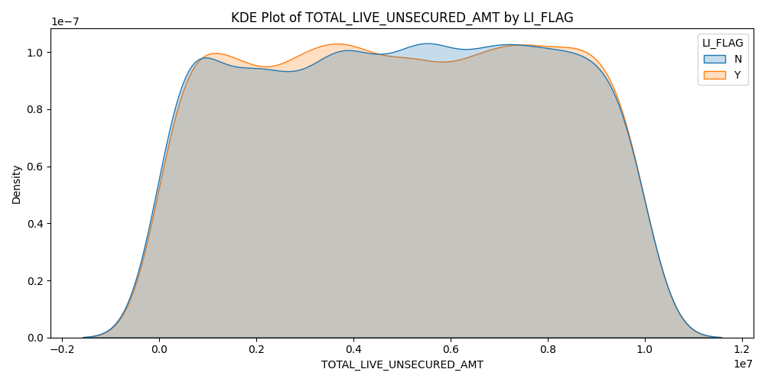
Kde Plot Of Total_Live_Unsecured_Amt By Li_Flag

Slide 11
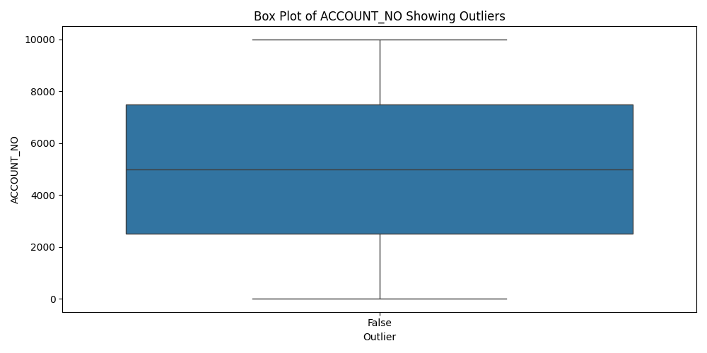
Box Plot Of Account_No Showing Outliers

Slide 12
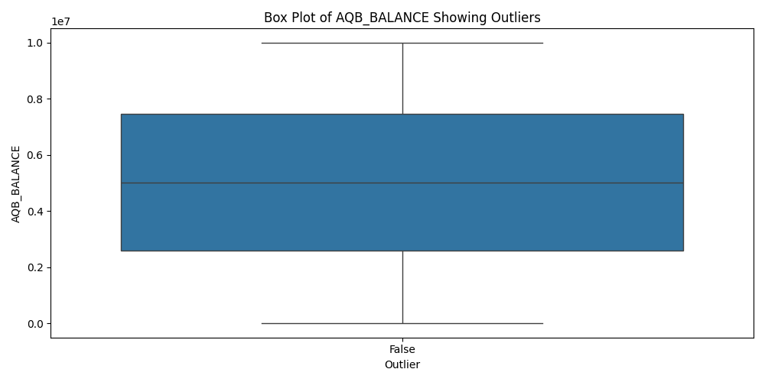
Box Plot Of Aqb_Balance Showing Outliers

Slide 13
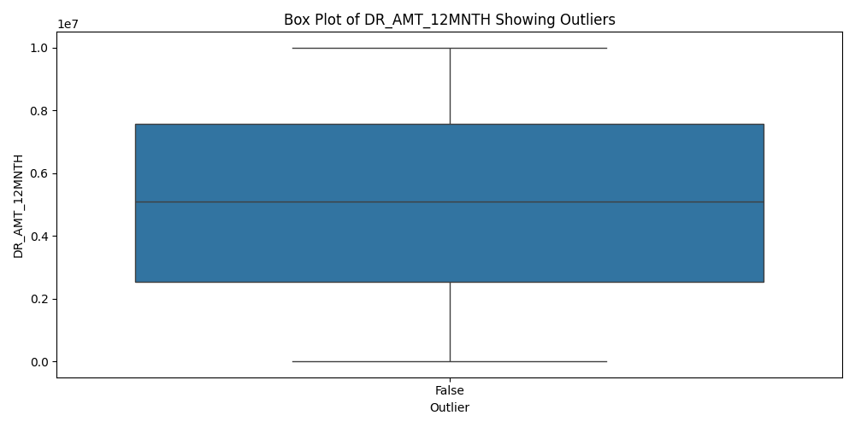
Box Plot Of Dr_Amt_12Mnth Showing Outliers

Slide 14
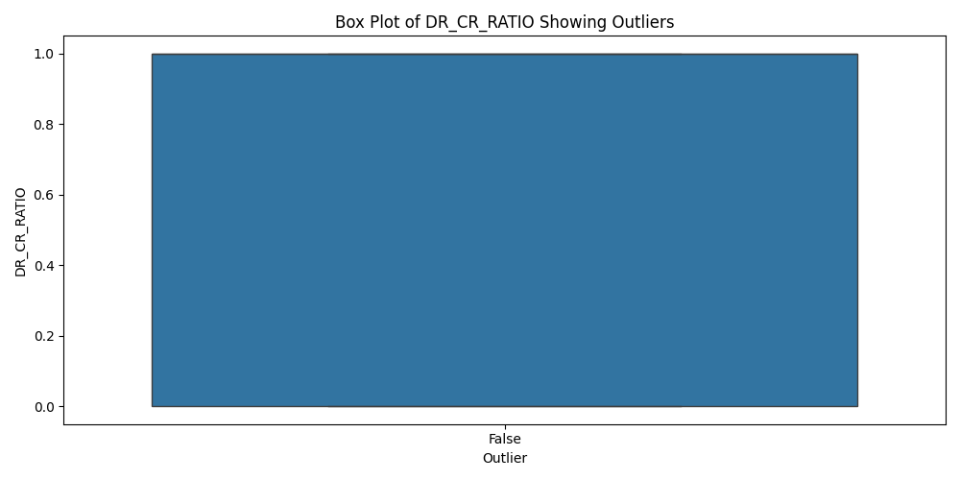
Box Plot Of Dr_Cr_Ratio Showing Outliers

Slide 15

Box Plot Of Fd_Currentmonthanr Showing Outliers

Slide 16

Box Plot Of Income_Net Showing Outliers

Slide 17
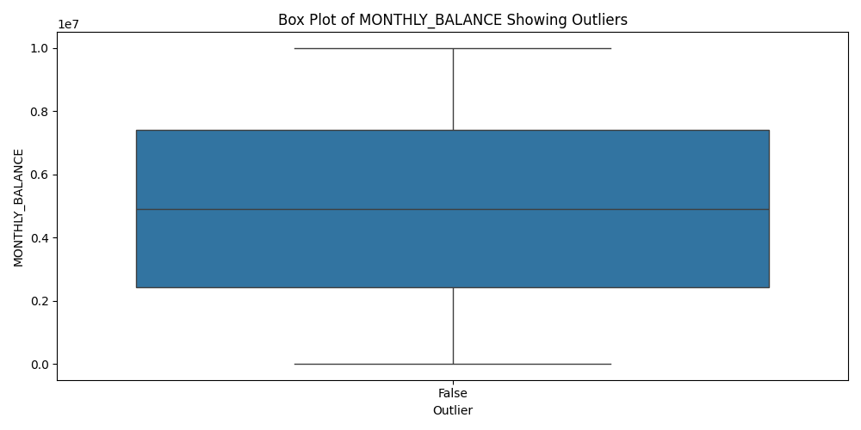
Box Plot Of Monthly_Balance Showing Outliers

Slide 18
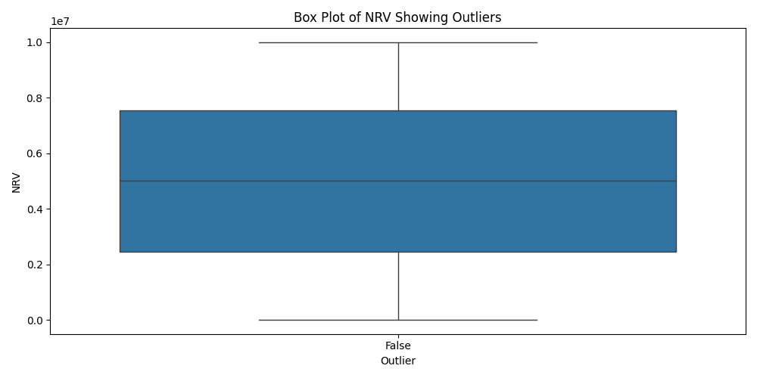
Box Plot Of Nrv Showing Outliers

Slide 19
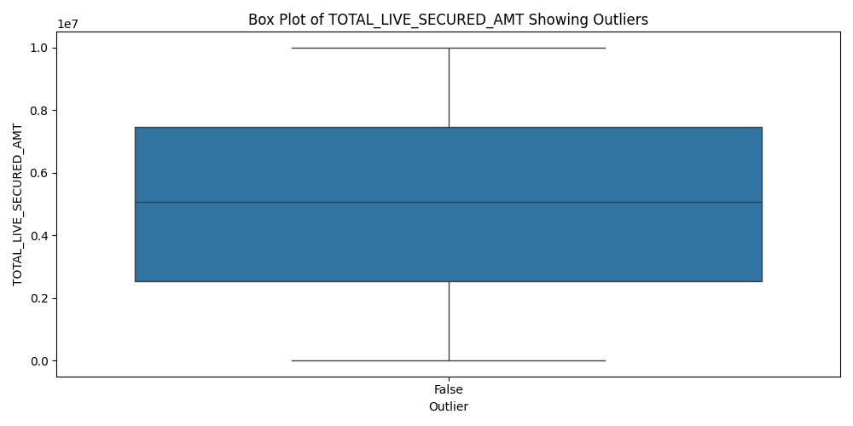
Box Plot Of Total_Live_Secured_Amt Showing Outliers

Slide 20

Box Plot Of Total_Live_Unsecured_Amt Showing Outliers

Slide 21
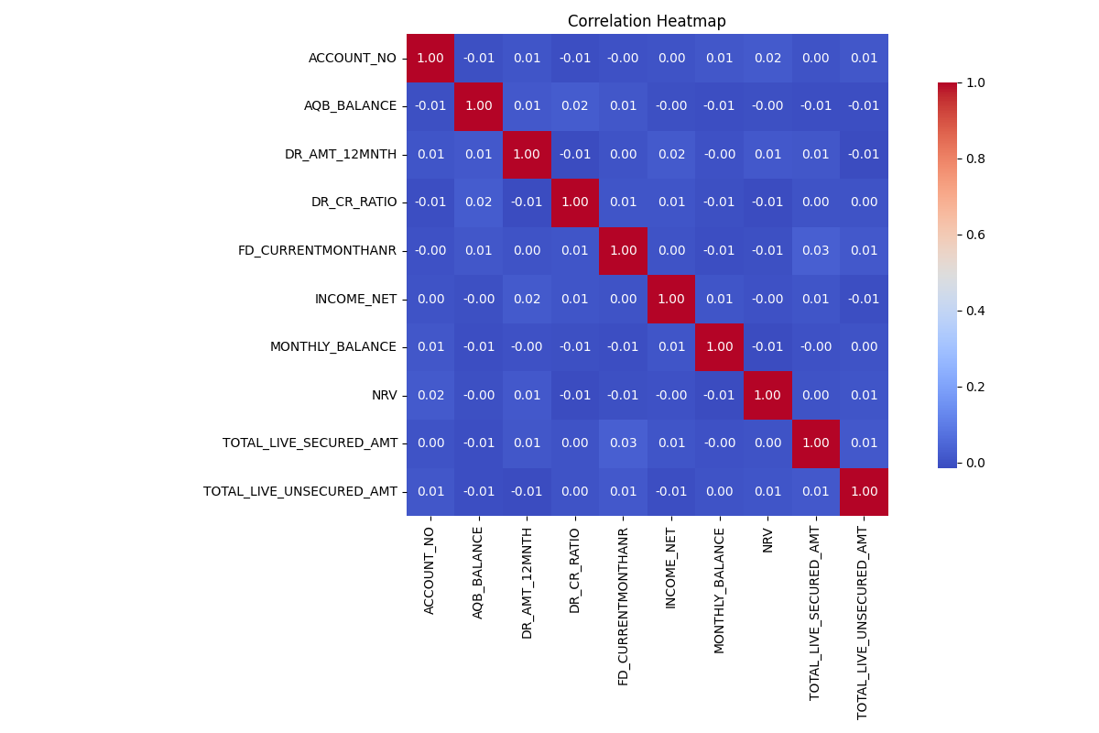
Correlation Heatmap

Slide 22
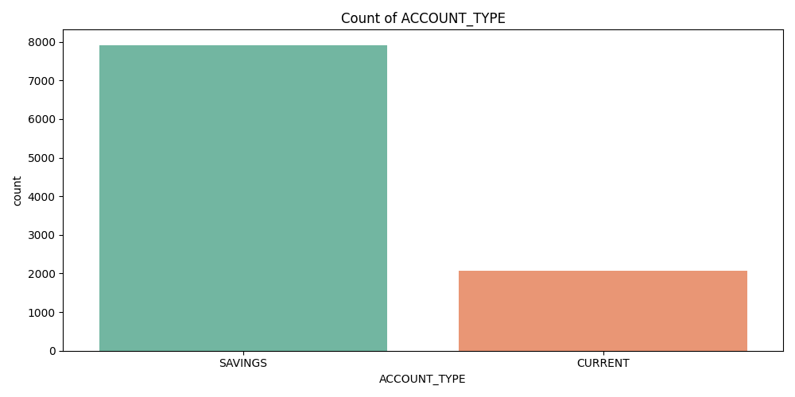
Count Of Account_Type

Slide 23
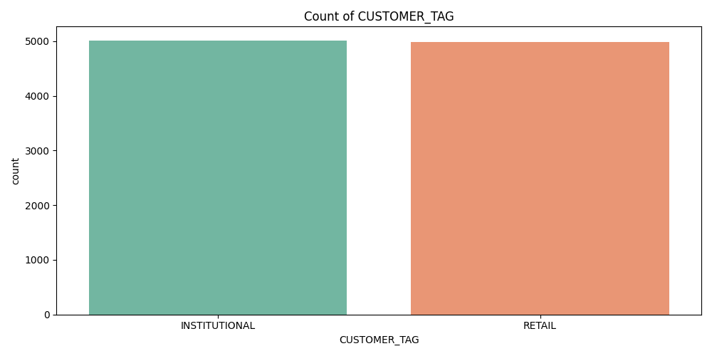
Count Of Customer_Tag

Slide 24
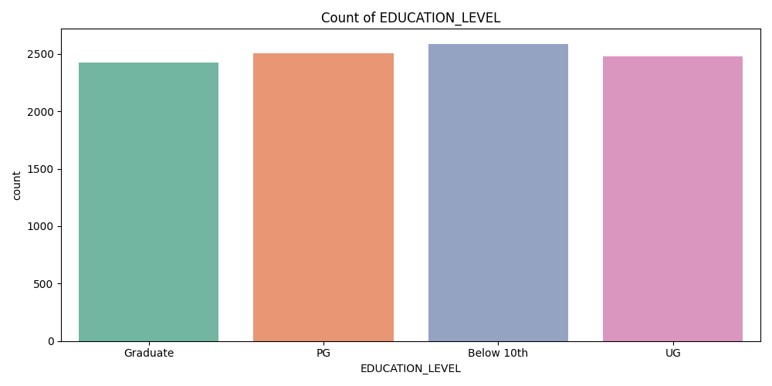
Count Of Education_Level

Slide 25
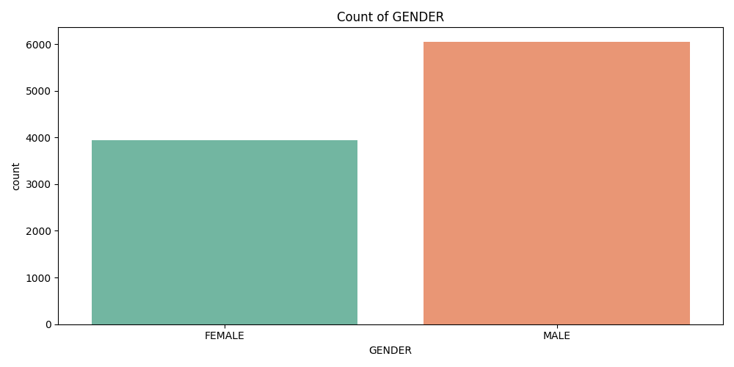
Count Of Gender

Slide 26
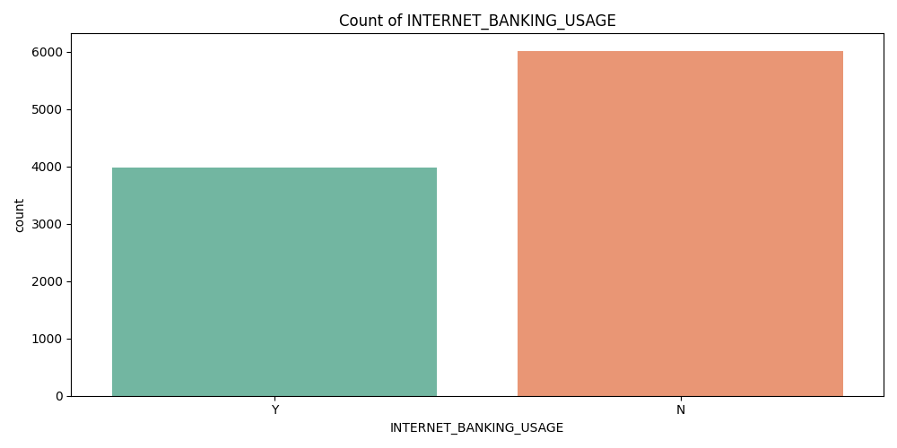
Count Of Internet_Banking_Usage

Slide 27
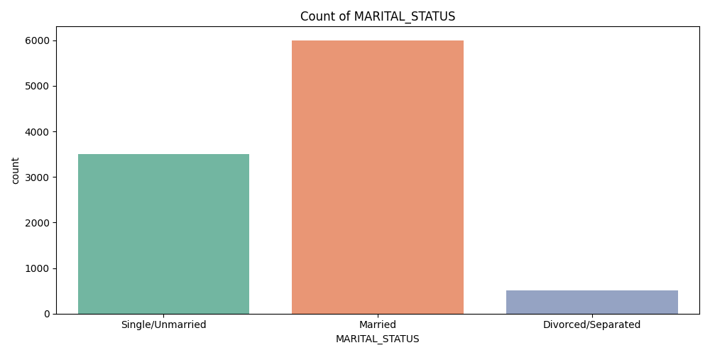
Count Of Marital_Status

Slide 28
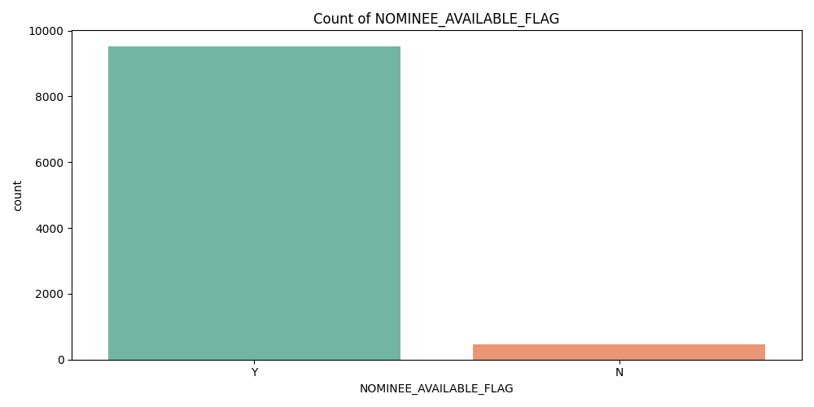
Count Of Nominee_Available_Flag

Slide 29
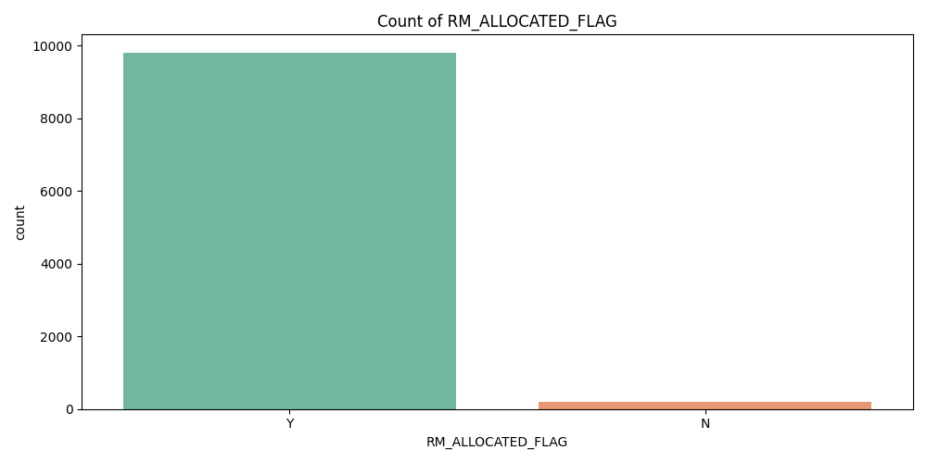
Count Of Rm_Allocated_Flag

Slide 30
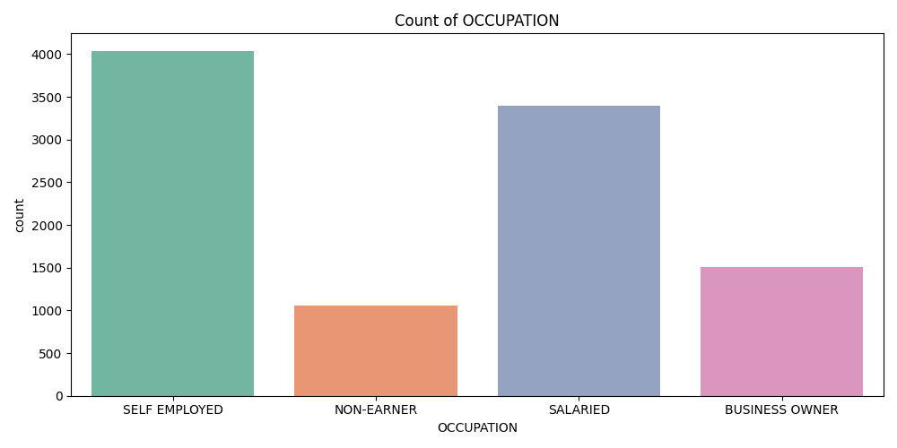
Count Of Occupation

Slide 31
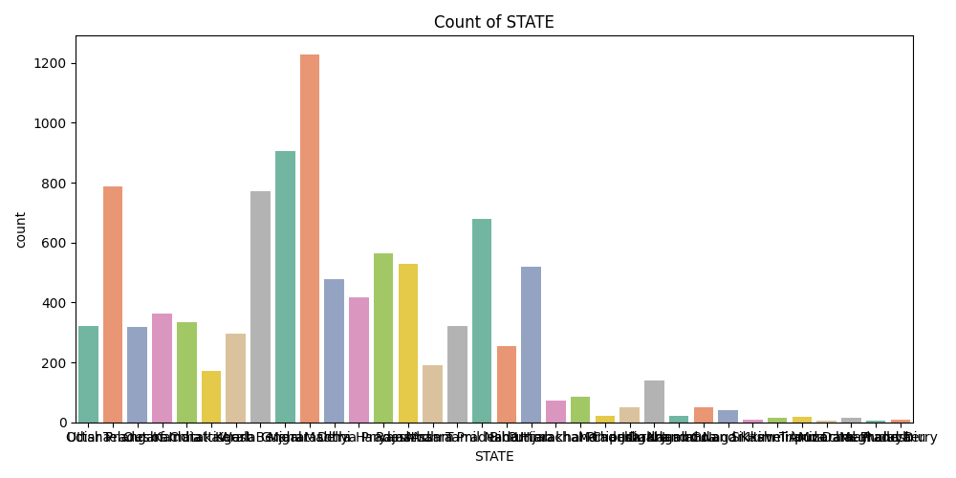
Count Of State

Slide 32
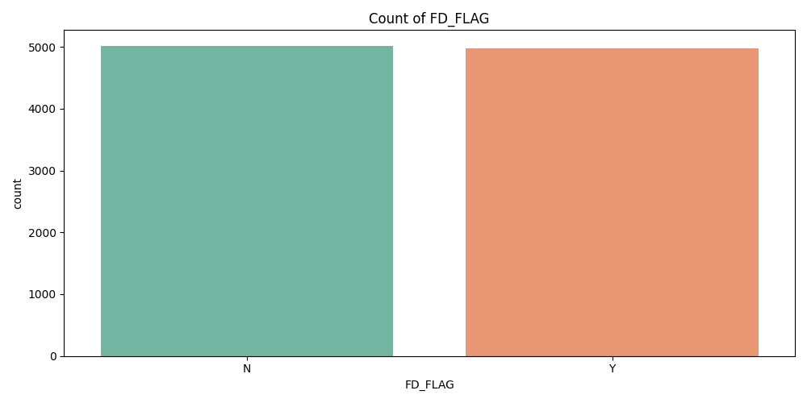
Count Of Fd_Flag

Slide 33
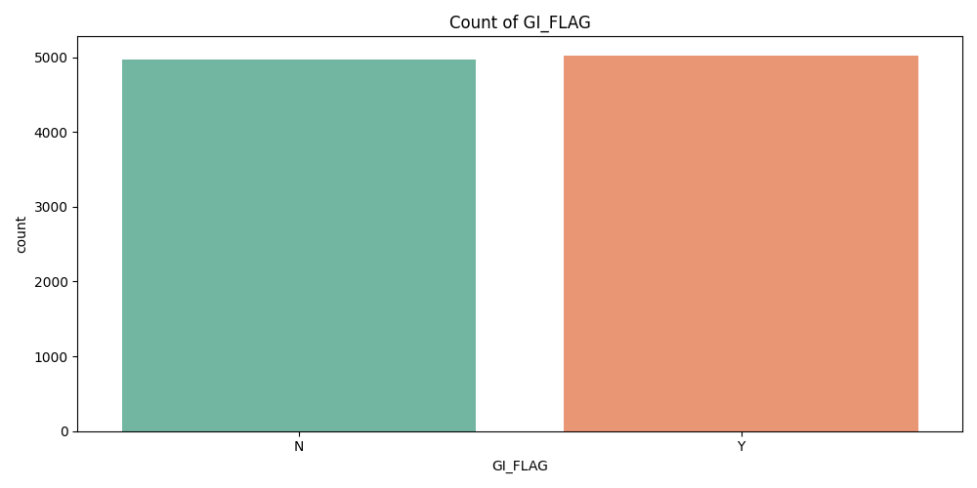
Count Of Gi_Flag

Slide 34
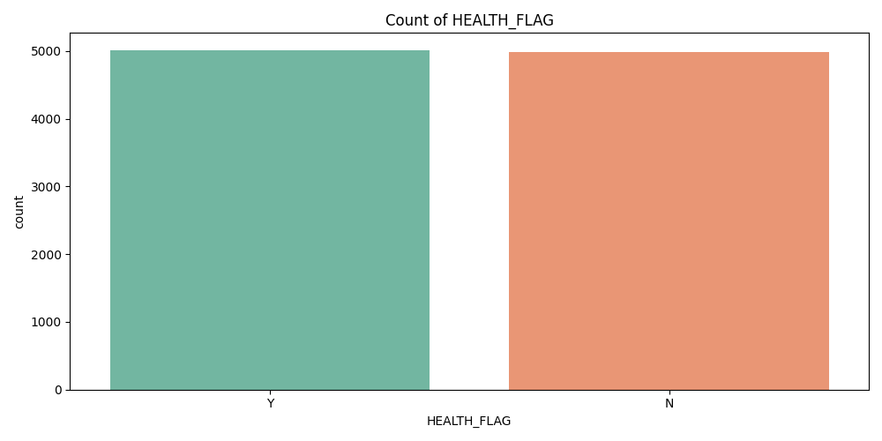
Count Of Health_Flag

Slide 35
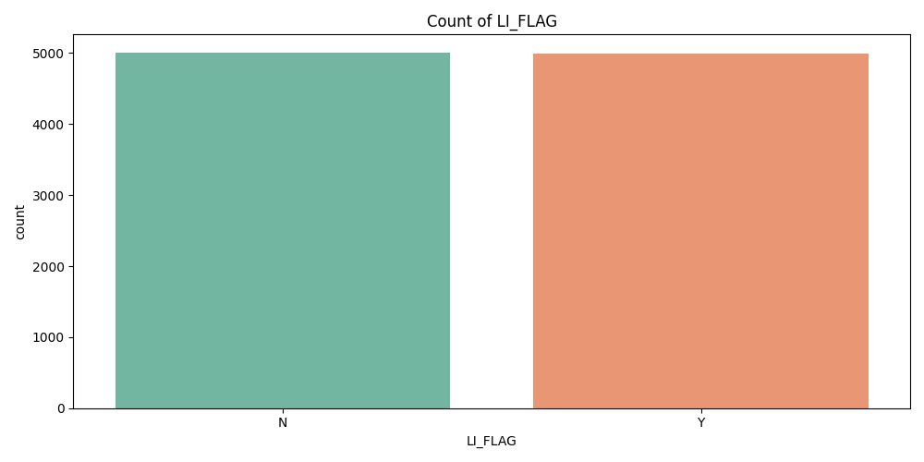
Count Of Li_Flag

Slide 36
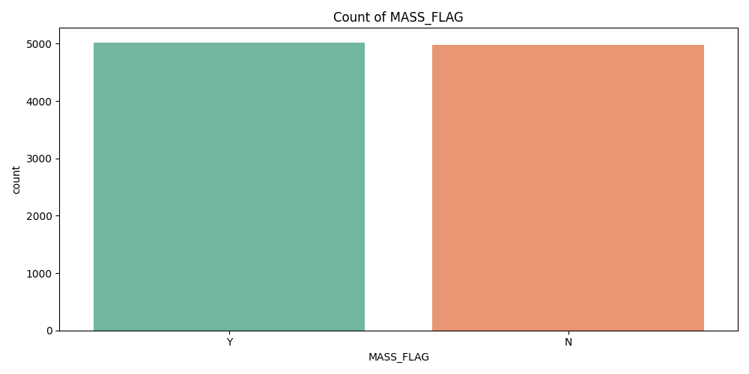
Count Of Mass_Flag

Slide 37
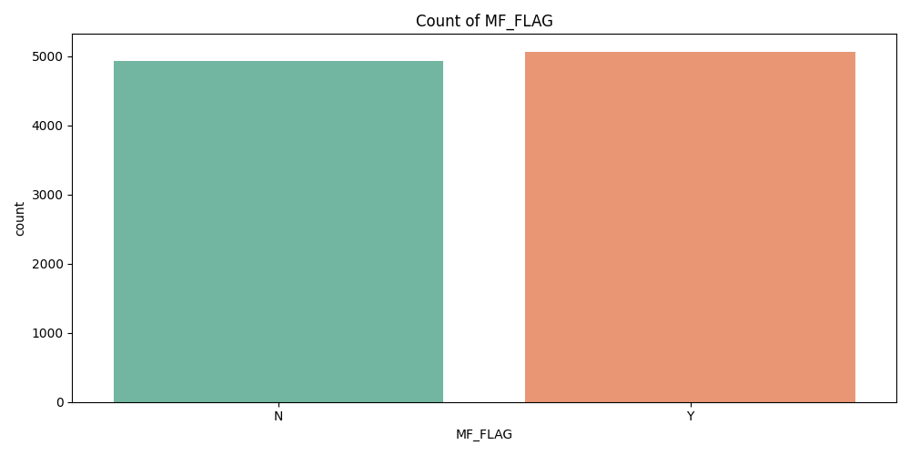
Count Of Mf_Flag

Slide 38
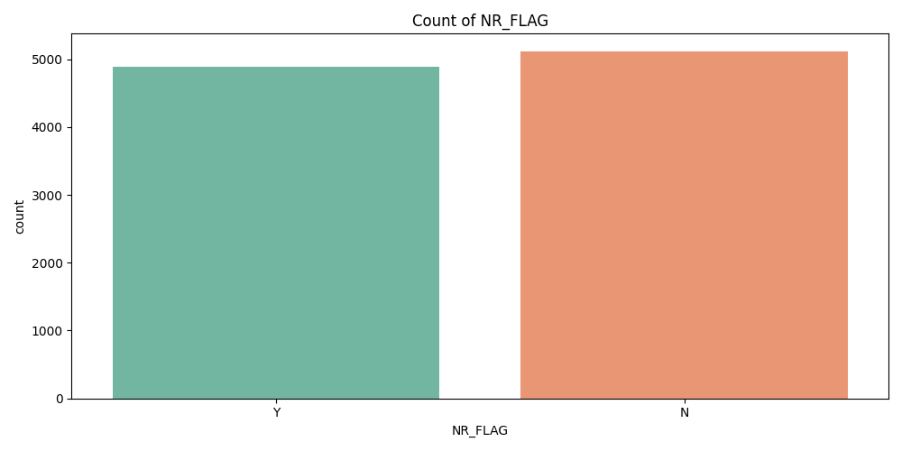
Count Of Nr_Flag

Slide 39
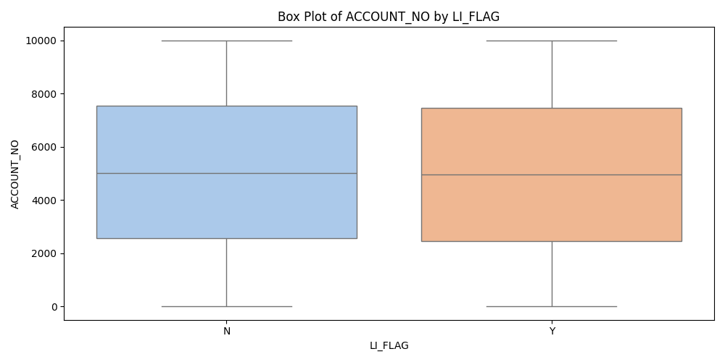
Box Plot Of Account_No By Li_Flag

Slide 40
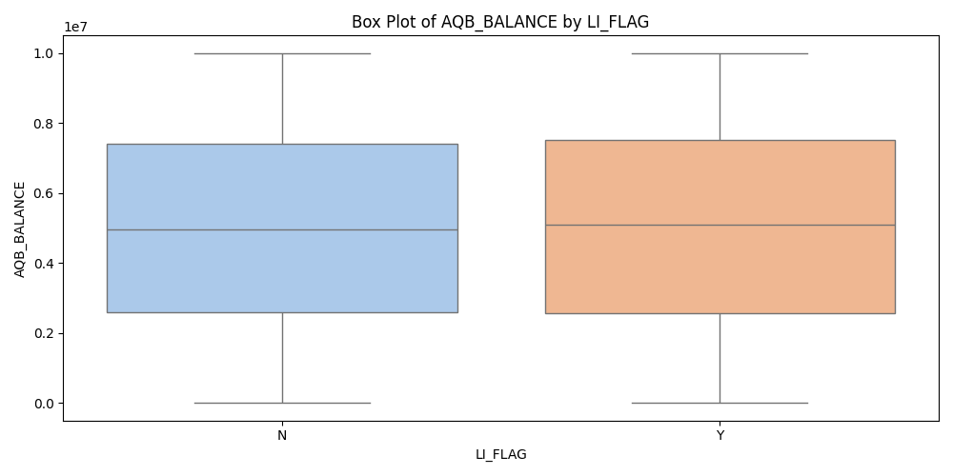
Box Plot Of Aqb_Balance By Li_Flag

Slide 41
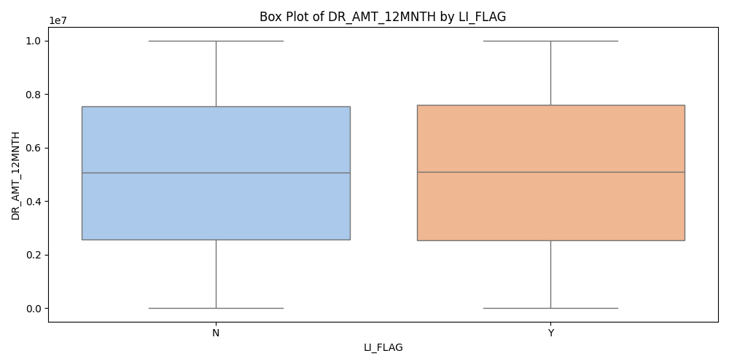
Box Plot Of Dr_Amt_12Mnth By Li_Flag

Slide 42
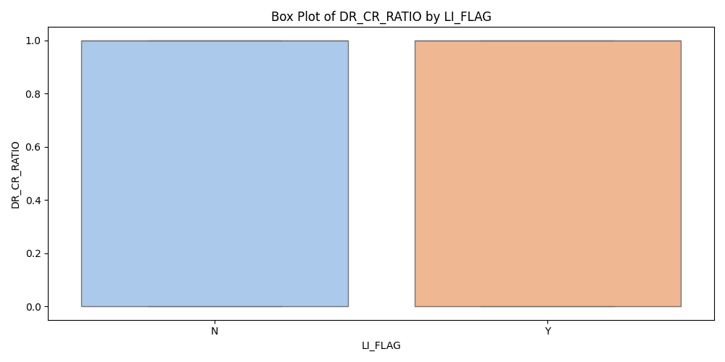
Box Plot Of Dr_Cr_Ratio By Li_Flag

Slide 43
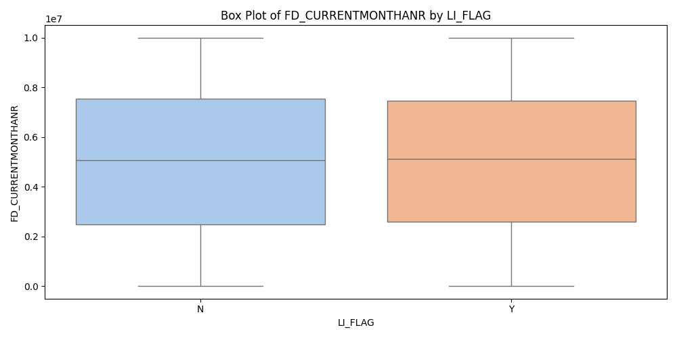
Box Plot Of Fd_Currentmonthanr By Li_Flag

Slide 44
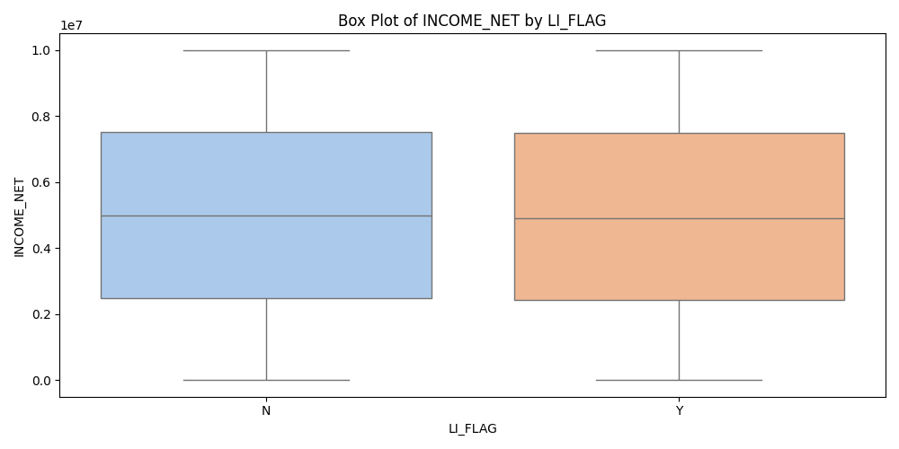
Box Plot Of Income_Net By Li_Flag

Slide 45
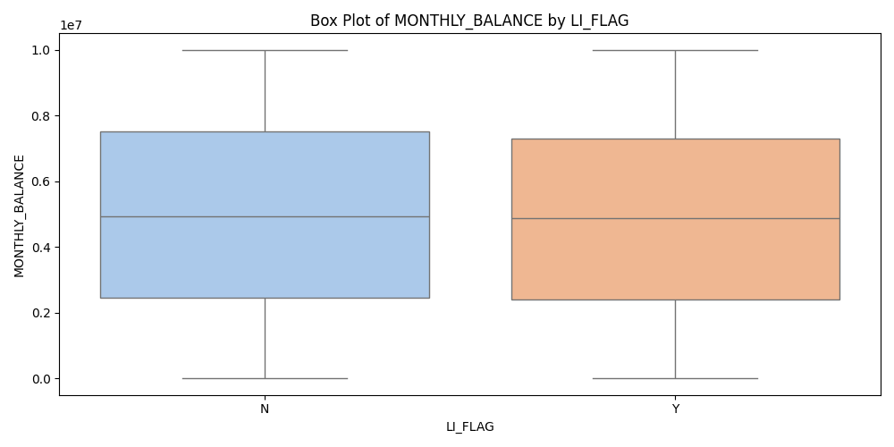
Box Plot Of Monthly_Balance By Li_Flag

Slide 46
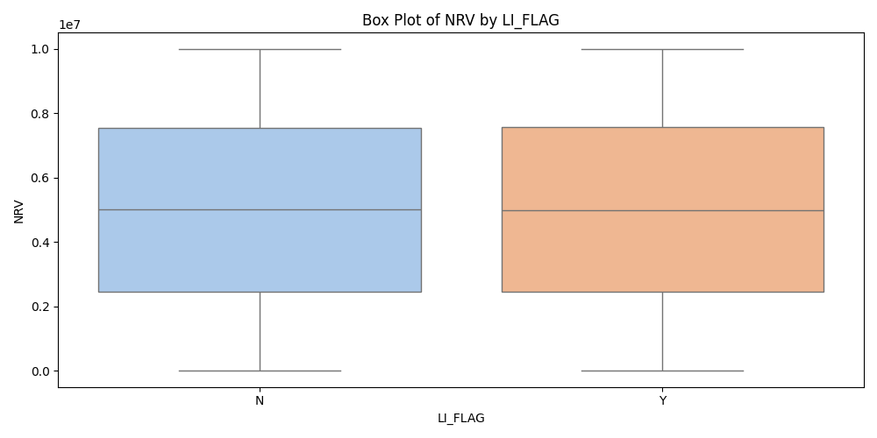
Box Plot Of Nrv By Li_Flag

Slide 47
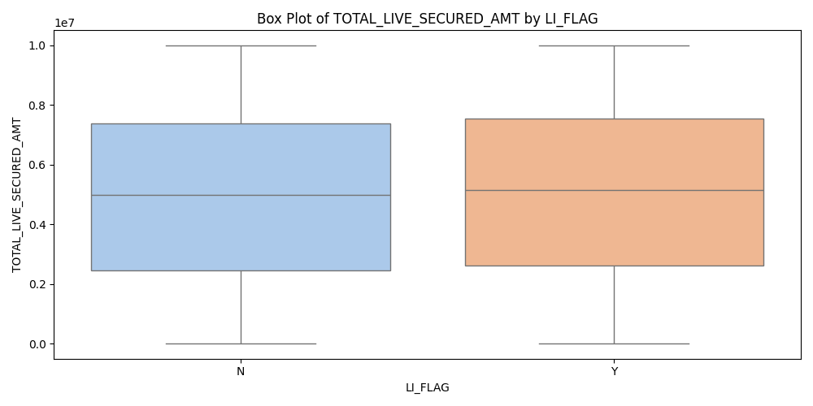
Box Plot Of Total_Live_Secured_Amt By Li_Flag

Slide 48
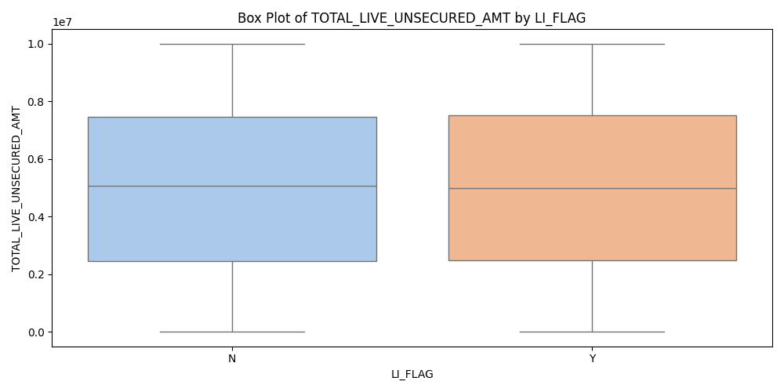
Box Plot Of Total_Live_Unsecured_Amt By Li_Flag

Slide 49
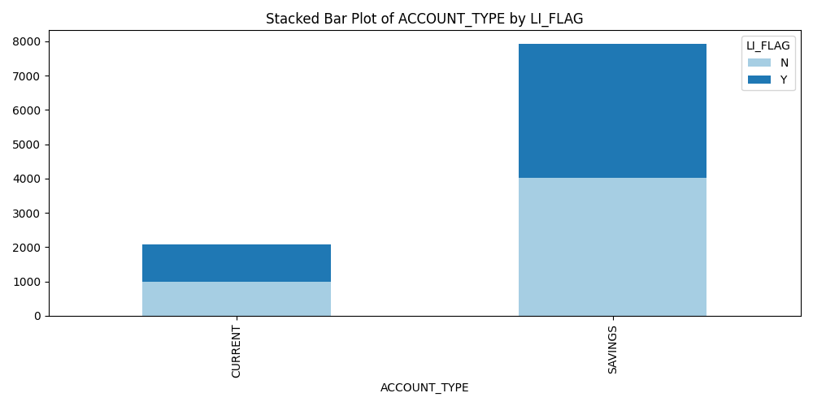
Stacked Bar Plot of ACCOUNT_TYPE by LI_FLAG

Slide 50
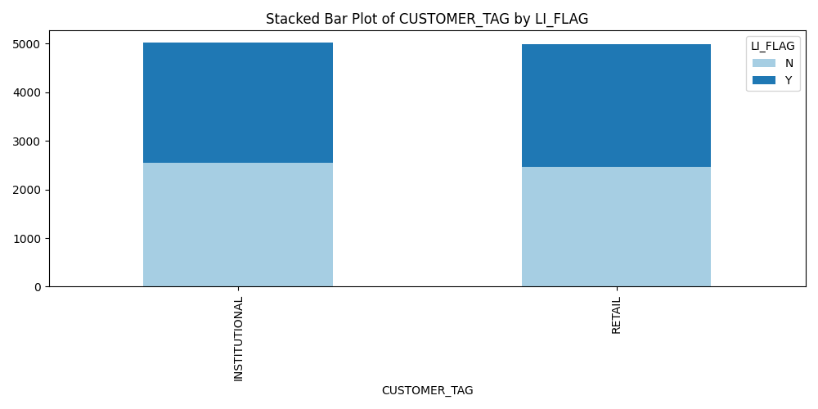
Stacked Bar Plot of CUSTOMER_TAG by LI_FLAG

Slide 51
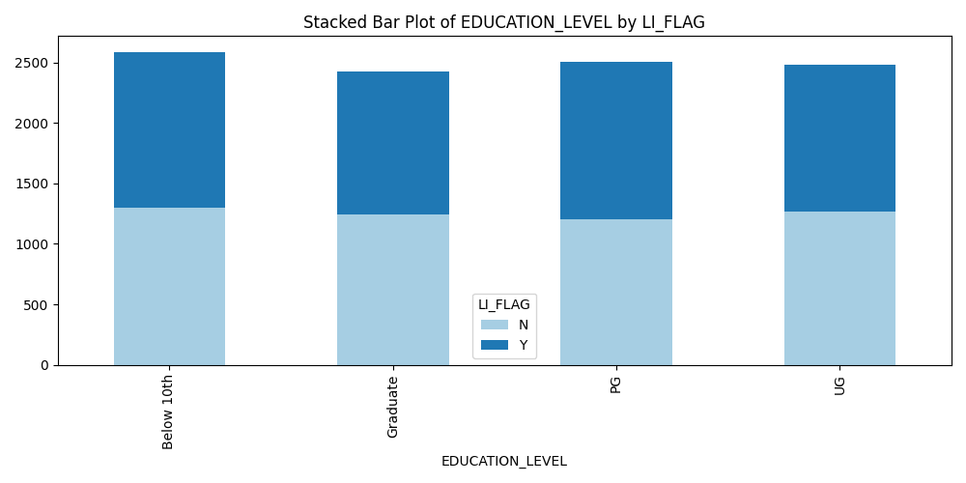
Stacked Bar Plot of EDUCATION_LEVEL by LI_FLAG

Slide 52
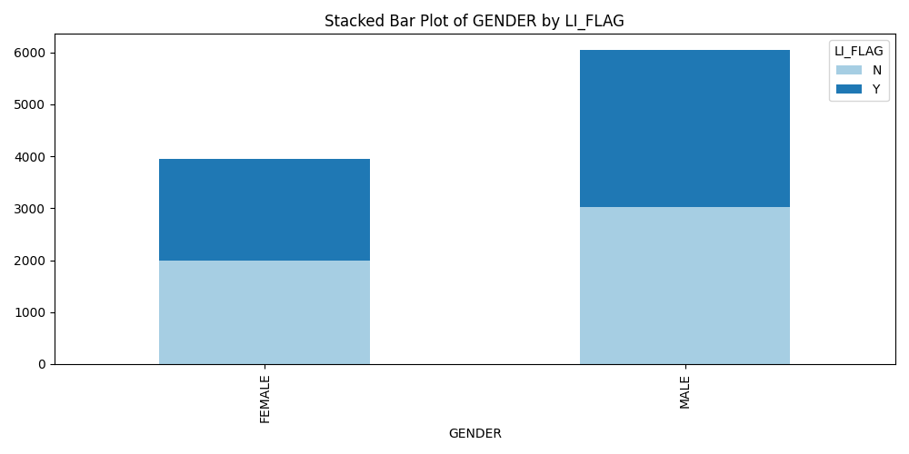
Stacked Bar Plot of GENDER by LI_FLAG

Slide 53
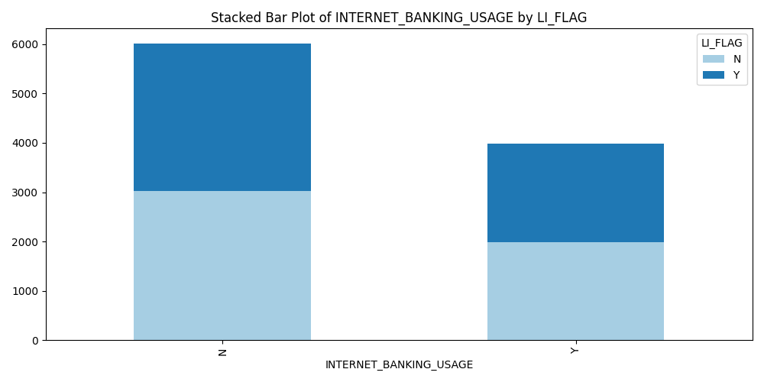
Stacked Bar Plot of INTERNET_BANKING_USAGE by LI_FLAG

Slide 54

Stacked Bar Plot of MARITAL_STATUS by LI_FLAG

Slide 55

Stacked Bar Plot of NOMINEE_AVAILABLE_FLAG by LI_FLAG

Slide 56

Stacked Bar Plot of RM_ALLOCATED_FLAG by LI_FLAG

Slide 57

Stacked Bar Plot of OCCUPATION by LI_FLAG

Slide 58

Stacked Bar Plot of STATE by LI_FLAG

Slide 59

Stacked Bar Plot of FD_FLAG by LI_FLAG

Slide 60

Stacked Bar Plot of GI_FLAG by LI_FLAG

Slide 61

Stacked Bar Plot of HEALTH_FLAG by LI_FLAG

Slide 62

Stacked Bar Plot of MASS_FLAG by LI_FLAG

Slide 63

Stacked Bar Plot of MF_FLAG by LI_FLAG

Slide 64

Stacked Bar Plot of NR_FLAG by LI_FLAG

