Slide 1
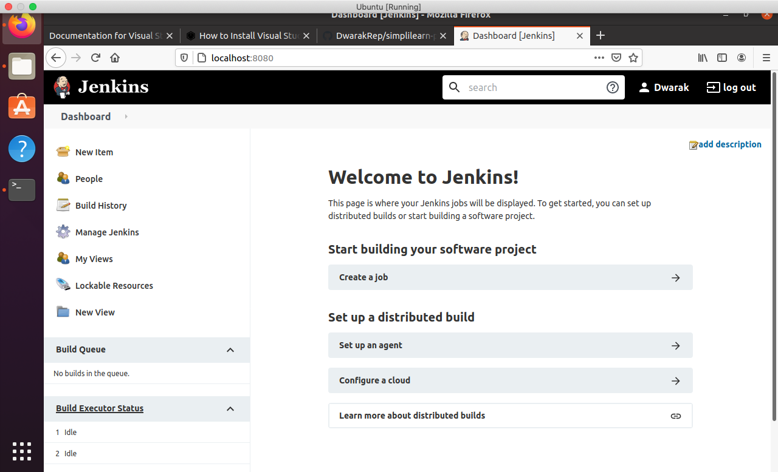
PreRequiste: - Create Virtual machine. - Install Jenkins and Docker on the same machine. - Docker plugin should be installed in Jenkins

Slide 2
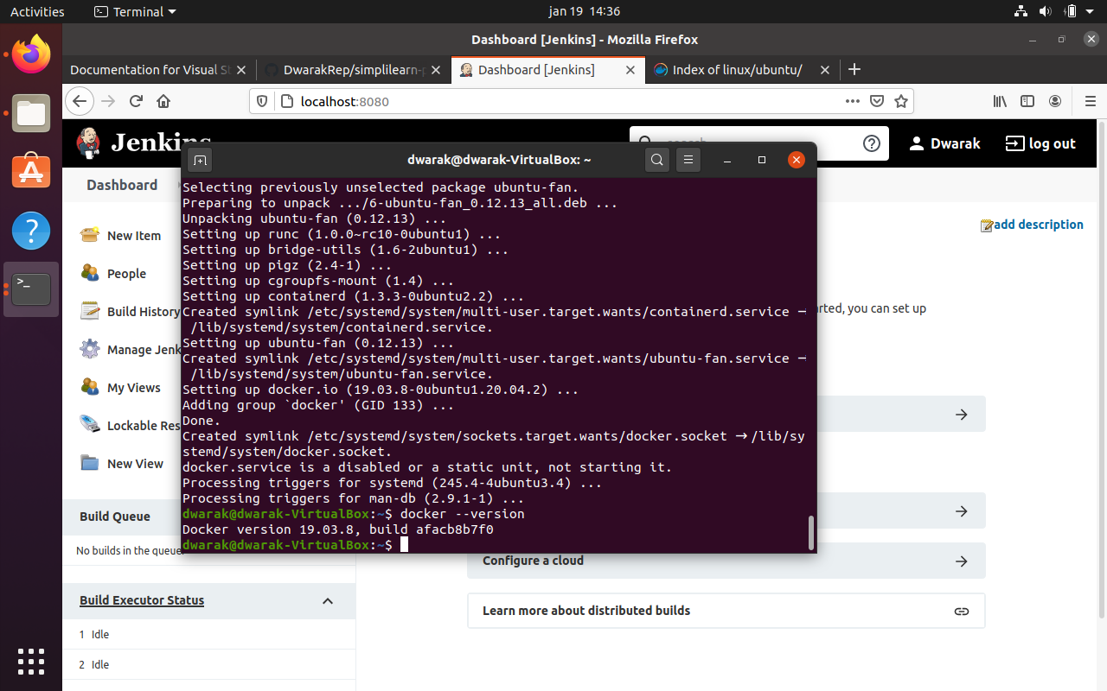
Install Docker

Slide 3
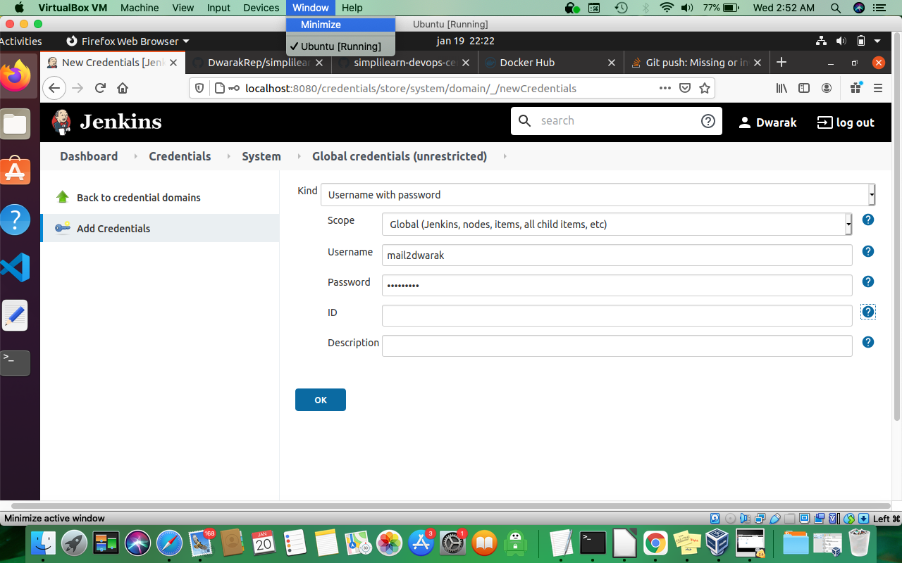
Create Credentials for Docker in Jenkins

Slide 4
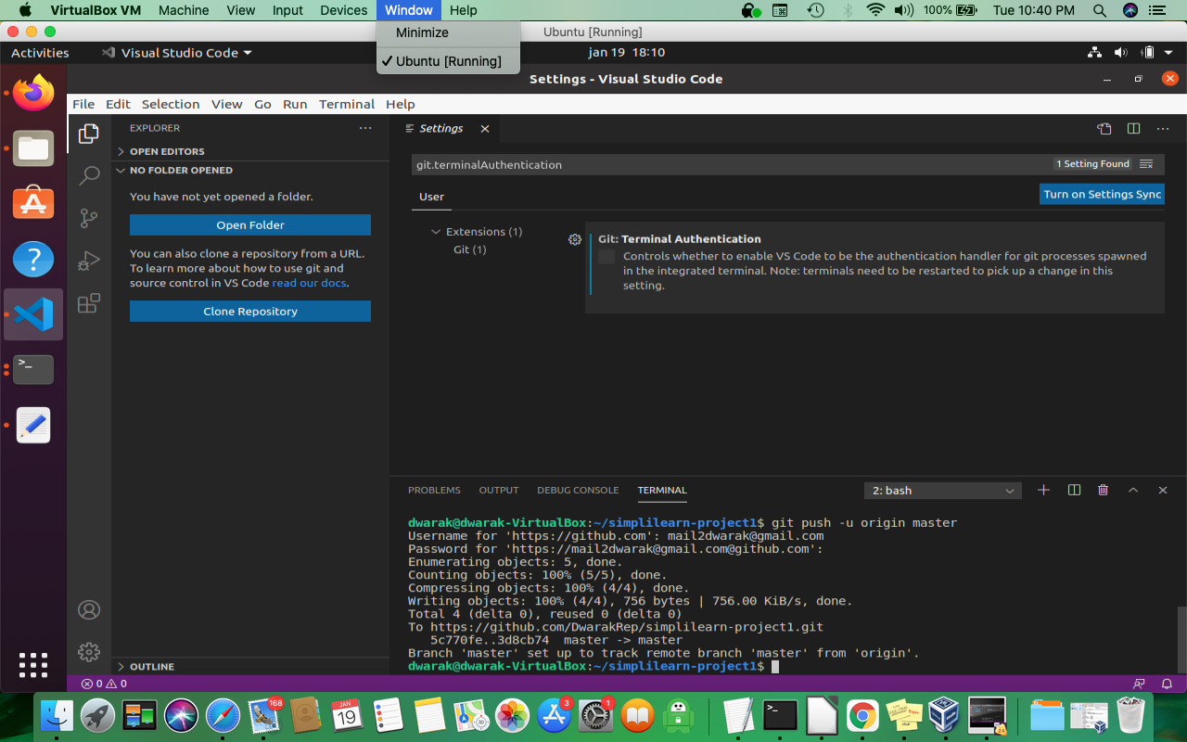
Setup workspace Repository and

Slide 5
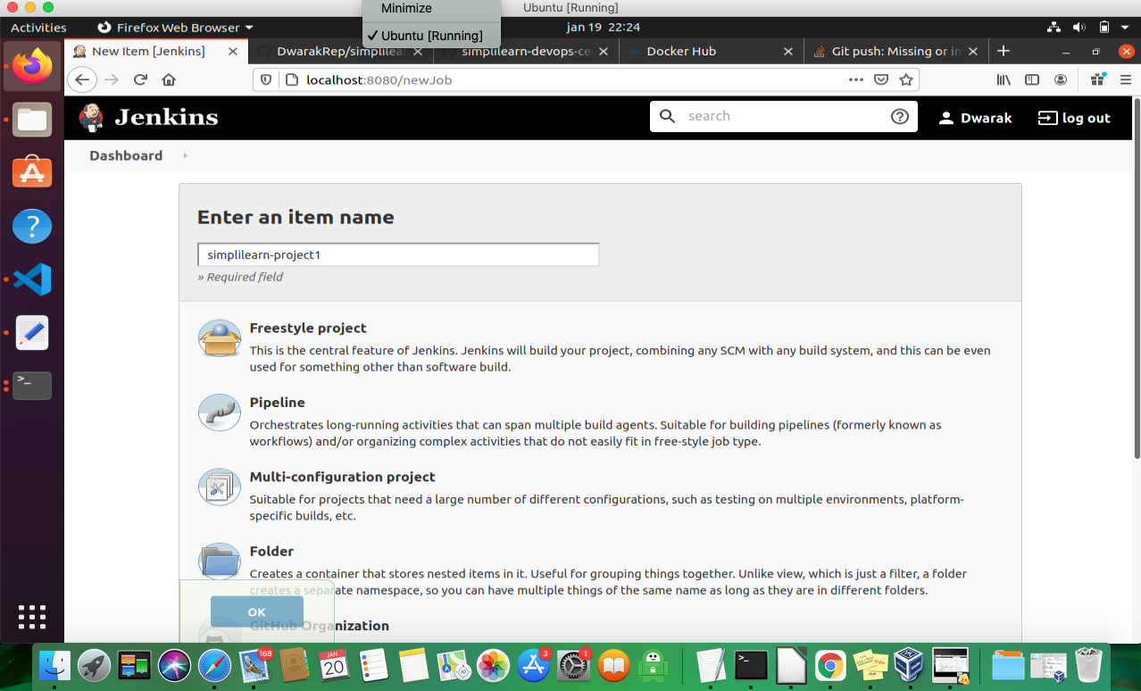
Create Pipeline

Slide 6
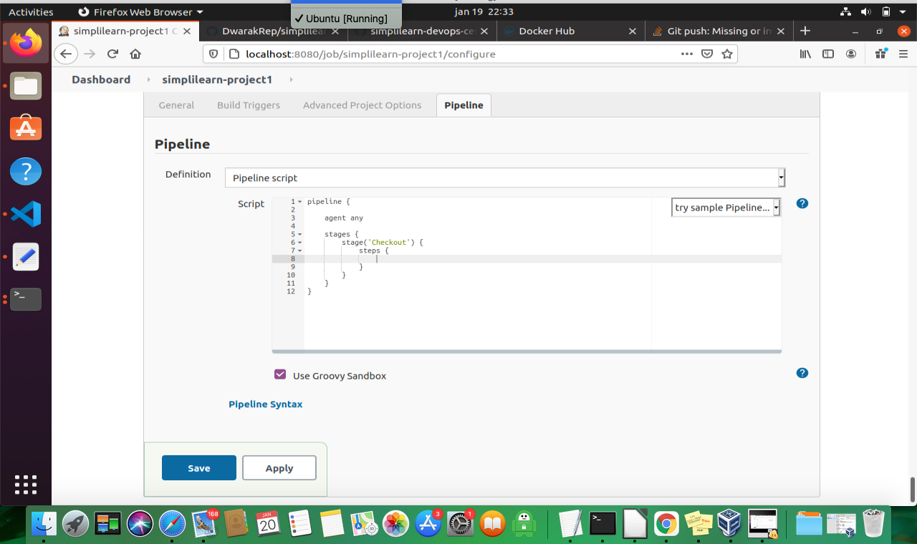
Write Pipeline Script

Slide 7
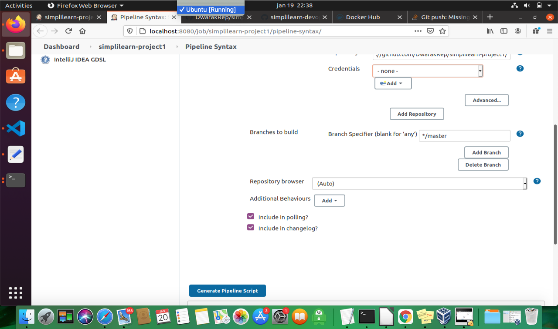
Use pipeline syntax

Slide 8
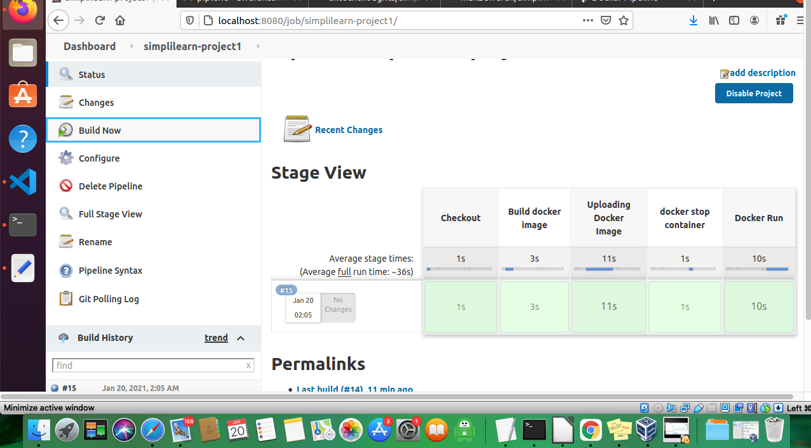
Run Script

