Slide 1
Impact of AI and ML Technologies in Chicago Law Enforcement
Group 3, Project 1
Dwann Wilson, Kanish Mohan, Kyle Williams and Marcellus Smith
© 2023 edX Boot Camps LLC. Confidential and Proprietary. All Rights Reserved.
Notes:
Brief overview of what this project is about.

Slide 2

Presentation Agenda
1
Executive Summary
2
Overview of the data collection, cleanup, and exploration processes
3
Approach
4
Addressing future challenges
5
The results of the analysis
6
Conclusion

Slide 3

Executive Summary
The main objective of this project is to explore the many ways the Chicago Police Department has used AI and ML technologies to arrest criminals
Our goal is to explore a dataset which contains Chicago’s arrest records from 2014-2023 and analyze four key areas:
Analysis of Predictive Technology in Larceny including Retail Theft
Computer Assistance in Stopping Traffic Violations
ShotSpotter Gun Detection and its Impact on Minority Communities
Law Enforcement's use of AI to Arrest Perpetrators of Crimes Related to Sexual Abuse

Slide 4
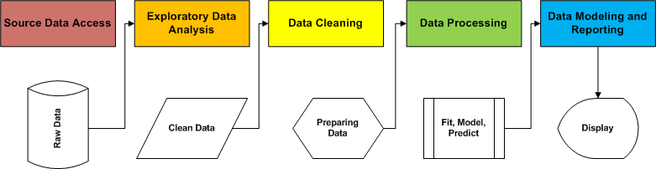
Overview of the data collection, cleanup, and exploration

Slide 5
Approach

Slide 6
Addressing future challenges
Assumptions for our approach
Data only covers arrests and not convictions
Data does not contain specific uses of AI technology in an incident
Potential Research Opportunities
Ways to address ethical or any type of bias the data may indicate
Our analysis is from the law enforcement perspective not how criminals are misusing technology

Slide 7
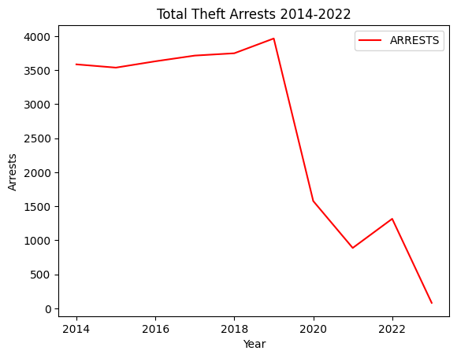
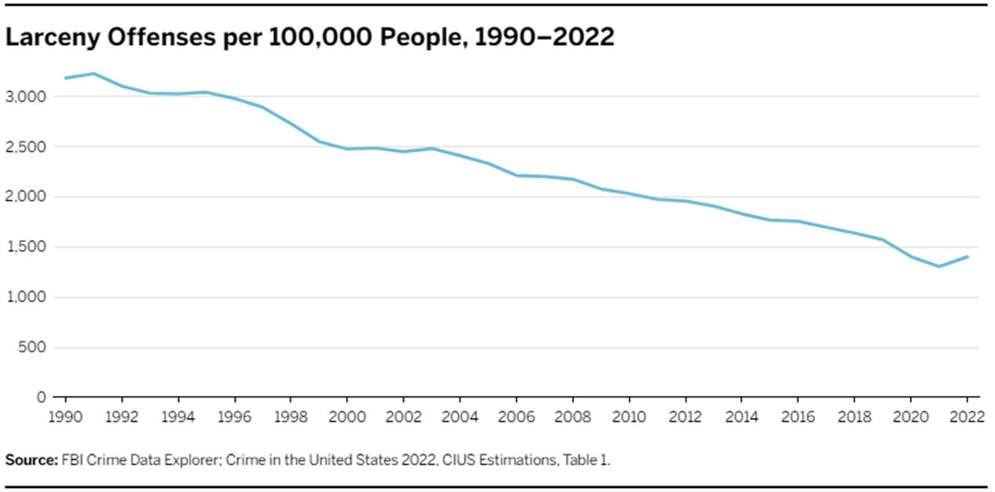
The results of the analysis
Section 1: Analysis of Predictive Technology in Larceny including Retail Theft in Chicago
National Trend
Chicago Trend
Source: Brennan Center for Justice
Notes:
Surveillance technology and
Police Observation Devices (POD) cameras advancement

Slide 8
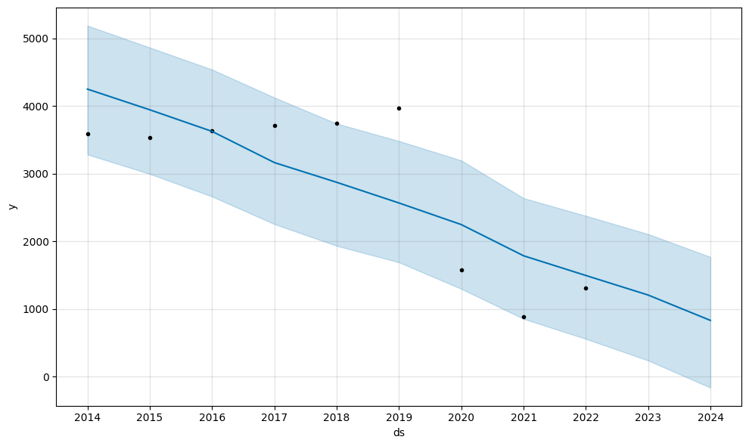
The results of the analysis; 2023-24 Prediction
Section 1: Analysis of Predictive Technology in Larceny including Retail Theft in Chicago

Slide 9
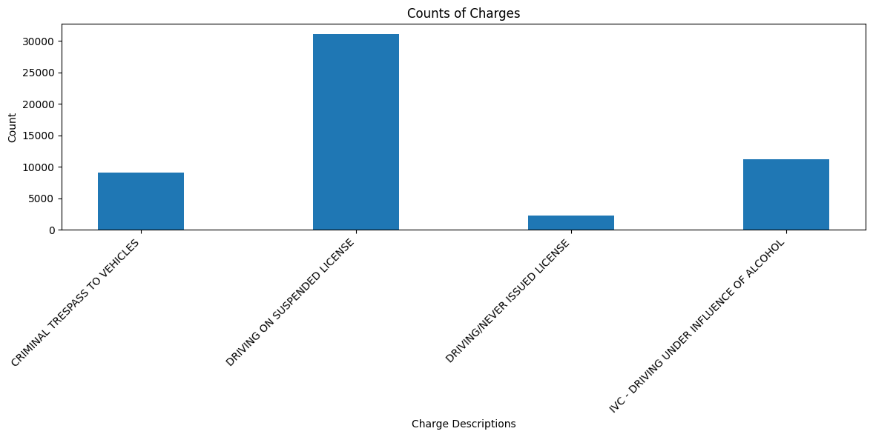
The results of the analysis
Section 2: Computer Assistance in Stopping Traffic Violations

Slide 10
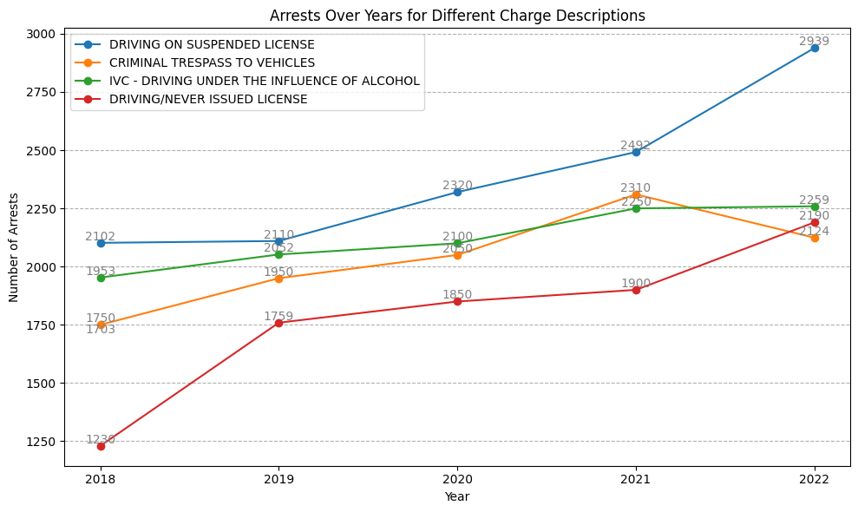
The results of the analysis

Slide 11
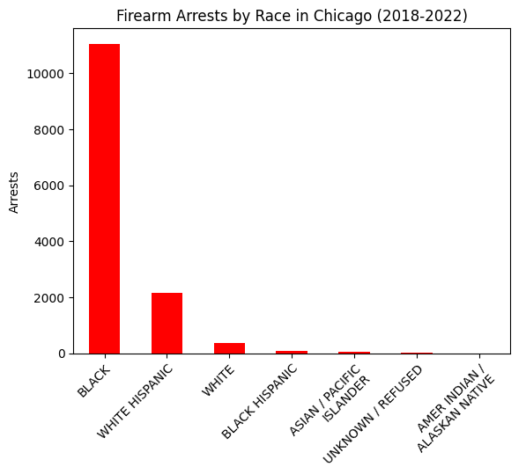
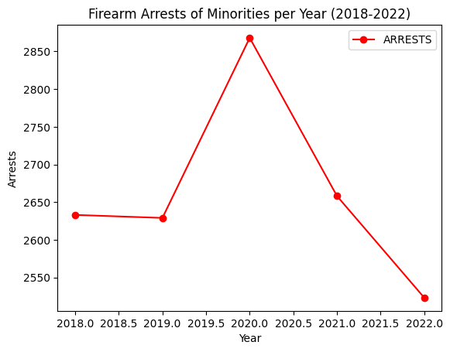
The results of the analysis
Section 3: ShotSpotter Gun Detection and its Impact on Minority Communities

Slide 12
Current Technology
Section 4: Arrests due to Sexually Related crimes in Chicago, 2014-2023
Chatbots
Chat + Robot
AI and Machine Learning
Designed to simulate natural human conversation
3 level Maturity framework
Level 1 - if/then conversational flow
Level 2 - uses NLP for contextual understanding
Level 3- Level 2 bots with enhanced AI abilities
Law Enforcement Investigations
Victim Services and Support
Notes:
Chatbots are chat robots that utilize AI and machine learning to to personalize conversation through the gathering of information and processing of information.
level 1 chat bots are rule-based decision-tree bots that us if/then rules to generate conversation flow. However they do not implement
Neurolanguage pathways.lv1 is not autonomous and requires some level of human interaction. Level 2 and 3 utilize NLP, with level 2 applying it to create conversational responded based on contextual understanding. The chatbot is trained through machine learning of 11,000/ question/answer pairings in order to train the bot to understand the appropriate context as opposed to a predefined menu.
Level 3 chatbots can develop conversational listening by leveraging machine learning through the implementation of user input, historical
analysis, training, and NLP to generate an answer. There is limited data currently on the use of lvl 3 chatbots in the criminal justice system.
Level 2 and 3 chatbots utilize NLP however they are more likely to misinterpret input and respond inaccurately.
Major cities including New York, Los Angeles, and Chicago are utilizing chatbots to crackdown on prostitution, sex traffciking and the solicitation of minors.
chatbots are being used to assist the victims of sexual harassment, acting as a personal assistant to support victims by providing them with easy access to
resources and information including after hour support
The Chatbot mimics the converations of a minor, discussing the sexual act of interest, pricing, and the meeting location of the act. The solicitor is sent a message warning them of the consequences of such illegal activity and depending on the severity they may be arrested. The intended goal is to prevent individuals from committing these acts

Slide 13
Ethics in AI
Section 4: Arrests due to Sexually Related crimes in Chicago, 2014-2023
NLP trained using historical data
Potential for social biases
Early stage prevention
Affecting marginalized groups
People with disabilities
People of color
Facial Recognition
Speech Recognition
Recidivism Calculations
Notes:
Social biases could be inadvertently incorporated into the the AI applications through the use of historical data.f it is vital to recognize and prevent these biases in the early stages of deve
lopment when using NLP and machine learning
recidivism or reoffending. Involves participating in recurring criminal behavior after an initial involvement with the criminal justice system

Slide 14
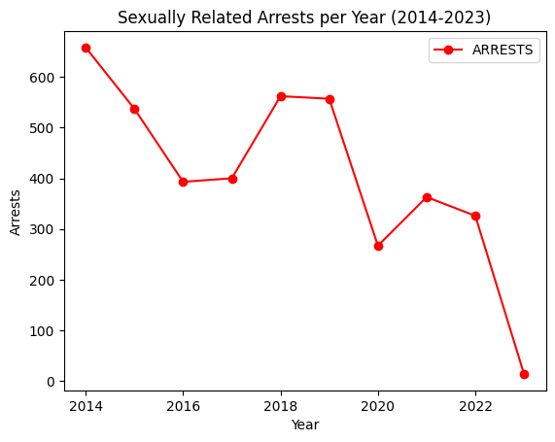
The results of the analysis
Section 4: Arrests due to Sexually Related crimes in Chicago, 2014-2023
Notes:
A chatbot was utilized starting June 2019 by the company childsafe.ai.
Although causation does not always equal correlation there does appear to be a cause and effect in the utilization of the chatbots

Slide 15
Conclusion
After analyzing Chicago’s arrest data:
Advancements in video recording and predictive AI may contribute to crime reduction.
ShotSpotter’s impact on minority arrests remains unclear. Factors like demographics and law enforcement bias play a role.
Chicago uses technology (plate scanners, biometrics, etc.) for traffic enforcement.
Predictive technology can aid law enforcement in stopping and reducing the amount the overall amount of arrests.

Slide 16


Questions?

