Slide 1
Natural Language Processing
WEEK 1

Slide 2

Introduction to Natural Language Processing
Natural Language Processing (NLP) is a subfield of artificial intelligence and computational linguistics that focuses on the interaction between computers and human language. NLP involves the development of algorithms and models to enable computers to understand, interpret, and generate human language in a way that is meaningful and useful.

Slide 3
Introduction to Natural Language Processing
Natural language processing (NLP) is the intersection of computer science, linguistics and machine learning. The field focuses on communication between computers and humans in natural language and NLP is all about making computers understand and generate human language. Applications of NLP techniques include voice assistants like Amazon’s Alexa and Apple’s Siri, but also things like machine translation and text-filtering.

Slide 4
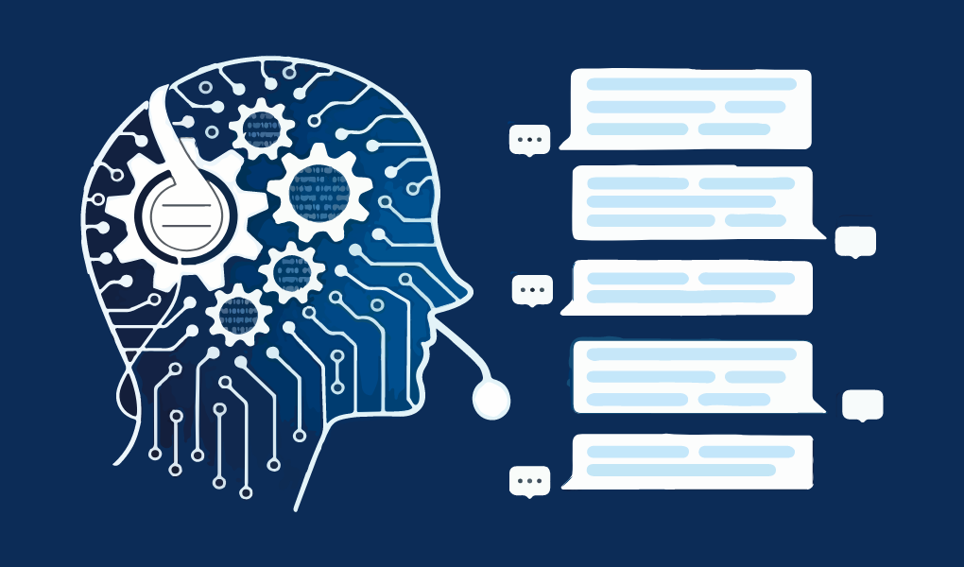
WHAT IS NATURAL LANGUAGE PROCESSING?
Natural language processing studies interactions between humans and computers to find ways for computers to process written and spoken words similar to how humans do. The field blends computer science, linguistics and machine learning.

Slide 5
NLP is divided into three parts:
Speech recognition — the translation of spoken language into text.
Natural language understanding — a computer’s ability to understand language.
Natural language generation — the generation of natural language by a computer.
Notes:
Natural language processing has heavily benefited from recent advances in machine learning, especially from deep learning techniques.

Slide 6
“Pope’s baby steps on gays*”
If we take ‘baby’ as a noun, attach it with ‘pope’ to form a noun compound and take ‘steps’ as a verb, we get that funny meaning!
If we make a noun compound baby-steps, it gives the intended meaning
Gay people should be forgiven their sins like other people,
Notes:
It is a complex system, although little children can learn it pretty quickly.

Slide 7
Why Natural Language Processing Is Difficult
Human language is special for several reasons specifically in constructing to convey the speaker/writer’s meaning.
Human Language is is all about symbols. According to Chris Manning, a machine learning professor at Stanford, it is a discrete, symbolic, categorical signaling system
The encoding by the human brain is a continuous pattern of activation by which the symbols are transmitted via continuous signals of sound and vision.
Notes:
It is a complex system, although little children can learn it pretty quickly.

Slide 8
Why Natural Language Processing Is Difficult
Understanding human language is considered a difficult task due to its complexity. For example, there are an infinite number of different ways to arrange words in a sentence. Also, words can have several meanings and contextual information is necessary to correctly interpret sentences.
Every language is more or less unique and ambiguous. Just take a look at the following newspaper headline “The Pope’s baby steps on gays.” This sentence clearly has two very different interpretations, which is a pretty good example of the challenges in natural language processing.
Notes:
It is a complex system, although little children can learn it pretty quickly.

Slide 9
Natural Language Processing Techniques for Understanding Text
Parsing
Stemming
Text Segmentation
Named Entity Recognition
Relationship Extraction
Sentiment Analysis
Notes:
It is a complex system, although little children can learn it pretty quickly.

Slide 10
PARSING
According to the dictionary, to parse is to “resolve a sentence into its component parts and describe their syntactic roles.”
Parsing refers to the formal analysis of a sentence by a computer into its constituents, which results in a parse tree showing their syntactic relation to one another in visual form, which can be used for further processing and understanding.
Notes:
It is a complex system, although little children can learn it pretty quickly.

Slide 11
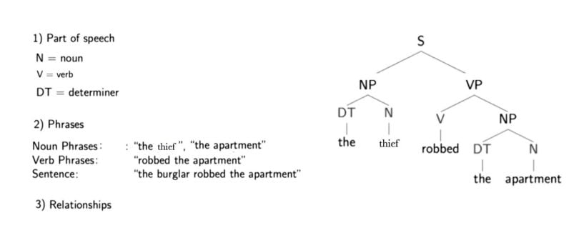
PARSING
“The thief robbed the apartment.”
For example, “the thief” is a noun phrase, “robbed the apartment” is a verb phrase and when put together the two phrases form a sentence, which is marked one level higher.
Notes:
The letters directly above the single words show the parts of speech for each word (noun, verb and determiner). One level higher is some hierarchical grouping of words into phrases. For example, “the thief” is a noun phrase, “robbed the apartment” is a verb phrase and when put together the two phrases form a sentence, which is marked one level higher.
But what is actually meant by a noun or verb phrase? Noun phrases are one or more words that contain a noun and maybe some descriptors, verbs or adverbs. The idea is to group nouns with words that are in relation to them.
A parse tree also provides us with information about the grammatical relationships of the words due to the structure of their representation. For example, we can see in the structure that “the thief” is the subject of “robbed.”
With structure I mean that we have the verb (“robbed”), which is marked with a “V” above it and a “VP” above that, which is linked with a “S” to the subject (“the thief”), which has a “NP” above it. This is like a template for a subject-verb relationship and there are many others for other types of relationships.

Slide 12
STEMMING
Stemming is a technique that comes from morphology and information retrieval which is used in natural language processing for pre-processing and efficiency purposes. It’s defined by the dictionary as to “originate in or be caused by.”
Basically, stemming is the process of reducing words to their word stem. A “stem” is the part of a word that remains after the removal of all affixes. For example, the stem for the word “touched” is “touch.” “Touch” is also the stem of “touching,” and so on.

Slide 13
STEMMING
Example
I was taking a ride in the car.
I was riding in the car.
These two sentences mean the exact same thing and the use of the word is identical.
Notes:
Now, imagine all the English words in the vocabulary with all their different fixations at the end of them. To store them all would require a huge database containing many words that actually have the same meaning. This is solved by focusing only on a word’s stem. Popular algorithms for stemming include the Porter stemming algorithm from 1979, which still works well.

Slide 14
TEXT SEGMENTATION
Text segmentation in natural language processing is the process of transforming text into meaningful units like words, sentences, different topics, the underlying intent and more. Mostly, the text is segmented into its component words, which can be a difficult task, depending on the language. This is again due to the complexity of human language. For example, it works relatively well in English to separate words by spaces, except for words like “icebox” that belong together but are separated by a space. The problem is that people sometimes also write it as “ice-box.”

Slide 15
NAMED ENTITY RECOGNITION
Named entity recognition (NER) concentrates on determining which items in a text (i.e. the “named entities”) can be located and classified into predefined categories. These categories can range from the names of persons, organizations and locations to monetary values and percentages.
For example:
Before NER: Martin bought 300 shares of SAP in 2016.
After NER: [Martin]Person bought 300 shares of [SAP]Organization in [2016]Time.

Slide 16
RELATIONSHIP EXTRACTION
With sentiment analysis we want to determine the attitude (i.e. the sentiment) of a speaker or writer with respect to a document, interaction or event. Therefore it is a natural language processing problem where text needs to be understood in order to predict the underlying intent. The sentiment is mostly categorized into positive, negative and neutral categories.

Slide 17
SENTIMENT ANALYSIS
Relationship extraction takes the named entities of NER and tries to identify the semantic relationships between them. This could mean, for example, finding out who is married to whom, that a person works for a specific company and so on. This problem can also be transformed into a classification problem and a machine learning model can be trained for every relationship type.

Slide 18
Syntactic and Semantic Analysis
Syntactic analysis (syntax) and semantic analysis (semantic) are the two primary techniques that lead to the understanding of natural language.
Syntax is the grammatical structure of the text, whereas semantics is the meaning being conveyed. A sentence that is syntactically correct, however, is not always semantically correct.
Example - “cows flow supremely” is grammatically valid (subject — verb — adverb) but it doesn’t make any sense.
Notes:
It is a complex system, although little children can learn it pretty quickly.

Slide 19
SYNTACTIC ANALYSIS
Syntactic analysis, also known as parsing, is a fundamental task in natural language processing (NLP) that involves analyzing the grammatical structure of sentences to understand their syntactic relationships and dependencies. It aims to determine the syntactic structure of a sentence based on a set of predefined grammar rules.
Notes:
It is a complex system, although little children can learn it pretty quickly.

Slide 20
The process of syntactic analysis typically involves the following steps:
Tokenization: The sentence is divided into individual tokens, such as words or punctuation marks.
Part-of-Speech (POS) Tagging: Each token is assigned a specific part-of-speech tag that indicates its grammatical category (e.g., noun, verb, adjective).
Phrase Chunking: The tokens are grouped into phrases based on their syntactic roles, such as noun phrases, verb phrases, or prepositional phrases.
Parsing: The parsed tree structure is generated, representing the hierarchical relationships between the words and phrases in the sentence. This can be done using various parsing algorithms, such as constituency parsing or dependency parsing.
Notes:
It is a complex system, although little children can learn it pretty quickly.

Slide 21
SEMANTIC ANALYSIS
Semantic analysis, also known as semantic parsing or understanding, is a key task in natural language processing (NLP) that focuses on extracting meaning and interpreting the semantics of text. It involves going beyond the surface-level structure of sentences to understand the intended meaning and context.
Notes:
It is a complex system, although little children can learn it pretty quickly.

Slide 22
Semantic analysis encompasses various subtasks, including:
Named Entity Recognition (NER): Identifying and classifying named entities in text, such as names of people, organizations, locations, dates, and other specific entities.
Word Sense Disambiguation: Resolving the correct meaning of ambiguous words or phrases based on the context in which they are used. This helps in capturing the intended sense of a word and avoiding ambiguity.
Sentiment Analysis: Determining the sentiment or emotion expressed in a text, whether it is positive, negative, or neutral. This is often used for analyzing opinions, reviews, and social media sentiment.
Textual Entailment: Assessing the logical relationship between two text fragments, determining whether one statement can be inferred or logically derived from another.
Semantic Role Labeling: Identifying the roles played by different entities and phrases in a sentence, such as the subject, object, or location. This helps in understanding the underlying relationships and interactions between entities.
Question Answering: Interpreting questions and retrieving relevant information from a given text to generate accurate and meaningful answers.
Natural Language Understanding (NLU): Understanding and interpreting the meaning of complex natural language queries or commands to perform specific tasks, such as voice assistants or chatbots.
Notes:
It is a complex system, although little children can learn it pretty quickly.

Slide 23
Benefits of Natural Language Processing
ENHANCED DATA ANALYSIS
While NLP and other forms of AI aren’t perfect, natural language processing can bring objectivity to data analysis, providing more accurate and consistent results.
FASTER INSIGHTS
With the Internet of Things and other advanced technologies compiling more data than ever, some data sets are simply too overwhelming for humans to comb through. Natural language processing can quickly process massive volumes of data, gleaning insights that may have taken weeks or even months for humans to extract. .

Slide 24
Benefits of Natural Language Processing
INCREASED EMPLOYEE PRODUCTIVITY
NLP handles mundane tasks like sifting through data sets, sorting emails and assessing customer responses. With these repetitive responsibilities out of the way, workers are freed up to focus on more complex and pressing matters.
HIGHER-QUALITY CUSTOMER EXPERIENCE
In the form of chatbots, natural language processing can take some of the weight off customer service teams, promptly responding to online queries and redirecting customers when needed. NLP can also analyze customer surveys and feedback, allowing teams to gather timely intel on how customers feel about a brand and steps they can take to improve customer sentiment.

Slide 25
NLP Use Cases
CUSTOMER SERVICE
While NLP-powered chatbots and callbots are most common in customer service contexts, companies have also relied on natural language processing to power virtual assistants. These assistants are a form of conversational AI that can carry on more sophisticated discussions. And if NLP is unable to resolve an issue, it can connect a customer with the appropriate personnel.
MARKETING
Gathering market intelligence becomes much easier with natural language processing, which can analyze online reviews, social media posts and web forums. Compiling this data can help marketing teams understand what consumers care about and how they perceive a business’ brand.

Slide 26
NLP Use Cases
HUMAN RESOURCES
Recruiters and HR personnel can use natural language processing to sift through hundreds of resumes, picking out promising candidates based on keywords, education, skills and other criteria. In addition, NLP’s data analysis capabilities are ideal for reviewing employee surveys and quickly determining how employees feel about the workplace.
E-COMMERCE
Natural language processing can help customers book tickets, track orders and even recommend similar products on e-commerce websites. Teams can also use data on customer purchases to inform what types of products to stock up on and when to replenish inventories.

Slide 27
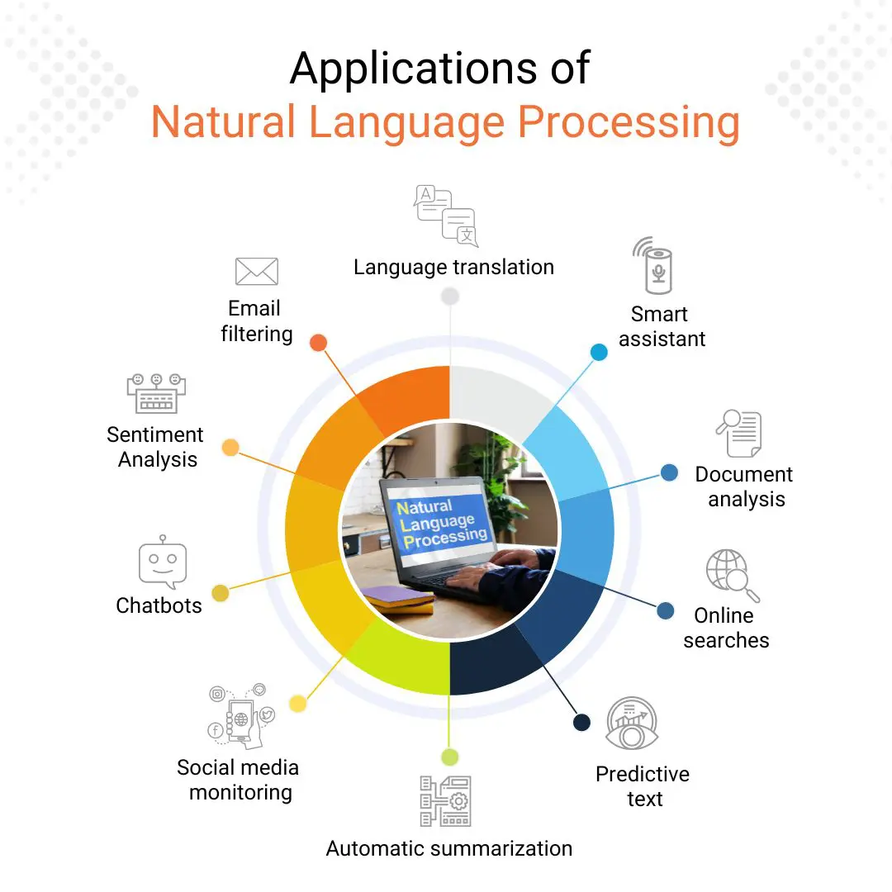

Slide 28
Natural Language Processing Applications:
1. Email filtering
Email is a part of our everyday life. Whether it is related to work or studies or many other things, we find ourselves plunged into the pile of emails. We receive all kinds of emails from various sources; some are work-related or from our dream school or university, while others are spam or promotional emails. Here Natural Language Processing comes to work. It identifies and filters incoming emails into “important” or “spam” and places them into their respective designations.
2. Language translation
There are as many languages in this world as there are cultures, but not everyone understands all these languages. As our world is now a global village owing to the dawn of technology, we need to communicate with other people who speak a language that might be foreign to us. Natural Language processing helps us by translating the language with all its sentiments.

Slide 29
Natural Language Processing Applications:
3. Smart assistants
In today’s world, every new day brings in a new smart device, making this world smarter and smarter by the day. And this advancement is not just limited to machines. We have advanced enough technology to have smart assistants, such as Siri, Alexa, and Cortana. We can talk to them like we talk to normal human beings, and they even respond to us in the same way.
4. Document analysis
Another one of NLP’s applications is document analysis. Companies, colleges, schools, and other such places are always filled to the brim with data, which needs to be sorted out properly, maintained, and searched for. All this could be done using NLP. It not only searches a keyword but also categorizes it according to the instructions and saves us from the long and hectic work of searching for a single person’s information from a pile of files. It is not only limited to this but also helps its user to inform decision-making on claims and risk management.

Slide 30
Natural Language Processing Applications:
5. Online searches
In this world full of challenges and puzzles, we must constantly find our way by getting the required information from available sources. One of the most extensive information sources is the internet. We type what we want to search and checkmate! We have got what we wanted. But have you ever thought about how you get these results even when you do not know the exact keywords you need to search for the needed information? Well, the answer is obvious.
6. Predictive text
A similar application to online searches is predictive text. It is something we use whenever we type anything on our smartphones. Whenever we type a few letters on the screen, the keyboard gives us suggestions about what that word might be and when we have written a few words, it starts suggesting what the next word could be. These predictive texts might be a little off in the beginning.

Slide 31
Natural Language Processing Applications:
7. Automatic summarization
With the increasing inventions and innovations, data has also increased. This increase in data has also expanded the scope of data processing. Still, manual data processing is time taking and is prone to error. NLP has a solution for that, too, it can not only summarize the meaning of information, but it can also understand the emotional meaning hidden in the information. Thus, making the summarization process quick and impeccable.
8. Sentiment analysis
The daily conversations, the posted content and comments, book, restaurant, and product reviews, hence almost all the conversations and texts are full of emotions. Understanding these emotions is as important as understanding the word-to-word meaning. We as humans can interpret emotional sentiments in writings and conversations, but with the help of natural language processing, computer systems can also understand the sentiments of a text along with its literal meaning.

Slide 32
Natural Language Processing Applications:
9. Chatbots
With the increase in technology, everything has been digitalized, from studying to shopping, booking tickets, and customer service. Instead of waiting a long time to get some short and instant answers, the chatbot replies instantly and accurately. NLP gives these chatbots conversational capabilities, which help them respond appropriately to the customer’s needs instead of just bare-bones replies.
10. Social media monitoring
Nowadays, every other person has a social media account where they share their thoughts, likes, dislikes, experiences, etc., which tells a lot about the individuals. We do not only find information about individuals but also about the products and services. The relevant companies can process this data to get information about their products and services to improve or amend them. NLP comes into play here. It enables the computer system to understand unstructured social media data, analyze it and produce the required results in a valuable form for companies.
Notes:
We now understand that NLP has many applications, spreading its wings in almost every field. Help decrease manual labor and do the tasks accurately and efficiently.

