Slide 1
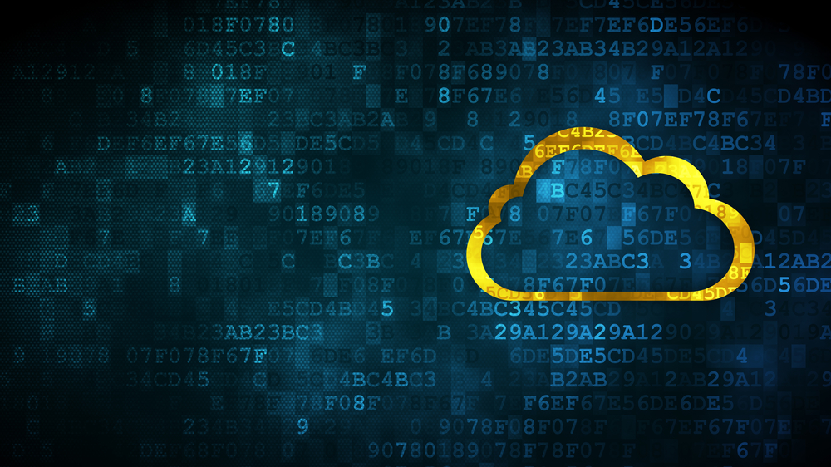
Cloud computing

Slide 2
What is cloud computing?
Cloud computing is an on-demand service model for IT provision based on virtualization and distributed computing technologies.
Abstraction of computing, networking, and storing infrastructure is the foundation of cloud computing.

Slide 3
Risks and security concerns with cloud computing
There are so many companies and organizations that outsource significant part of their business due to globalization.
This raises the question about what are the security policies that the cloud service provider is providing.

Slide 4
Top threats to cloud computing
Abuse and Unallowed use of Cloud Computing
Insecure Application Programming Interfaces
Malicious Insiders
Shared Technology Vulnerabilities
Data Loss and Leakage
Account, Traffic, and Service Hijacking
Unknown Risk Profile

Slide 5
Most common topics related to cloud computing risk
Due to dynamic nature of cloud computing, information can be stored at any physical location. This may introduce latencies while retrieval of information. Also there is no guarantee that the customer will get the information when needed.
Service provider must provide for existence of effective and robust security controls, assuring customers that their information is properly secured against unauthorized access.
There can be data losses due to some disaster. The business continuity and recovery plans must be well documented and tested.

Slide 6
Can we use the security measures used by traditional data centers?
Unfortunately, No.
In traditional data center, controls on physical access, access to hardware and software & identity controls all combine to protact the data.
In clouds that potential barrier that secures infrastructure is diffused.
The data needs its own security.

