Slide 1


CLOUD
COMPUTING

Slide 2
What is cloud computing?
Simply put, cloud computing is the delivery of computing services—including servers, storage, databases, networking, software, analytics, and intelligence—over the Internet (“the cloud”) to offer faster innovation, flexible resources, and economies of scale.

Slide 3
What is cloud security?
Cloud security is control-based technologies and policies adapted to stick to regulatory compliances, rules & protect data applications and cloud infrastructure.
Proper security and other potentially vulnerable areas.
Provides data security, privacy & compliance to customers.

Slide 4
Cloud Security Challenge
Data Breaches
Vulnerability in VMs
APTs
DDoS Attack
APIs
Cloud Service Hijacking
Loss of Data
Data Loss
Lack of Visibility and Control
Vender Lock-In
Shared Technology Vulnerability

Slide 5

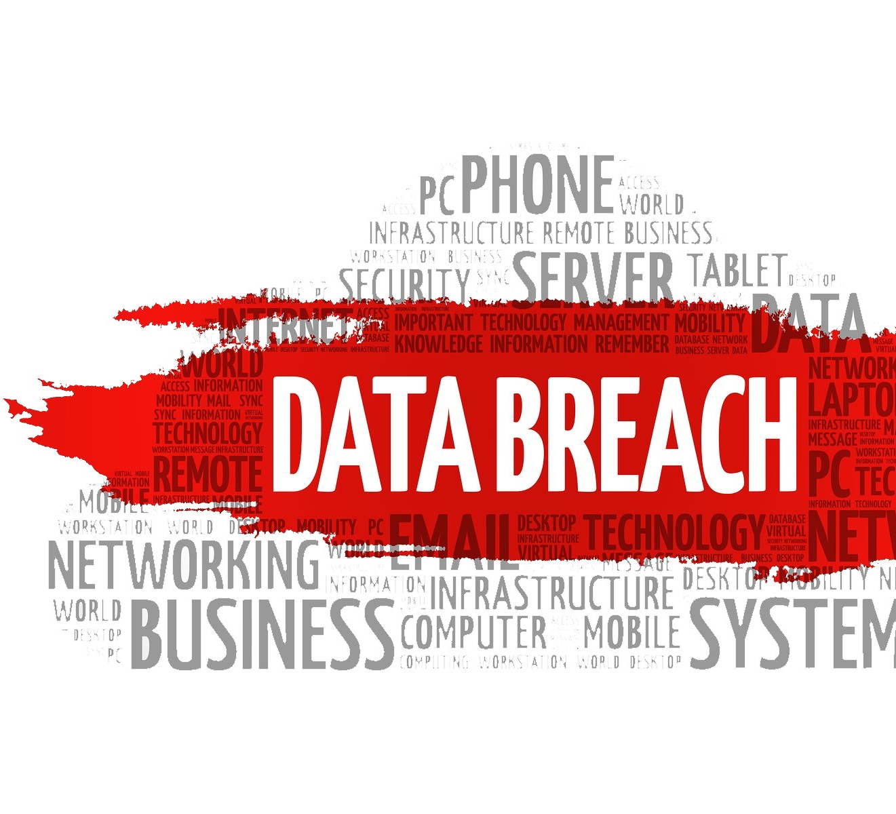
Data breaching
What is Data Breaching?
Reasons behind it?
Example: In the 12th annual Cost of Data Breach Study, sponsored by IBM, it was found that the global cost of data breaches amounted to $3.62 million

Slide 6
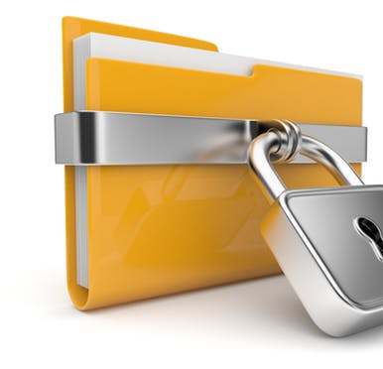
Prevention of data breach can be achieved at firms' end as follows:
Framing of the access so that the users get only the permitted data
Authenticate the running software and also the software patches
The process of request permission must be formalized
Monitor all the network activity and detect intruders
Recommended to log all the users and programs activity
Encrypt all the data that needs protection
Regularly monitor the network for vulnerabilities
Aware of malicious insiders and protect the data

Slide 7
api
What is an API in cloud computing?
Issues.
Solutions.

Slide 8
Vulnerabilities in the system
What are virtual machines?
How do they work in cloud computing?
Issues?

Slide 9
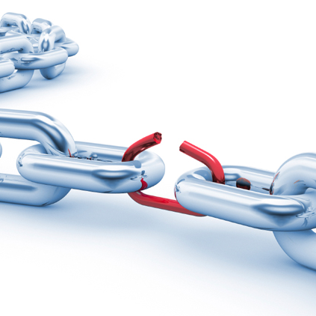
To combat these kinds of system vulnerabilities
Follow a secure system approach adhering to National Institute of Standards [NIST] benchmark that validate the security baseline system
Configure the vulnerability scanner to know the unknown risks that the system may get subjected to on the daily basis
Implementation of security within the system development life cycle is recommended

Slide 10
Cloud source hijacking
What is cloud source hijacking?

Slide 11
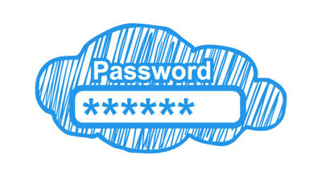
To combat the hijacking
Ensure with the service providers for trustworthy employees who access the servers at data centers
Possess a stringent authentication for the cloud app users
Have a regular and secure backup of the data to prevent loss of data
The IP addresses must be restricted for cloud applications access so that the users use only corporate networks
The users must have multi-factor authentication like static password and dynamic one-time password delivered through tokens, biometrics, or other means.
The sensitive data must be encrypted before it gets transferred to cloud environment.

Slide 12
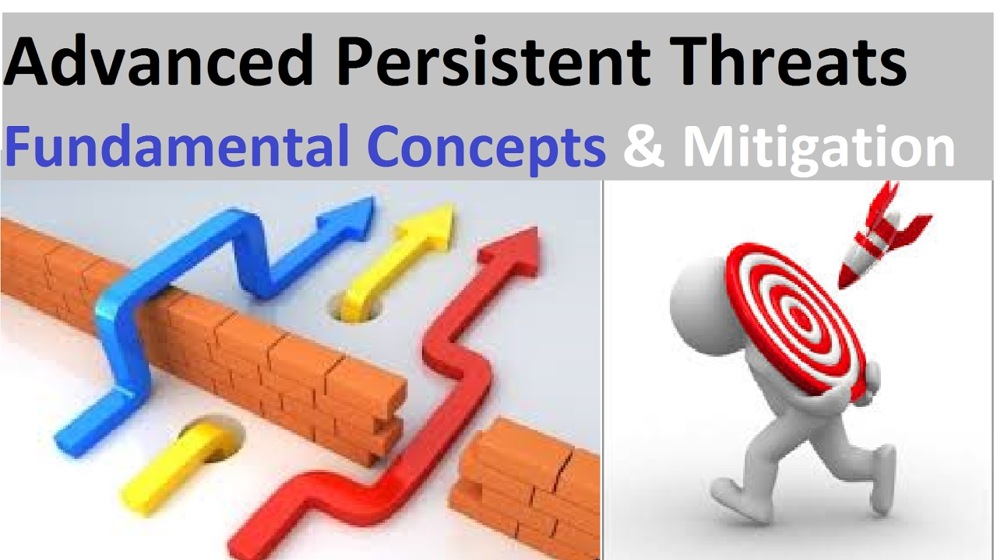
A few of the protective measures for APTs are as follows:
Adoption of multi-layered security strategy
Educate the employees regarding security
Understanding of data control policies
Use of firewalls, malware scanning, and server hardening
Regular update of software
Post-event analysis to prevent recurrence
Blocking of the entry points
Implement reasonable defense methods

Slide 13
TO SECURE APIs:
To Prevent Loss of revenue:
While choosing the cloud service provider, the documentation of their API must be checked. You must hire a penetration tester to test the API provided and same measures must be taken while developing own APIs to ward-off security bugs if any.
The companies must be aware of the associated risks related to the implementation of the cloud services and mitigate them, take proactive approaches in securing the data, and thus availing the clear benefits of the cloud.

Slide 14
data losses
What is data losses?
How does it occure?

Slide 15
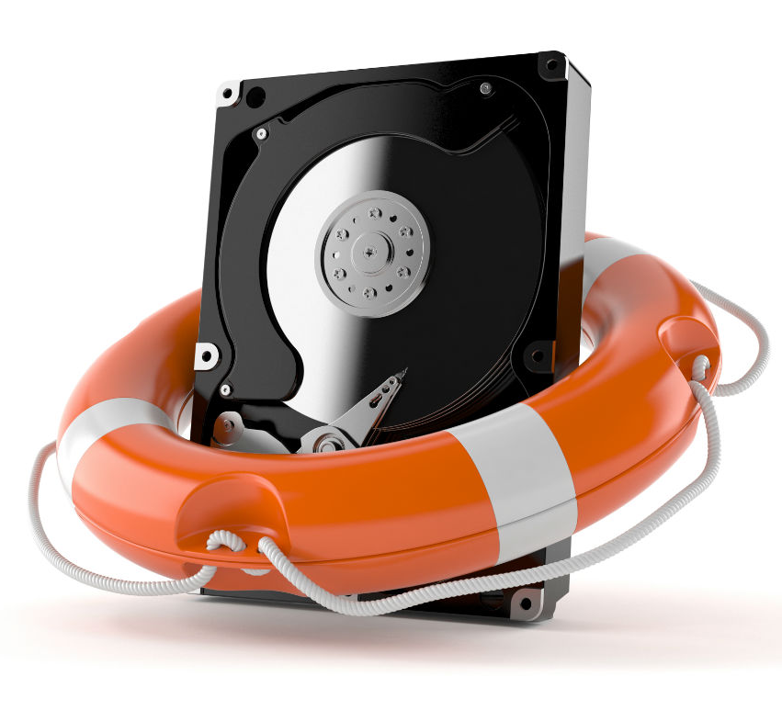
A few of the methods recommended FOR DATA RECOVERY are:
Protect the data either at disk level or through scale-out storage
Periodic backup of the data at cost-effective lower tier medium
Journaled file system or checkpoint replication will enable to recover data

Slide 16
References
https://azure.microsoft.com/en-in/overview/what-is-cloud-computing/
https://www.cdnetworks.com/cloud-security-blog/5-key-cloud-security-challenges/
https://dzone.com/articles/cloud-computing-security-challenges-and-considerat
https://www.mercurysolutions.co/blog/7-top-cloud-security-challenges-and-solutions
https://link.springer.com/content/pdf/10.1007%2F978-3-642-19228-9_13.pdf

Slide 17

Thank You!
Shailesh yadav 2017CS10489
Gohil Dwijeshkumar Navinbhai 2017cs50407

