Slide 1

Cloud computing-Security implications
Cloud computing

Slide 2
What is cloud computing?
Cloud computing is an on-demand service model for IT provision based on virtualization and distributed computing technologies.
Abstraction of computing, networking, and storing infrastructure is the foundation of cloud computing.

Slide 3
WHAT IS CLOUD SECURITY?
Cloud security is control-based technologies and policies adapted to stick to regulatory compliances, rules & protect data applications and cloud infrastructure.
Provides data security, privacy & compliance to customers.

Slide 4
Risks and security concerns with cloud computing
There are so many companies and organizations that outsource significant part of their business due to globalization.
This raises the question about what are the security policies that the cloud service provider is providing.

Slide 5
Most common topics related to cloud computing risk
Due to dynamic nature of cloud computing, information can be stored at any physical location. This may introduce latencies while retrieval of information. Also there is no guarantee that the customer will get the information when needed.
Service provider must provide for existence of effective and robust security controls, assuring customers that their information is properly secured against unauthorized access.
There can be data losses due to some disaster. The business continuity and recovery plans must be well documented and tested.

Slide 6
Can we use the security measures used by traditional data centers?
Unfortunately, No.
In traditional data center, controls on physical access, access to hardware and software & identity controls all combine to protact the data.
In clouds that potential barrier that secures infrastructure is diffused.
The data needs its own security.

Slide 7
Cloud Security Challenge
Data Breaches
Vulnerability in VMs
APTs
DDoS Attack
APIs
Cloud Service Hijacking
Loss of Data
Lack of Visibility and Control
Vender Lock-In
Shared Technology Vulnerability

Slide 8
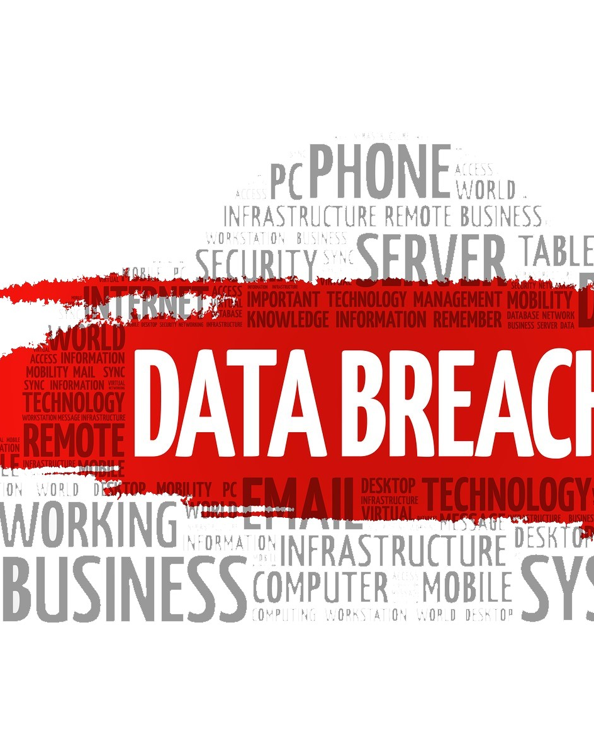
Data breaching
What is Data Breaching?
How can it occur?
Example: In the 12th annual Cost of Data Breach Study, sponsored by IBM, it was found that the global cost of data breaches amounted to $3.62 million

Slide 9

Prevention of data breach can be achieved at firms' end as follows:
Authenticate the running software and also the software patches
Monitor all the network activity and detect intruders
Encrypt all the data that needs protection
Regularly monitor the network for vulnerabilities

Slide 10
API
What is an API in cloud computing?
Issues.
Solutions.

Slide 11
TO SECURE APIs:
To Prevent Loss of revenue:
While choosing the cloud service provider, the documentation of their API must be checked. You must hire a penetration tester to test the API provided and same measures must be taken while developing own APIs to ward-off security bugs if any.
The companies must be aware of the associated risks related to the implementation of the cloud services and mitigate them, take proactive approaches in securing the data, and thus availing the clear benefits of the cloud.

Slide 12
Vulnerabilities in the system
What are virtual machines?
How do they work in cloud computing?
Issues?

Slide 13
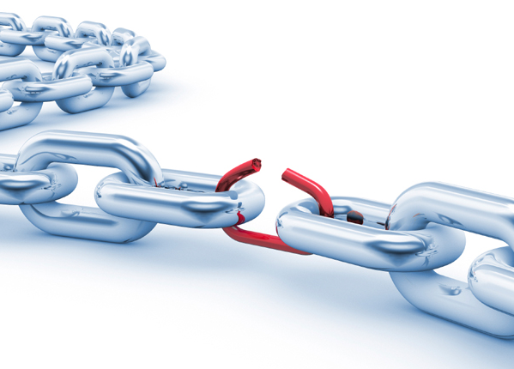
To combat these kinds of system vulnerabilities
Follow a secure system approach adhering to National Institute of Standards [NIST] benchmark that validate the security baseline system
Configure the vulnerability scanner to know the unknown risks that the system may get subjected to on the daily basis

Slide 14
Cloud source hijacking
What is cloud source hijacking?

Slide 15
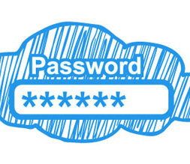
To combat the hijacking
Ensure with the service providers for trustworthy employees who access the servers at data centers
Have a regular and secure backup of the data to prevent loss of data
The users must have multi-factor authentication like static password and dynamic one-time password delivered through tokens, biometrics, or other means.
The sensitive data must be encrypted before it gets transferred to cloud environment.

Slide 16
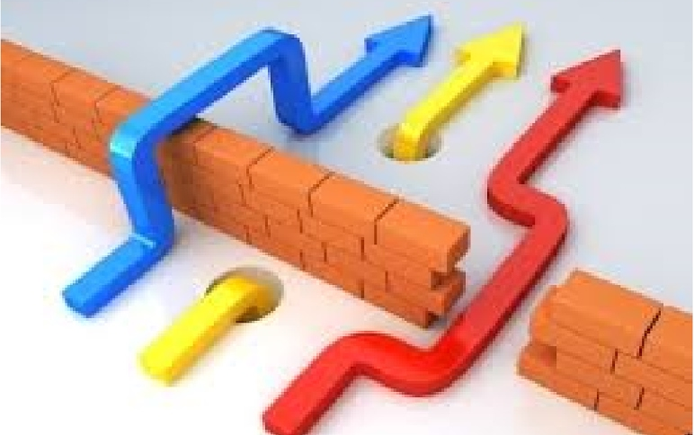
A few of the protective measures for APTs are as follows:
Adoption of multi-layered security strategy
Educate the employees regarding security
Understanding of data control policies
Use of firewalls, malware scanning, and server hardening
Regular update of software
Post-event analysis to prevent recurrence
Blocking of the entry points
Implement reasonable defense methods

Slide 17
data losses
What are data losses?
How does it occur?

Slide 18

A few of the methods recommended FOR DATA RECOVERY are:
Protect the data either at disk level or through scale-out storage
Periodic backup of the data at cost-effective lower tier medium
Journaled file system or checkpoint replication will enable to recover data

Slide 19
References
https://azure.microsoft.com/en-in/overview/what-is-cloud-computing/
https://www.cdnetworks.com/cloud-security-blog/5-key-cloud-security-challenges/
https://dzone.com/articles/cloud-computing-security-challenges-and-considerat
https://www.mercurysolutions.co/blog/7-top-cloud-security-challenges-and-solutions
https://link.springer.com/content/pdf/10.1007%2F978-3-642-19228-9_13.pdf

Slide 20

Thank You!
Shailesh yadav 2017CS10489
Gohil Dwijeshkumar Navinbhai 2017cs50407

