Slide 1


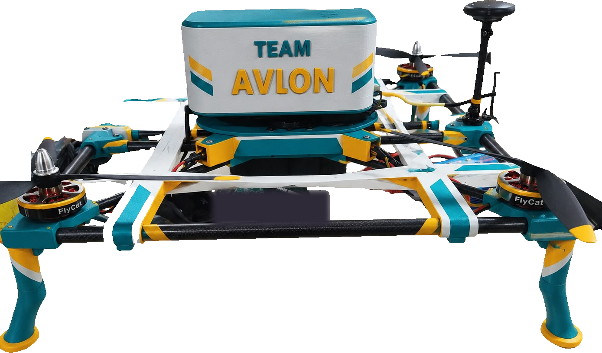
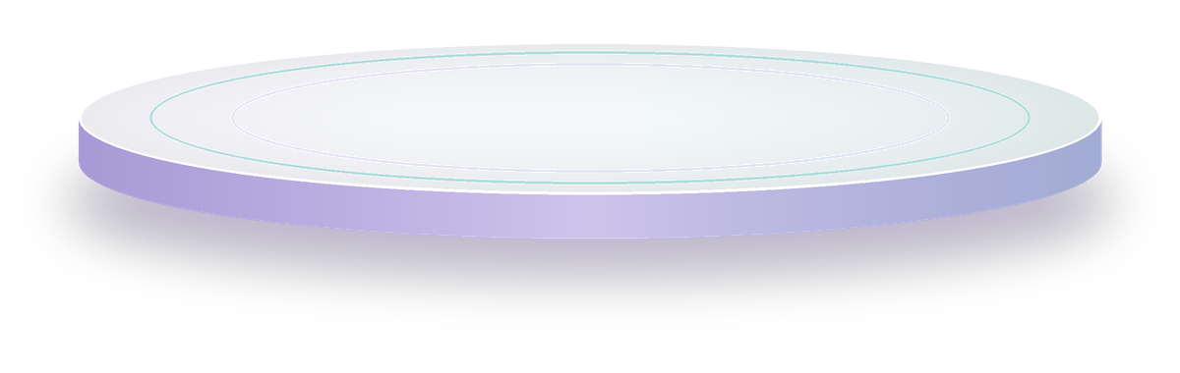
GPS AUTOPILOT
TEAM AVION · BVM · DISASTER-RELIEF UAV
Avion
IN-HOUSE AIRFRAME
When the roads disappear,
relief still arrives.
An autonomous drone that carries medikits and food parcels to people cut off by floods, landslides and earthquakes.
AUTONOMOUS
CARBON + 3D-PRINTED
PATENT PLANNED
PROJECT MENTOR Dr. Dipak M. Patel
BASE CAMP
BROKEN BRIDGE
CUT-OFF VILLAGE
Notes:
Open strong: when the roads disappear, relief still arrives. Avion is our autonomous relief drone — designed and built entirely by our team for one job: getting medicine and food to people no vehicle can reach.

Slide 2

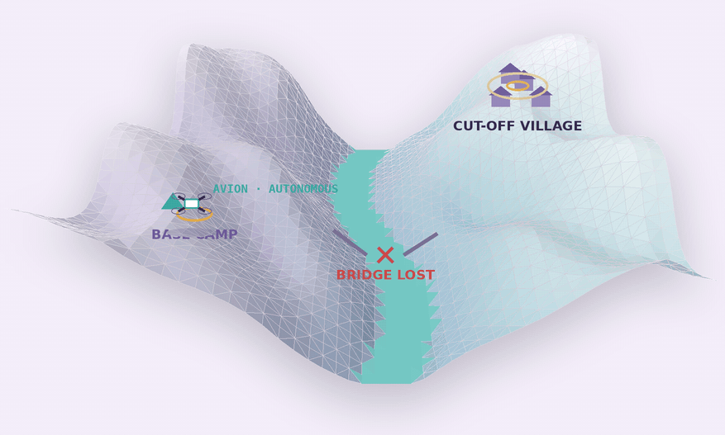
Floods cut the roads. Help can't get through
01 — THE PROBLEM
Rasuwa–Bhotekoshi flood, Nepal · 26 August 2026
A flash flood tore down the valley, washing away homes, bridges and highways. Weeks later, parts of Rasuwa are still unreachable by road.
1,453
5,644
32
lives lost
people still missing
bridges swept away
THE GAP Survivors need medicine, water and food first — but no vehicle can reach them, and helicopters are scarce and weather-bound.
Sources: UN RCO / OCHA Situation Report No. 9, citing NDRRMA (23 Sep 2026); CARE International (Sep 2026)
Notes:
This is happening right now. The Rasuwa flood in Nepal has claimed 1,453 lives with 5,644 still missing, according to Nepal's disaster authority via the UN. 32 bridges were swept away. Weeks later, parts of Rasuwa are still unreachable by road, and relief is being flown in by helicopter and drone. The gap: survivors need medicine and food first, and nothing on the ground can reach them.

Slide 3
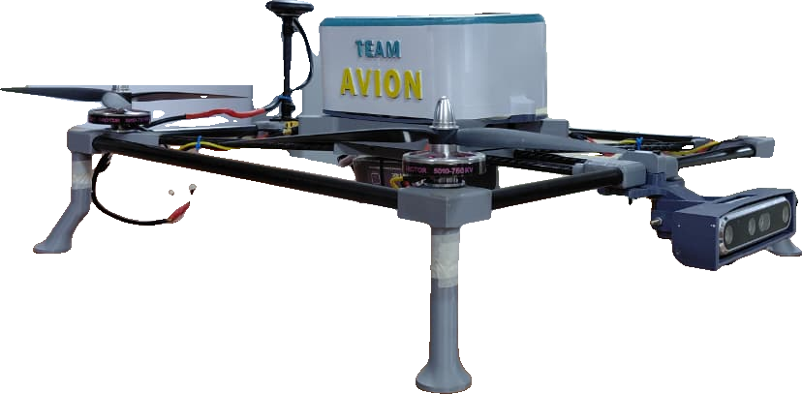


Avion: a first responder that flies
02 — THE SOLUTION
It flies a GPS route on its own, sees the ground in 3D, and lowers a relief payload exactly where people are waiting.
Navigation
Onboard brain
GPS + Pixhawk 2.4.8
Raspberry Pi 4
WHAT IT DOES
1
Autonomous waypoint flight
GPS route, no manual piloting
2
3D depth perception
Sees terrain and the drop zone
3
Precision payload release
Depth vision
Medikit lowered on target
Intel RealSense D455
4
Return-to-launch failsafe
Comes home on its own
Carbon-fibre frame
Light, stiff, crash-tolerant
Notes:
Avion is a quadcopter with a Pixhawk autopilot, a Raspberry Pi companion computer and an Intel RealSense depth camera. It flies the route itself, sees the ground in three dimensions, and lowers the payload onto a confirmed safe spot.

Slide 4
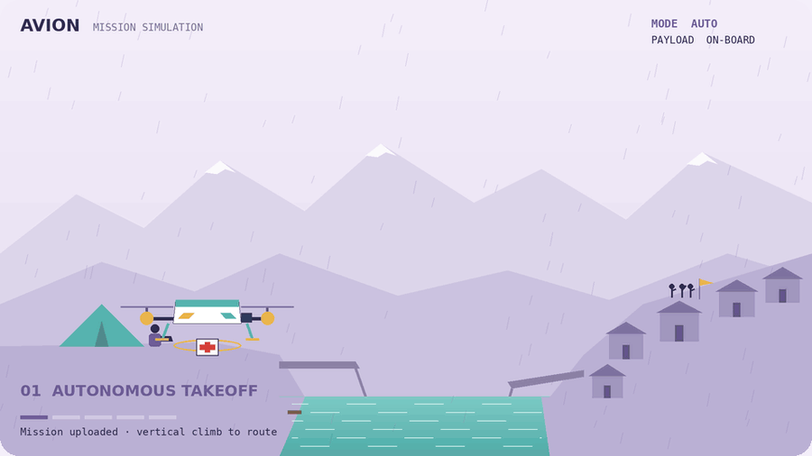
One sortie, start to finish
03 — HOW IT WORKS
01
Flies itself
Waypoint route over broken roads and bridges, tracked live from the ground station.
02
Sees the drop zone
The depth camera confirms a clear, safe spot before anything is released.
03
Operator in command
The ground station confirms every release; a crew exclusion zone keeps people safe.
Notes:
Here is one complete sortie: take-off from base camp, a GPS route over the washed-out bridge, the depth camera scanning and locking the rooftop, the medikit lowered and released, and an autonomous return. A human operator confirms every release.

Slide 5


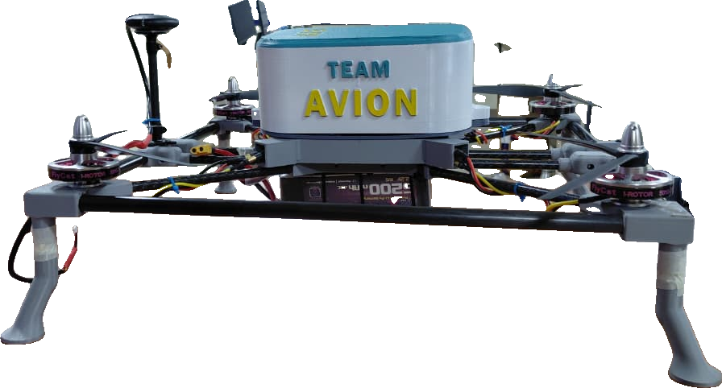




Built for relief. Ready for more
04 — APPLICATIONS
ONE AIRFRAME · MANY MISSIONS
PRIMARY MISSION
Medikits and food parcels for survivors stranded by disaster
Clinic logistics
Search & mapping
Vaccines, drugs and lab samples to cut-off health posts
Depth + GPS data to locate people and safe routes
Landslides & earthquakes
Damage assessment
Where collapsed roads stop ground teams
Fast aerial survey for recovery planning
Notes:
Our primary mission is medikits and food parcels to stranded survivors. The same airframe and sensors serve clinic logistics, search and mapping, landslide and earthquake response, and damage assessment.

Slide 6
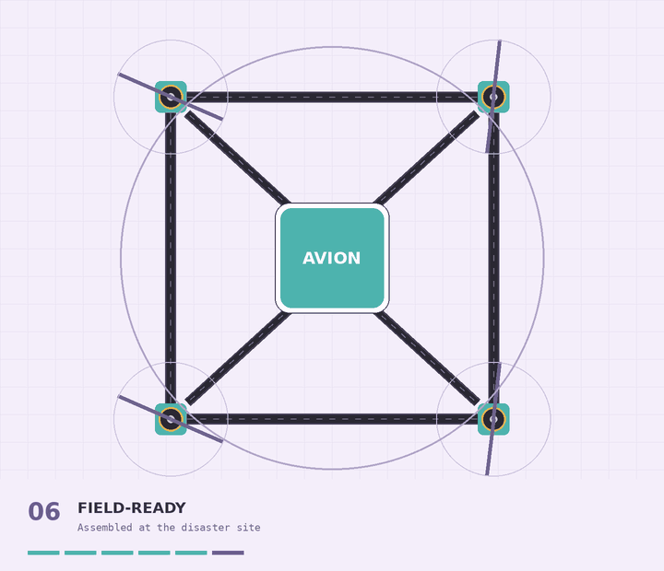





Carbon-fibre tubes, 3D-printed joints
05 — ENGINEERING
Lighter
Stronger
Carbon fibre is ~40% less dense than aluminium — more lift left for the payload.
Tubes carry flight loads; printed nodes spread and absorb impacts.
Modular & portable
Repairable in the field
Travels as a compact kit and is assembled at the disaster site.
A broken joint is simply re-printed from the CAD file.
100% IN-HOUSE · design patent planned
Design
Print
Cut tubes
Assemble
Code & fly
Notes:
The frame is our core innovation: carbon-fibre tubes for strength at very low weight, joined by our own 3D-printed nodes. It travels as a kit, is assembled at the site, and any broken joint can be re-printed. Everything — design, printing, assembly and code — was done in-house, and we plan to file a design patent.

Slide 7
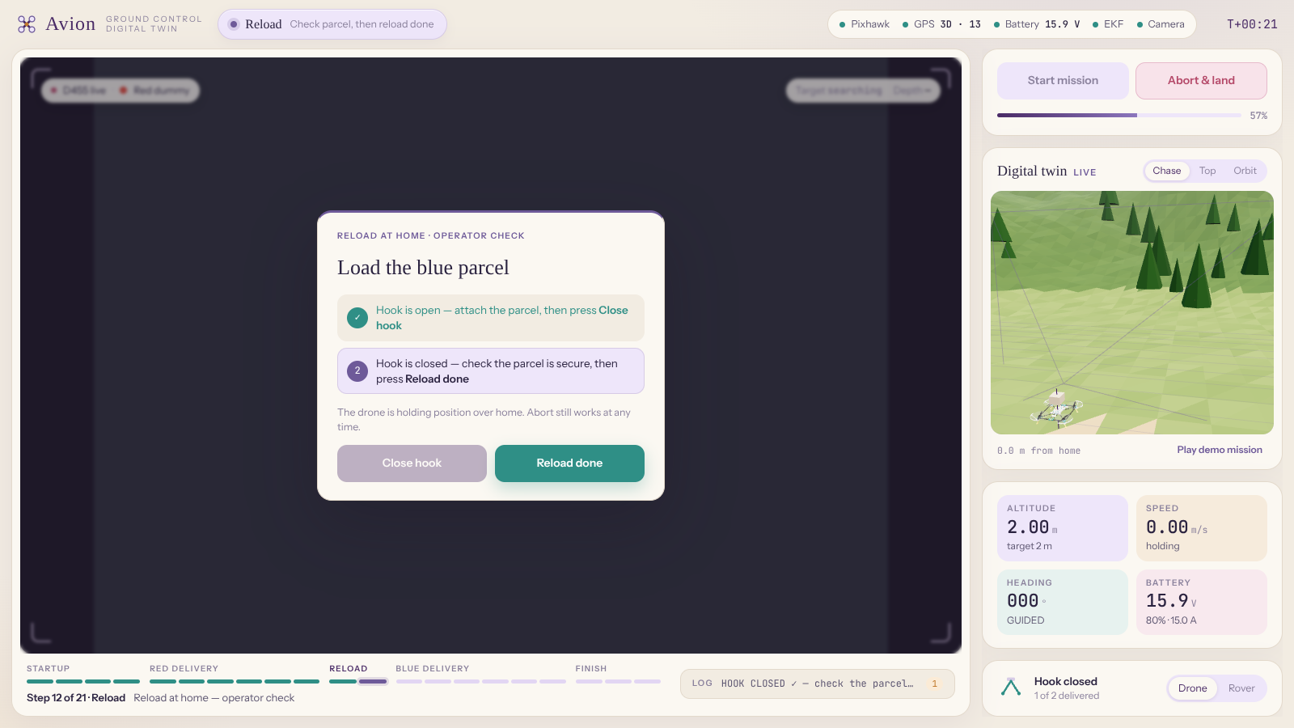




Autonomous flight. Human oversight.
06 — HYBRID OPERATION
LIVE
Avion flies the mission on its own — while the operator watches the live camera, digital twin and telemetry, and confirms every critical step.
Live camera + digital twin
D455 feed beside a live 3D twin of the drone
Flight telemetry
Pixhawk, GPS, EKF, battery, altitude and speed
Guided mission timeline
Startup, deliveries, reload and finish, step by step
Operator checks + abort
Confirm hook + parcel before drops; abort anytime
Hybrid by design: autonomy does the flying, people stay in command.
Notes:
Avion is hybrid by design. The drone flies the mission autonomously, and this is our ground-station interface: the live RealSense camera feed, a real-time 3D digital twin of the drone, full telemetry from the Pixhawk, and a guided mission timeline. At critical moments — like reloading the parcel at home — the operator confirms each step, and Abort and land is always one click away. Autonomy does the flying; people stay in command.

Slide 8
From one drone to a relief network
07 — FUTURE SCOPE & SCALABILITY
01
Improve
02
Connect
03
Scale
NEXT 6 MONTHS
NEXT 12 MONTHS
BEYOND
Thermal camera for night search
Heavier payload and longer range
Weather-sealing for monsoon flights
Field trials of the autonomous drop
Multi-drone fleets with shared mission planning
Long-range 4G / satellite links
Live feed into district control rooms
DGCA-compliant operations
Design-patent filing and licensing
Field-kit programme for responders
Distributed manufacturing — joints printable anywhere
Relief corridors in every flood-prone district
Why it scales: the airframe is standard tubes plus printable joints — production grows with printers, not factories.
Notes:
Next we improve: thermal vision for night search, more payload and range, weather-sealing and field trials. Then we connect: fleets, long-range links and live feeds into control rooms. Then we scale: patent and licensing, field kits for responders and distributed manufacturing — because our frame is tubes and printable joints, production grows with printers, not factories.

Slide 9

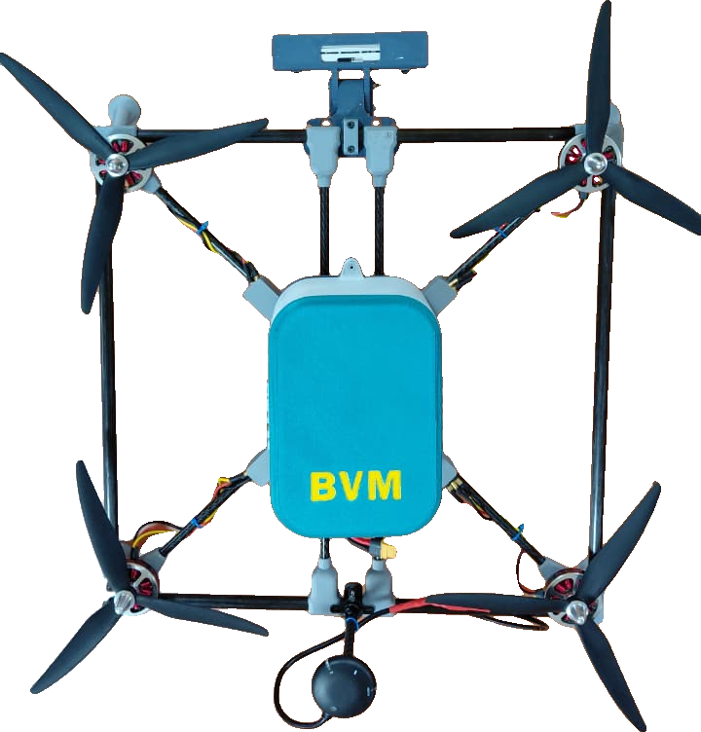
TEAM AVION · BVM
Built in-house.
Ready for anywhere.
SEARCH & MAP
MEDIKITS
Designed & manufactured entirely by Team Avion
Design patent filing planned
Field-ready modular, repairable frame
CLINIC SUPPLIES
Thank you.
FOOD PARCELS
Questions welcome
Notes:
Avion is built in-house and ready for anywhere: designed and manufactured by our team, with a design patent planned and a frame that can be assembled and repaired in the field. Medikits, food, clinic supplies, search and mapping — one autonomous platform. Thank you — we'd love your questions.

