Slide 1

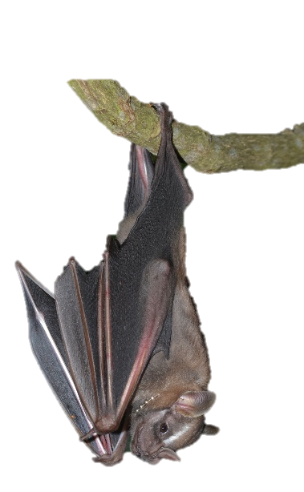
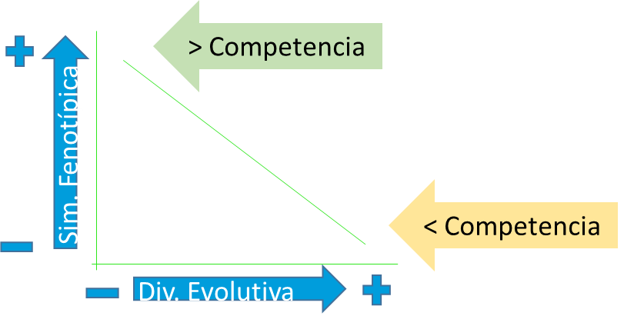
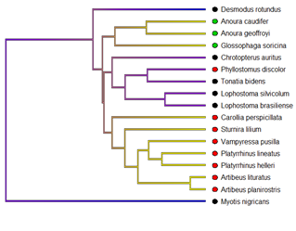
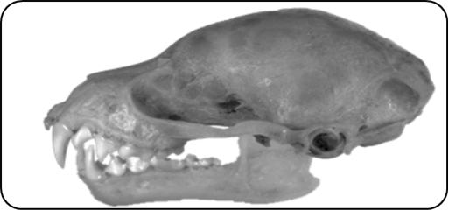
Influence of diet and feeding strategies on the morphology of the skull and jaw of a community of bats
1 - What are you working on? (Main interests, specific questions)
General Questions
1. Are bat communities structured by the influence of trophic segregation, and can species with similar morphologies coexist in the same environments?
The high phenotypic similarity in the species with less evolutionary divergence, could do stimulate a high competence for resources?
Aim
Hypothesis
Asses if the influence of diet and feeding behavior on the morphology of the skull and jaw in a community of bats has phylogenetic signal
The morphology of skull and jaw are influence by trophic guilds and feeding behaviour because the trophic function is the evolution force for the differents morphologies
Adriana Carolina Acero-Murcia
adriana.carolina.acero@gmail.com
Notes:
Good morning, My name is Adriana Acero, I’m from Colombia. And I’m working with Evolutionary dynamics in communities through of the geometric morphometrics and the partitioning of niche trophic and habitat in bat communities in central west Brazil. In this first part of my research, I'm focused only on GM.
My general question are ….
My aim is…..
And My hypothesis is …..

Slide 2
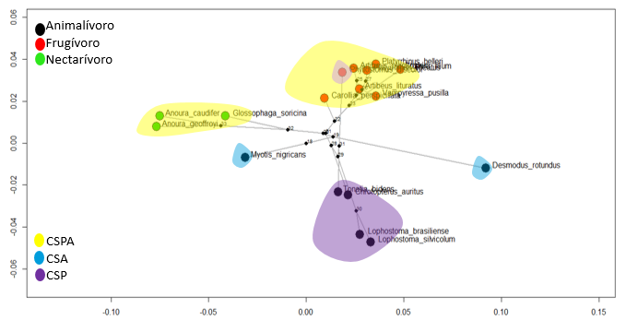
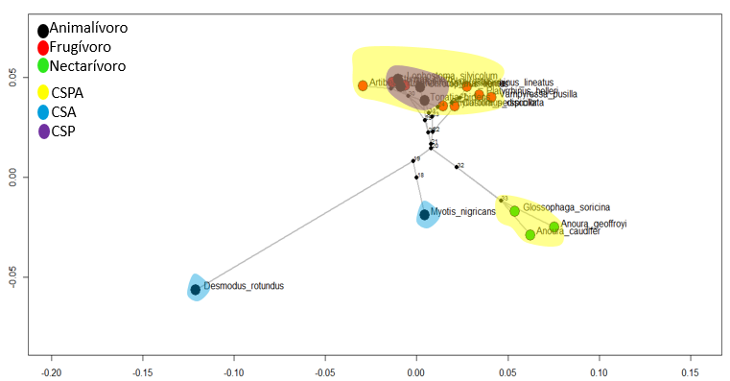
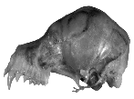
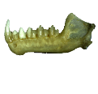
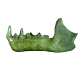



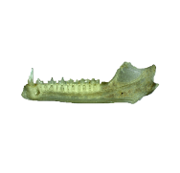
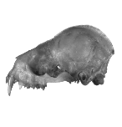
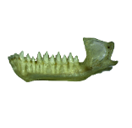
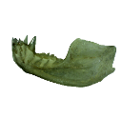
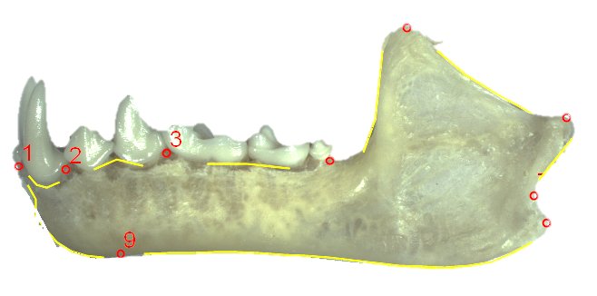
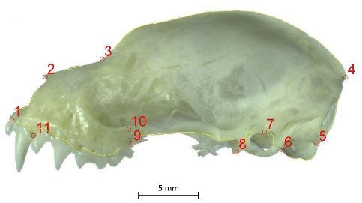
2 - What figures can you show that represents the work that you're doing?
PC2 20.82%
PC2 27.98%
PC1 49.5%
PC1 45.44%
(K_{mult}= 1.05, P = 0.001)
(K_{mult}= 1.08, P = 0.025)
Landmarks cráneo (n=11)
Semilandmarks cráneo (n=61, 10 curvas)
Landmarks mandíbula (n=9)
Semilandmarks mandíbula (n=48, 8 curvas )
Adriana Carolina Acero-Murcia
adriana.carolina.acero@gmail.com
Notes:
In my preliminary results, I found that the morphological space showed that nectarivores (green points) species were well segregate for skull and jaw. The specialization to eat insects, small vertebrates, and drink blood could influence the segregation for skull, but in the jaw the animalivores (black points) from Phyllostominae share the same space with the frugivores of Stenodermatinae.
The fact to share the same morphological space could suggest that both families passed for similar selective pressures to get an optimal phenotype to eat fruits between Stenodermatinae, and to eat insect and small vertebrates in Phyllostominae. The size, could be key to contribute to this trophic segregation.
The similarity of forms can be a good predictor to identify the dynamics of the exploration of resources and the coexistence of the species in the communities.

Slide 3




3 - What do you want to learn and what software do you usually use? (a list of things you want to learn).
How make landmarks and Semilandmarks?
How process that images to work with Slicermorph?
With Slicermorph, Can I define land.. and semi.. for all my images? Or I need to do this process one by one
What kind of analyses can i do with slicermorph?
What is the advantage of working with 3d morphology with slicermorph?
Images 2D
Images 3D
Adriana Carolina Acero-Murcia
adriana.carolina.acero@gmail.com
Notes:
I use TPSDig to process the images in 2D, and Rstudio to do my analyses. But I want to work with Slicermorph because, I have the opportunity of scan more bats and get more species to my study. I want to learn ....

