Slide 1
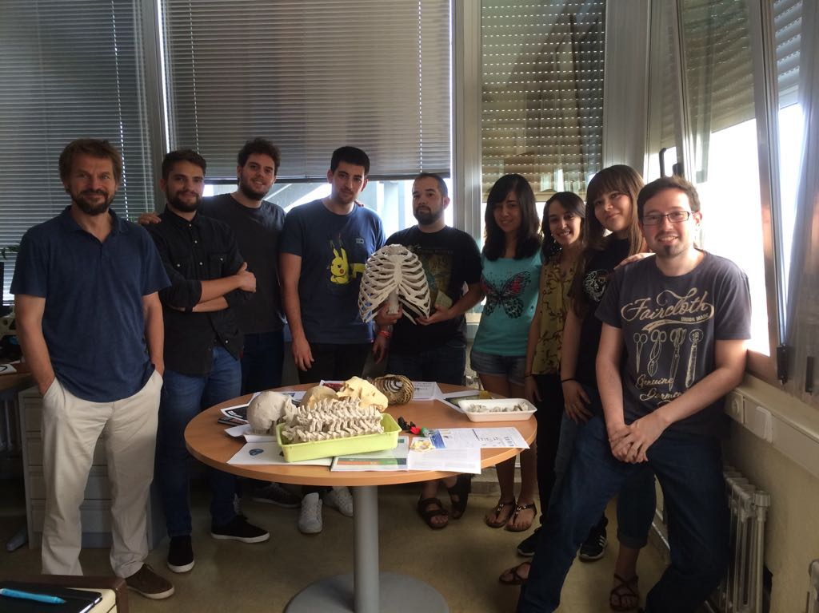


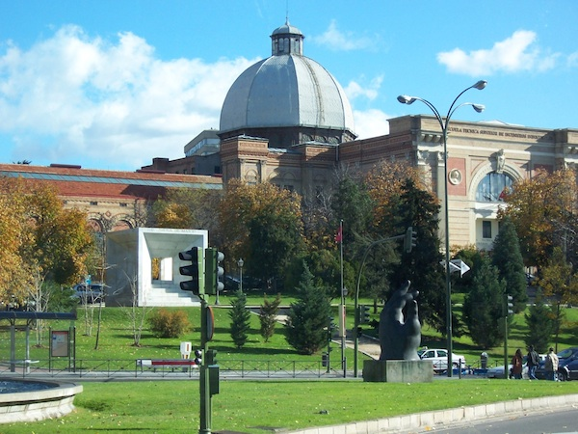
Who am I?
BSc Biology, MSc Biomedical Physics (Complutense University of Madrid)
Now: PhD student at the Museo Nacional de Ciencias Naturales (FPI fellowship CGL2015-63648P, Spanish Ministry of Economy and Competitiveness).
PhD thesis supervised by Dr. Markus Bastir 2016-2020: Functional anatomy and evolution of the torso in the genus Homo through 3D geometric morphometric techniques.
My team
Madrid (Spain)

Slide 2
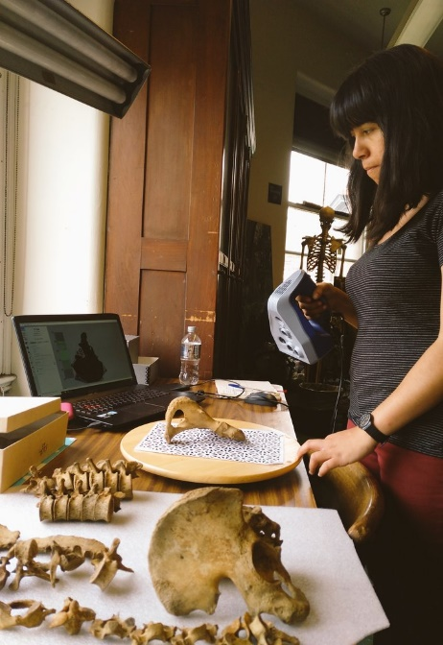
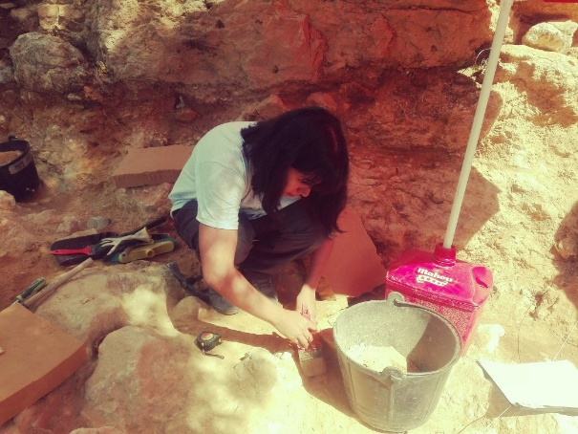
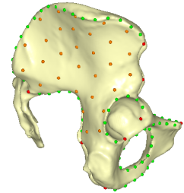
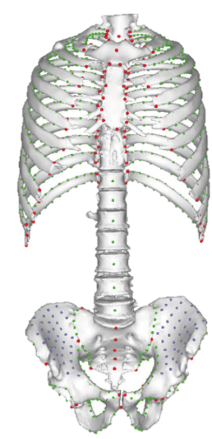
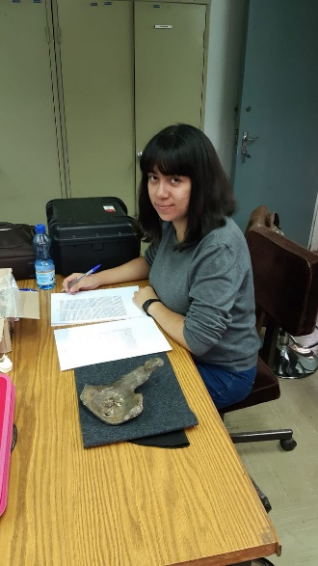
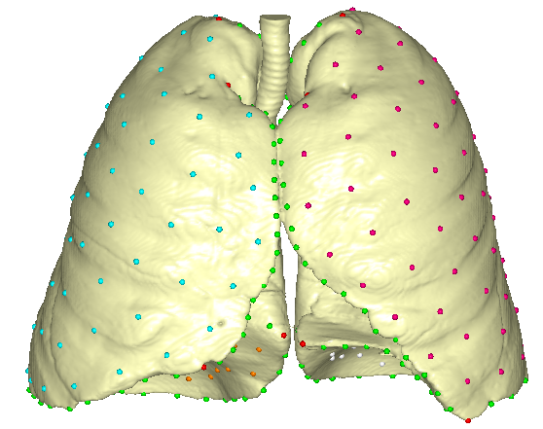
What is my PhD research about?
But I am really interested in…
3D geometric morphometrics and statistical methods
Fieldwork: Valle de los Neandertales (September, 2018).
AMNH (June, 2019).
3D Surface scanner
Torres-Tamayo et al. 2017
National Museum of Nairobi (July, 2019).
Torres-Tamayo et al. 2018a
Torres-Tamayo et al. 2018b

Slide 3
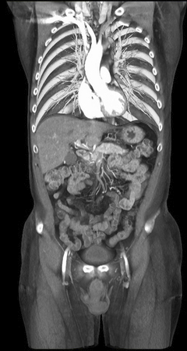
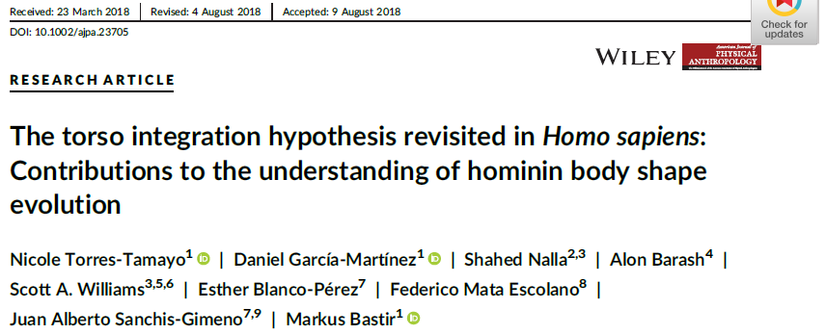
What is my PhD research about?
I study: Patterns of covariation between the thorax and the pelvis in H. sapiens and Pan
In order to: Build predictive models to reconstruct the trunk (body plan) of extinct hominins.
Chapter 1: Adult H. sapiens
Chapter 2: Adult Pan vs. adult H. sapiens
Chapter 3: Predictive covariation models to reconstruct thorax from pelvis morphologies and viceversa.
Chapter 4: Thorax reconstruction KNM-WT 15000 (H. erectus)
3D geometric
morphometrics
CT-data

Slide 4
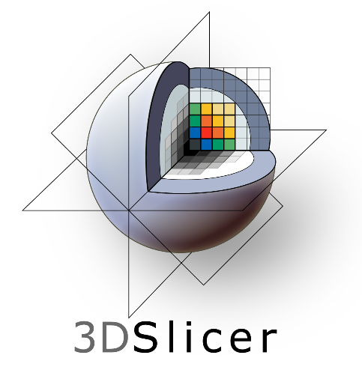
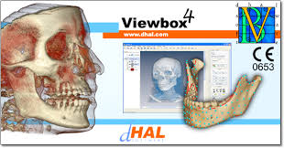

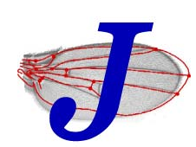

GMM experience
CT scans
segmentation
3D models
post-processing
Landmarks and
semilandmarks
Landmarking
in R?
GMM analyses
Morpho
Geomorph

Slide 5

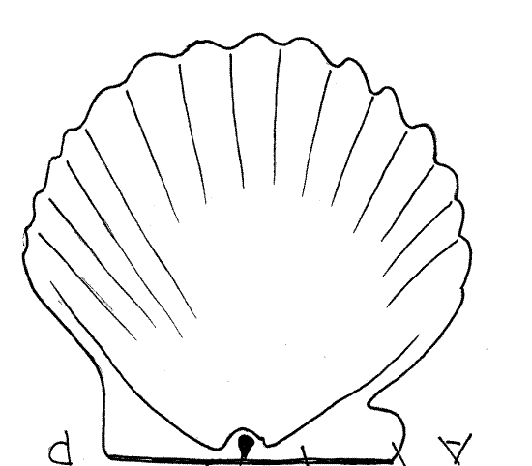
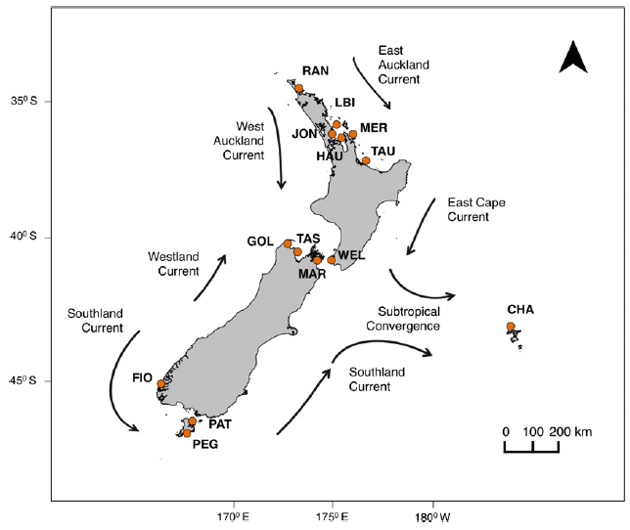
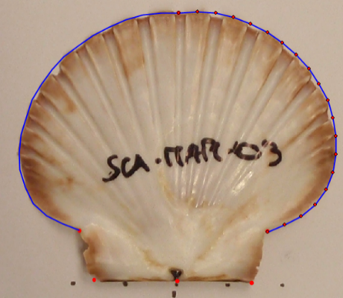
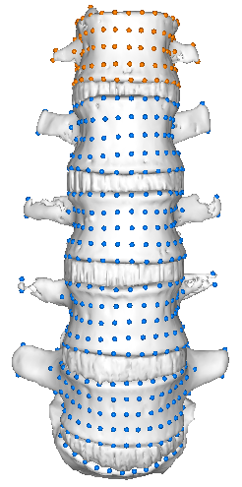
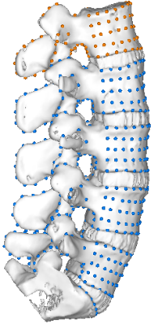

Other collaborations and interests
Ecogeographical variables influencing the scallop morphology
Dr. Catarina Silva (James Cook University, Australia)
Curve 1:
18 sml
4
Curve 2:
18 sml
3
5
2
1
6
Trajectory analyses to assess lumbar vertebral ontogeny in Hominoidea
Dr. Sandra Martelli (University College of London)

Slide 6
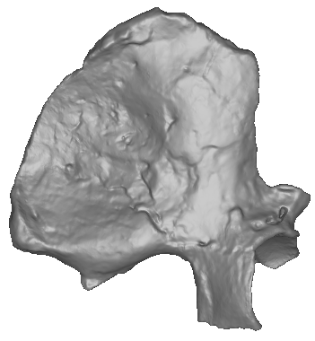
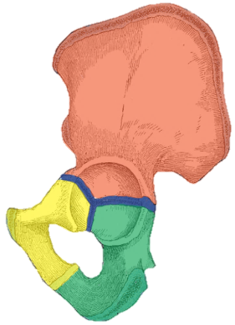
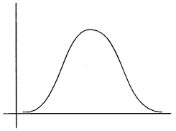

Other collaborations and interests
Ischiopubis region from ilium region
Dr. Stefan Schlager (University of Freiburg, Germany)
Ilium and ischiopubis → separate modules (blocks) in primates (Grabowski et al, 2011; Lewton, 2012; Huseynov et al., 2017). These structures are developmentally regulated by different genetic pathways (Malashichev et al., 2005; Malashichev et al., 2008).
Australopithecus sediba MH2
Method 1: Two Blocks PLS prediction
Method 2: Statistical Shape Modelling
Block 2 (N=65 ischiopubic regions,
RESPONSE)
Block 1 (N= 65 ilia, PREDICTOR)

Slide 7

Future plans…
PhD defense in October 2020. Already looking for post-doc opportunities.
Available from October onwards, to travel to any place in the world.
Interested in evolutionary biology, not necessarily human fossils.
I love Biology, I am very adaptable to any organism.
I would like to expand my methods skills:
Statistical Shape Modelling.
Finite element analysis.
I love teaching and supervising students.
THANK YOU FOR YOUR ATTENTION!
@GMM_field
@paleonicole
nicole.torres@mncn.csic.es

