Slide 1
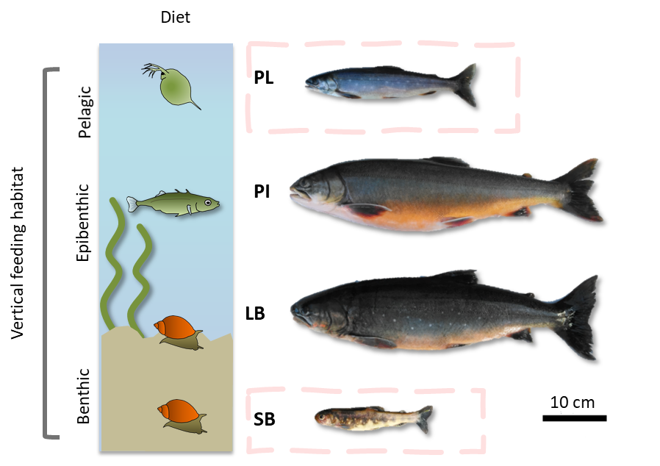

Post-zygotic isolation in Arctic charr
Quentin Horta-Lacueva
@HortaQuentin
Kalina Kapralova
Sigurður Snorrason
University of
Iceland

Slide 2
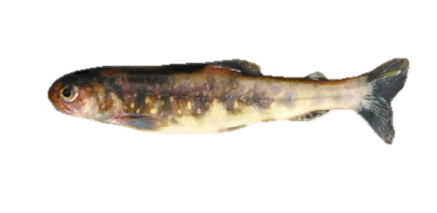
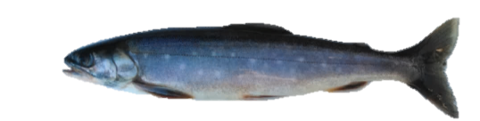









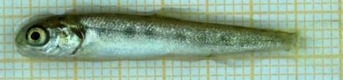
The project Some figures Things to learn
Small-benthic
Planktivorous

Slide 3
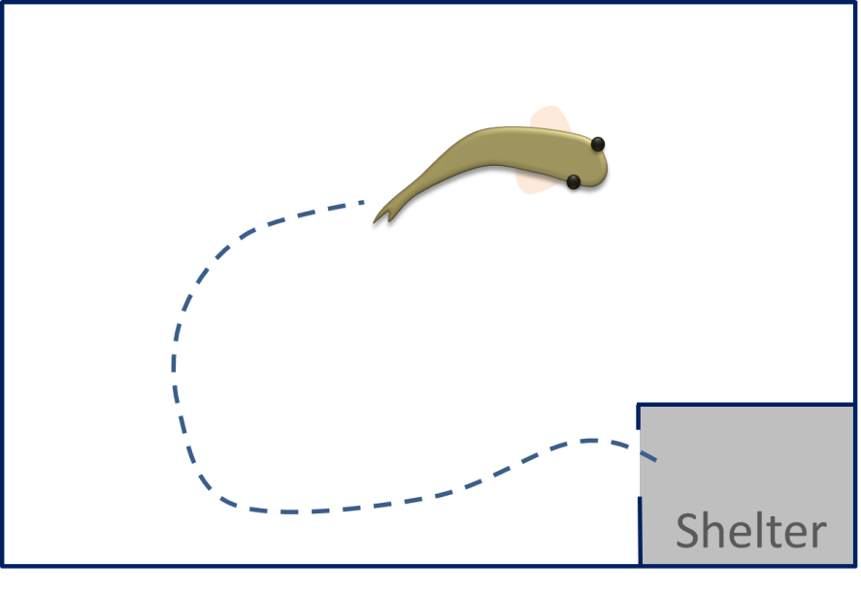
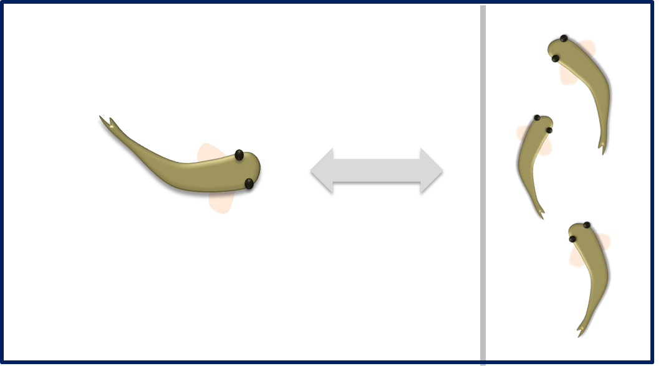
The project Some figures Things to learn
Growth
Yolk-sac resorption
Small-benthic
Planktivorous
Morphology
Personality
Feeding behaviour

Slide 4
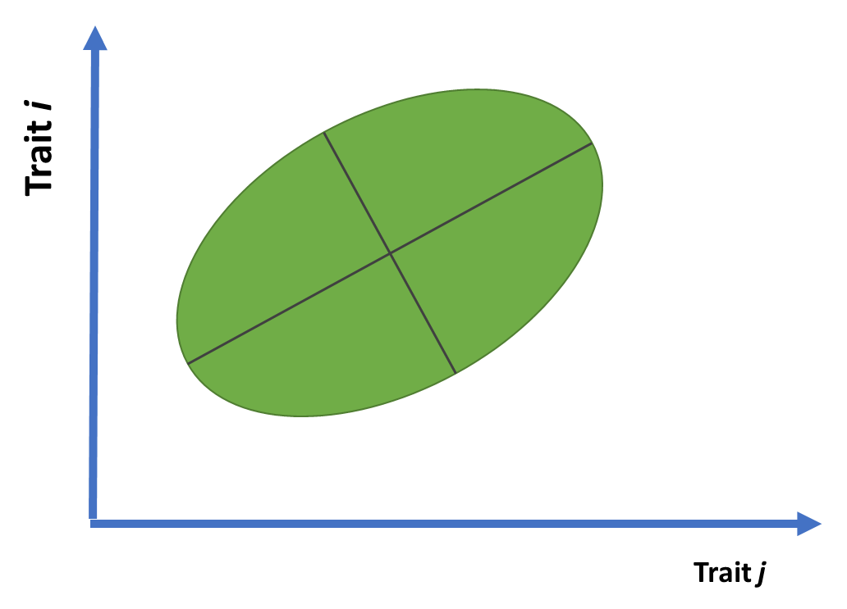
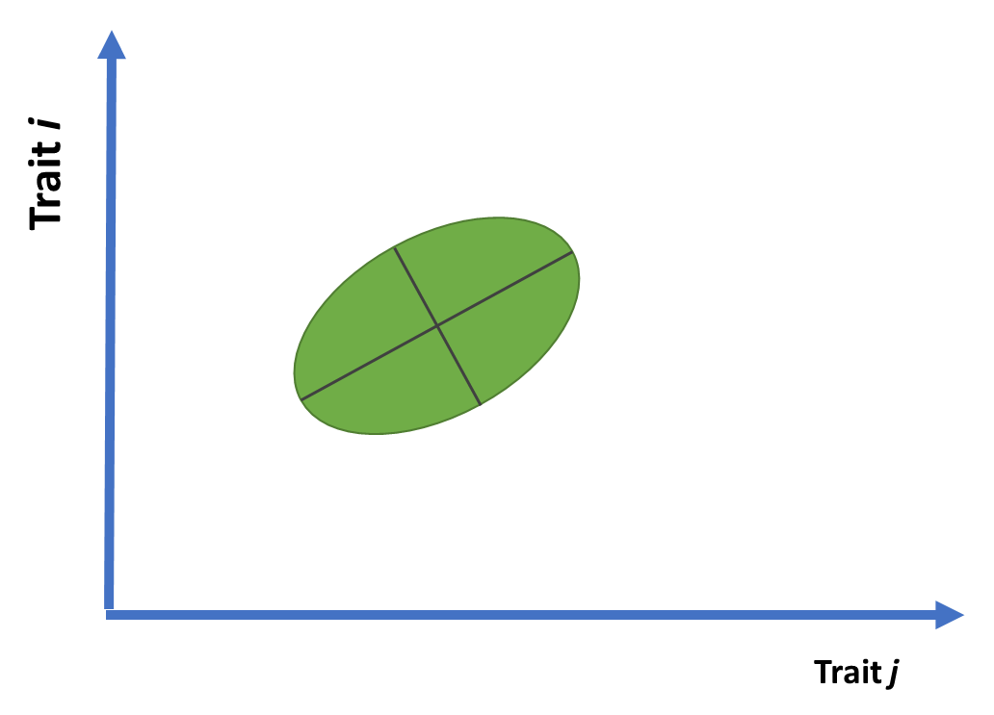

The project Some figures Things to learn
Differences in P matrices?
VS.
(Size of P)

Slide 5
The project Some figures Things to learn
Software used
Geomorph/RRPP
LORY
MCMCglmm
Would like to master
Proper analyses with nested/crossed designs in Geomorph

