Slide 1
Shape and Asymmetry in Crop Leaf
Sergey G. Baranov, docent, Vladimir State University, Russia
bar.serg58@gmail.com
Soft: MorphoJ, TPS, PAST
Analysis: Procrustes ANOVA, PCA, thin spline,
canonical covariance analysis of the symmetry and asymmetry matrices
Fields: developmental stability\instability and fluctuating asymmetry, directional asymmetry,
Interests: phenotype and genotype, ontogenetic noise, epigenetics

Slide 2
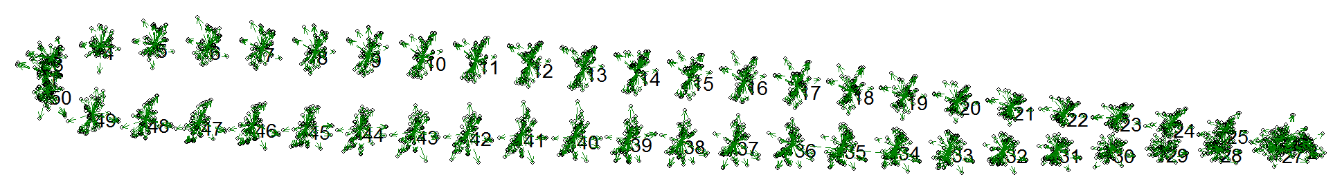
Samples and Methods
Fig.2. Deviation of landmarks from the consensus
The wheat cultivation was carried out on а gray forest medium loamy soil (the flat relief of the Suzdal district, Vladimir region, Russia).
Four doses mineral fertilizer nitroammophos were used:
1) intensive mineral (N90P90K90),
2) highly-intensity mineral (N120P120K120),
3) intensive organic-mineral (60t organic fertilizer + N90P90K90),
4) highly-intensity organic-mineral (80t organic fertilizer + N120P120K120).
The geometric morphometrics included:
a) labeling, b) mirroring the labels on the left and right half, c) finding a consensus shape and removing the effect of the size of the plate, and: d) determining the difference in the coordinates of the landmarks labeled on the margin of both sides of the plate. We labeled 50 landmarks. The leaf blades were photographed twice.

Slide 3
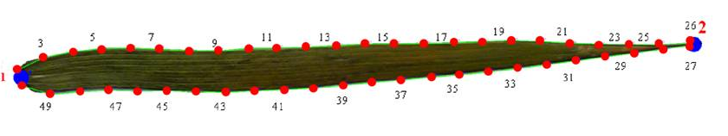
How to arrange LMs?
?
?
What for?
Fluctuating asymmetry (FA) is a random non-directional deviation from the strict symmetry of bilateral structures and serves the indicating of ontogenetic noise, the adaptation and co-adaptation of a natural population of living things to the environment influence.
Fluctuating asymmetry is an indicator of the developmental stability in populations on genetic and epigenetic level.
Shape and asymmetry associate?
Fig.1. The leaf blade of wheat labeled by 50 LMs
1st and 2d are LMs Ist type
Other are semiLMs

Slide 4
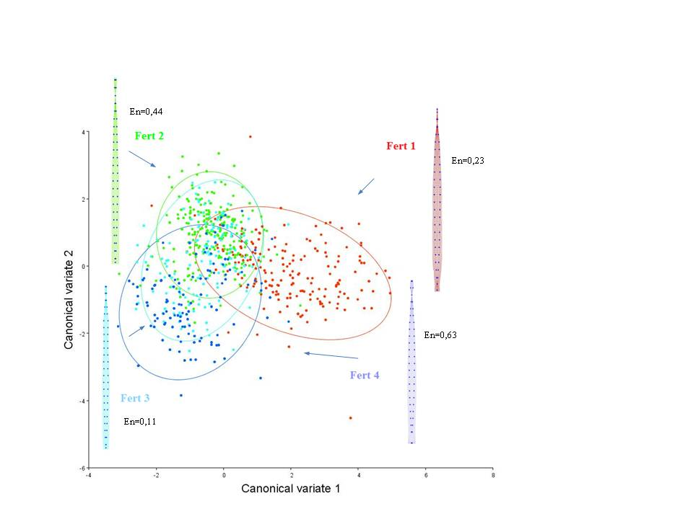
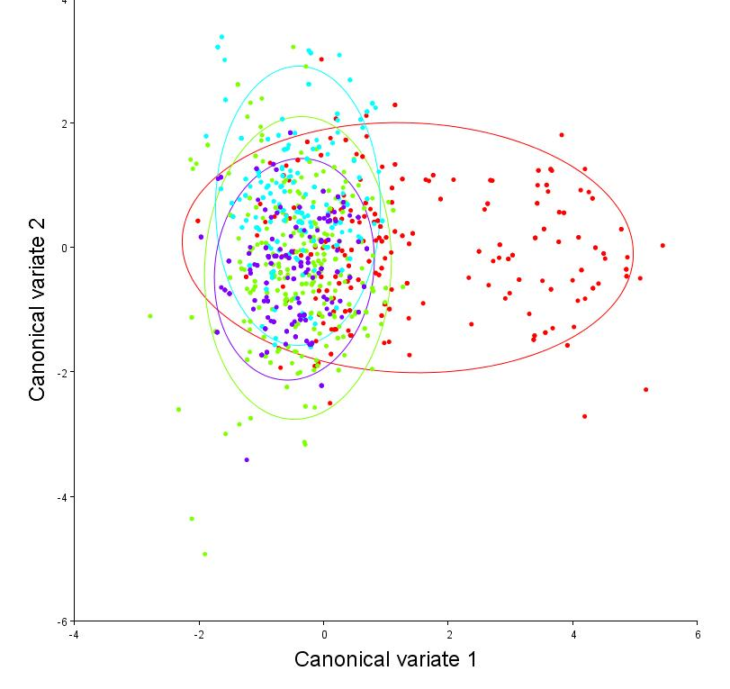
How Differ Components?
Fig. 3. PC1 of symmetry matrix (left) and bending energy. Right: PC1 asymmetry matrix

Slide 5
Strong Difference Between 1st and 4th Dose?
Table.4. The difference in the shape of the leaf blade depending on 4 doses of fertilizer. Procrustes and Mahalanobis distances (in brackets) in the first principal component of the covariance matrix show the highest difference in matrix of asymmetry* – p <0.0001; ns – p >0.05
 | Matrix of symmetry |  |  | Matrix of asymmetry
Dose, № | 1 | 2 | 3 | 1 | 2 | 3
2 | 0.016* (2.753*) |  |  | 0.058* (1.85*)
3 | 0.015* (2.80^{*)} | 0.007* (1.34*) |  | 0.057* (1.89*) | 0.002^{ns} (1.09*)
4 | 0.019* (3.179*) | 0.013* (2.086*) | 0.01* (1.618*) | 0.057* (1.91*) | 0.002^{ns} (0.9*) | 0.002^{ns} (1.13*)
A “true” fluctuating asymmetry was not detected, therefore we can not say the developmental stability is violated. In all samples a statistically significant directional asymmetry was obtained (MS “side”, p <0.05).
To determine the difference among groups, a covariance analysis was performed for the pull of leaves for doses. The first and second canonical variates occupied a large part of the shape variation, which consisted of two components: symmetric and asymmetric. The first (symmetric) component explains the variation in the coordinates of the landmarks along the sheet plate, while the asymmetric component means the variation in pair landmarks.
The thin-plate spline method showed the final distribution of vectors in the procrustes space in the first, most informative principle component, explaining 60-80% of the total variance of landmarks.
Transformation grids demonstrated the conformation of a sheet plate with an uniform, or isometric shift of landmarks. The bending energy of structural distortion of the splines was highest in the 4th group of leaves, both in the asymmetry (BE = 1.17) and in the symmetry component (BE = 0.63).
Thanks

