Slide 1
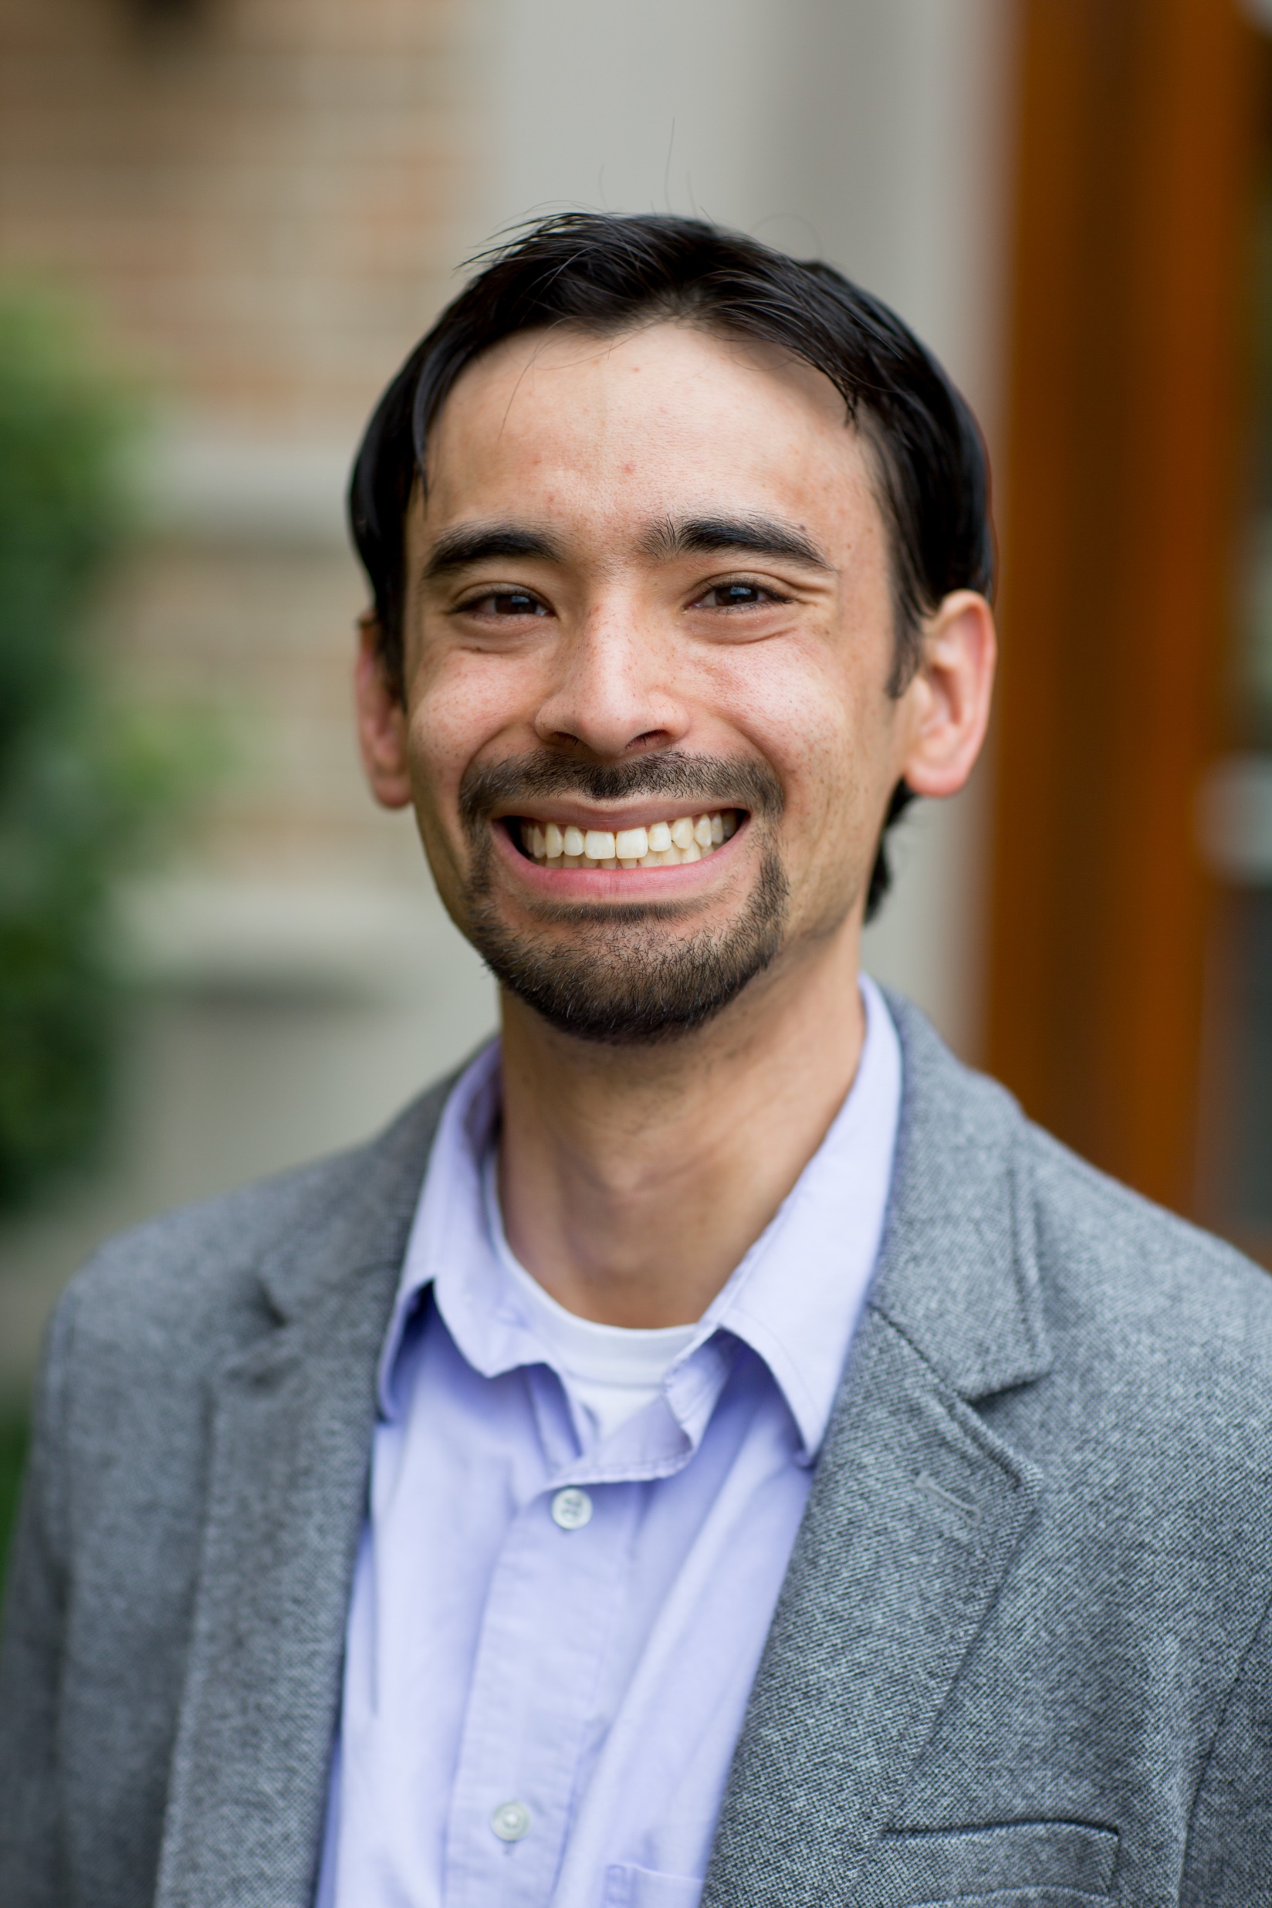
K. James Soda
Assistant Professor of Mathematics, Statistics, and Data Science
Quinnipiac University
Hamden, CT USA

Slide 2
Research Interests
Broad Interests:
Development of novel GM techniques for new questions/systems
Implementation of software to make these techniques accessible
Current Work: Shape Trajectory Analysis
Integrate theory/methods from time series literature into GM
Representations that incorporate emergent properties

Slide 3
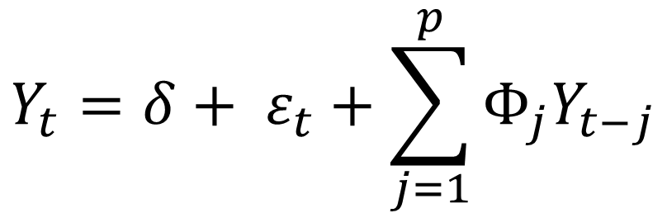
Example Work
Vector Autoregressive Models:
$$Y_{t}=δ+ ε_{t}+\sum_{j=1}^{p}{Φ_{j}Y_{t−j}}$$
Original Trajectory
Trajectory Based on a VAR Model

Slide 4


Learning Goals and Software
Learning Goal: What projects do practitioners wish to pursue that are not well addressed using current methodologies?
Software Used:
(Generally) create my own software using two languages.
Image from https://www.r-project.org/
Image from https://www.python.org/

