Slide 1

Evaluation Warning : The document was created with Spire.PDF for Python.
经济合同与劳动合同
主讲：袁琳

Slide 2
Evaluation Warning : The document was created with Spire.PDF for Python.
劳动合同

Slide 3
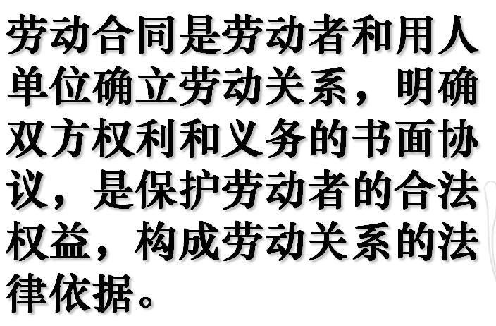
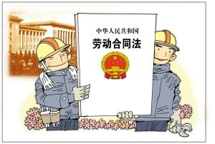
Evaluation Warning : The document was created with Spire.PDF for Python.
一、劳动合同的内涵

Slide 4
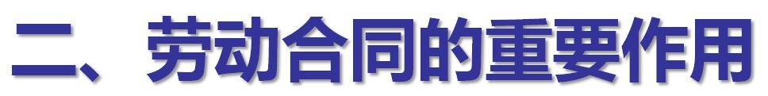
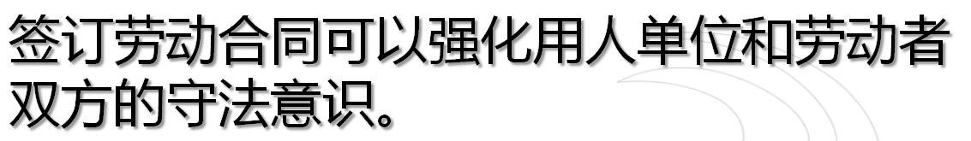
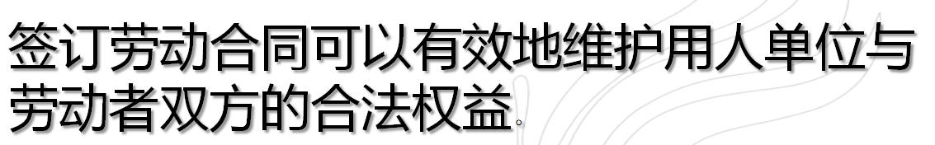
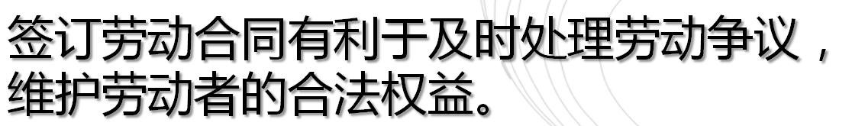
Evaluation Warning : The document was created with Spire.PDF for Python.
Evaluation Warning : The document was created with Spire.PDF for Python.

Slide 5

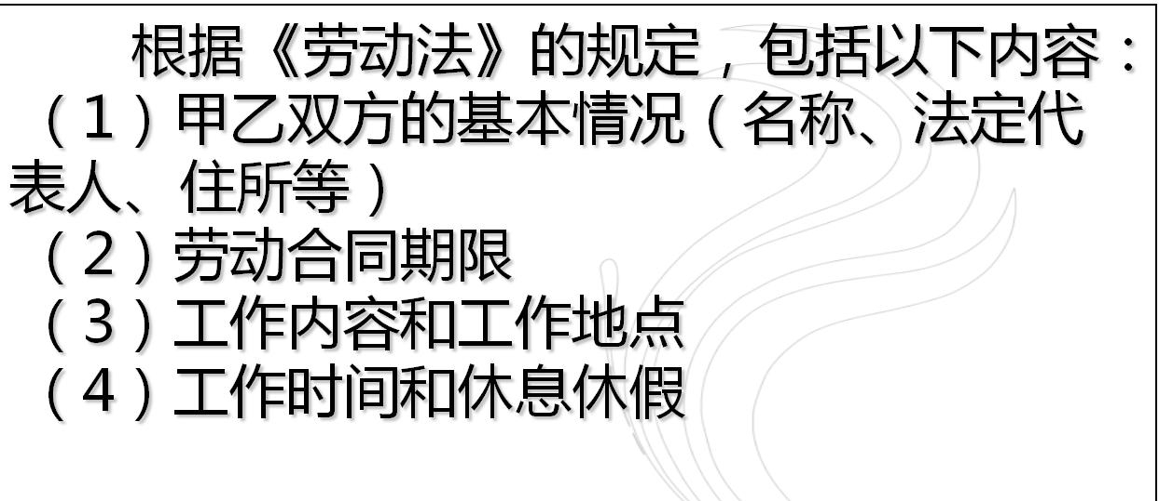
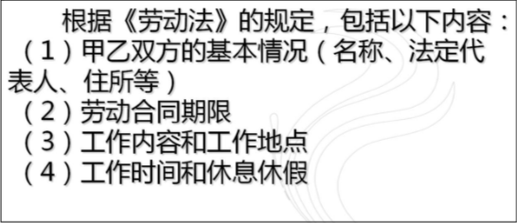
Evaluation Warning : The document was created with Spire.PDF for Python.
Evaluation Warning : The document was created with Spire.PDF for Python.

Slide 6
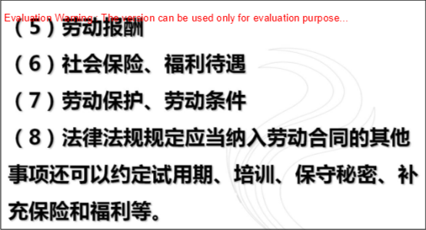

Slide 7

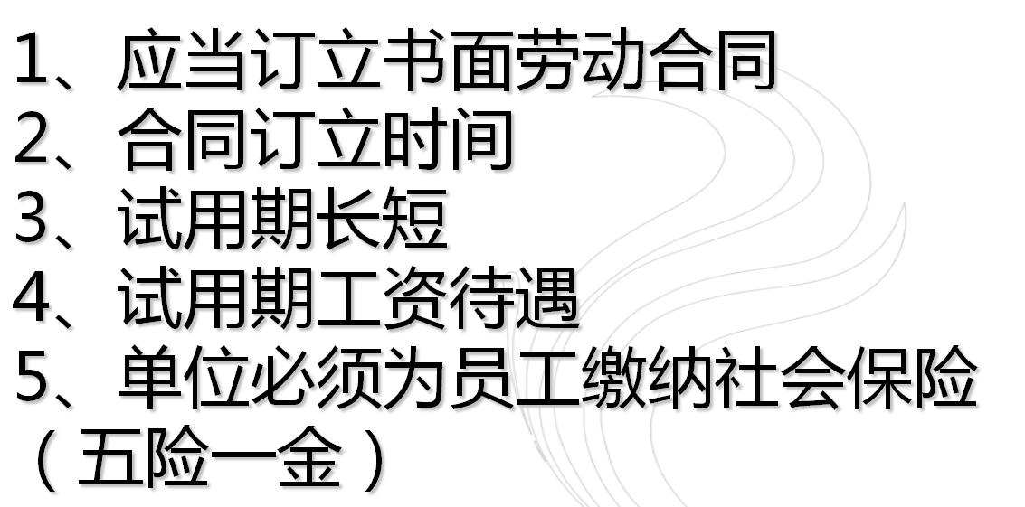
四、签订劳动合同注意事项
Evaluation Warning : The document was created with Spire.PDF for Python.

Slide 8
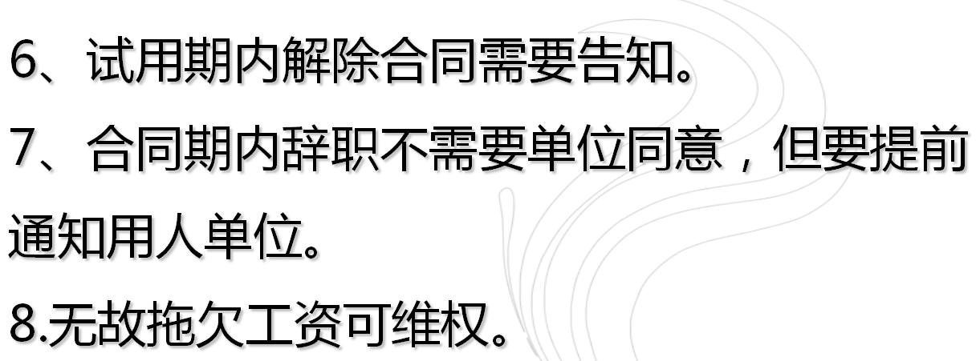
Evaluation Warning : The document was created with Spire.PDF for Python.
Evaluation Warning : The document was created with Spire.PDF for Python.

