Slide 1
Analysis of development tools used in blockchain-based projects
Tuesday, July 21, 2020

Slide 2
15
Total Responses
Date Created: Friday, April 10, 2020
Complete Responses: 15

Slide 3
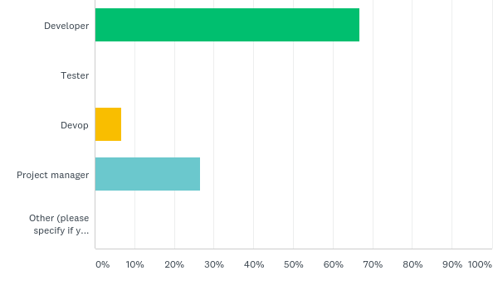
Q2: What is your main roles in the project?
Answered: 15 Skipped: 0

Slide 4
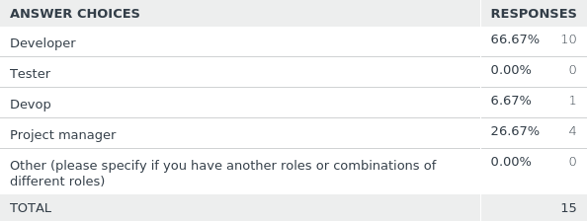
Q2: What is your main roles in the project?
Answered: 15 Skipped: 0

Slide 5
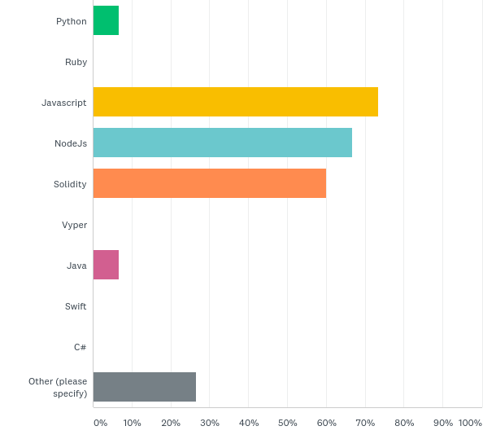
Q4: What are the main programming languages used in the project?
Answered: 15 Skipped: 0

Slide 6
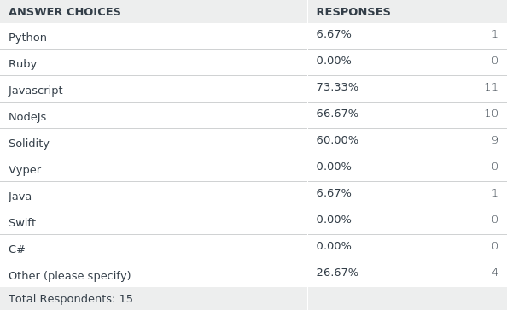
Q4: What are the main programming languages used in the project?
Answered: 15 Skipped: 0

Slide 7
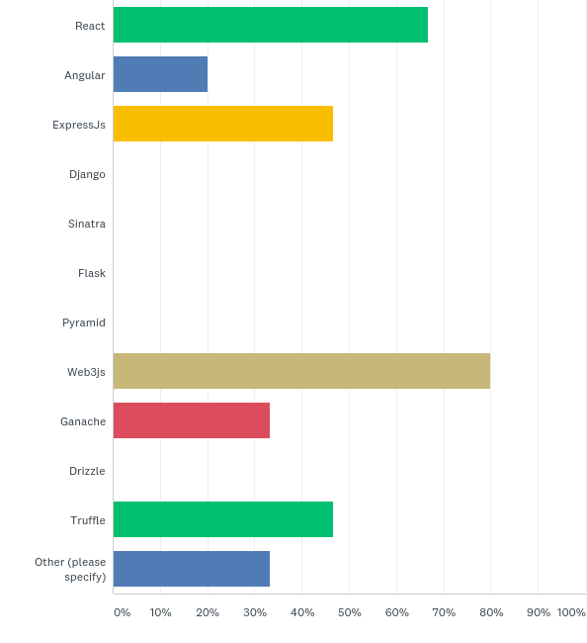
Q5: Which tools or frameworks have been used for developing?
Answered: 15 Skipped: 0

Slide 8
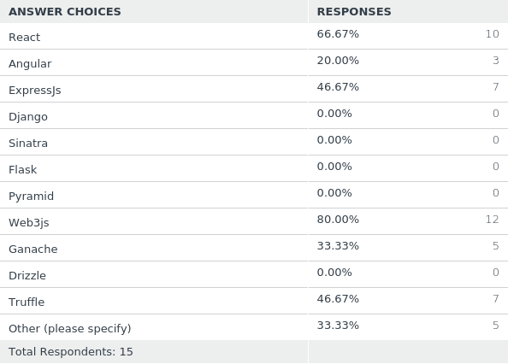
Q5: Which tools or frameworks have been used for developing?
Answered: 15 Skipped: 0

Slide 9
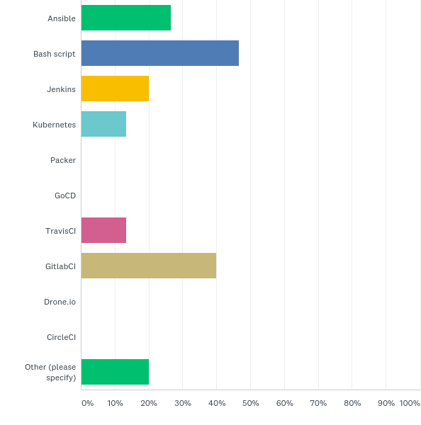
Q6: Which tools have been used during deployment?
Answered: 15 Skipped: 0

Slide 10
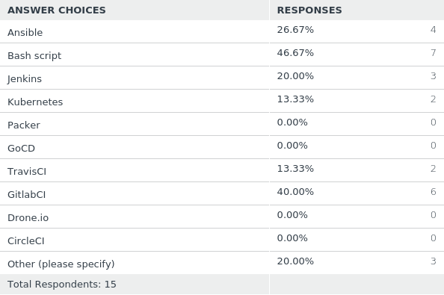
Q6: Which tools have been used during deployment?
Answered: 15 Skipped: 0

Slide 11
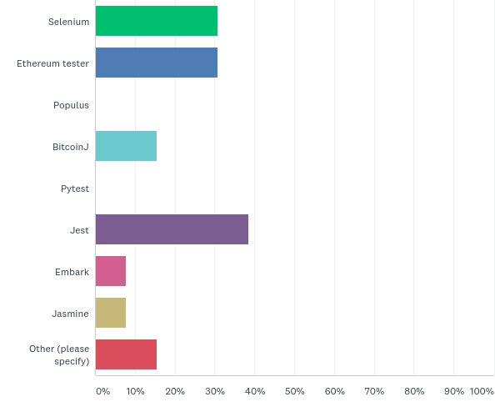
Q7: Which tools have been used for testing?
Answered: 13 Skipped: 2

Slide 12
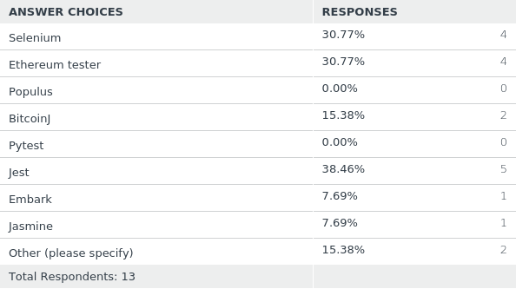
Q7: Which tools have been used for testing?
Answered: 13 Skipped: 2

Slide 13
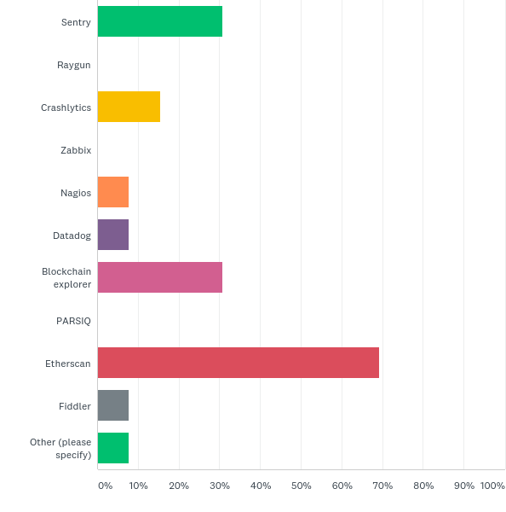
Q8: Which tools have been used for monitoring or logging management?
Answered: 13 Skipped: 2

Slide 14
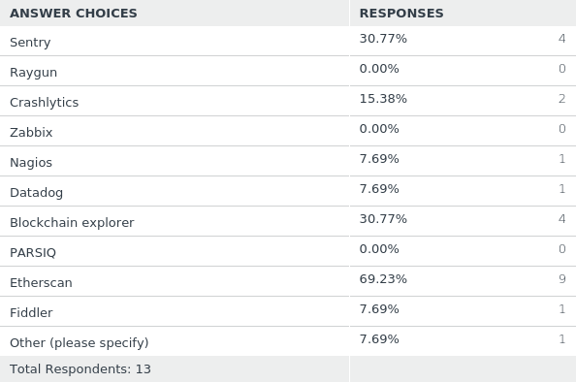
Q8: Which tools have been used for monitoring or logging management?
Answered: 13 Skipped: 2

Slide 15
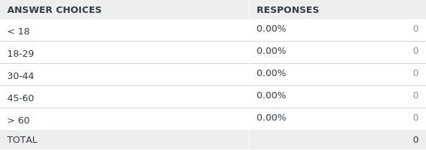
Q11: Age
Answered: 0 Skipped: 15

Slide 16
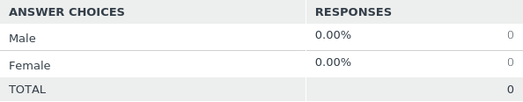
Q12: Gender
Answered: 0 Skipped: 15

Slide 17
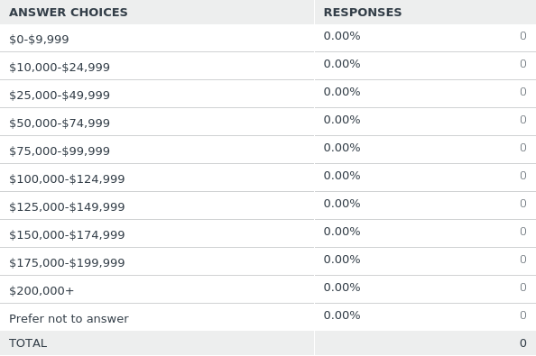
Q13: Household Income
Answered: 0 Skipped: 15

Slide 18
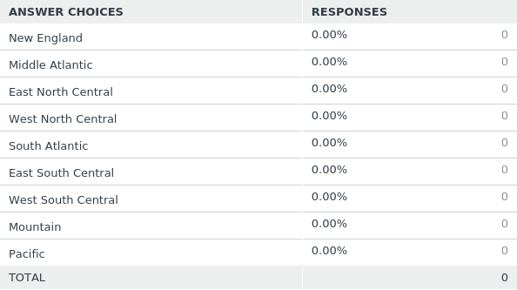
Q14: Region
Answered: 0 Skipped: 15

Slide 19
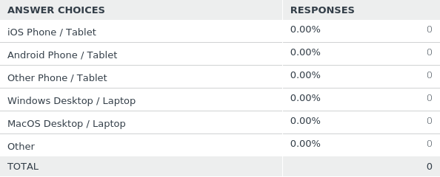
Q15: Device Type
Answered: 0 Skipped: 15

