Slide 1
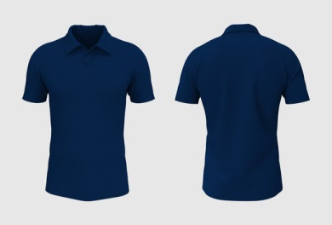

MALE PARTNERS | FEMALE PARTNERS
Polo shirt with Black pants/slacks and black shoes | Tucked-in Polo shirt with black pants/slacks and black shoes with heels

