Slide 1
One loop turns camera frames into actionable guidance
main.py starts visual_guide_runtime.py; config.py supplies every switch and threshold.
CONTROL LAYER
config.py
Capture
Perceive
Assess
Caution
Camera
320 × 240 · 30 FPS
Detection
thresholds · intervals
Risk
growth · speed · direction
Output
beep / speech · repeat limits
camera_api.py
detection_api.py
guidance_api.py
risk_api.py
warning_api.py
output_api.py
Open camera
read fresh frame
Background + motion
YOLO recognition
Direction · closeness
approach grade
Stable message
terminal + audio
The runtime repeats this path for every frame until the user quits or the camera is lost.
Architecture principle: fast OpenCV signals decide danger; YOLO adds identity.
01
Notes:
Start from config.py: it is the project's control panel for camera, detector sensitivity, YOLO, risk grading, stability, and audio behavior.
main.py only calls run_visual_guide_session(). The runtime constructs the camera, three detection sources, the stabilizer, and the approach-risk tracker.
For each frame the same pipeline runs: capture, perceive, assess, then caution. This separation makes each module testable and lets us tune behavior without rewriting the loop.

Slide 2
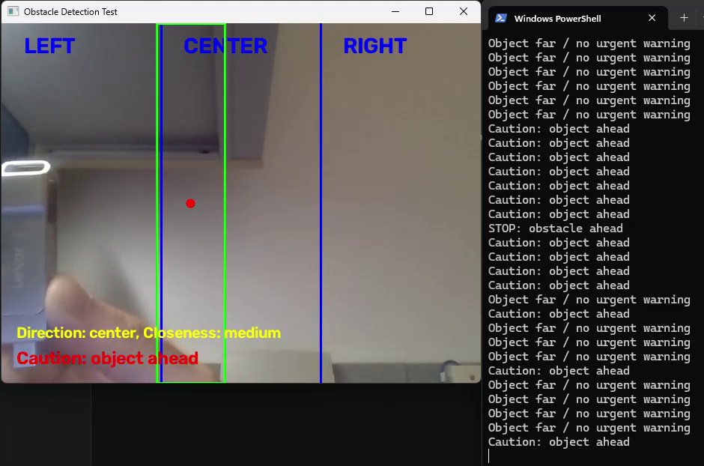
The camera minimizes latency and builds a stable baseline
CAMERAAPI.START()
1
Open the fastest backend
V4L2 on Raspberry Pi/Linux; DirectShow on Windows.
2
Request a responsive stream
320 × 240, 30 FPS, one-frame buffer; resize if the camera returns another size.
3
Discard stale frames
cap.grab() drops two buffered frames before reading the newest one; failed reads retry three times.
4
Capture the empty scene
After a 1-second settle, the median of 12 frames becomes the background reference.
Real test frame: object center → direction; box size → closeness; warning appears in the overlay and terminal.
02
Notes:
The camera is monocular: it supplies ordinary color frames, not depth data.
Low resolution and buffer control reduce lag. Dropping old frames is important because a safety warning based on an old image can be worse than no warning.
Before the continuous loop, the system asks for an empty view and builds a median background from 12 frames. Median capture is robust to a brief moving object or exposure fluctuation.

Slide 3
Danger comes from change, size, position, and approach
BACKGROUND
MOTION
YOLO
What entered the scene?
What is moving now?
What is the object?
Absolute difference from the saved empty view
Blur → threshold 14 → clean mask → contours ≥ 550 px
Runs every 2 frames; must persist for 2 processed cycles
Difference between consecutive frames
Threshold 18 → contours ≥ 450 px
Runs every frame and prioritizes actively moving candidates
Runs every 10 frames at 320 px
Recognizes person, chair, car, bicycle
By default it labels a matched candidate; it does not trigger a warning alone
SELECT
Close + center wins
GRADE APPROACH
Growth + trajectory + speed
10% frame area = medium · 25% = close
box grows · distance falls · moves center/down · moves fast
Risk score ≥ 4 medium · ≥ 6 high
03
Notes:
There are two fast danger signals. Background difference finds anything that changed from the empty scene; frame-to-frame difference finds active motion.
Contours become bounding boxes. Very small regions are rejected as noise, and boxes covering too much of the image are rejected because camera movement can create one huge false region.
The primary candidate is selected mainly by closeness, then center direction, vertical position, source priority, and size.
YOLO answers 'what is it?' and is intentionally not the safety authority by default. Approach risk uses up to eight observations and requires size growth or falling estimated distance before lateral motion can become serious.

Slide 4
Warnings escalate only when the evidence is stable
01
02
03
04
Stabilize
Classify
Upgrade
Deliver
Smooth the box; hold a missed detection for 2 frames. Normal text must persist 4 frames; urgent stop can pass in 1.
Far + not approaching: silent
Medium center: caution
Close center: stop
Medium/high approach can promote a far object to caution. Close + center + approaching becomes an urgent stop.
Print stable text. Use non-blocking audio so the camera loop never waits for a beep or speech.
CAUTION POLICY
“Caution. approaching car ahead.”
Anti-spam
→ terminal warning + vehicle/approach beep
beep ≥ 2 s apart · urgent repeat 5 s · normal repeat 8 s
04
Notes:
A raw detection is not announced immediately. The box is smoothed, brief dropouts are held, and warning text must remain stable before it replaces the current output.
The message rules are simple to explain: far objects are ignored unless the approach tracker says medium or high risk; medium center objects receive caution; close center objects receive stop.
Audio is non-blocking. In the current beep configuration, audio is reserved for an approaching object ahead or for a warning containing a recognized car or bicycle. Repetition limits prevent continuous alarm fatigue.
Close by emphasizing that the system combines responsiveness with filtering: it reacts quickly to an urgent center danger but suppresses flicker, lateral-only motion, and repeated messages.

