Slide 1

DySAS Dynamic Skill Assessment System
GROUP 18: Yatn Bangad 1901222
Ujjwal Goel 1901209
Soumyajit Karmakar 1901200
CS331
Dr. Angshuman Jana

Slide 2
Index
About DySAS
User characteristics
Models for design
Implementation details
Individual contribution

Slide 3
About DySAS

Slide 4
Brief Introduction
Examinations are a very integral part of everyone’s life. It provides a platform where people can prove their knowledge and capabilities. As exams are used to determine a person's success and career, it is really important to ensure that these actually provide a fair opportunity to everyone.
We believe the age-old method of having a fixed set of question paper does not satisfy these criteria properly. A few decades back when internet and the other technologies were not available, it was the only option, but now with all these advancements we believe we can reinvent and improve the process of examination to make it more convenient for both the examinees and the examiner.
We believe having a fixed set of questions for evaluation induces bias in the results. If the exam is easy, then the density at the higher end increases as more and more people get good marks, thus differentiating the examinees become difficult. Similarly, tougher exams increase the density at the lower end, and thus differentiating becomes difficult again.
Setting a perfectly balanced paper is a really difficult task which requires a lot of time which could have been used in other useful purposes otherwise.

Slide 5
Idea: Examinee point-of-view
We propose a software which creates the question paper for each examinee on the fly, depending on the current performance of the person.
If a student is able to correctly answer some questions in a row, then the difficulty and the marks of the subsequent questions would be increased to allow the student to show his/her true potential.
On the other hand, if a student is unable to answer some questions, then the difficulty and marks of the subsequent questions would be reduced to allow the examinee to attempt whatever he/she has prepared.
This makes sure that the exam is able to capture the examinee’s capabilities properly.

Slide 6
Idea: Examiner point-of-view
For the examiner, a dedicated question bank is set up where he/she can upload questions long with its difficulty all year round.
At the time of exam, the examiner has to determine the duration and the software will automatically pick questions from the bank.
This approach saves time and effort of the examiner while reducing any kind of bias in the paper.

Slide 7
User characteristics

Slide 8
User characteristics
Our users can be divided into 2 categories:
Administrators:
These users are essentially the teachers of the class.
They are granted the privilege to create classrooms, tests, validate results and respond to objections raised.
Users:
These users are essentially the students of the class.
They are made a part of classes by their administrators and are then allowed to give tests, view results and raise objections if they feel so.

Slide 9
Design models

Slide 10
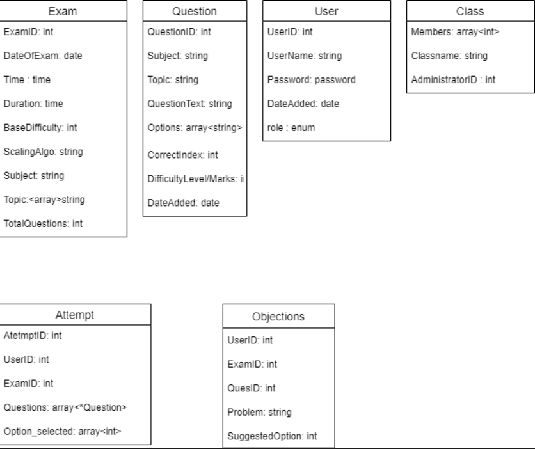
Entity Relationship Diagram (ERD)

Slide 11
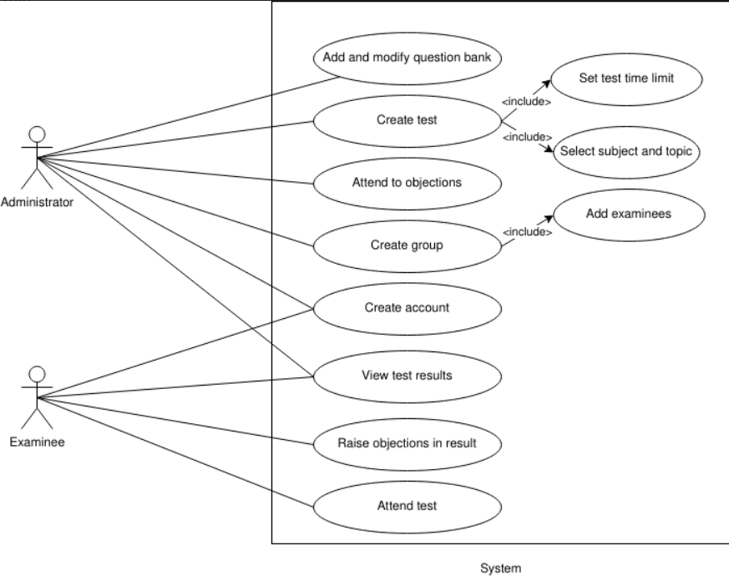
Use Case Diagram (UCD)

Slide 12
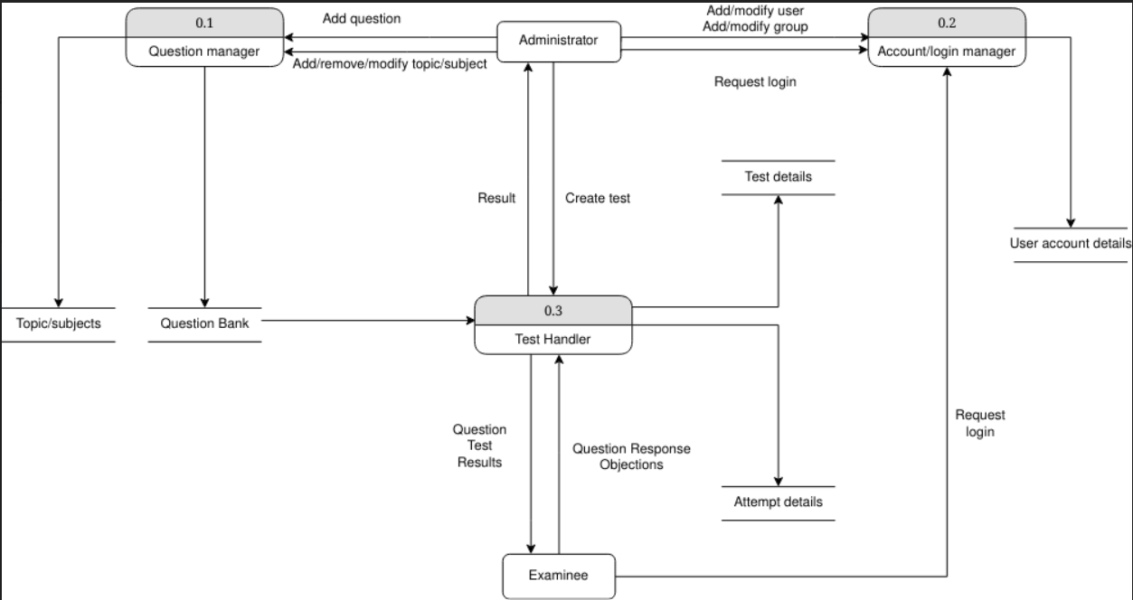
Data Flow Diagram (DFD)

Slide 13
Implementation details

Slide 14
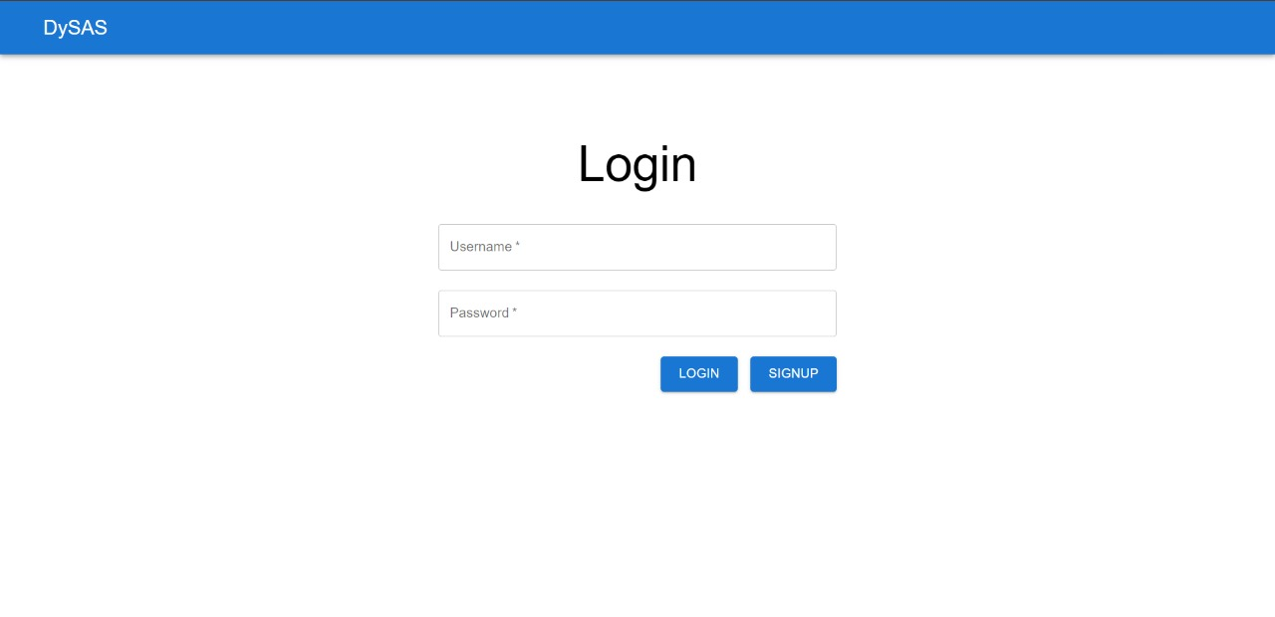
Login Page
The login page has a simple UI for validating a person’s identity.
Both the examiner and the examinee have the same login page.
After entering the credentials, the user is shown either the Examinee homepage or the Examiner homepage.

Slide 15
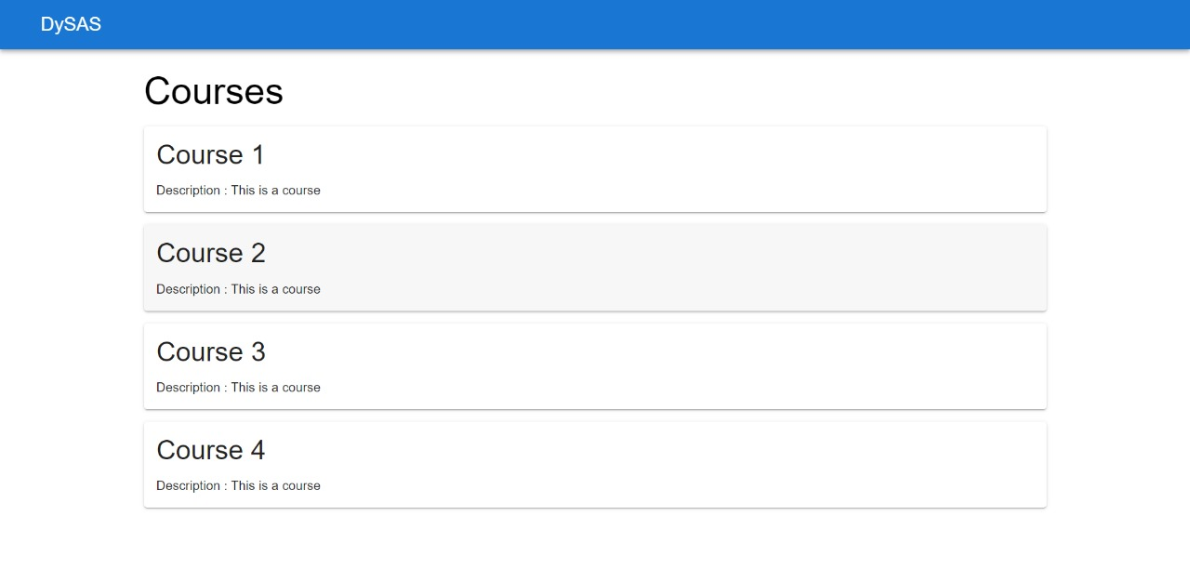
Examinee Homepage
This is the page which displays a list of all the courses taken by the student.
When an examinee select any of the courses, they are shown the respective exams assigned to them.

Slide 16
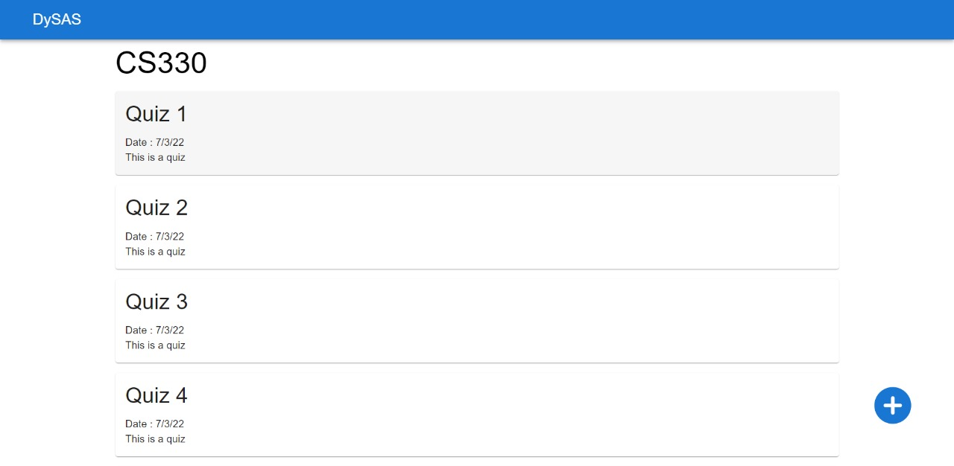
Examinee Course page
This page displays all the exams for the selected course (in order of their date and time).
This has color coding to differentiate between attempted exams and upcoming exams.
It shows if there are any upcoming exams for a subject.

Slide 17
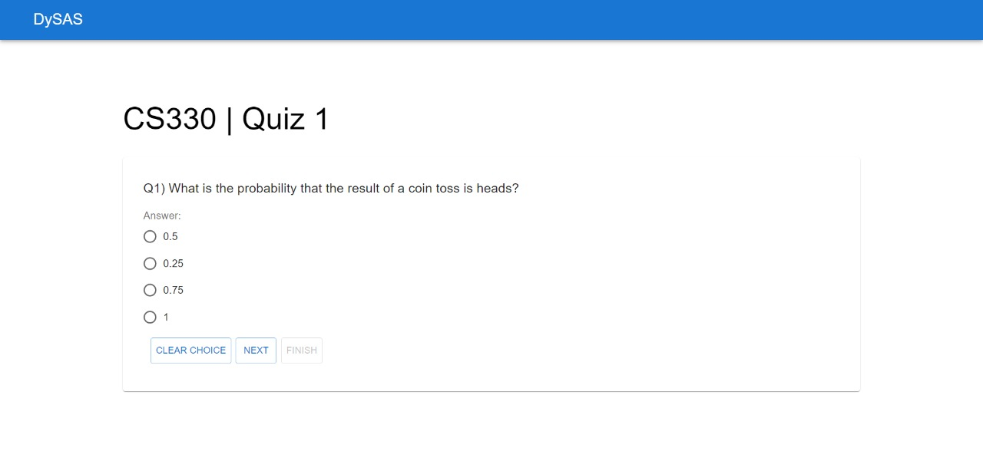
Exam Page
This is the main page for attempting the exam.
The UI is made as clutter-free as possible to prevent any kind of distraction.
At the top, it has a timer and the question number currently attempting.
At the bottom are three simple buttons for Finishing, Skipping and Continuing to next question.

Slide 18
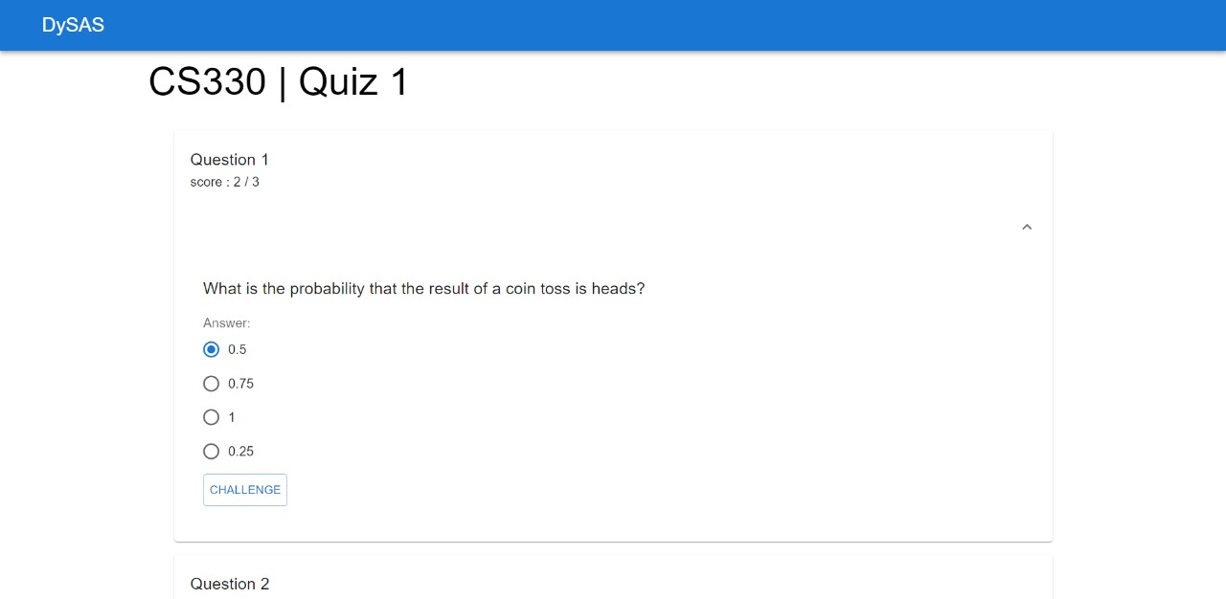
Result Page
This page provides details about the past exams.
Details we show include:
Final score
Number of questions attempted
All the questions along with their correct answers are conveniently arranged.

Slide 19
Examiner Homepage
This page displays a list of all the courses taught by the examiner.
There is also an option to create a new course.
On selecting a course, the examiner is taken to the Examiner Course page

Slide 20

Examiner Course Page
The middle portion shows all the exams taken.
On the bottom right is a link to add a test.
It shows scheduled exams for the students as well.

Slide 21
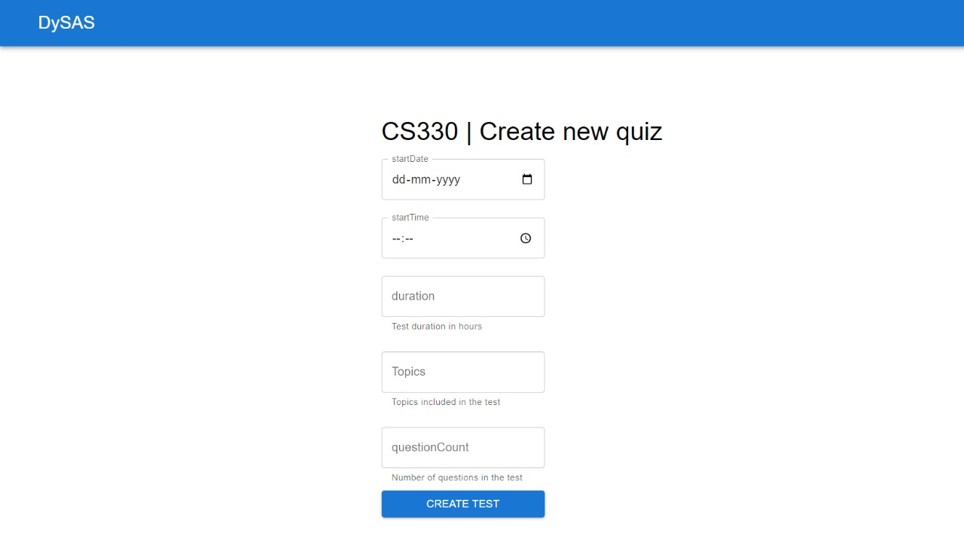
Question Bank and Create Exam Page
Lastly, we have two form like pages.
One of them is used to add new questions in the question bank for a subject.
While the other is to set the details for an exam.

Slide 22
Individual Contribution
Soumyajit Karmakar (1901200): SRS, ERD, Backend Database structure using MongoDB Atlas and Slides
Yatn Bangad (1901222) : Frontend using React & auth backend, testing using Mocha and Chai, SRS functional requirements
Ujjwal Goel (1901209): API, database connection and queries, UI (login page, courses page)

Slide 23
Thank you!

