Slide 1
Workshop: Programming With Dyalog APL
ECUST, July 5th 2018
Morten Kromberg
(based on work by Jay Foad, Roger Hui & John Scholes)

Slide 2
Agenda
Morning
Install APL
Introduction to APL
Exercises
Afternoon
A quick look at tools for
Importing Data from Excel
Charts
Review of MatLab code (SA_Cal) converted to APL
Gitte + Morten depart for airport at 2PM

Slide 3
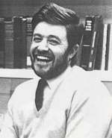
History of APL
Canadian of Norwegian Descent
Born on a small farm in Alberta (Canada)
Finished one-room school after 9th grade and worked on the farm
Army 1942, Flight Engineer in Air Force from 1943
Almost finished High School in the service
Promised his officers and mates that he would pursue an academic career after the war
B.A. from Queens University, Kingston Ontario
Ken didn’t know there was such a thing as University before he joined the army!
Kenneth E. Iverson 1920-2004
APL Workshop, ECUST July 5th 2018
Notes:
Enjoyed teaching his mates math in the armed forces

Slide 4
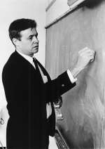
History of APL, continued
Doctoral work at Harvard with Aiken and Leontief
Taught at Harvard for 6 years,
frustrated with inadequacies of mathematical notation
Developed ”Iverson Notation” in response
Published ”A Programming Language” in 1962
Failed to get tenure at Harvard; moved to IBM
Used APL for modelling and teaching
First APL Interpreter in 1966
IBM Fellow in 1970
J (”rationalised APL”) from ca. 1989
ACM Turing award in 1979:
“For his pioneering effort in programming languages and mathematical notation resulting in what the
computing field now knows as APL, for his contributions to the implementation of interactive systems, to educational uses of APL, and to programming language theory and practice.”
Notes:
Leontied was awarded the Nobel Prize for Economics in …?

Slide 5











Syntaxes of Mathematics
Problems:
- Wide variety of syntactical forms
- Strange and inconsistent precedence rules - Things get worse when you deal with matrices See http://www.jsoftware.com/papers/EvalOrder.htm
APL Workshop, ECUST July 5th 2018

Slide 6
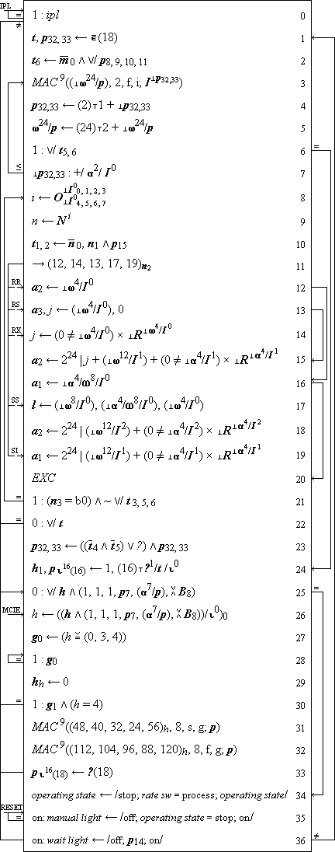
Iverson Notation: Description of IBM\360

Slide 7
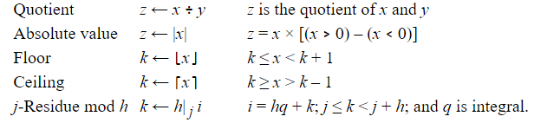
A Programming Language
The book, 1962
APL Workshop, ECUST July 5th 2018

Slide 8
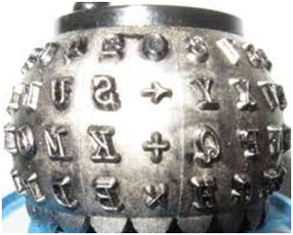
Linearization => APL\360
The 5: Ken Iverson, Adin Falkoff, Larry Breed, Dick Lathwell, Roger Moore. Operated by “Quaker Consensus”.
APL Workshop, ECUST July 5th 2018

Slide 9
A Programming Language (for Mathematics)
a×b
Mat1 +.× Mat2
*x
f g x
(f+g) x
x÷y
(3○x)*2
b⍟a
+/4×⍳6 ×/4×⍳6
a*÷n
(2×a)÷⍨(-b)(+,-)0.5*⍨(b*2)-4×a×c
APL Workshop, ECUST July 5th 2018

Slide 10
APL Was Born...
The first running system started running in November of 1966.
Let's do some exercises.

Slide 11
Exercises
The folder "Exercises" contains numbered files, starting with "01-syntax.txt"
Enter each expression (line)

Slide 12
Saving Your Work
Historically, APL users have saved workspaces containing code and data as a single file
Similar to an Excel Spreadsheet
Takes a ”snapshot of the VM”
Beware: also saves the execution stack if there is one
Save your work using )save /path/mywsname[.dws]
Load it again with )load /path/mywsname
You can extract named objects from a workspace: )copy /path/mywsname foo goo x y
Saved workspaces can have a ”latent expression” ⎕LX, which is executed when the workspace is loaded, unless you )xload /path/mywsname
APL Workshop, ECUST July 5th 2018

Slide 13
Saving Your Work, continued
In the last few years, it has become more popular to use Unicode text files (and SVN/GIT), especially for source code
You can save a fn/var, namespace or class using]save (]save is a ”user command” - written in APL): ]save name /path/name[.dyalog] (it is customary to use the same name for the file)
You can bring it back into the active workspace using ]load /path/name ]load /path/*
If you edit objects that were ]loaded, the system will offer to update the file each time you make a change
From version 15.0, the interpreter (editor) knows how to open and view source files without user commands.
APL Workshop, ECUST July 5th 2018

Slide 14
Reading APL
CB←{⍵[1+(⍴⍵)|X∘.+X←(⍳⍺)-1]}
Imagine arguments: 8 CB ' ⎕'
APL Workshop, ECUST July 5th 2018

Slide 15
Reading APL
What does this function do?
{(~R∊R∘.×R)/R←1↓⍳⍵}
Or:
{{(~⍵∊⍵∘.×⍵)/⍵}1↓⍳⍵}

Slide 16
Procedures / Tradfns
Monadic:
∇ R←Sum X
[1] R←+/X
∇
Dyadic:
∇ R←A MatMult B
[1] R←A+.×B
∇
Niladic:
∇ Run
[1] ⎕←'Boo Hiss!'
∇

Slide 17
Procedures / Tradfns
”Ambi-valent” (+ use a control structure)
∇ R←{Window} Sum X
[1] :If 0=⎕NC 'Window' ⋄ R←+/X [2] :Else ⋄ R←Window +/ X
[3] :EndIf
∇

Slide 18
Procedures / Tradfns
Name Elements of Right Argument
+ Local Variable
+ Class / DotNet declarations
∇ r←Round(n decimals);base
[1] :Access Public Shared
[2] :Signature Double←Round Double N, Int32 Decimals
[3] base←10*decimals
[4] r←(⌊0.5+n×base)÷base
∇

Slide 19
Errors
1 2 3÷4 5 LENGTH ERROR 1 2 3÷4 5 ∧
⎕EN 5
1÷0 DOMAIN ERROR: Divide by zero 1÷0 ∧
⎕EN (⎕EM 11)
11 DOMAIN ERROR
⎕DMX.Message Divide by zero

Slide 20
Errors
18 FILE TIE ERROR
19 FILE ACCESS ERROR
20 FILE INDEX ERROR
21 FILE FULL
22 FILE NAME ERROR
23 FILE DAMAGED
24 FILE TIED
25 FILE TIED REMOTELY
26 FILE SYSTEM ERROR
28 FILE SYSTEM NOT AVAILABLE
30 FILE SYSTEM TIES USED UP
31 FILE TIE QUOTA USED UP
32 FILE NAME QUOTA USED UP
34 FILE SYSTEM NO SPACE
35 FILE ACCESS ERROR - CONVERTING FILE
36 INCOMPATIBLE ARRAY
38 FILE COMPONENT DAMAGED
1 WS FULL
2 SYNTAX ERROR
3 INDEX ERROR
4 RANK ERROR
5 LENGTH ERROR
6 VALUE ERROR
7 FORMAT ERROR
10 LIMIT ERROR
11 DOMAIN ERROR
12 HOLD ERROR
13 OPTION ERROR
15 LST FULL
16 NONCE ERROR
17 ACCESS ERROR

Slide 21
Error Trapping: Dfns
div←{0::'Something Else is Wrong' 11::0 ⍝ DOMAIN error: return 0 ⍺÷⍵}
3 div 0 0
1 2 3 div 4 5 Something Else is Wrong

Slide 22
Error Trapping: Tradfns
Using :Trap
∇ R←A DIV B
[1] :Trap 0
[2] R←A÷B
[3] :Case 11 ⋄ R←0 ⍝ DOMAIN error
[4] :Else ⋄ R←'Something Else is Wrong'
[5] :EndTrap
∇

Slide 23
Error Trapping: Tradfns
Using ⎕TRAP
∇ R←A DIVQ B;⎕TRAP
[1]
[2] ⎕TRAP←(11 'E' '→DOMERR')(0 'C' '→CATCHALL')
[3] R←A÷B ⋄ →0
[4]
[5] DOMERR:→R←0
[6] CATCHALL:R←'Something Else is Wrong'
∇

