Slide 1
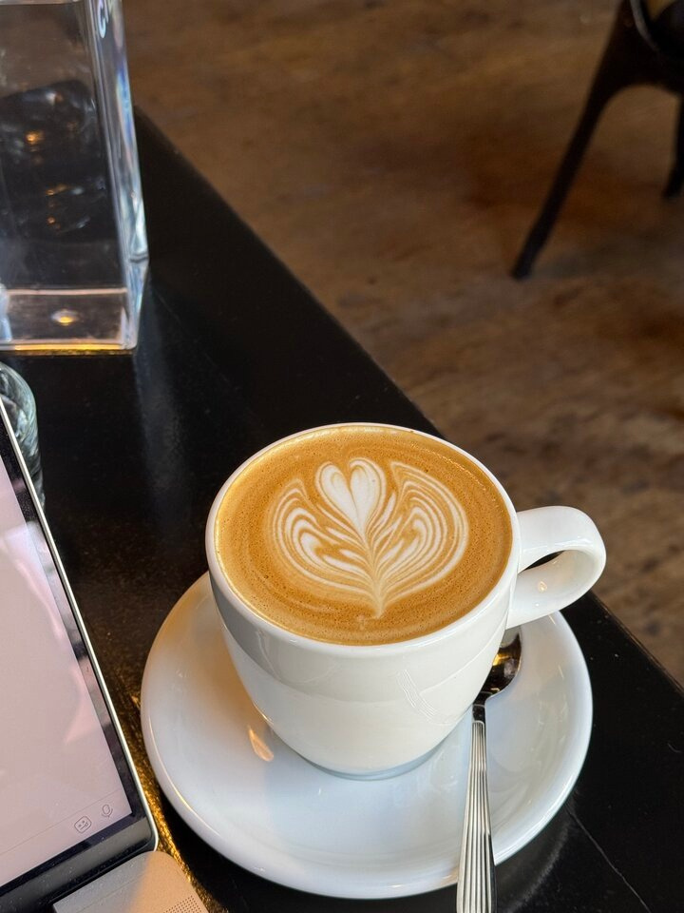
Coffee Shop Analysis
Driving Business Growth: Sales Forecast Analysis (Jan - June2023)
Presented by Sivuyile Langa
1

Slide 2
Presentation Outline
1.Project Overview
2.Overall Bright Coffee Shop Sales Trends 3.Cross Store Comparison Analysis 4.Recommendations
2

Slide 3
Project Overview
The objective of this project is to analyze sales performance across products, time periods, and store locations in order to identify key drivers of revenue, optimize the product mix, and recommend strategies to maximize growth, profitability, and customer engagement.
3

Slide 4
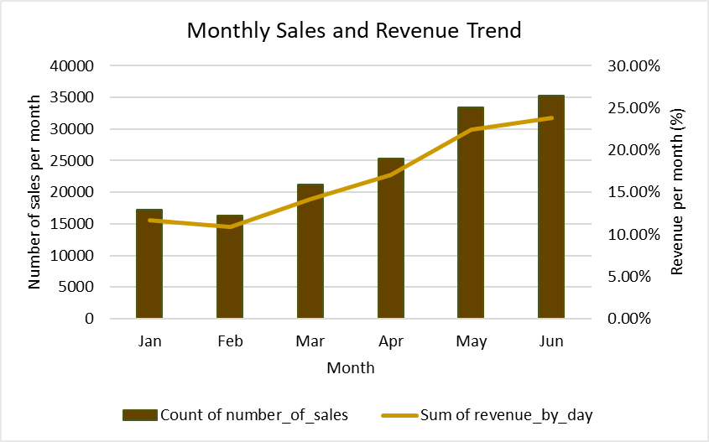
Monthly Sales Growth and Revenue Trends
Description
Spending Levels
% of Revenue
% of Customer Count
Low spend
R00.00 - R50.00
99.44%
99.95%
Medium spend
R51.00 - R150
0.52%
0.04%
High spend
R151.00 - R250.00
0%
0%
Ballers
R251 or more
0.05%
0.01%
Key Insights
Strong correlation between sales volume and revenue growth (positive growth trends).
Total revenue contribution increases from 11.69% (Jan) to 23.82% (Jun), with peak performance in June (23.82%) followed by May
February records the lowest sales and revenue contributing 16308 in sales volume and 10.90% in revenue.
Most revenue is generated from customers who spend =< R50 and this segment accounts for 99.95% of customer volume.
4

Slide 5
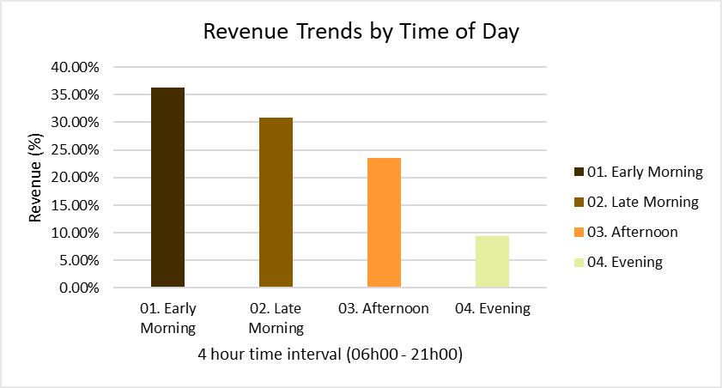
Sales Trends Across Time Intervals (Jan–Jun)
Description
Time Interval
% of Revenue
% of Customer Count
Early Morning
06:00:00 - 09:59:59
36.25%
35.77%
Late Morning
10:00:00 - 13:59:59
30.85%
30.66%
Afternoon
14:00:00 - 17:59:59
23.51%
24.03%
Evening
18:00:00 - 21:00:00
9.40%
9.53%
Key Insights
Early Morning has the highest share of revenue at 36.25%, followed by Late Morning at 30.85%. The Evening period has the lowest revenue share of 9.40%: indicating lower sales activity. Early Morning and Late Morning account for the majority of customers by 66.43: highlighting that morning is the peak period.
5

Slide 6
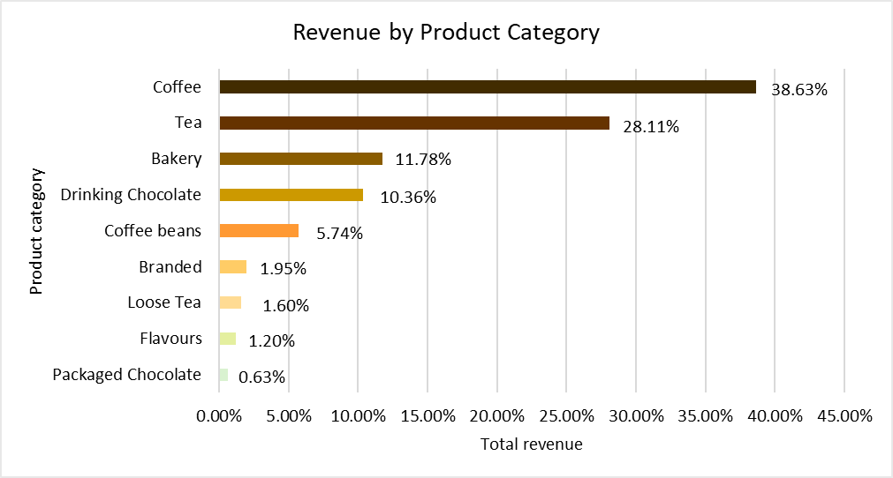
Product Category Performance Overview
Top 3 Best Performing Products
1. Coffee
2.Tea 3.Bakery
Bottom 3 Worst Performing Products
1. Packaged Chocolate 2. Flavours 3. Loose Tea
▼
Key Insights
Coffee generates the highest revenue at 38.63%, making it the top-performing product category. Tea follows with 28.11% of the total revenue. Loose Tea, Flavours and Packaged Chocolate represents low revenue products accounting for combined 3.43% revenue.
Coffee(39.21%) and Tea (30.54%) dominate product sales followed by Bakery (15.16%) and Drinking Chocolate (7.71%) indicating these are popular complementary items..
Loose Tea, Flavours and Packaged Chocolate have minimal share of product sold contributing by 1.64%.
6

Slide 7
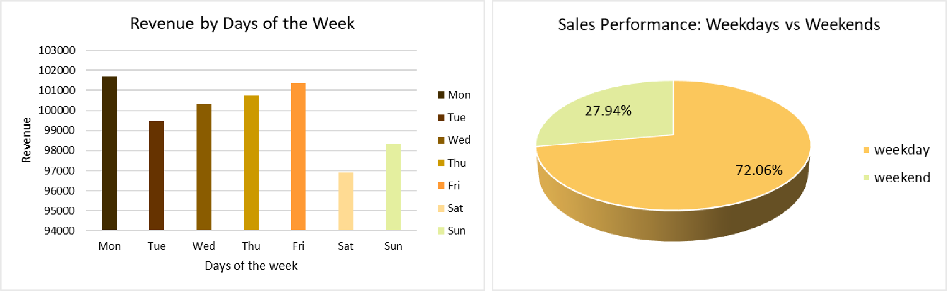
Weekly Revenue Insights: Top Performing Days
Key Insights
Mondays generates the most revenue (R101,677) , closely followed by Fridays R101,373.
Saturday generates the least revenue "R96,894".
Weekdays generate the highest revenue accounting for 72.06% of the total revenue and 72.09% of products sold
7

Slide 8
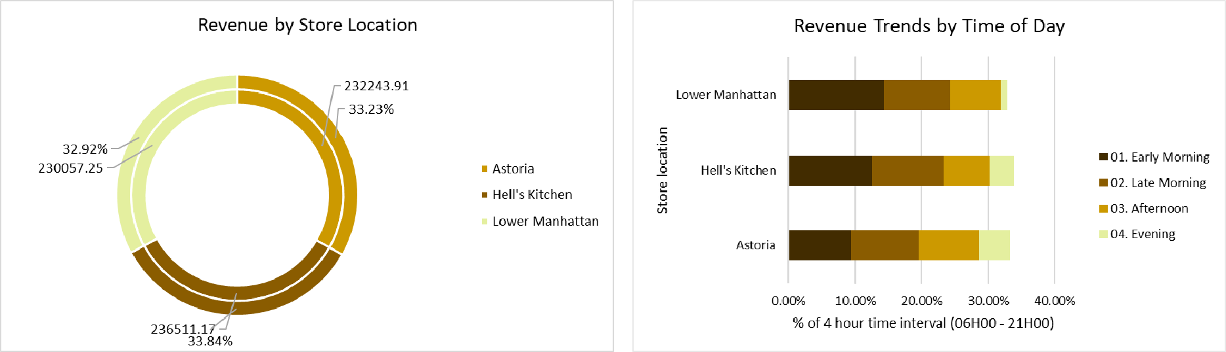
Revenue Performance Across Store Locations
Key Insights
Hell's Kitchen slightly leads in revenue by 33.84%. Astoria follows by 33.23%.
Sales performance is low across all stores during the evening contributing 9.53% of total revenue
All stores peak during the morning drive with Lower Manhattan contributing 24.24% of total revenue
8

Slide 9
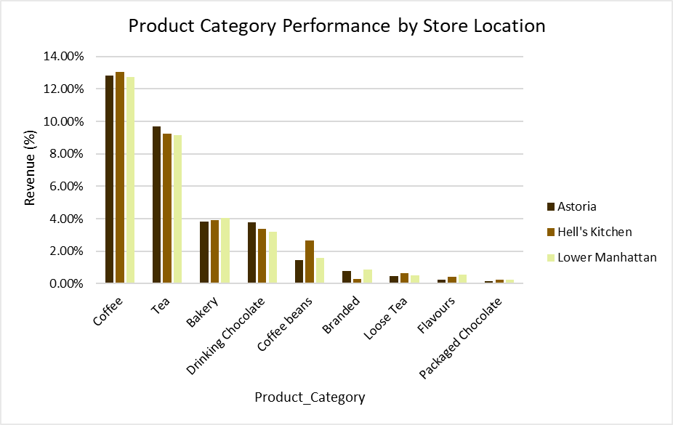
Product Performance Across Store Location
Key Insights
Coffee is the top-selling product category across all locations, accounting for 38.63%. Hell’s Kitchen accounts for the highest revenue by 13.05%followed Astoria with 12.84%.
Tea contributes the second highest revenue by 9.71% in Astoria and Hell’s Kitchen contributes 9.24%.
Branded, Loose Tea, Flavours and Packaged Chocolate contribute minimally (under 2% individually), suggesting these are less popular items.
9

Slide 10
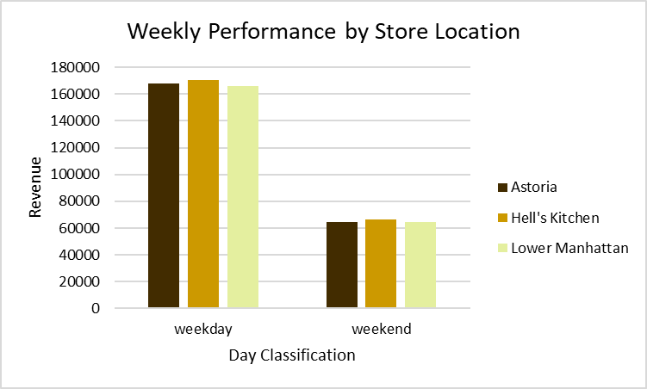
Revenue Trends by Day Classification Across Store Location
Key Insights
Hell’s Kitchen generates the highest revenue accounting for 24.39% followed by Astoria (23.98%).
Lower Manhattan generates slightly lower revenue compared to the two store (23.72%).
Weekdays are the primary revenue driver, making up nearly three-quarters of total sales (72.09%). Astoria accounts for the highest number of sales (24.52%) followed by Hell’s Kitchen (24.51%).
10

Slide 11
Recommendations
Product Strategy
Review or reposition low-selling categories (e.g., packaged chocolate, flavours). Consider bundling them with high-demand products (e.g., coffee + small chocolate). Promotions or discounts to encourage trial and remove/introduce new products if customer behaviour does not change.
Coffee (38.63%) and Tea (28.11%) are the main revenue contributors. Introduce premium or seasonal variants, limited-time flavors, or customizable options to increase average spend per customer.
Offer loyalty rewards for repeat visits outside peak hours (Afternoon and Evenings).
Promote combo deals (coffee + bakery, tea + chocolate) during morning drive to maximize revenue.
Enhance Store & Location Strategy
Promote bakery + coffee combos for busy mornings in Lower Manhattan.
Identify High-Potential Areas: Analyze foot traffic patterns, commuter density, and competitor presence in potential neighborhoods.
Use existing store performance (Astoria, Hell’s Kitchen, Lower Manhattan) to model expected sales per location.
Marketing and Customer Engagement
Leverage digital channels, social media and email marketing for promotions, new product launches, new packaging and loyalty programs. Morning upsell campaigns: Promote combo deals during peak hours to maximize high traffic.
Off-peak promotions: Introduce discounts or loyalty incentives in the afternoon/evening to drive traffic.
Weekend experiences: Create events, special menus, or promotions to increase weekend footfall.
11

Slide 12
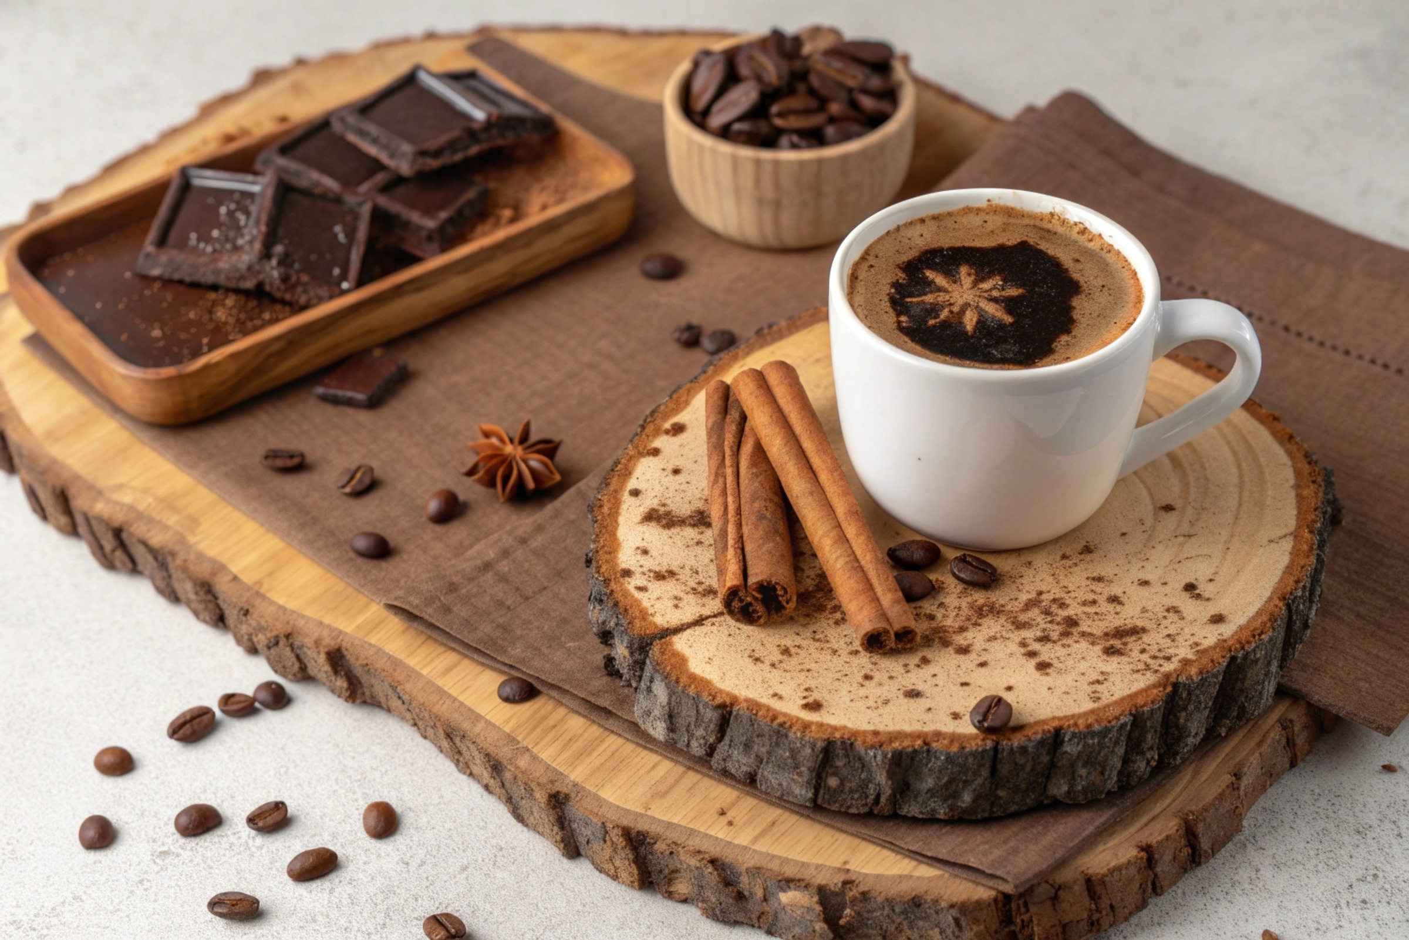
Thank You
12

