Slide 1
Edge-AI Driven Electronic Indian Astrological Calendar for Offline Applications
BATCH –A1
GUIDED BY:
Dr R S Sabeenian
Head of the Department
DATE:07-04-2026
MEMBERS:
Raghav Kanva V R : 61781922103099
Dyanesh M : 61781922103026
Soundrarajan S A : 61781922103129

Slide 2
LITERATURE REVIEW
Paper Details | Description
Calendars, Rituals, and Astral Science in India Focus: Analyzes the complexity of the Indian calendric system and the role of software in calculating auspicious moments. Journal: https://orca.cardiff.ac.uk/id/eprint/99684/1/642-1536-2-PB.pdf | Analyzes the complexity of the Indian calendric system and the role of software in calculating auspicious moments.
Meeus, Jean (1998) Title: Astronomical Algorithms (2nd Edition) Publisher: Willmann-Bell, Richmond, USA | Julian Day, solar longitude, declination, obliquity

Slide 3
AUTHOR NAME AND TITLE | CORRESPONDING EXPLANATION
M. Banzi and D. Cuartielles, 2023, Arduino Nano Technical Specifications, Arduino Hardware Documentation | Point-1: Provides a compact, breadboard-friendly form factor for embedded health devices. Point-2: Offers sufficient analog and digital pins for connecting various medical sensors. Point-3: Has limited SRAM, making it difficult to process heavy machine-learning data.
L. Fried, 2023, 2.4 Inch TFT LCD Display Guide, Adafruit Industries Documentation | Point-1: Provides a clear visual interface for displaying real-time patient health metrics. Point-2: Supports customizable touch-screen inputs for easy user navigation. Point-3: Consumes significant power and memory, requiring careful resource management.
N. Zambetti, 2022, Wire Library for I2C Communication, Arduino Library Documentation | Point-1: Enables master-slave communication between the controller and multiple sensors. Point-2: Simplifies complex data transfers into a standard two-wire interface. Point-3: Lacks advanced error-handling for long-distance or high-noise environments.

Slide 4
EXISTING METHODOLOGY
No multi-parameter analysis
Mostly Only online model exists
Lack of real-time monitoring
Poor accuracy in future prediction
High power consumption
No intelligent decision-making

Slide 5
MOTIVATION
Overcoming Connectivity Barriers: Eliminating dependence on cloud APIs and internet access for critical daily solar calculations in remote or low-signal areas.
Rectifying Digital Latency and Inaccuracy: Solving the "city-level" approximation error by providing hyper-local, coordinate-specific timings for Sunrise (Suryodaya) and Sunset (Suryasta).
Standalone Real-Time Intelligence: Transitioning from passive data retrieval to an active, Edge-AI driven system that computes solar events independently on-device.

Slide 6
PROPOSED METHOD
Accurate sunrise and sunset timings are calculated using standard astronomical algorithms such as Julian Day conversion, solar declination, Equation of Time, and hour angle computation.
The calculated sunrise time is used as the reference point for daily Panchang calculations.
Auspicious and Inauspicious periods such as Rahu Kalam are derived by dividing the daytime duration obtained from sunrise and sunset.
The system operates completely offline using RTC, GPS, and environmental sensors, ensuring reliable Panchang generation without internet dependency.
Finally the output was taken

Slide 7
OBJECTIVE
Precision Astronomical Modeling
Localized Geospatial Integration
Automated Solar Event Generation

Slide 8
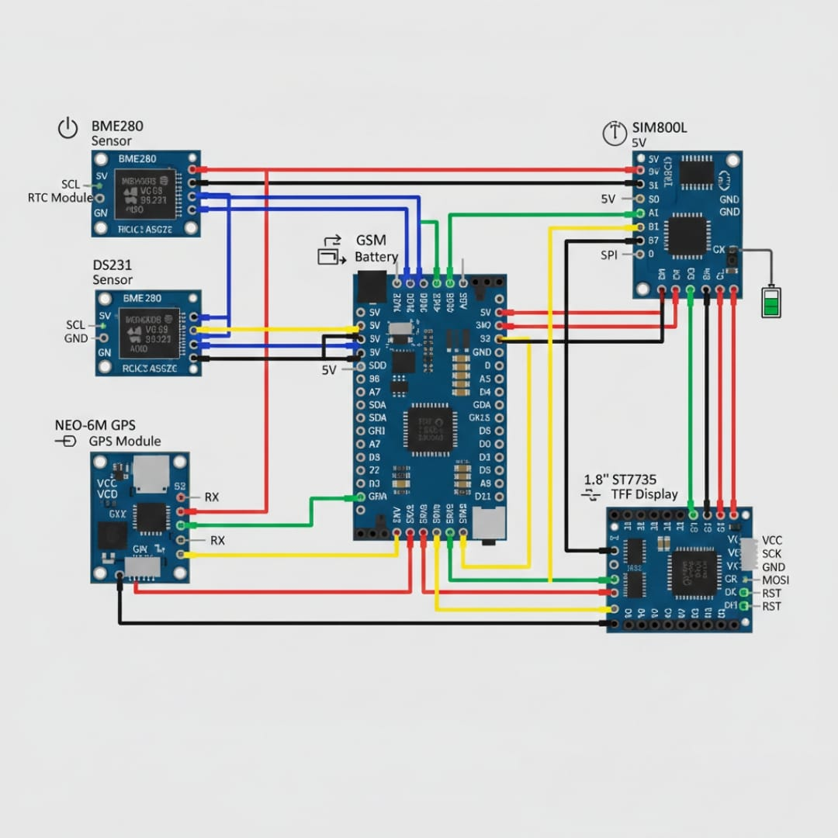
BLOCK DIAGRAM
EMG SENSOR
LED DISPLAY
MICROCONTROLLER
(ARDUINO UNO)
GSR SENSOR
ALARM/BUZZER
SP02 SENSOR
TEMPERATURE SENSOR

Slide 9
WORKING
Sensors collect time, date and location and pressure
Data sent to Arduino
Data processed and analyzed
Calculate sunrise and sunset timings
TFT displays status
Continuous monitoring

Slide 10
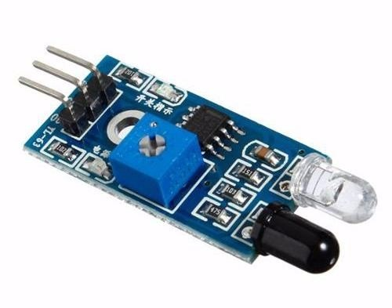
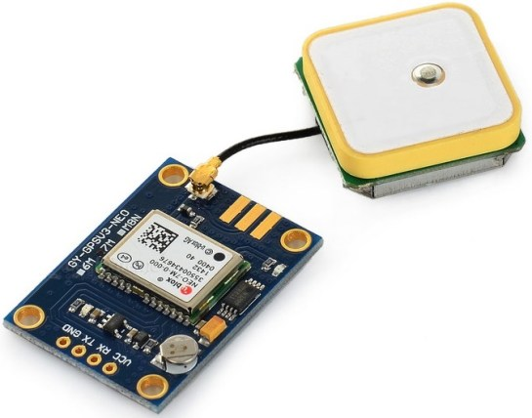
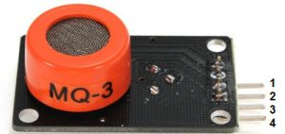
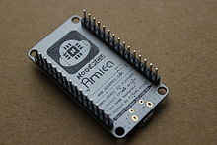
HARDWARE / SOFTWARE REQUIREMENT
Arduino NANO
RTC Sensor
BMP280 Sensor
GPS Sensor
TFT Display

Slide 11
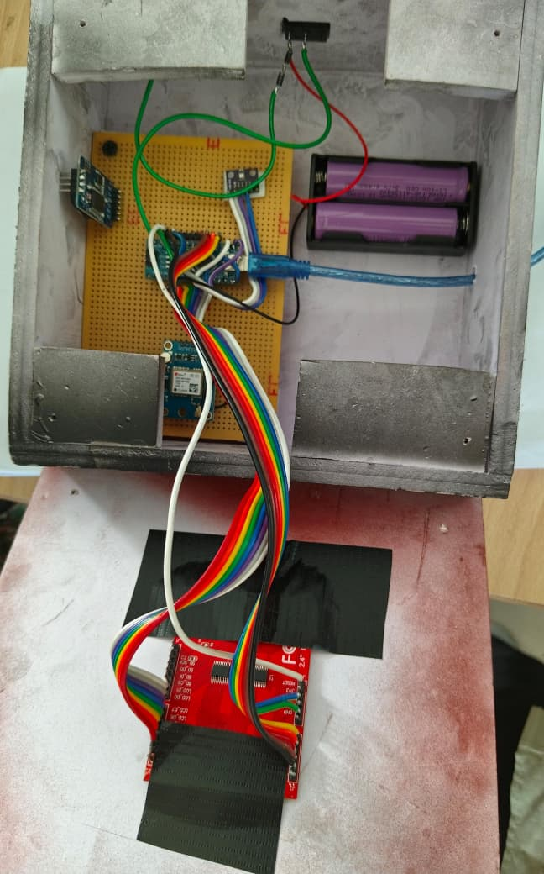
DEVELOPED PROTO MODEL

Slide 12
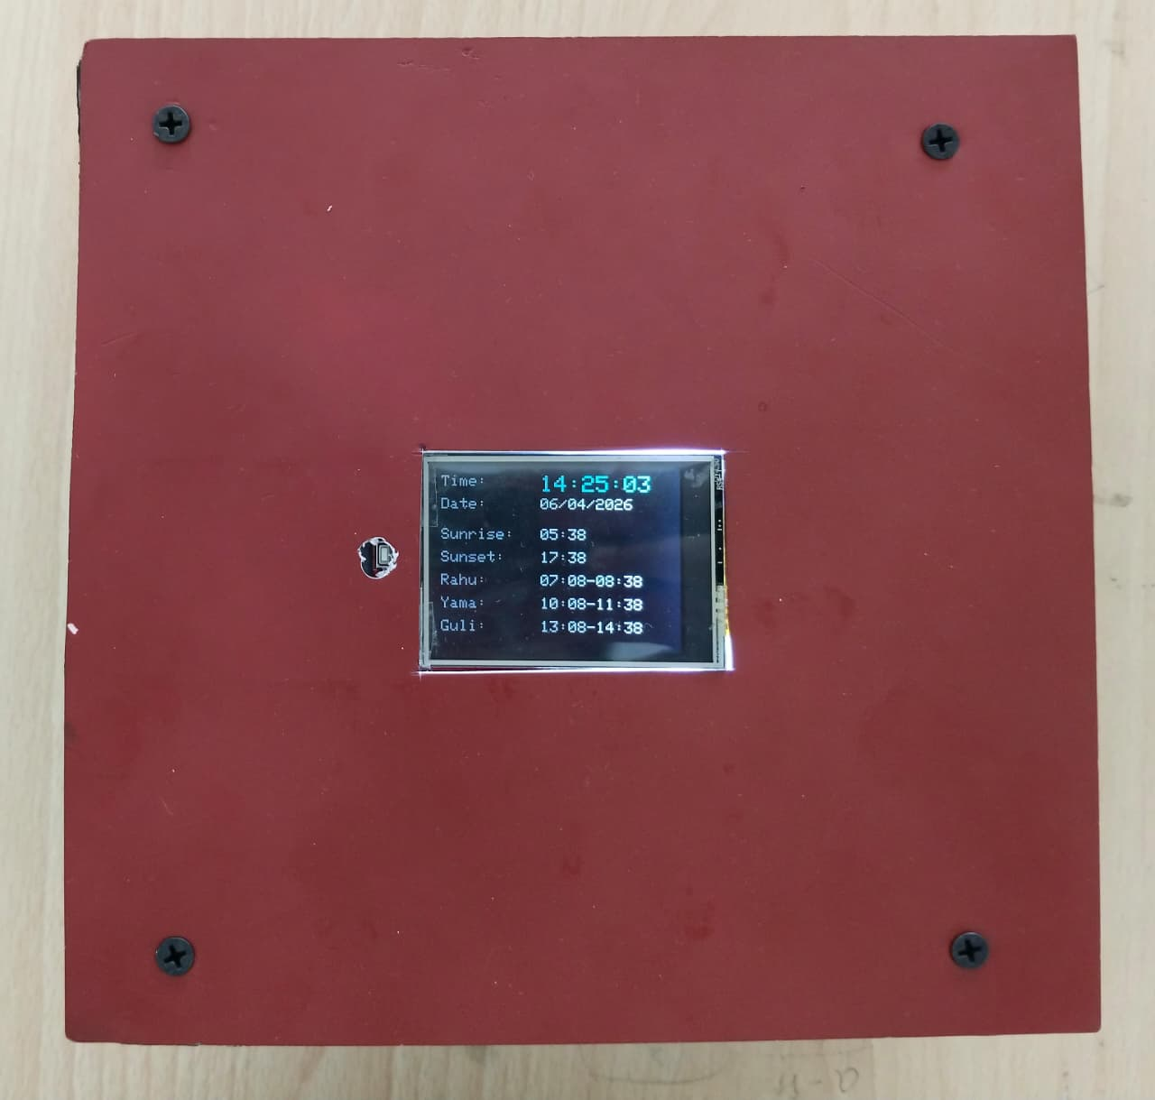
DEVELOPED PROTO MODEL

Slide 13





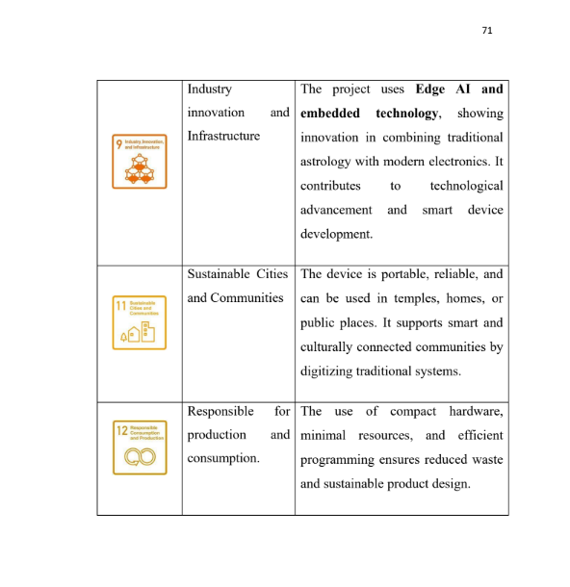
SDG MAPPING

Slide 14
LIST OF PUBLICATIONS
[1] DYANESH M, RAGHAV KANVA V R, SOUNDRARAJAN S A, R
S SABEENINAN SARCIUS, (2026), ‘EDGE - AI DRIVEN
ELECTRONIC INDIAN ASTROLOGICAL CALENDAR FOR
OFFLINE APPLICATION’, International Conference on Green
Computing for Communication Technologies (ICGCCT 2026), 19 & 20
February(2026).

Slide 15
CONCLUSION
The proposed system, "Edge AI-Based Electronic Indian
Astrological Calendar," has been successfully designed and implemented
by utilizing the Arduino Nano platform. The hardware components used
in this project, like the RTC module (DS3231), Neo-6M GPS module,
BMP280 sensor, and 2.4-inch TFT display, have been integrated to
develop a complete hardware solution to compute and display the
astrological details. The design and development of this project have been
greatly influenced by the literature survey conducted, which helped to
develop a strong foundation in the design of embedded systems and
astronomical calculation methodologies.

Slide 16
REFERENCES
[1] N. Zambetti, 2022, Wire Library for I2C Communication, Arduino
Library Documentation,1-5.
[2] M. Banzi and D. Cuartielles, 2023, Arduino Nano Technical
Specifications, Arduino Hardware Documentation,1-4.
[3] L. Fried, 2023, 2.4 Inch TFT LCD Display Guide, Adafruit Industries
Documentation,1-6.
[4] D. Mellis, 2023, Arduino Software Environment, Arduino Development
Framework Documentation,1-3.
[5] T. K. Hareendran, 2017/2019, BMP280 and NEO-6M Technical
Implementation, Technical Article,1-7.
[6] S. Monk, 2021, Programming Arduino, McGraw Hill Education, 1–182.

Slide 17
REFERENCES
[7] J. Smith and R. Kumar, 2020, Design of Embedded Real-Time Systems
using Arduino, International Journal of Embedded Systems, 12, 3, 145–
152.
[8] H. Lee and S. Park, 2021, Solar Position Algorithm for Embedded
Systems, IEEE Access, 45521–45532.
[9] X. Wang et al., 2022, Accurate Sunrise and Sunset Calculation using
Embedded Platforms, IEEE Transactions on Instrumentation, 1–10.
[10] A. Singh and P. Verma, 2021, Design of Real-Time Clock Based
73
Systems, International Journal of Electronics, 88–95.
[11] S. Kumar and D. Patel, 2020, IoT Based Environmental Monitoring
using BMP280, International Journal of IoT Applications, 33–40.
[12] Y. Zhang et al., 2023, Edge Computing in Embedded Systems, IEEE
Internet of Things Journal, 2201–2212.

Slide 18
THANK YOU

