Slide 1


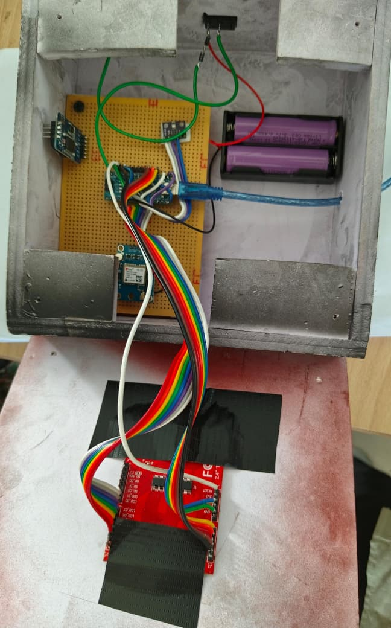
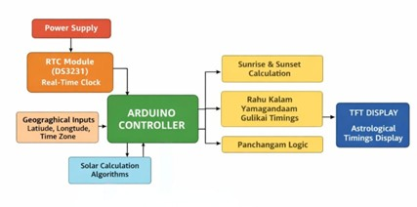
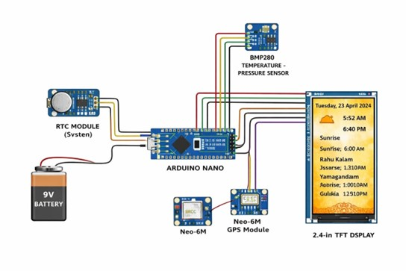
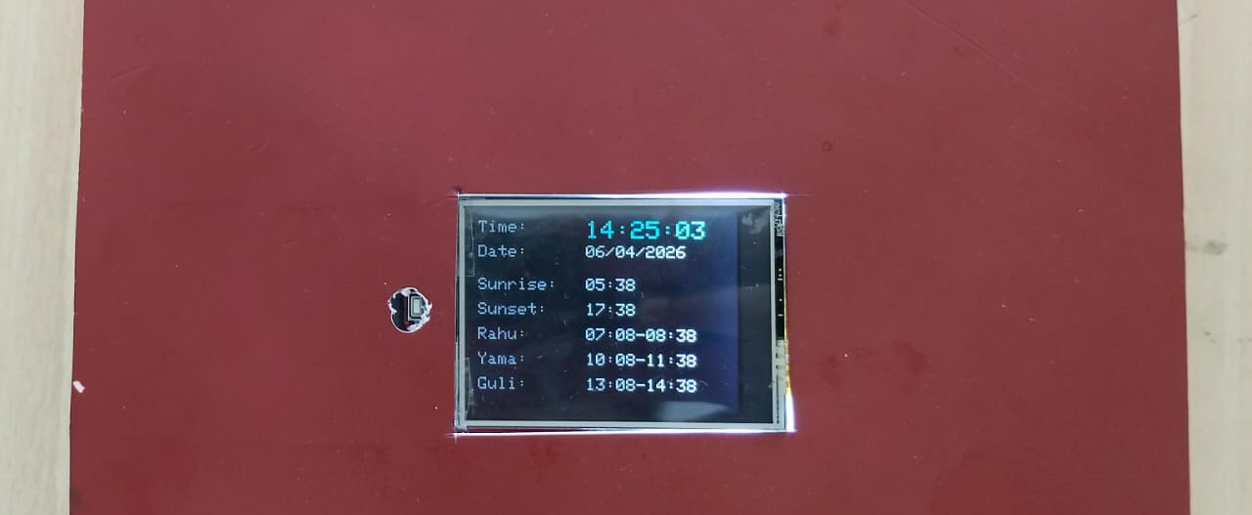
EDGE – AI DRIVEN ELECTRONIC INDIAN ASTROLOGICAL CALENDAR
Name of the Students: Dyanesh M, Raghav Kanva V R, Soundrarajan S A (2022- 2026)
DEPARTMENT OF ELECTRONICS & COMMUNICATION ENGINEERING
SONA COLLEGE OF TECHNOLOGY [AUTONOMOUS] , SALEM – 636 005
MOTIVATION
OBJECTIVE
APPLICATIONS
The system automates real-time calculation of astrological timings using GPS and embedded processing, eliminating manual errors and the need for traditional Panchang references while providing accurate updates on a digital display.
It computes sunrise, sunset, and periods like Rahu Kalam, Yamagandam, and Gulikai based on location and date, ensuring reliable information for efficient planning.
Used in homes and temples for daily Panchang reference
Helps individuals plan activities based on auspicious and inauspicious timings
Useful for priests and astrologers for quick and accurate calculations
Can be installed in public places like halls and offices for general awareness
Suitable for digital clock systems with added astrological features
To design and develop a GPS-synchronized electronic astrological calendar using Arduino that accurately computes and displays real-time parameters such as time, date, sunrise, sunset, Rahu Kalam, Yamagandam, and Gulikai based on geographic location.
The system aims to provide a reliable, automated, and user-friendly solution that eliminates manual calculation errors and enhances the accessibility of Panchang information for everyday use.
EXPERIMENTAL SETUP
BLOCK DIAGRAM/ALGORITHM
WORKING PRINCIPLE
The system acquires real-time location and time data from the GPS module and synchronizes it with the RTC for continuous timekeeping. Using the obtained latitude, longitude, and date, the Arduino performs astronomical calculations to determine sunrise and sunset timings. All calculated values are processed and displayed on the TFT LCD screen, with periodic updates to ensure accurate and real-time information.
EXPERIMENTAL / SIMULATION RESULTS
CONCLUSION
The system processes real-time data from the GPS and RTC modules using the Arduino for automated computation of astrological parameters. It calculates sunrise, sunset, and segments of the day to determine Rahu Kalam, Yamagandam, and Gulikai, and displays the results on a TFT LCD. The system continuously updates and ensures accurate, location-based information, providing a reliable and efficient digital Panchang solution for users.
The project successfully implements a GPS-based electronic astrological calendar that provides accurate and real-time Panchang information. By integrating embedded systems with astronomical calculations, it eliminates manual errors and simplifies access to important timings. The system is reliable, user-friendly, and demonstrates an effective application of Arduino in real-world scenarios.
The proposed system delivers accurate real-time calculation of Panchang parameters such as sunrise, sunset, Rahu Kalam, Yamagandam, and Gulikai based on GPS-derived location and time.
The implementation demonstrates reliable performance with continuous updates and reduced dependency on manual calculations, ensuring faster and error-free results.
The system’s stability and consistent output validate its effectiveness as a practical and user-friendly digital astrological calendar solution.
SUPERVISOR : Dr.R.S.Sabeenian M.E., Ph.D.,

