Slide 1
Simulating Changes in Raman Spectra of Point Defects in UO₂ from Lattice Dynamics
Eugene J. Ragasa¹
Aleksandr Chernatynskiy¹
Simon R. Phillpot¹
¹Materials Science and Engineering
University of Florida

Slide 2
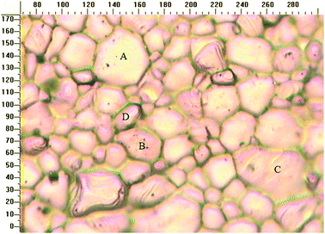
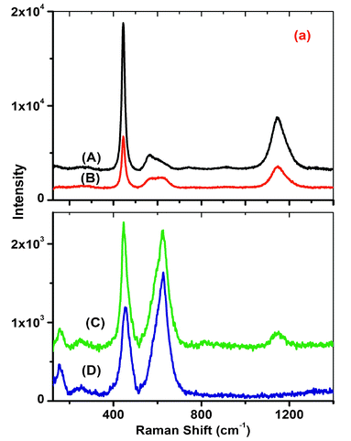
Motivation for Studying Raman UO2 point defects
UO₂ is the primary fuel in current nuclear reactors
In-reactor operation causes irradiation damage:
Chemical changes
Atomic displacements
Off-stoichiometry due to accommodation of O[1]
Characterization of defects
[1] He et al. Phys. Chem Chem. Phys. 12 (2010) 8109-8118
Fig 1. Irradiated UO₂ with Raman spectra of different grains[1]
Notes:
UO₂ a fluorite structure. Group theory predicts 3 frequency modes
278 cm⁻¹ (3xF_{1u}IR active), 445 cm⁻¹ (2xT_{2g}) and 578 cm⁻¹ (F_{1u}).

Slide 3
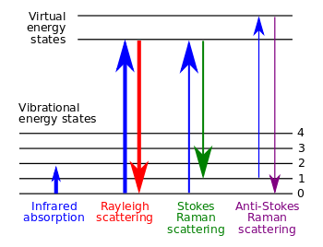
Vibrational Spectroscopy
Infrared (IR) Spectroscopy
Light is absorbed
Change in dipole moment
Raman Spectroscopy
Light is scattered
Change in polarizability
Energy-level diagram showing the states involved in Raman signal. [2]
[2] Wikipedia. “Raman spectroscopy.” http://en.wikipedia.org/wiki/Raman_spectroscopy. Accessed June 11, 2014.

Slide 4
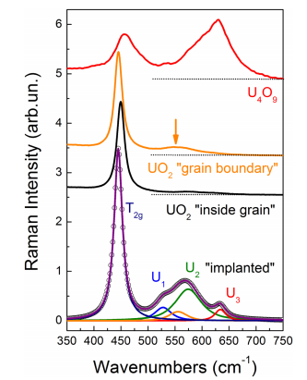
Raman Characterization of UO₂ defects
Irradiation-induced defects[3]
25 MeV He ions
U1, U2, U3 compared to U₄O₉
Proposed to correspond to
O vacancies
O interstitials
Changes in Raman Spectrum should be interpreted by symmetry breaking arguments
[3] Guimbretiere, et al. Appl. Phys. Lett. 103, 251914 (2012)

Slide 5

Raman Spectra Simulation Strategy
Intensity gives height of the Raman peak[4]
Eigenvalues and Eigenvectors of dynamical matrix
From calculation of phonon density of states[5]
Calculated using lattice dynamics
Numerical derivatives of 3rd Order Polarization tensor
Calculated from modern theory of polarization[6]
Calculated from density functional theory methods
[4] Wood, RF. "Lattice Dynamics and Related Properties of Point Defects." Vibrational Properties of Solids 15 (1976): 119-162.
[5] Born, Max, and Kun Huang. Dynamical theory of crystal lattices. Vol. 188. Oxford: Clarendon Press (1954).
[6] King-Smith, R. D., and David Vanderbilt. "Theory of polarization of crystalline solids." Physical Review B 47.3 (1993): 1651.

Slide 6
Process Flowchart
Calculate Raman Signature
DFT with EFIELD
Get Raman Tensor
Interatomic forces
Ionic Relaxation
Relaxed atomic positions
Phonon Calculations
Phonon Frequencies and Modes
Get Raman Intensity
Determine Raman Signature
[7] Umari et al, Diamond and related materials 14.8 (2005): 1255-126

Slide 7
Simulation Results
Calcium fluorite
Same fluorite structure as UO₂
Simpler electronic structure
Structures
CaF₂, ideal crystal
CaF₂ with fluorine vacancy
CaF₂ with Frankel defect
UO₂ Structures
UO₂ ideal crystal
UO₂ with oxygen vacancy

Slide 8
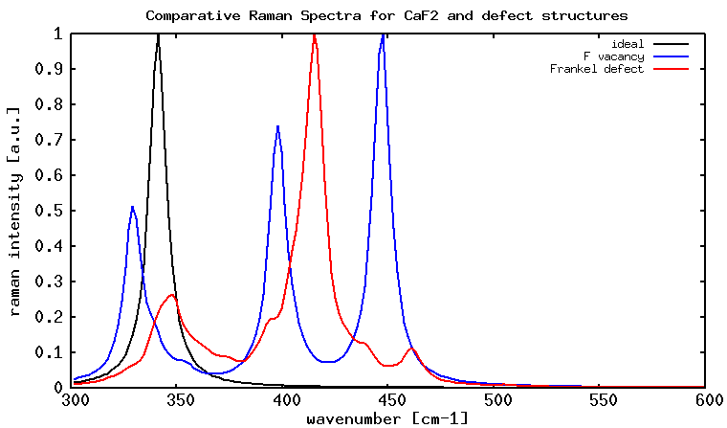
Computational Raman Spectra on CaF₂ with point defects
peak broadening
new peaks due to point defects

Slide 9
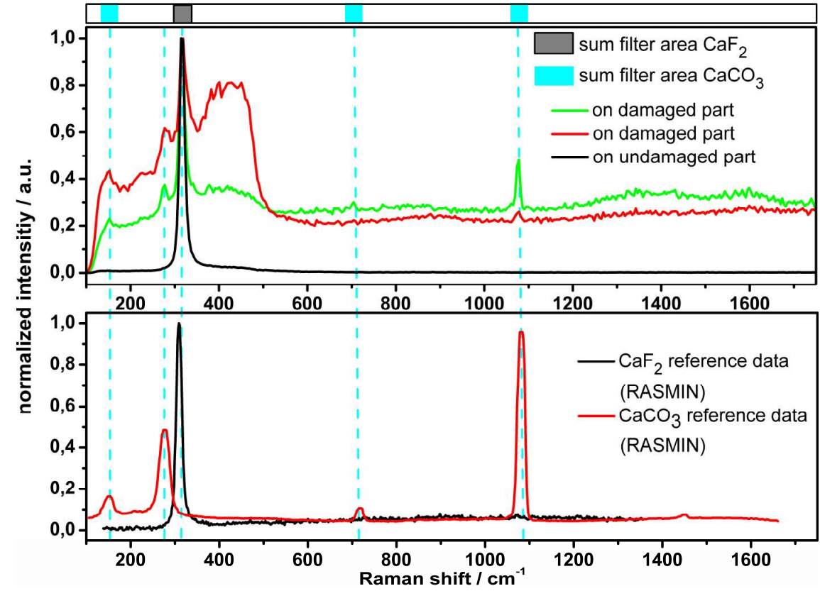
Raman Spectra on Damaged CaF₂
Change in spectra due to laser induced damage
[8] Bauer, et al. Optics Express. 17.10 (2009), 8253

Slide 10
UO₂ DFT Computational Details
Spin polarized calculations
+U correction for strongly correlated 5f elections
Creates multiple metastable phases (local minima)
Difficult to calculate ground state
Occupation Matrix Control[9]
Approximations
collinear antiferromagnetic order / paramagnetic order
antiferromagnetic assumption causes z-axis compression
use average lattice constants (a=b=c)
[9] Dorado, et al, Phys. Rev. B, 79:235125, 2009

Slide 11
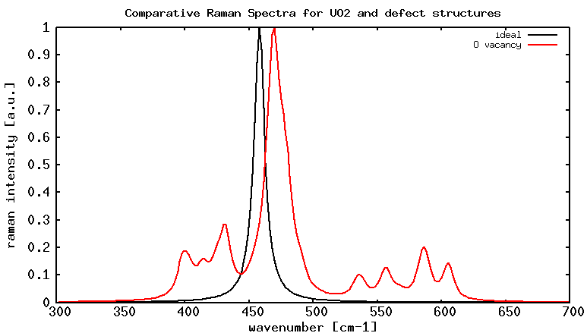
Simulated Raman Spectra on UO₂ with O vacancy

Slide 12
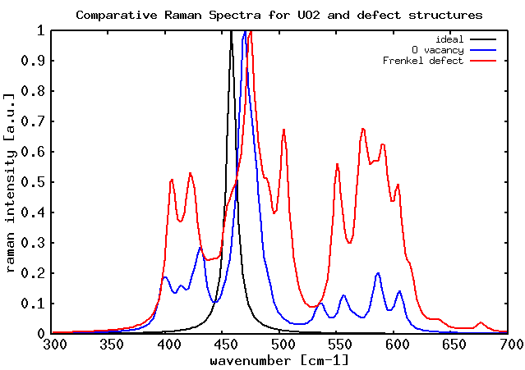

Slide 13
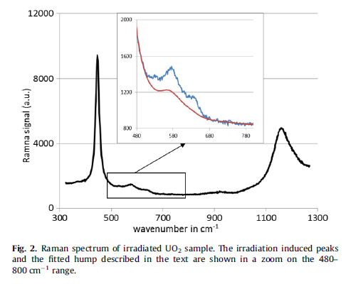
Raman Spectra on Irradiated UO₂
Change in Raman Spectra due to irradiation
[10] Desgranges, Raman spectrum of U₄O₉: a new interpretation of J. Raman Spectrosc., 43 (2012) 455–458.

Slide 14
Conclusion
Results:
Calculation of Raman signature for ideal crystals in CaF₂ and UO₂
Agreement with experimental data
Calculation of Raman signature for anion defects
Creation of new Raman peaks agrees with irradiation damage observations
Follow-on work:
Analysis of vibrational modes
Mode localization of new Raman active modes
Shift of original Raman mode
Other defect structures
Charged defect structures (interstitials)
Oxygen defect density
UO₂ DFT convergence of electronic structures
applied electric fields
U lattice vacancies and substitutions
Questions: Eugene Ragasa, eragasa@ufl.edu

Slide 15
Acknowledgements

Slide 16



Polarization Tensor
Raman Cross-section:
Raman Tensor:
Change in Polarization:
[12] Umari, P., and Alfredo Pasquarello. "Infrared and Raman spectra of disordered materials from first principles." Diamond and related materials 14.8 (2005): 1255-126

Slide 17
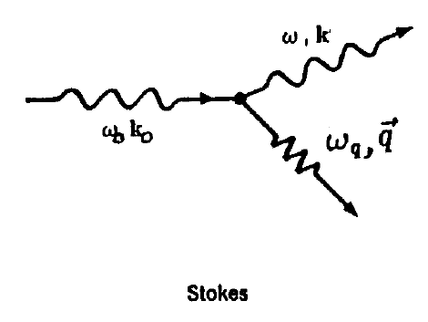
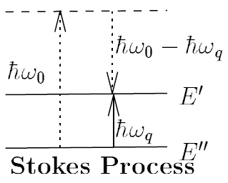
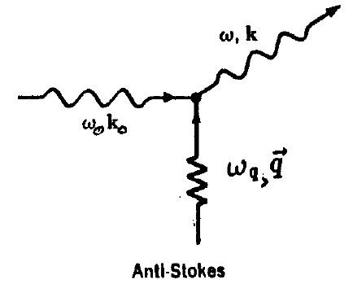
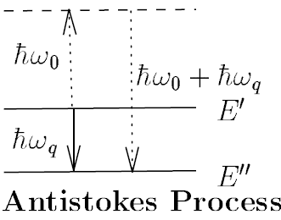
Raman scattering

Slide 18


Calculation of Raman Tensor
Raman Cross-section is
Elements of the Raman tensor
Associated with the eigenvectors
Derivative of dielectric susceptibility tensor w.r.t atomic position

Slide 19



Numerical Procedure
Calculate derivatives of dielectric susceptibility as derivatives of force w.r.t finite electric fields
Numerical derivatives
Diagonal elements
Cross-elements:

Slide 20
Calculation of Polarization Tensor
CaF2_01 0.00000 0.00000 0.00000
CaF2_02 -0.00200 0.00000 0.00000
CaF2_03 -0.00100 0.00000 0.00000
CaF2_04 0.00100 0.00000 0.00000
CaF2_05 0.00200 0.00000 0.00000
CaF2_06 0.00000 -0.00200 0.00000
CaF2_07 0.00000 -0.00100 0.00000
CaF2_08 0.00000 0.00100 0.00000
CaF2_09 0.00000 0.00200 0.00000
CaF2_10 0.00000 0.00000 -0.00200
CaF2_11 0.00000 0.00000 -0.00100
CaF2_12 0.00000 0.00000 0.00100
CaF2_13 0.00000 0.00000 0.00200
CaF2_14 0.00100 0.00100 0.00000
CaF2_15 0.00100 -0.00100 0.00000
CaF2_16 -0.00100 0.00100 0.00000
CaF2_17 -0.00100 -0.00100 0.00000
CaF2_18 0.00100 0.00000 0.00100
CaF2_19 0.00100 0.00000 -0.00100
CaF2_20 -0.00100 0.00000 0.00100
CaF2_21 -0.00100 0.00000 -0.00100
CaF2_22 0.00000 0.00100 0.00100
CaF2_23 0.00000 0.00100 -0.00100
CaF2_24 0.00000 -0.00100 0.00100
CaF2_25 0.00000 -0.00100 -0.00100

