Slide 1
MuseGAN
MuseGAN: Multi-track Sequential Generative Adversarial Networks for Symbolic Music Generation and Accompaniment
Hao-Wen Dong,* Wen-Yi Hsiao,* Li-Chia Yang, and Yi-Hsuan Yang (*equal contribution)
in Proceedings of the 32nd AAAI Conference on Artificial Intelligence (AAAI), 2018.

Slide 2
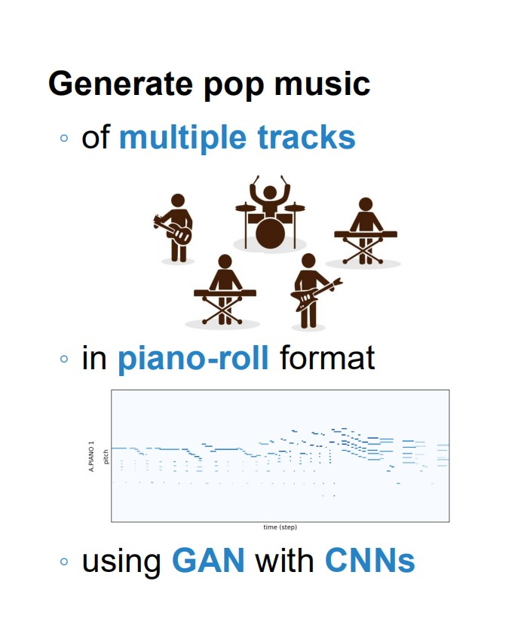
GOALS:

Slide 3
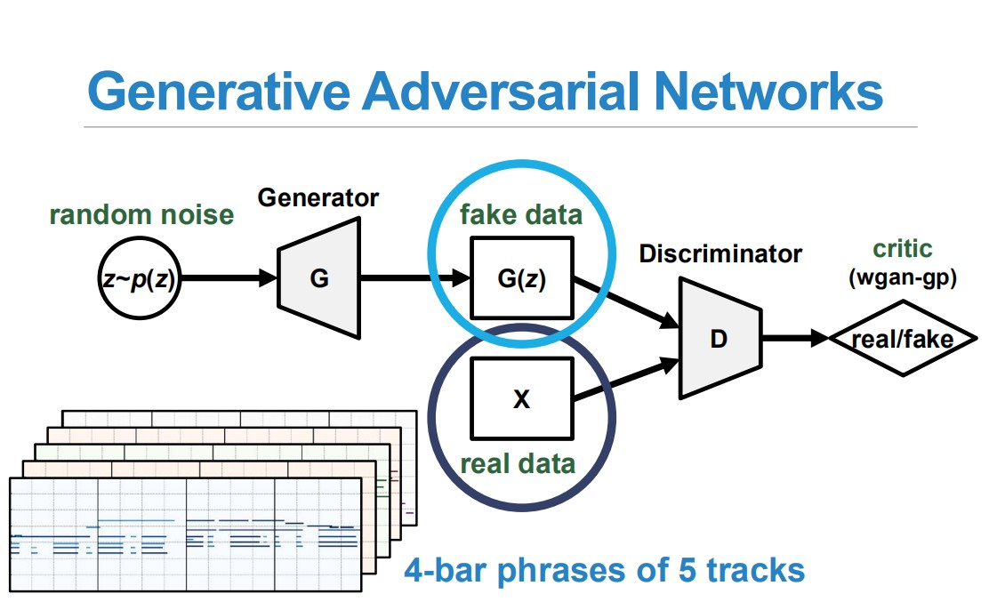

Slide 4
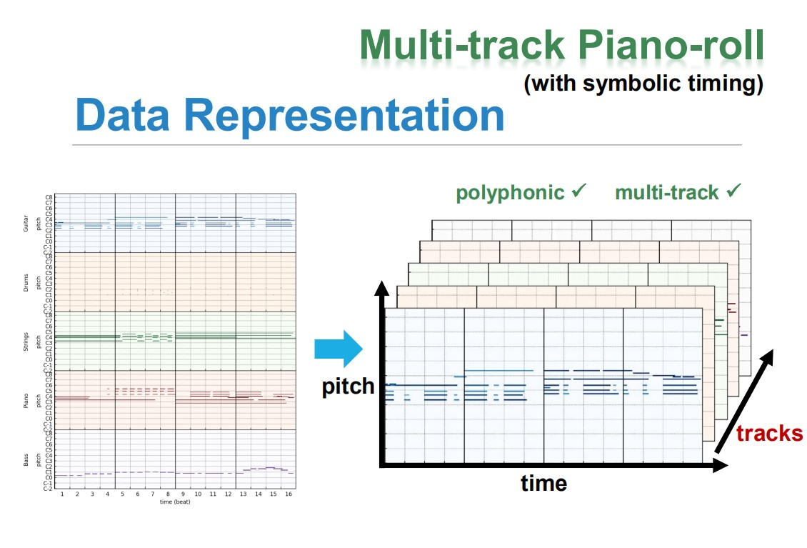

Slide 5
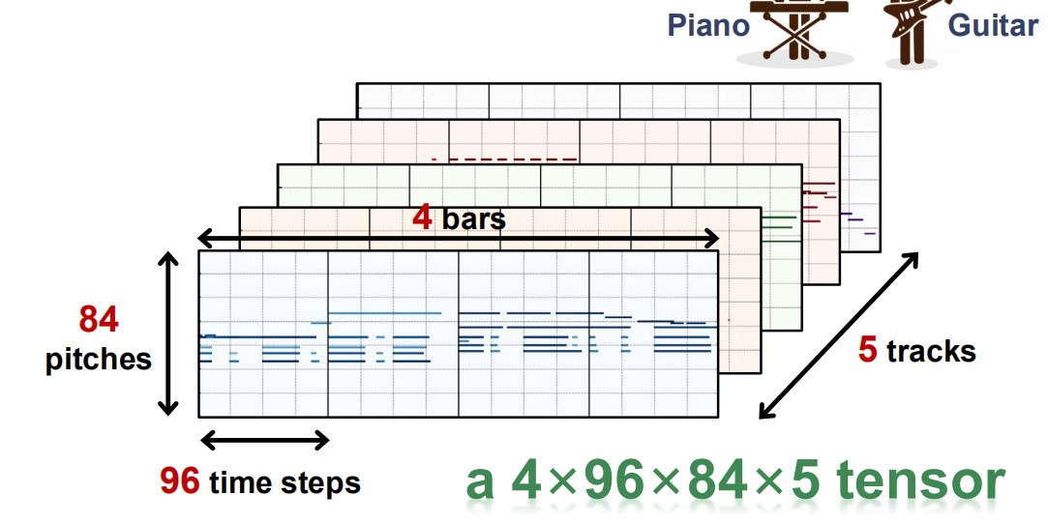
Problem1: art of time & melodies?

Slide 6
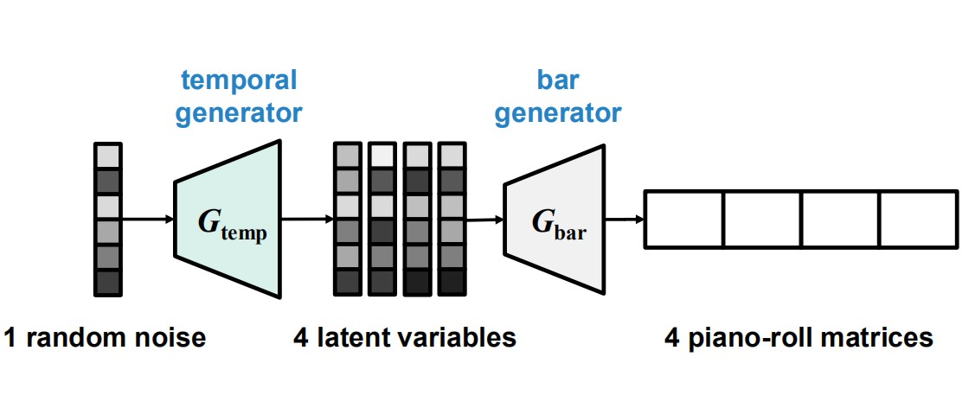
Gtemp + Gbar

Slide 7
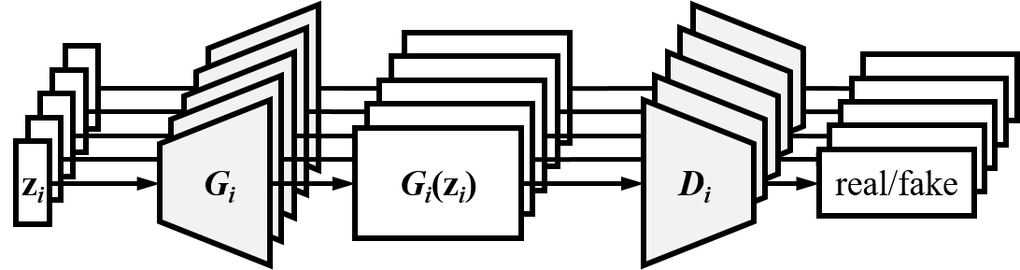
Multi-track

Slide 8
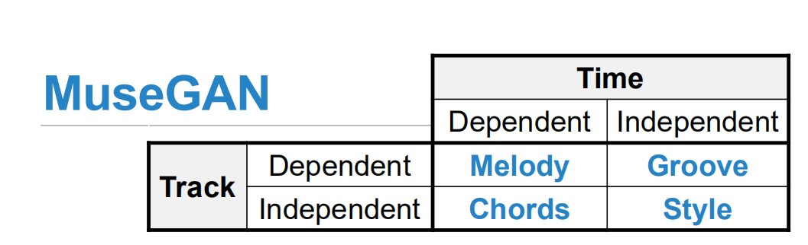
Problem2: To generate a piece of harmonious music, each bar should includes these four elements, rather than simply combining music notes.

Slide 9
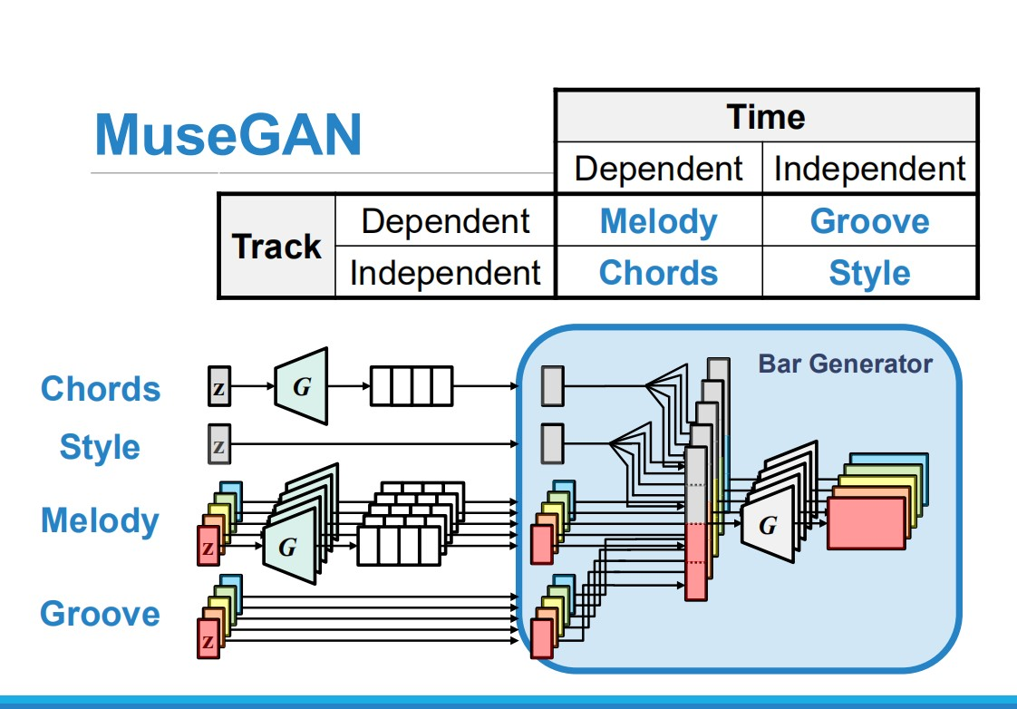
Gtemp: 4 parts

Slide 10
