Slide 1

Looking to do a project on Linux Memory or process Management
Katrina Siegfried

Slide 2
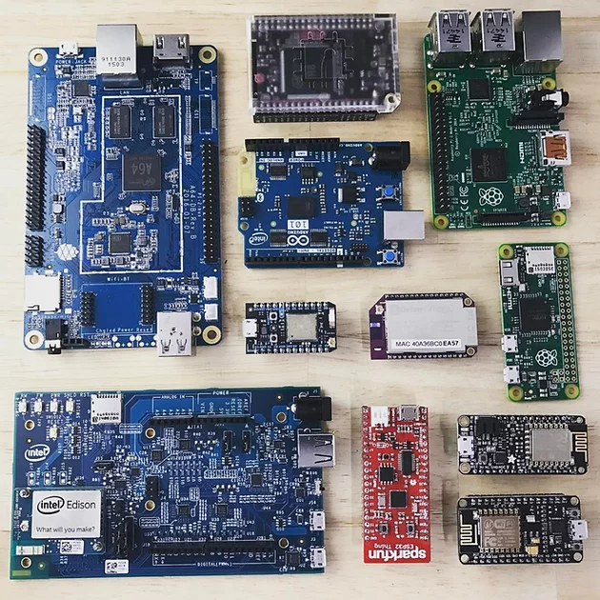
Embedded and safety critical systems
Limited memory
Real time scheduling
Containerization used to segment processes

Slide 3
Areas of Interest
Current OOM Killer heuristic is not always predictable
New heuristics that more aptly detects a memory leak in constrained memory application
Middleware to mark processes as sacrificial lambs to permit graceful shutdown
Medical device – alert user to failure and safely power down (ex. Devices pumping blood need to slowly stop pumping, insulin pumps need to shut valves)
Automotive – alert user and permit safety critical processes to move user out of harms way before impending shutdown
Sacrificial containers? Is it OK to lose UI or non-safety critical process if there is runaway mem allocation in safety critical container?
Using thrashing to predict potential memory issues when memory is limited
Can you see the storm brewing?

Slide 4
Half baked, looking for fully-Baked
These are just my interests
I'm flexible on a project idea
Looking to learn!
Katrina.Siegfried@Colorado.edu

Slide 5
Performance Survey Across Embedded OS
Examine across three different devices
Use case analysis
Replicate / Emulate
Memory Management
Profile / Benchmarks
OOM Killer – induce memory leaks (std way of approaching that)
Future Improvements
Proposed improvements to OOM
Protections to user-space processes
Safe-shutdown state (ciritical only mode)
Adaptive OOM Killer

