Slide 1
Welcome to the Dying 2 Talk Practitioner event
9th December 2021

Slide 2
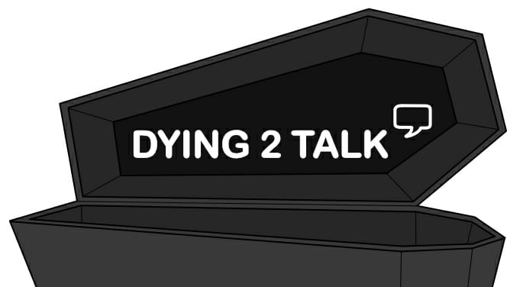

Slide 3
Schedule for the Day
Session 1: (12.30-1.45pm) Co-producing projects with young people (Jane Booth, Bozena Sojka, Aoife Sutton)
Lessons learnt from Dying to Talk
Developing a toolkit for coproducing with young people
Session 2: (2 – 3.15pm) Designing a Compassionate Community for Young People (Emmelia Booth, Jane Booth, Lynsey Brown)
Introduction from Headteacher
What would a compassionate community look like? Developing a model for school and youth groups
Session 3: (3.30-4.45pm) Supporting Young People with Bereavement (Ruth Owen, Aoife Sutton, Nicola Swales)
Introduction from Child Bereavement UK
Dying to Talk resources and website
What to do and what not to do!
Developing good practice toolkit

Slide 4
Contributors
Emmelia Booth (National Lottery Heritage Fund, Dying 2 Talk Volunteer)
Lyndsey Brown (Headteacher Oastlers School, Bradford)
Ruth Owen (Funeral Director, Full Circle Funerals)
Bozena Sojka (Researcher, Institute for Community Research and Development, University of Wolverhampton)
Aoife Sutton (PhD Student Archaeology, Dying 2 Talk, University of Bradford)
Nicola Swales (Child Bereavement UK)
Dr Jane Booth (Dying 2 Talk, University of Wolverhampton)

Slide 5
Supported by
Dr Karina Croucher (University of Bradford/ Dying 2 Talk and Continuing Bonds)
Mia Coe (Dying 2 Talk Volunteer)

Slide 6
Ambassadors
John Astley Annette Okeke Julia Wisniewska
Dharmini Chumber Samiat Onafuwa Poppy Clapton
Lily Clarkson Safoora Shehzad Faiz Kadar
Renn Ellis Maya Syeed Edie Reilly
Lana Forshaw Anna Tabner Laiba Hussain
Jasmine Gallant Tamanna Tai Emari Clarke
Pavan Gohani Niamh Taylor Jayden Rakhra
Omar Irani Jack Wilkinson
Martina Mendes Jess Wilkinson

