Slide 1
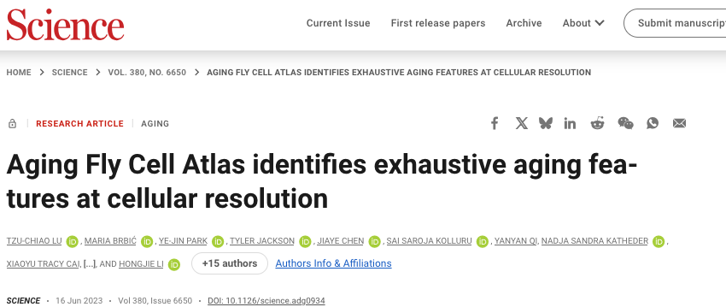
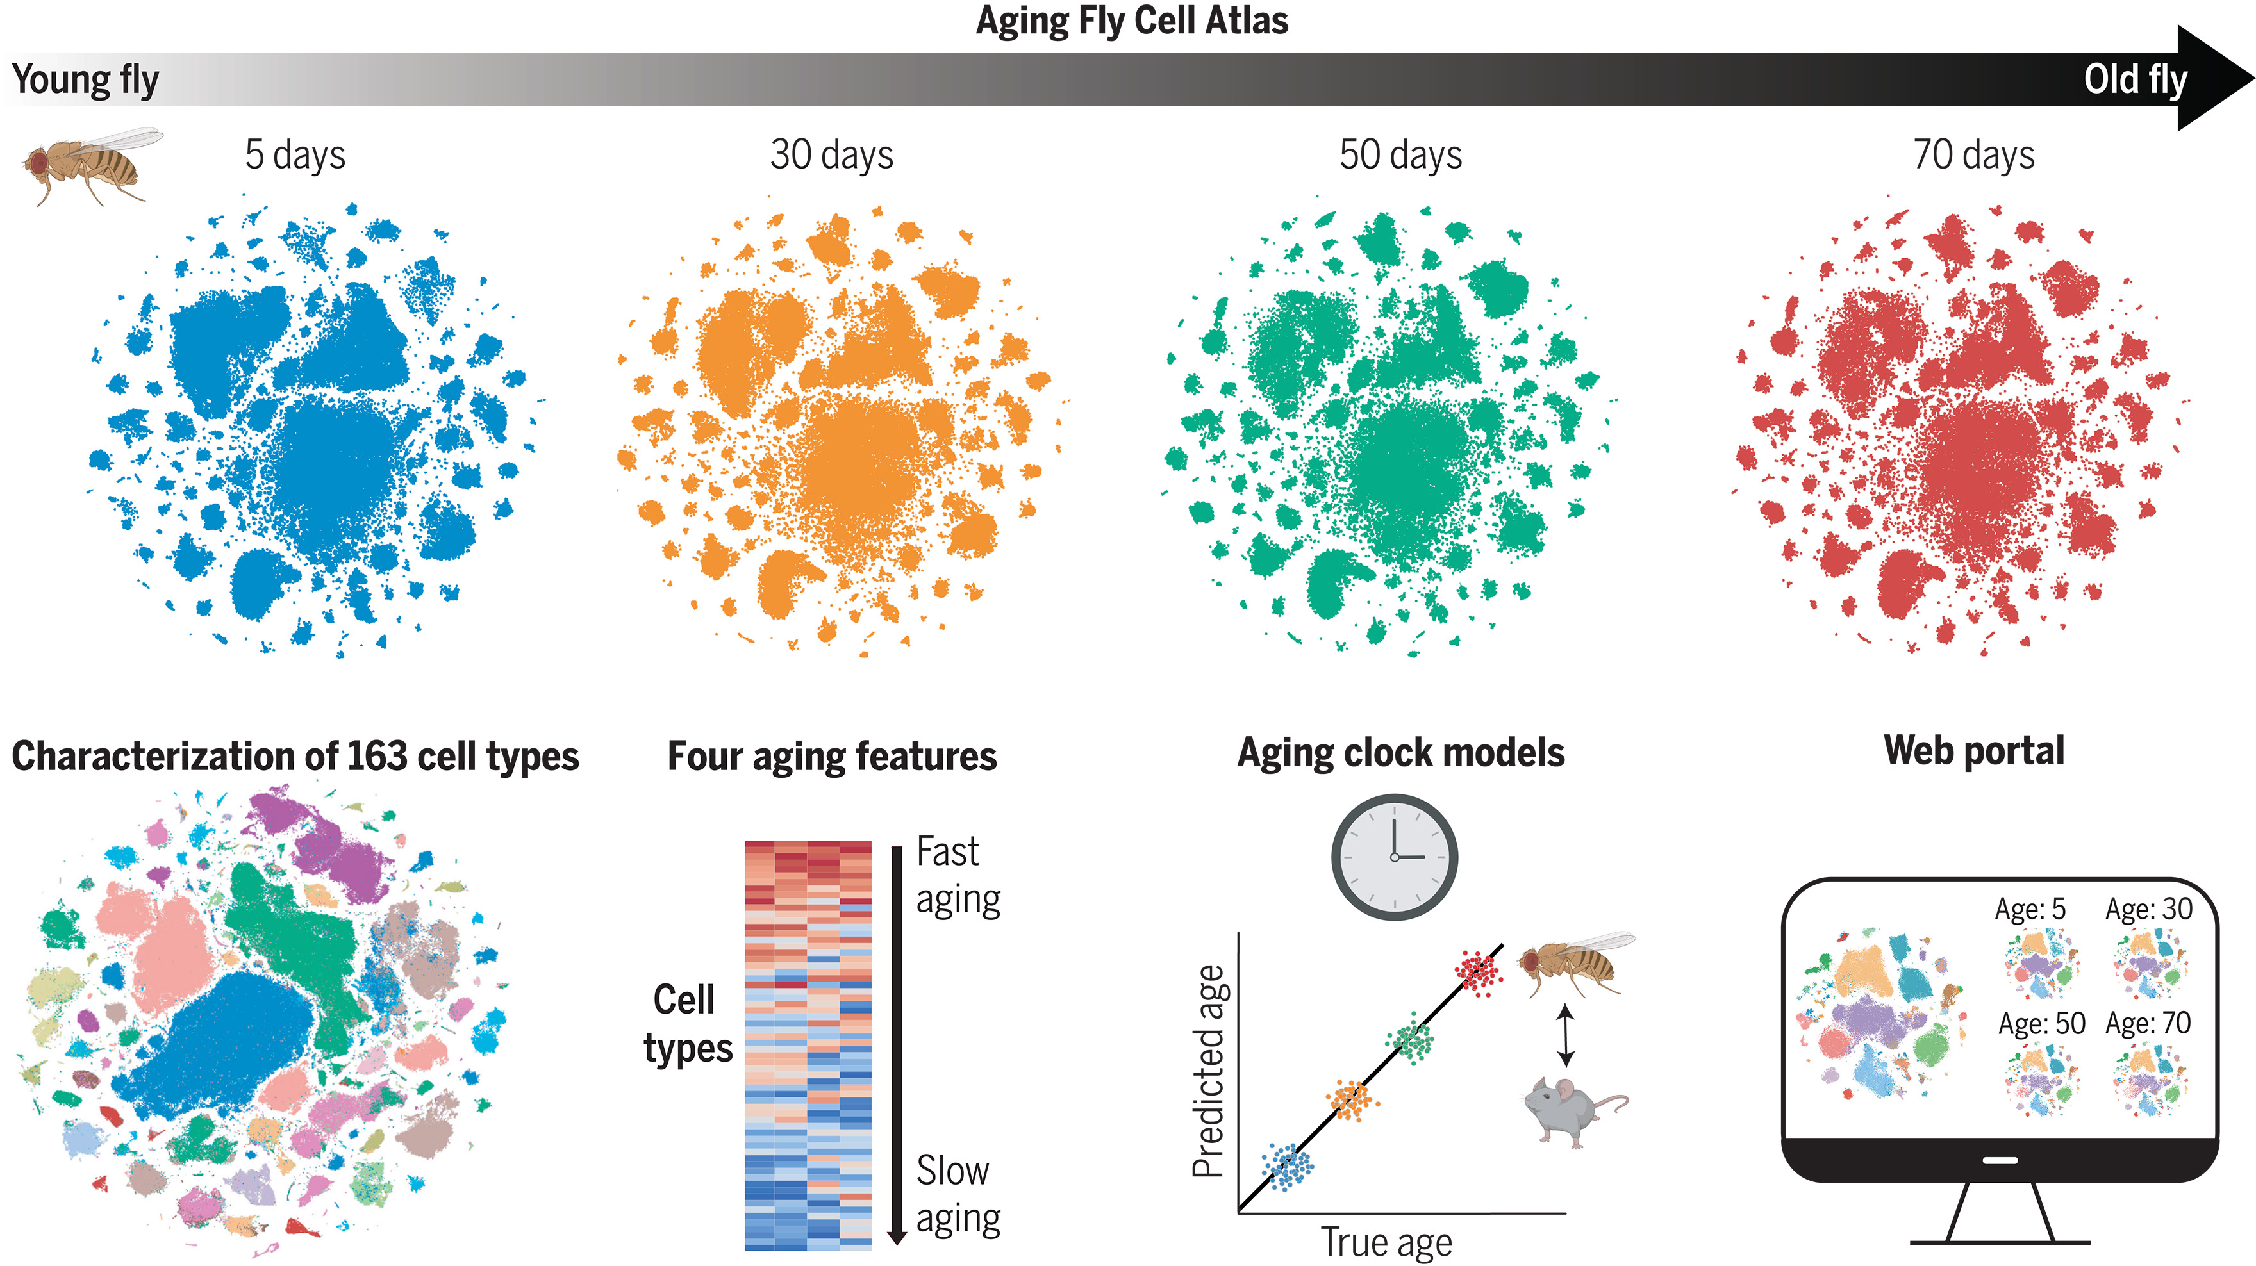

Slide 2
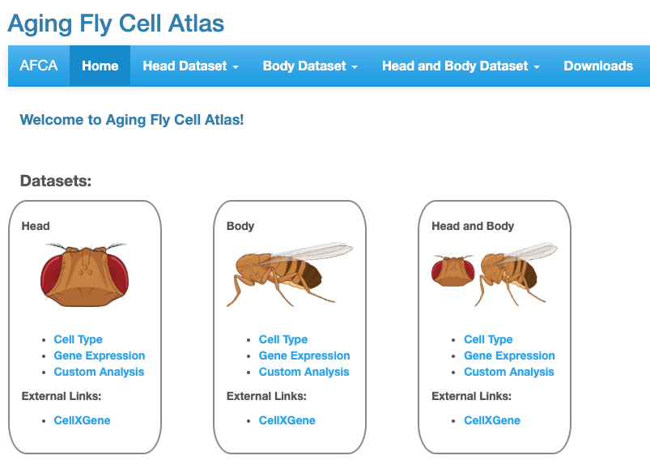
https://hongjielilab.shinyapps.io/AFCA/

Slide 3
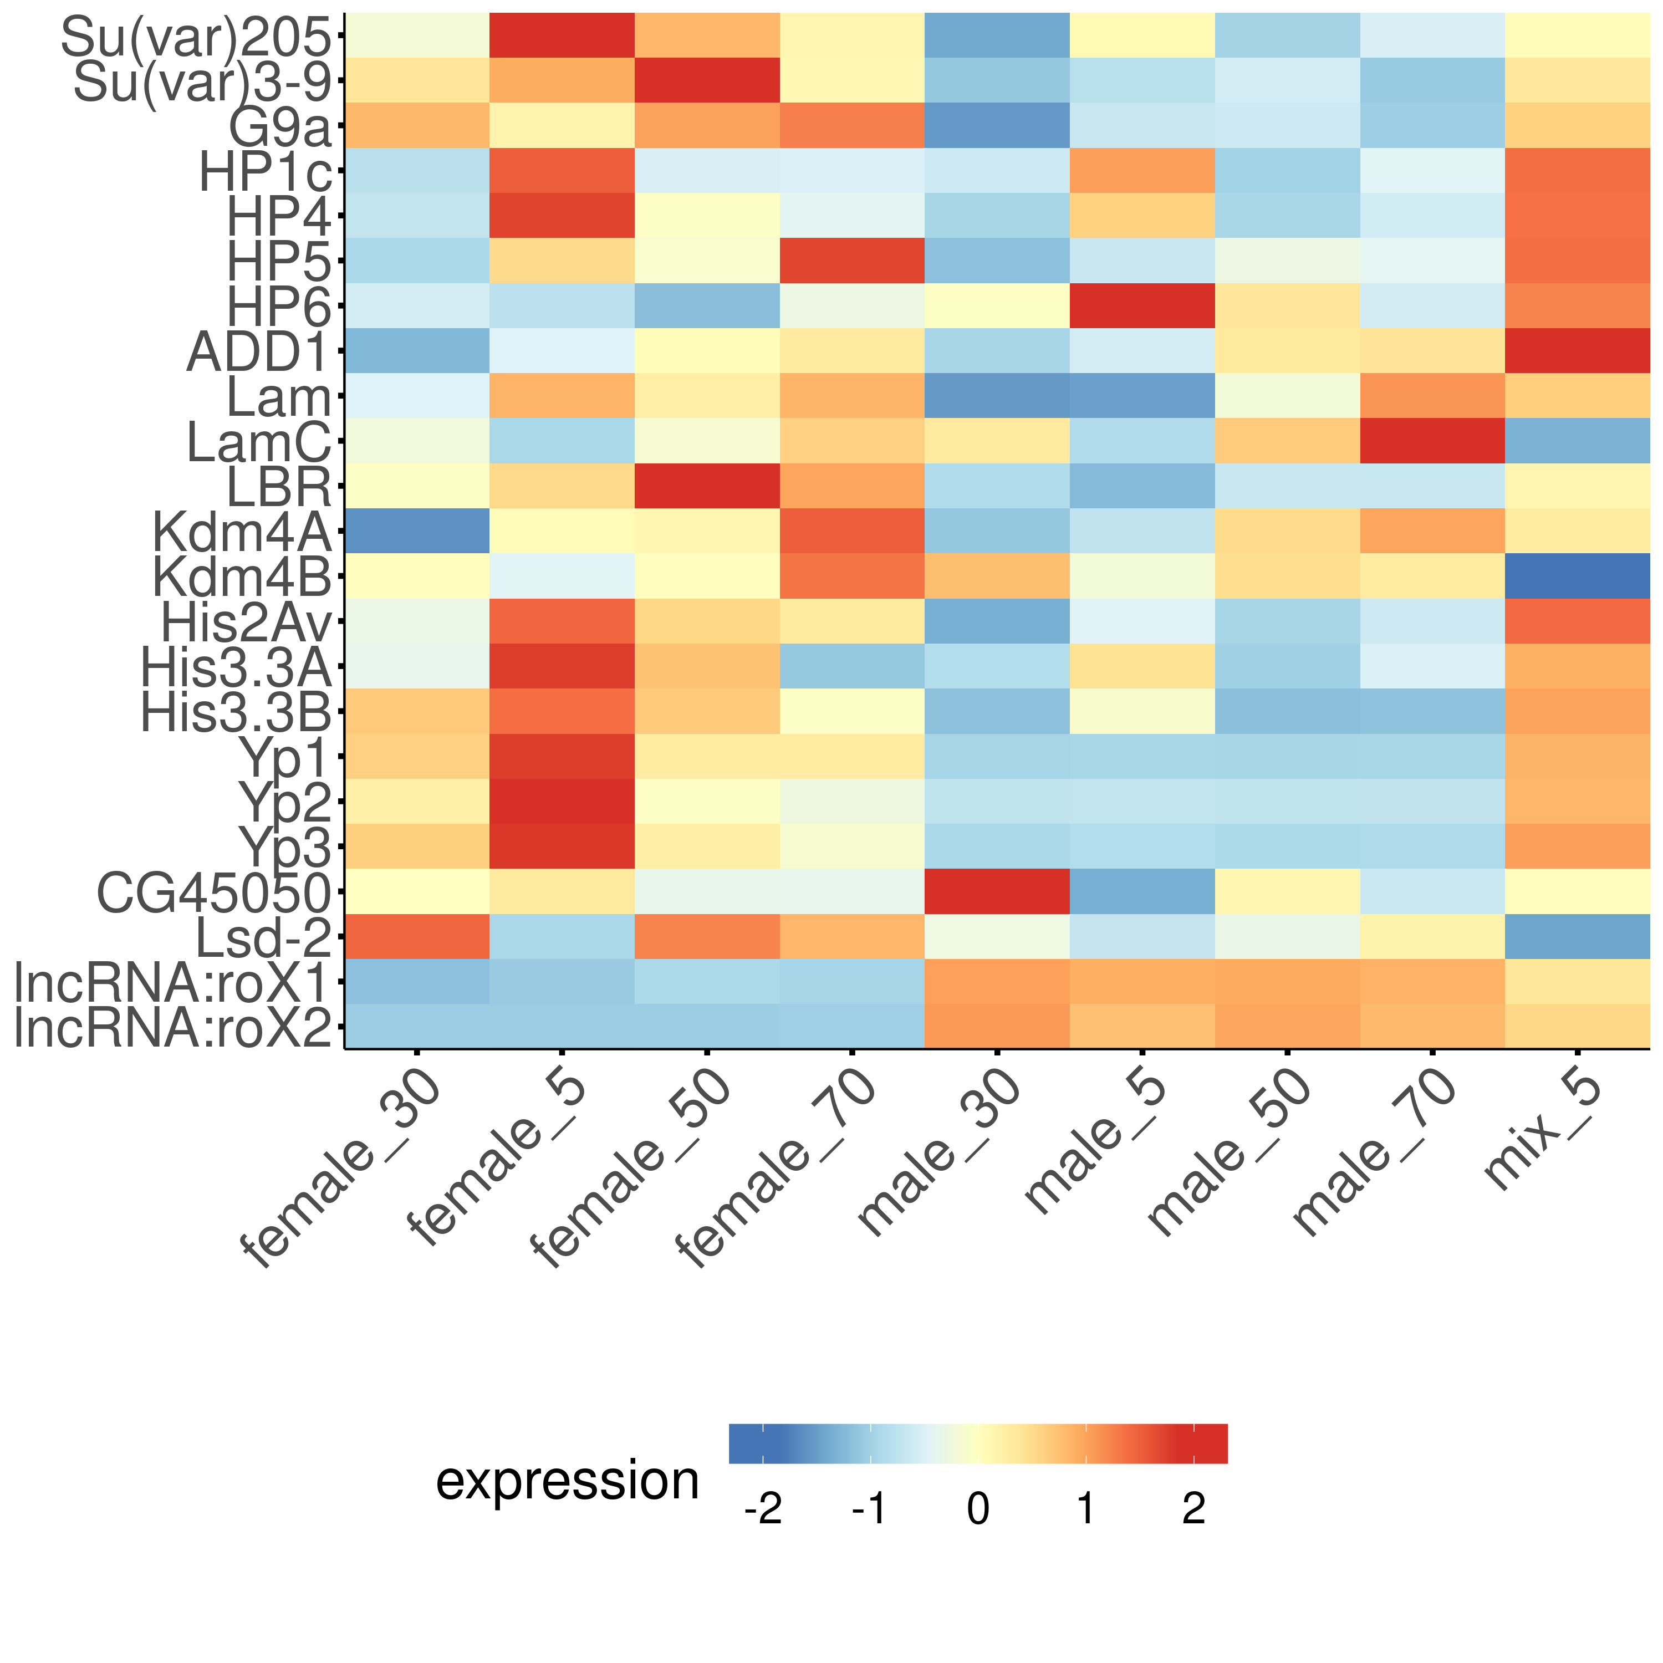
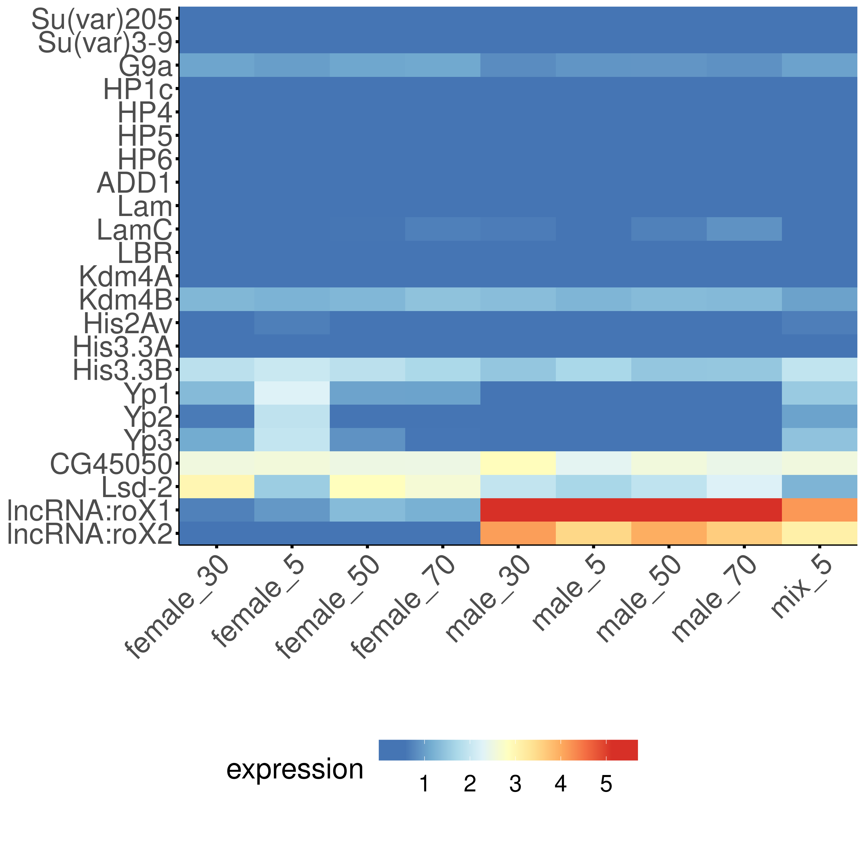
All cell types combined
”Scale gene expression”
not ”Scale gene expression”
"​Next, we performed sex-related analysis. We first observed that female marker yolk protein genes (Yp1, Yp2, and Yp3) showed a significant decrease during aging in most female cell types, while the male markers (roX1 and roX2) maintained high expression levels in most male cells (fig. S18, A and B). In addition, some genes, such as Lsd-2 and CG45050, showed different trends between males and females with age (fig. S18C), suggesting that aging affects male and female cells differently. "

Slide 4
Interesting candidates
Cell types (afca_annotation)
Enterocytes :
adult differentiating enterocyte
adult midgut enterocyte
enterocyte of anterior adult midgut epithelium
enterocyte of posterior adult midgut epithelium
enterocyte-like
Fatbody
adult fat body_body
ISCs:
intestinal stem cell
Genes
Su(var)205, Su(var)3-9, G9a, ​HP1b, HP1c, HP4, HP5, HP6, ADD1, Su(var)2-HP2, Su(var)3-7, Lam, LamC, LBR,
Kdm4A, Kdm4B,
Histone variants (?) : His2Av, His3.3A, His3.3B,

