Slide 1




Handwriting robot
Recognising a page and reproducing an individual writing style
Actual handwriting samples
Writer 150
Writer O
Writer Y
11 stored styles. One calibrated pen gantry.
D.R. Braune | EPR400 | Handwriting robot
1/6
Notes:
Suggested speaking time 40 seconds.
My project reads photographed handwriting, identifies its writer and reproduces new text in a selected writing style. The machine uses a Cartesian belt drive and a separate pen mechanism. The writing examples are actual photographed robot output, not font samples. I will show the processing chain, the main design choices and the measurements, then demonstrate capture, recognition and a short physical writing job.
Sources
Report/ResultsDiscussionRevision_2026-11-02/3_Main_Report/3_Design_and_Implementation.tex; Gantry.jpeg; NaturalVariationBaseline_2026-11-02/illustrated_folds.json

Slide 2
Full system operation
An offline preparation stage supports two operating paths
Labelled pages
Recognition models
Stored glyph profiles
PREPARE
Models support recognition. Profiles supply reproduction.
Camera photograph
Condition and split lines
Text and author
READ
New text + profile
Glyph paths and G-code
Gantry and written page
REPRODUCE
D.R. Braune | EPR400 | Handwriting robot
2/6
Notes:
Suggested speaking time 45 seconds.
The top path is preparation. Labelled handwriting trains recognition models, while the reader and known transcripts support alignment and glyph profile construction. During reading, a camera image is conditioned, divided into lines and passed to separate text and author classifiers. During reproduction, new text and a selected profile become placed and joined glyph paths, G-code and finally motor movements. Preparation is not repeated for every photograph. My design contribution lies in the numerical processing, glyph handling and motion control.
Sources
Report/ResultsDiscussionRevision_2026-11-02/3_Main_Report/design/3_4_segmentation.tex; 3_5_classification.tex; 3_6_reproduction.tex

Slide 3
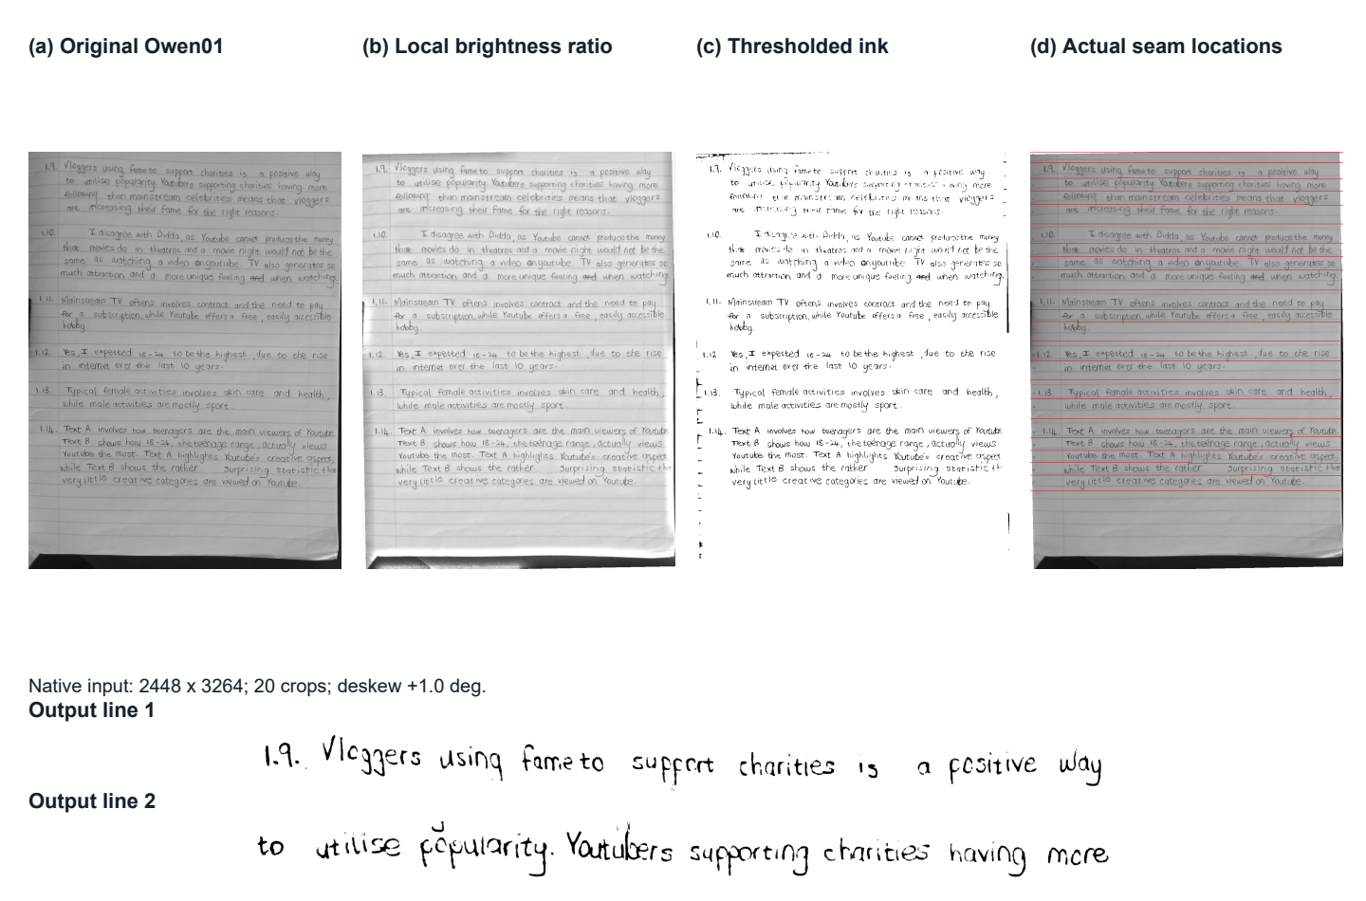
Preparing a page for recognition
Lighting, rotation and line ownership affect everything downstream
Correct lighting
Compare ink with its local background.
Recover the lines
Keep neighbouring strokes in the correct crop.
Inspect the stages
Trace a missing stroke to the operation that lost it.
D.R. Braune | EPR400 | Handwriting robot
3/6
Notes:
Suggested speaking time 50 seconds.
The camera does not supply a clean network input. Uneven lighting and rotation must be corrected first. This example follows an actual page through the grey image, brightness correction, ink mask and line boundaries. The difficult part is assigning connected ink to the correct line without cutting useful strokes. I kept intermediate images so that a recognition error can be traced back to a crop or preprocessing decision. The author classifier also receives normalised stroke thickness so that the original pen width has less influence on writer identity.
Sources
Report/ResultsDiscussionRevision_2026-11-02/Figures/design-segmentation-stages.pdf; Figures/design-stroke-normalisation.pdf

Slide 4
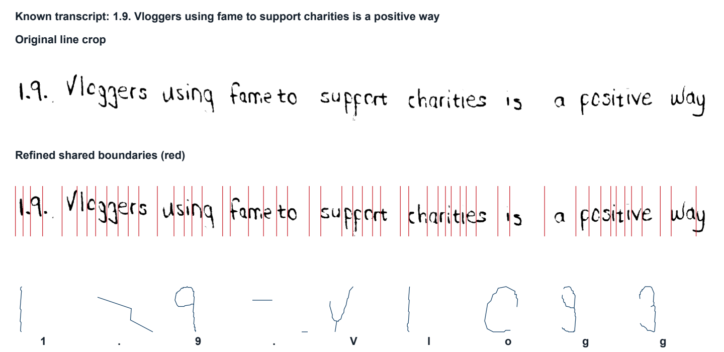
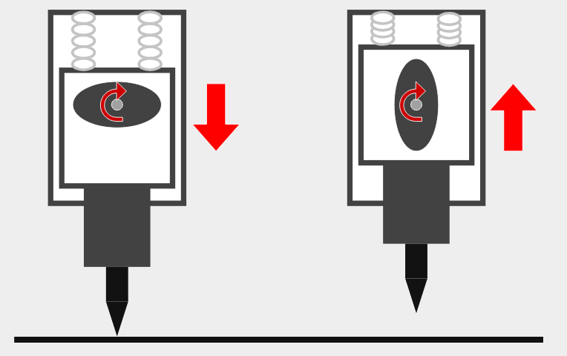
Reusing handwriting as pen trajectories
Known text locates glyphs. Stored paths retain their shapes.
Independent pen lift
Aligned source line and extracted glyphs
Known transcript
Glyph paths
Placement and joins
G-code and motion
D.R. Braune | EPR400 | Handwriting robot
4/6
Notes:
Suggested speaking time 45 seconds.
The photographs contain no recorded pen timing or stroke order. I therefore extract reusable glyph geometry from labelled lines instead of requiring an online handwriting trajectory. The line reader aligns a known transcript, boundaries are refined and skeleton paths are stored in writer profiles. Synthesis then selects variants, places them and adds suitable joins. This gives direct control of the pen geometry, but connected letters depend on their neighbours and remain harder to reproduce. The gantry executes the paths with a separate cam-operated pen lift.
Sources
Report/ResultsDiscussionRevision_2026-11-02/3_Main_Report/design/3_6_reproduction.tex; Figures/design-glyph-alignment.pdf; Figures/pen-up-down-mechanism.png

Slide 5
Measured system performance
Recognition, physical output and motion are checked separately
11
stored styles in physical output
70 / 70
lengths within 0.5 mm
Maximum error 0.49 mm
25 / 25
Original targets are 95% for text and author recognition.
completed jobs within 4 s per character
D.R. Braune | EPR400 | Handwriting robot
5/6
Notes:
Suggested speaking time 60 seconds.
Original-line validation gives 94.06 percent text accuracy and 98.08 percent author identification. On physical output the scores are 84.41 and 86.41 percent. All fourteen pooled page identities are correct, although some individual lines and styles remain difficult. The separate natural-variation geometry test gives a relative score of 86.68 percent on repeated words. That is a shape comparison, not recognition accuracy. All seventy measured feature lengths are within half a millimetre and all twenty-five completed drawing jobs meet four seconds per character. Side lengths do not establish absolute placement across the whole bed.
Sources
Report/ResultsDiscussionRevision_2026-11-02/3_Main_Report/4_Results.tex; QTP1, QTP2, QTP3 and QTP5. Validation populations 1076 reader lines and 156 author lines; physical population 184 lines, 5471 characters.

Slide 6
Timing limit and live demonstration
Faster inference helps, while image preparation still limits some pages
Laptop example, 1291 characters
Demonstration sequence
01
Capture and identify
02
Select a writer and new text
03
Preview and draw
04
Compare with the original
*Conditional estimate using a measured 2.76-fold network gain.
This is not a measured complete-request pass.
D.R. Braune | EPR400 | Handwriting robot
6/6
Notes:
Suggested speaking time 40 seconds.
Classification is the main time shortfall. All thirteen recorded laptop page means and both recorded ODROID requests exceed their budgets. A separate batched library benchmark reduced combined network time by a factor of 2.76. If that gain transfers, this laptop example would fit its allowance, but this remains a projection and other pages still need image-processing improvements. In the demonstration I will capture a page, show its recognised text and writer, select new text and a profile, preview and draw a short job, then compare the output with the original handwriting. The setup must be ready before the examiners arrive.
Sources
Report/ResultsDiscussionRevision_2026-11-02/3_Main_Report/results_tables/laptop_times.tex; laptop_projection.tex; Report/_dev/qtp_data/qtp4_results.json; FinalReport_v6/measurements/outputs/r4_conditions/conditions.json.

