Slide 1







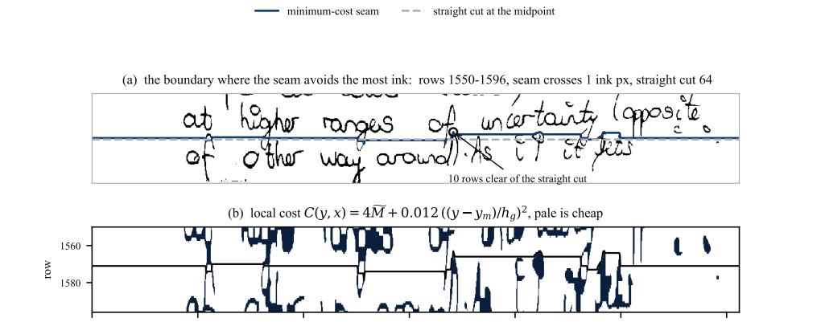


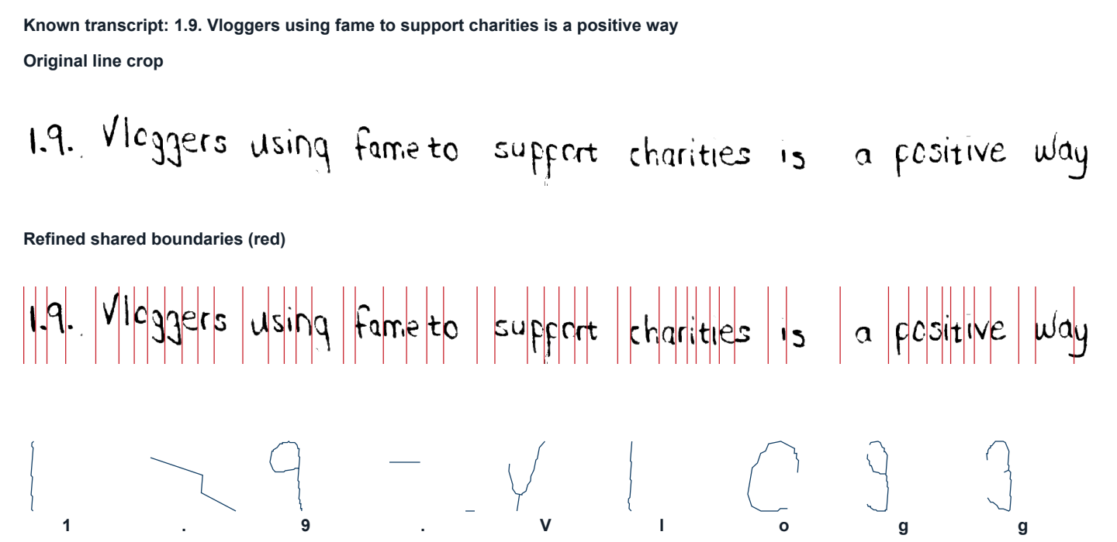
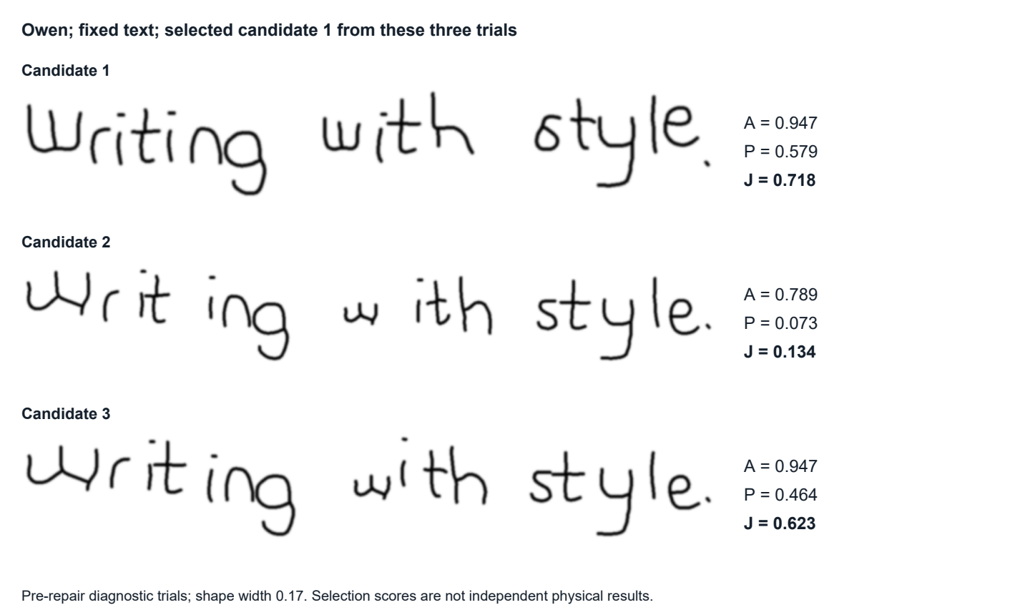
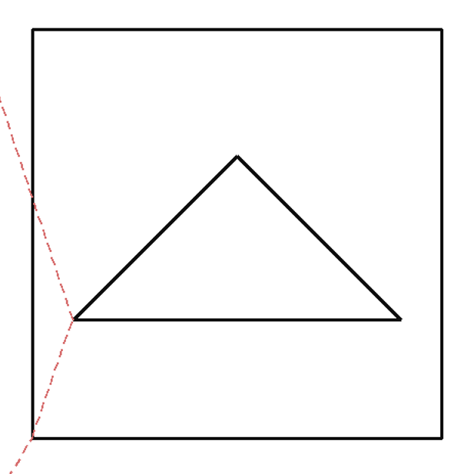
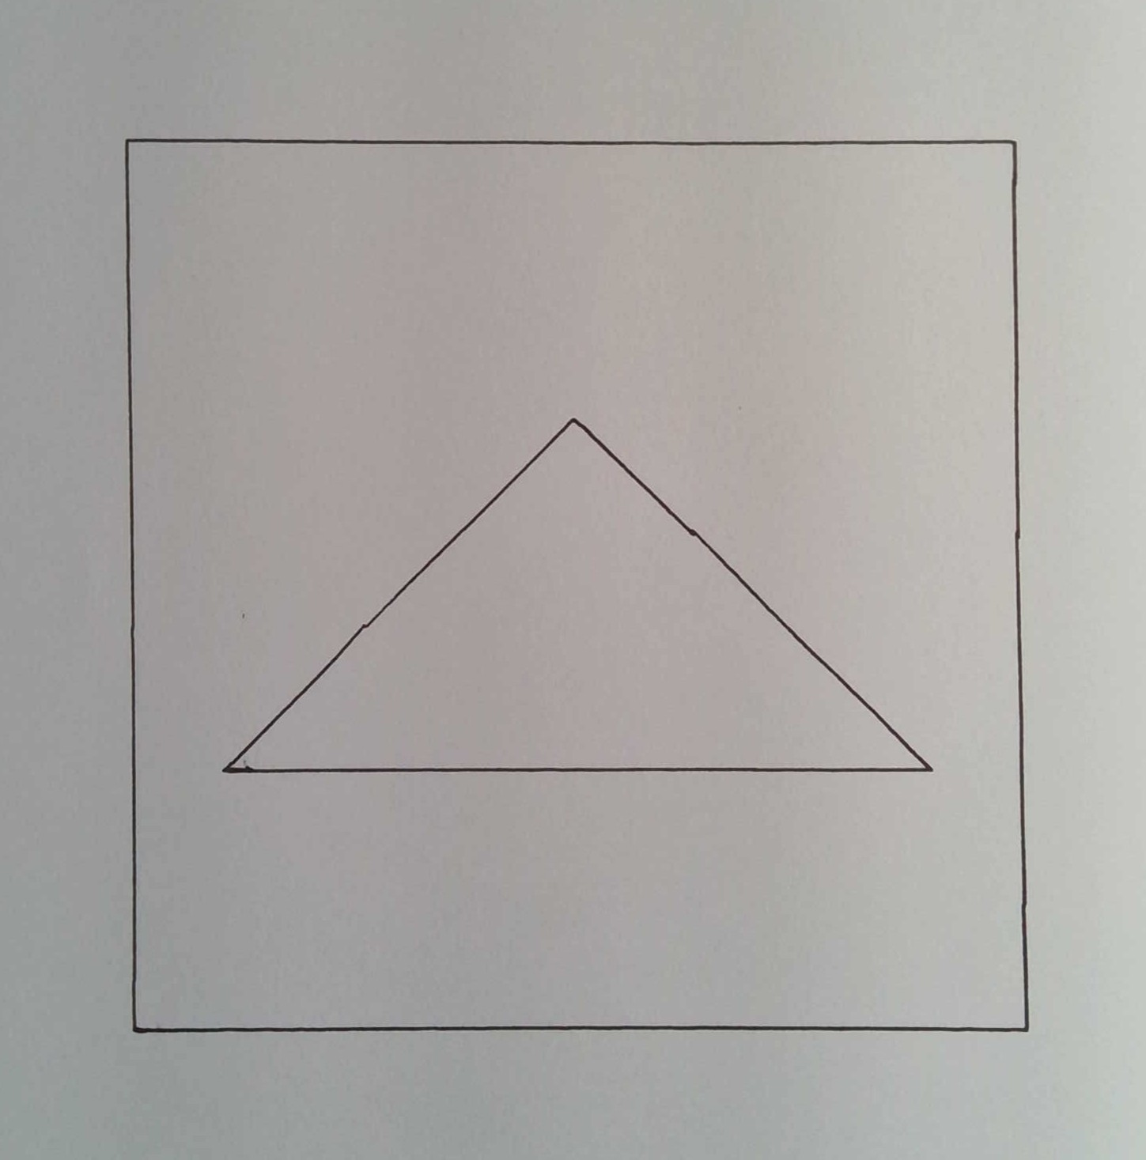

Handwriting robot
Recognise a page. Reproduce an individual writing style.
D.R. Braune | 23539195 | Supervisor: Prof. H.C. Myburgh
THE BUILT SYSTEM
ORIGINAL SAMPLE
ROBOT WRITING
150
O
Y
Cartesian belt drive, separate pen lift and ODROID control.
Actual word photographs show the style retained in physical output.
Full system functional flow
PREPARE
Labelled handwriting
Recognition models
Stored glyph profiles
READ
Camera photograph
Condition and split lines
Text + author
REPRODUCE
New text + profile
Glyph paths + G-code
Gantry + written page
Models and profiles are prepared offline, then reused during operation.
Subsystem design and visual checks
01
Page conditioning and segmentation
Correct lighting and rotation.
Assign ink to ordered line crops.
02
Text and author recognition
Centreline
Fixed width, 0.17 x-height
Read complete lines with CNN–BiLSTM–CTC.
Normalise stroke width for author identification.
03
Glyph extraction
Align known text, refine character cuts
and trace stored centreline paths.
04
Synthesis and G-code
Selected synthesis candidate, software preview
Select variants, place and join glyphs,
then map paths into machine coordinates.
05
Motion and pen control
Commanded path
Physical drawing
Coordinate two stepper axes and the pen lift.
Use switches for homing and interruption.
Measured performance
Reader and author classifier scores
Largest length error in each geometric sample
11 styles
70 / 70 lengths ≤ 0.5 mm
25 / 25 jobs ≤ 4 s / character
Main limits are connected-letter context and classification time.
Department of Electrical, Electronic and Computer Engineering
Methods: Graves et al. (2006), Haines et al. (2016), Zhang and Suen (1984).
Project records: original validation, 14 physical pages and 10 geometric samples.
Geometric results describe feature lengths. Classification latency remains above target.
Notes:
A1 portrait mock poster, adapted to the supplied template dimensions. Source branding artwork is retained unchanged.
Subsystem figures are project-generated visual checks, not new qualification tests. The handwriting samples are native photographed word crops. The reproduction paths in subsystem 04 are software previews, not additional physical measurements.
Recognition data: original text 94.06%, author 98.08%; physical text 84.41%, author 86.41%. Physical scores use 184 paired lines. All 70 lengths are within 0.5 mm. Largest sample errors shown are from the supplied ten-sample table. All 25 completed drawing jobs meet 4 s per character. The trained writer set has 11 identities.
Sources: Report/ResultsDiscussionRevision_2026-11-02/3_Main_Report/4_Results.tex; Report/NaturalVariationBaseline_2026-11-02/illustrated_folds.json; project VisualTests and design figures. Gantry photo: Downloads/Gantry.jpeg. Branding: Downloads/Poster Template.pptx.

