Slide 1
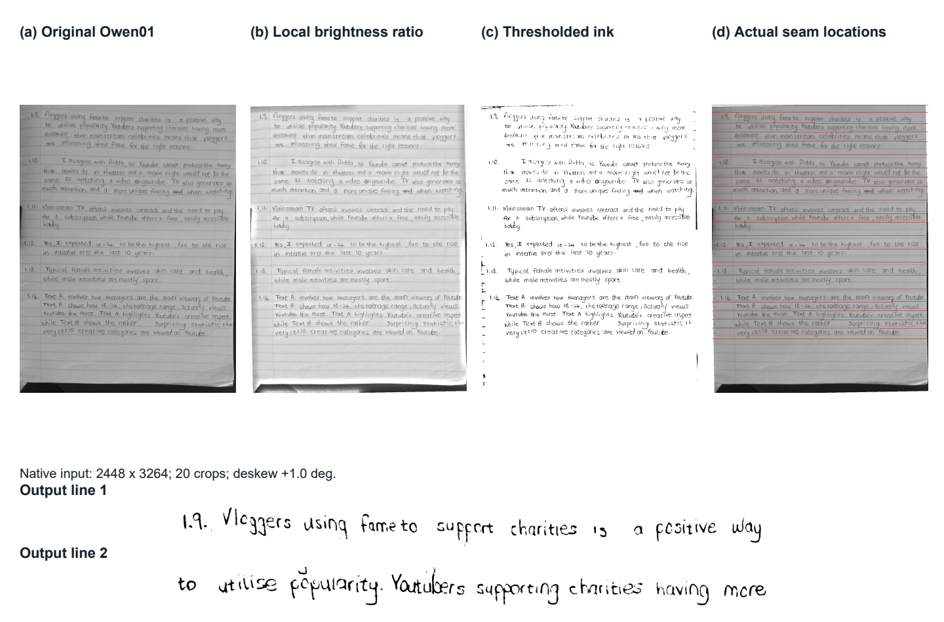








Handwriting robot
Reading handwriting and reproducing an individual writing style
D.R. Braune, 23539195 Supervisor Prof. H.C. Myburgh
Project overview
The system reads photographed handwriting, identifies the writer and uses stored glyphs
to write new text in that person’s style with a two-axis pen gantry.
READ A PAGE
Camera image
Page processing
Text and writer
WRITE NEW TEXT
New text + writer profile
Glyph paths + G-code
Gantry and pen
Preparation uses labelled handwriting to train the models and build the writer profiles.
01
Page processing
02
Text and writer recognition
Photographed page
Detected line boundaries
Recognition screenshot
Correct uneven lighting and rotation, then separate
the handwriting into ordered line images.
A line reader recognises the text. A separate classifier
identifies the writer using normalised stroke width.
03
Handwriting reproduction
04
Gantry and pen control
Original handwriting
Robot handwriting
Writer 150
Owen
Yeukita
Store each writer’s glyph shapes, place and join them,
then convert the paths into G-code for the gantry.
Two belt-driven axes position the pen. A separate motor
raises it, while switches support homing and stopping.
Results
Recognition scores
70 / 70
measured lengths within 0.5 mm
Largest error 0.49 mm
25 / 25
completed jobs within 4 s per character
Original validation and photographed robot output
are separate test sets. Physical output has 184 lines.
11 writer styles
Classification time remains above target.
Connected letters need more context.
Department of Electrical, Electronic and Computer Engineering
EPR400 project, 2026. Results from the project qualification records.
Length measurements assess drawn dimensions. Writing time covers completed jobs.
Notes:
Rebuilt A1 poster with four large subsystem panels. The pale recognition image area is intentionally reserved for a genuine UI screenshot showing an input line, recognised text and writer. No fabricated screenshot or experimental output is used.
Sources: Report/ResultsDiscussionRevision_2026-11-02, design and Results sections. Page-processing images reuse actual Owen01 and its detected boundaries from Figures/design-segmentation-stages.pdf. Original and physical robot word photographs come from Report/NaturalVariationBaseline_2026-11-02/illustrated_folds.json. Hardware photograph is Downloads/Gantry.jpeg.
Reader validation 94.06% on 1076 lines. Author validation 98.08% on 156 lines. Physical output text 84.41%, writer 86.41% on 184 lines from 14 pages. Original and physical test sets are distinct. All 70 supplied feature-length readings are within 0.5 mm, maximum 0.49 mm. This does not establish absolute XY positioning. All 25 completion-confirmed drawing jobs meet 4 s/character. Classification latency fails its target. No new data processing or model evaluation performed.
Original UP branding retained unchanged.

