Slide 1
CSGO Leader boards
Dylan Grimes

Slide 2
The Brief
Solo project
CRUD functionality
OOP based application

Slide 3
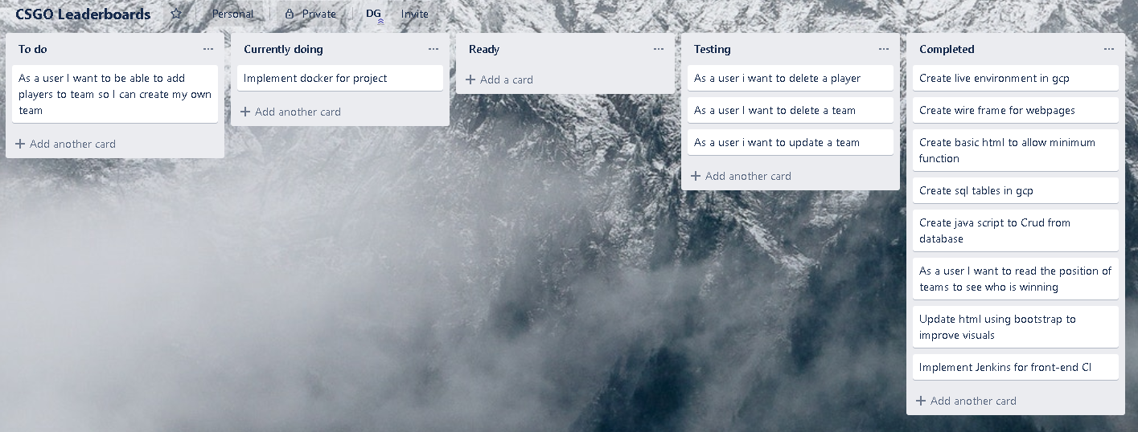
Solution

Slide 4
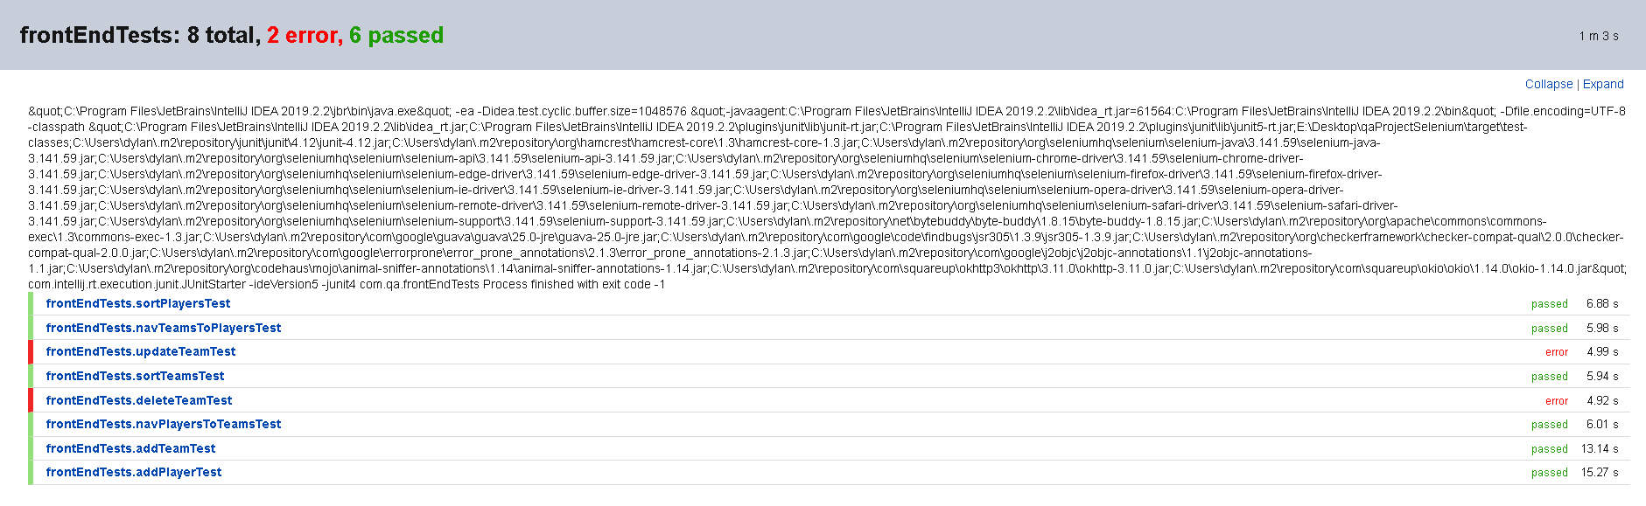
Testing - Selenium

Slide 5
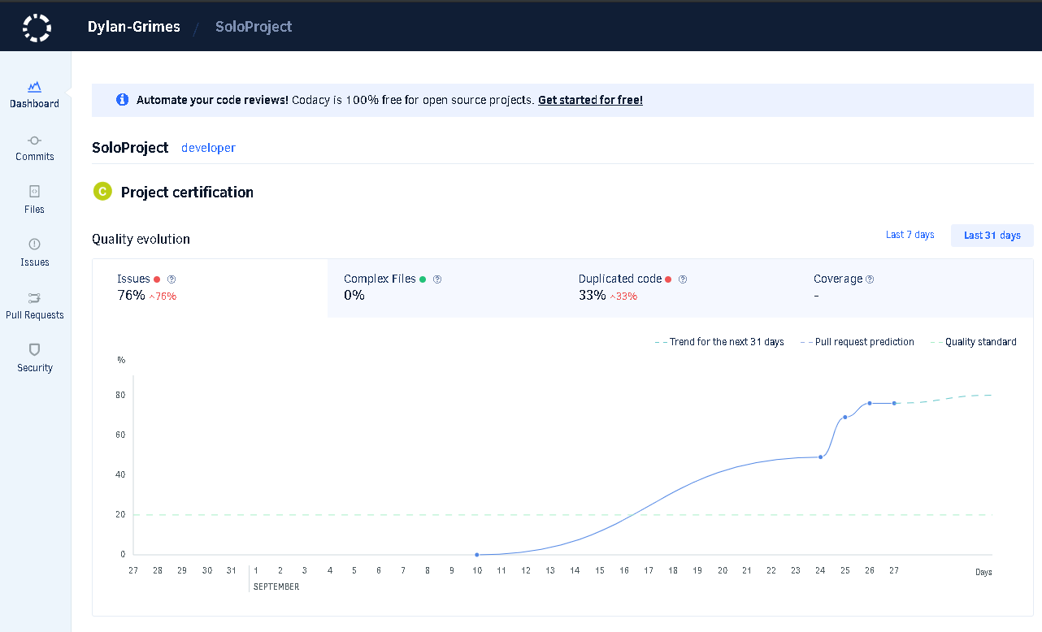
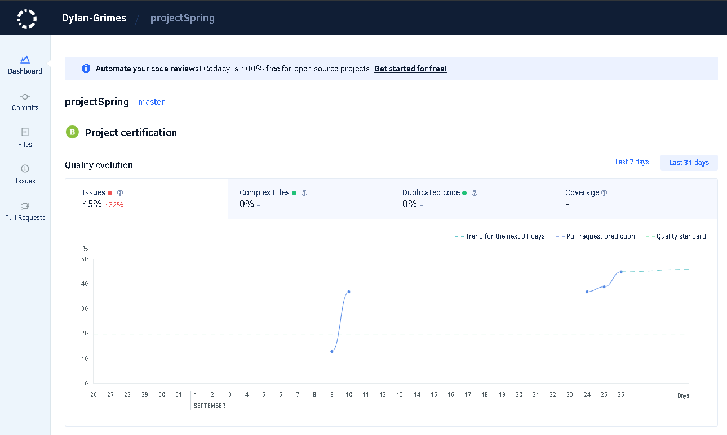
Testing - Codacy

Slide 6
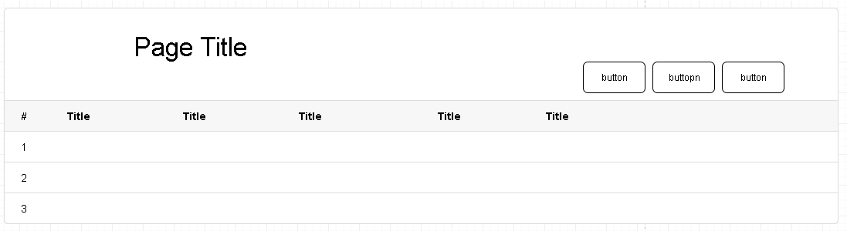
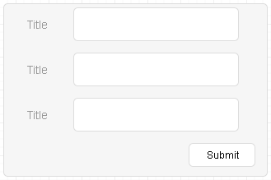
Wireframes

Slide 7
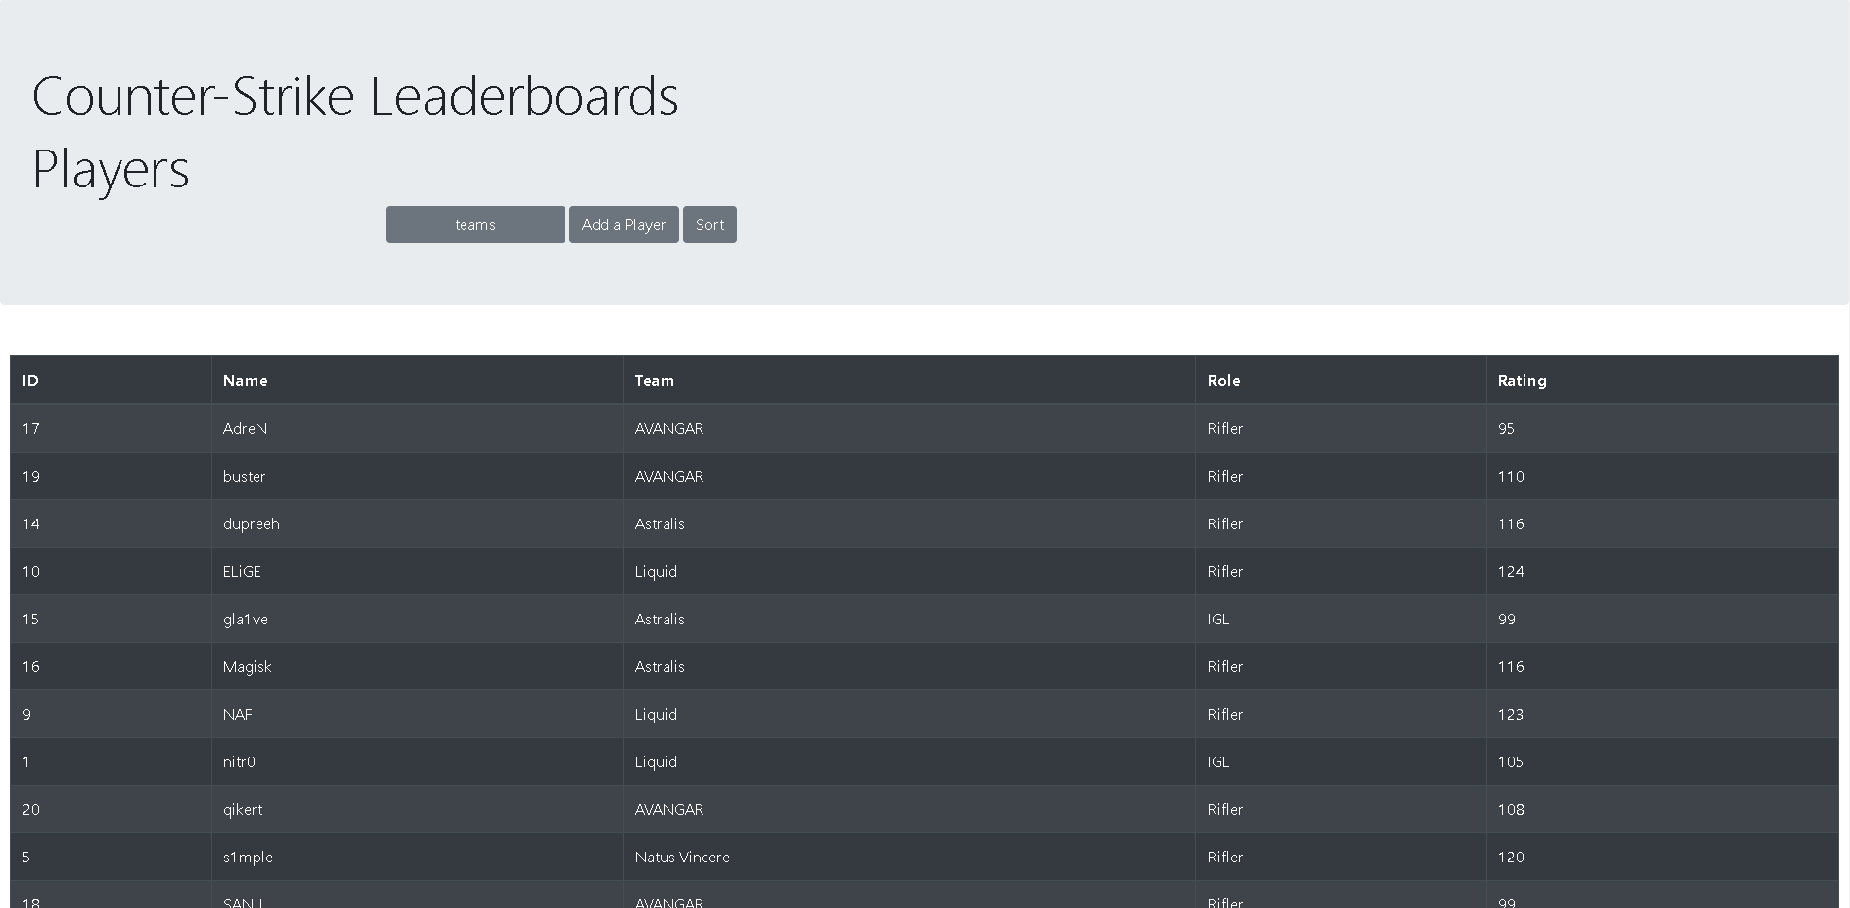
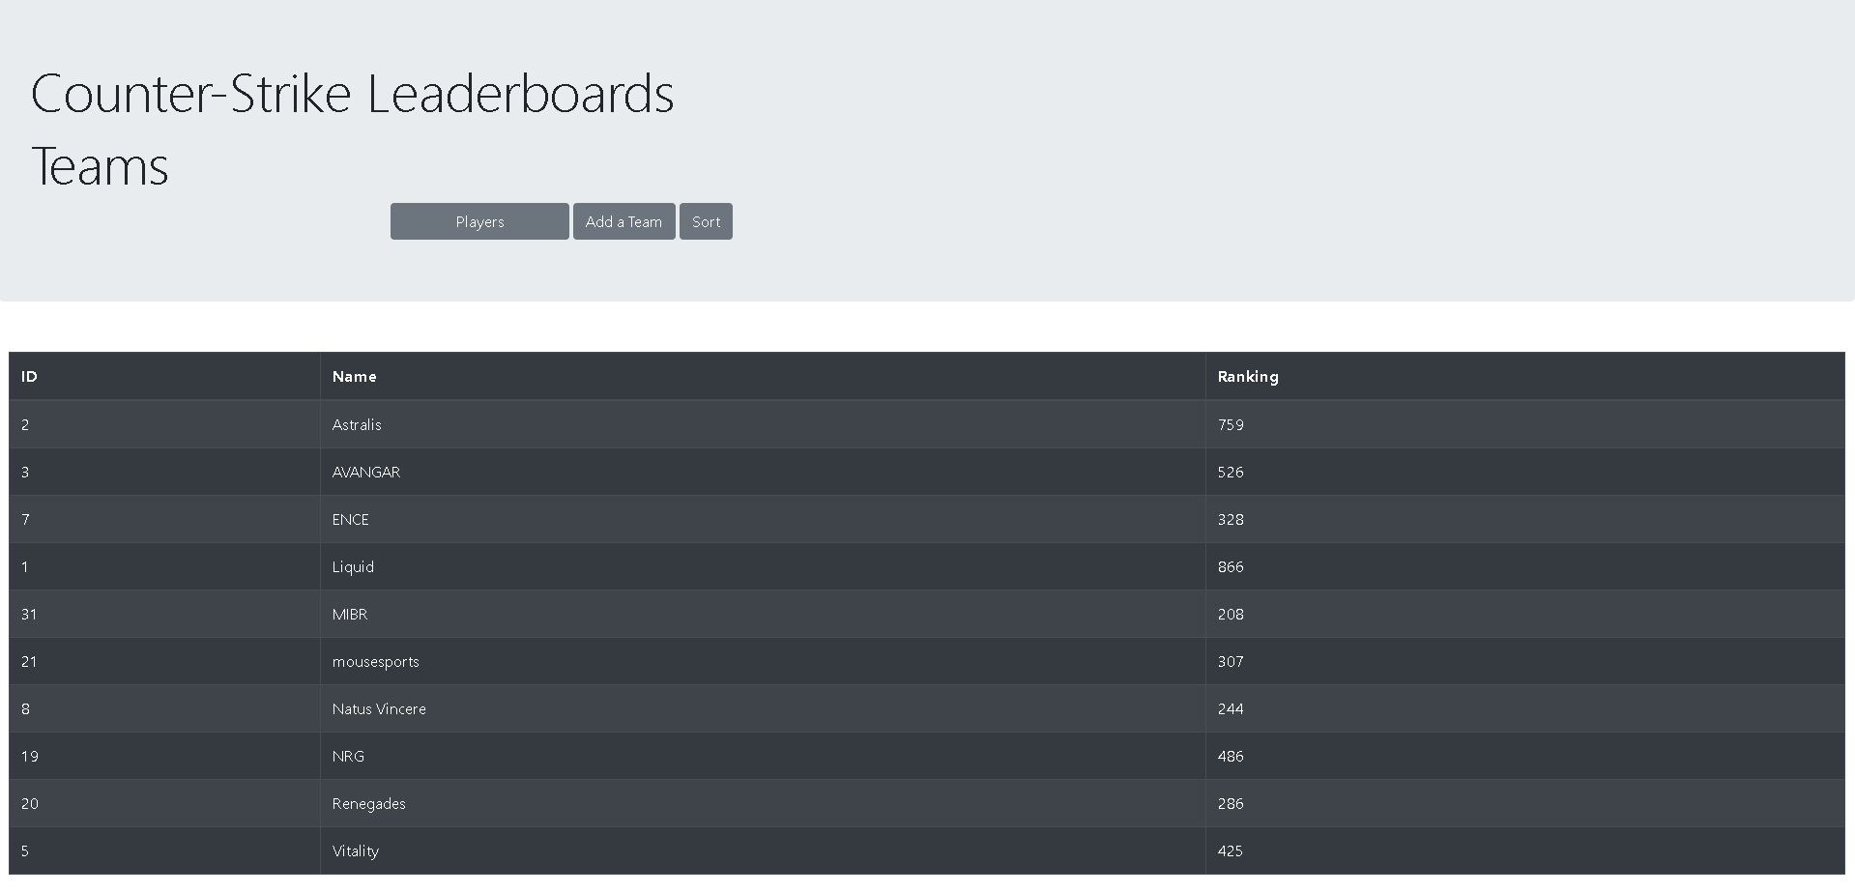
Solution – Leader boards

Slide 8
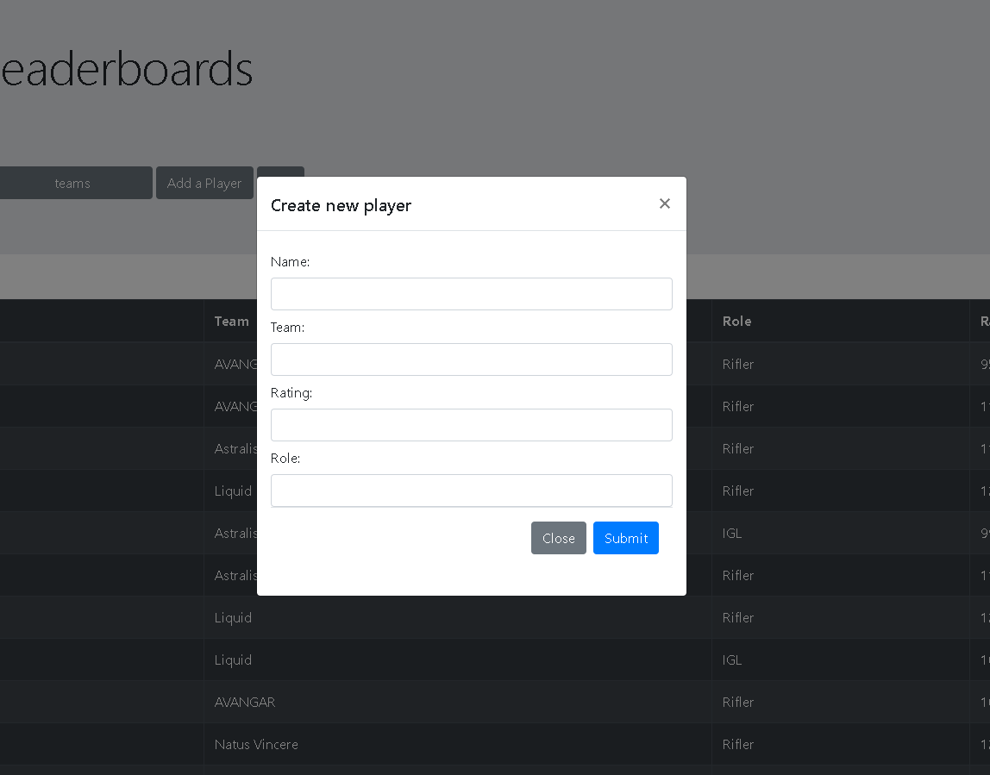
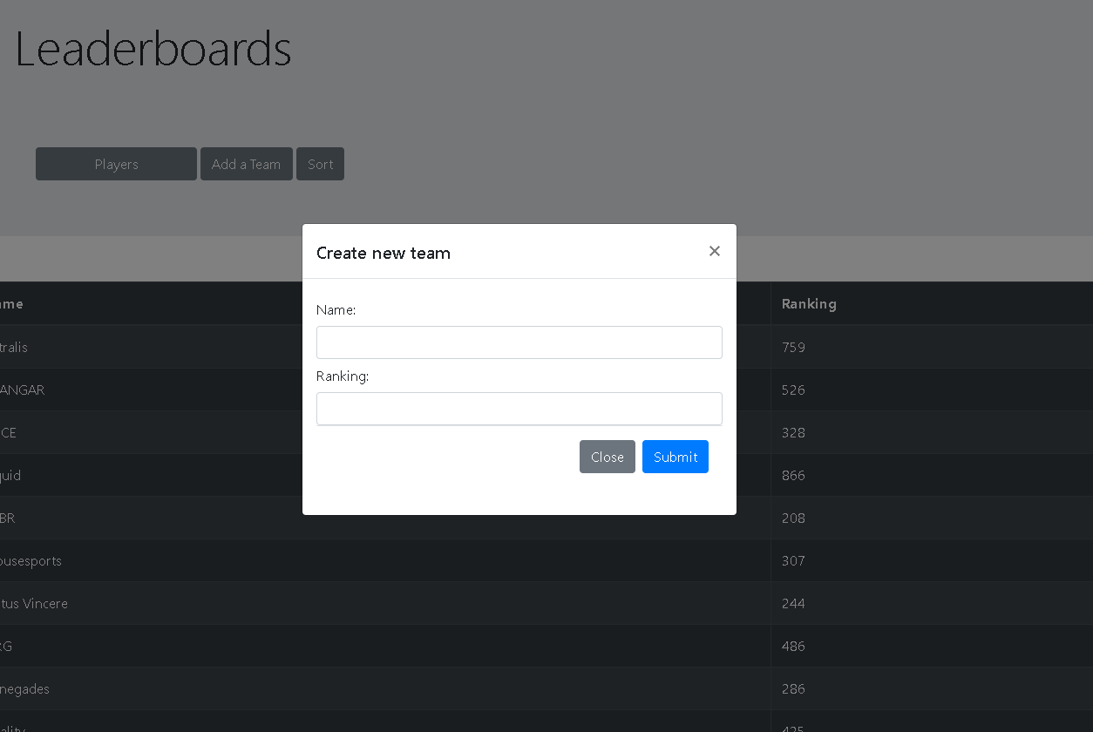
Solution – Add functions

Slide 9
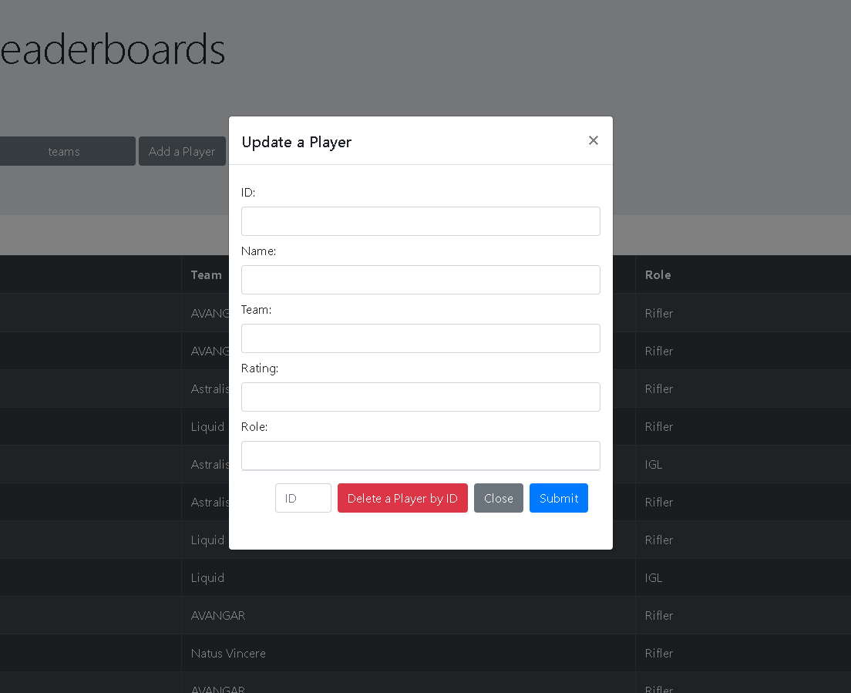
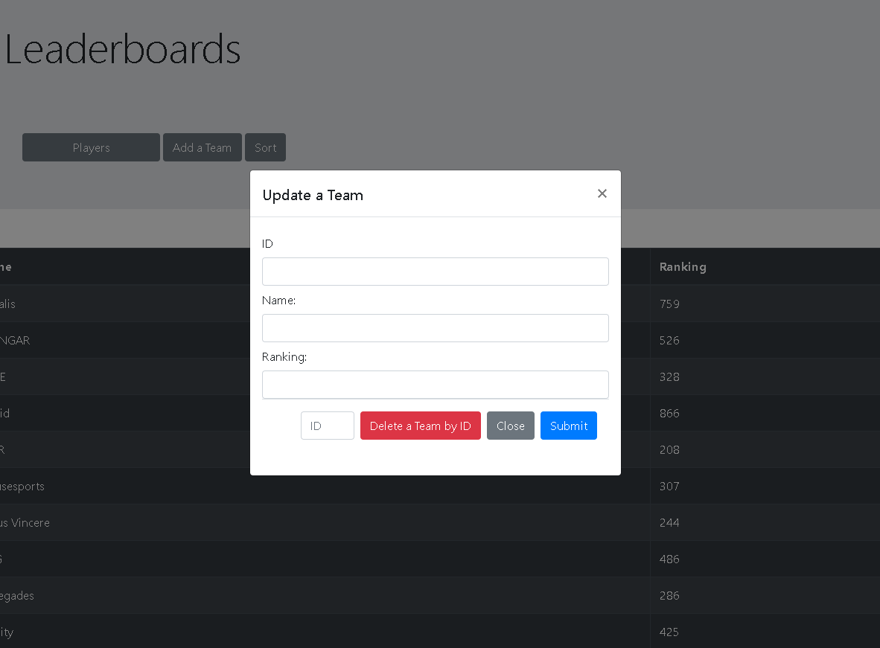
Solution – Modify functions

Slide 10
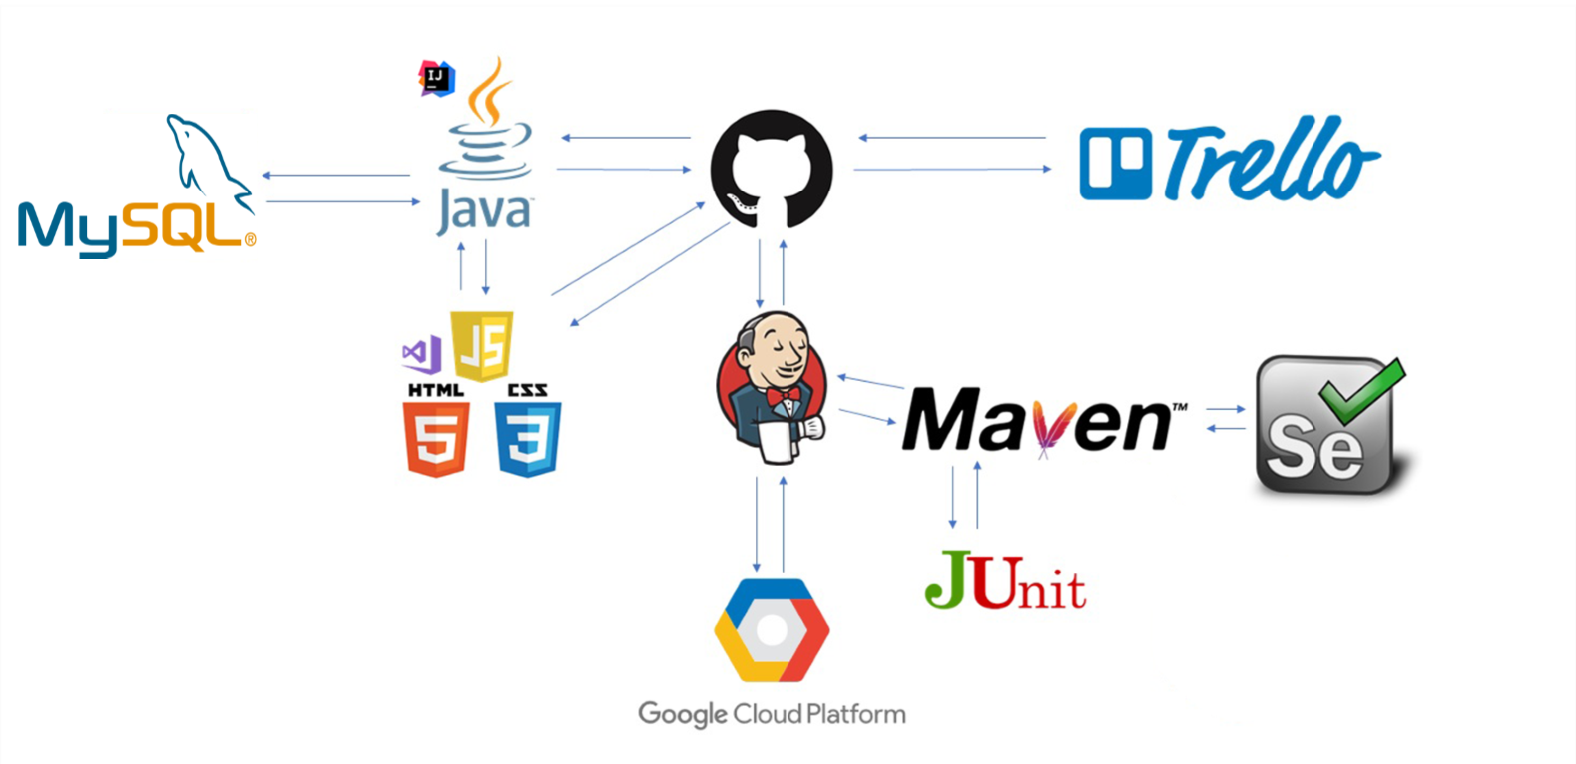
DevOps and CI

Slide 11
Summary

Slide 12
Demonstration

Slide 13
Questions and Feedback
Thank you for listening

