Slide 1

IT 3531 - Final Year Project Secure DevOps
Project Supervisor: Ms Huang
By: 190312k Dylan Liew

Slide 2
Overview
Introduction
Demonstration of Use Cases
Conclusion

Slide 3
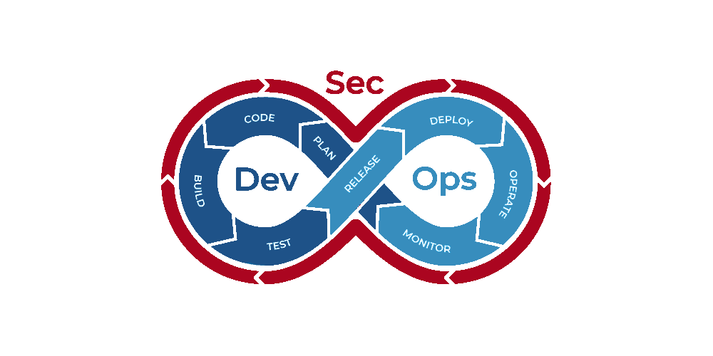
What is DevSecOps
DevOps -> A set of practices that automates the process between Dev & Ops
Build, test, and release software faster and more reliably.
DevSecOps -> Embeds security throughout the software development and delivery lifecycle

Slide 4



Project Objective
Research and evaluate enterprise DevSecOps models
Built by
Open source tools
Commercial offering
Cloud Service Providers
Software Development Platforms

Slide 5

What is GitLab
Complete DevOps Platform
Single Application

Slide 6
Git-based fully integrated platform for software development

Slide 7
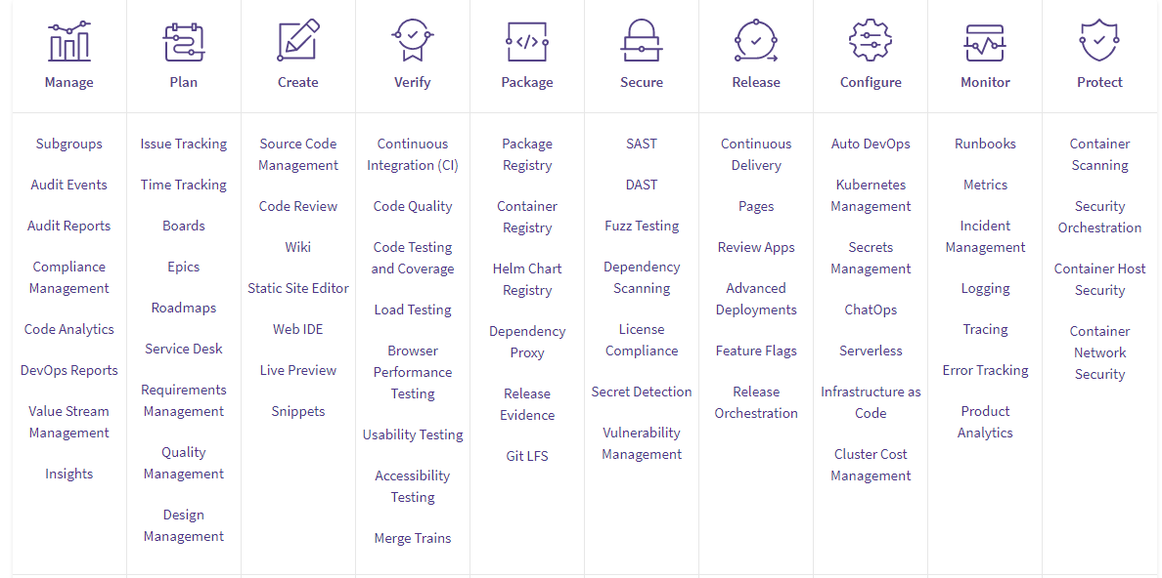
GitLab DevSecOps Toolchain

Slide 8
Security Tools
Security Tool | Description
Static Application Security Testing (SAST) | Analyze source code for known vulnerabilities.
Dynamic Application Security Testing (DAST) | Analyze running web applications for known vulnerabilities.
Container Scanning | Scan Docker containers for known vulnerabilities.
Dependency Scanning | Analyze your dependencies for known vulnerabilities.
Fuzz Testing | Find unknown bugs and vulnerabilities with fuzzing/coverage-guided fuzzing.
Secret Detection | Analyze Git history for leaked secrets.

Slide 9
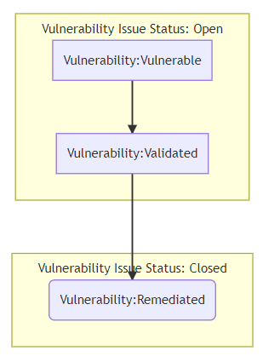
Vulnerability Management

Slide 10

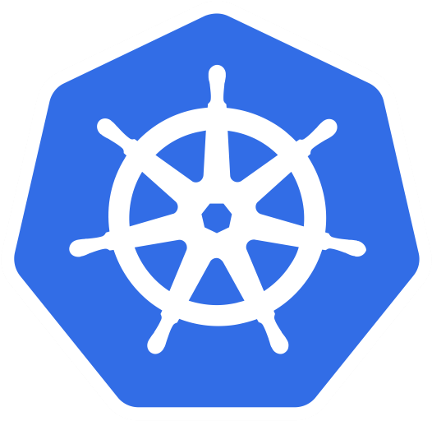
Other Technologies Implemented
Docker
Create, deploy, and run applications by using containers easily.
Package up an application with all of the parts it needs and deploy it as one package.
Kubernetes
Container-orchestration system
Azure Kubernetes Service (AKS)

Slide 11



Getting Started with GitLab CI/CD
Git Repository
Runner
.gitlab-ci.yml File

Slide 12
Demonstration of
Use Cases

Slide 13
AndroGoat
Kotlin Android Application

Slide 14
AndroGoat
Kotlin Android Application
Pipeline Stages
Build
Test
Package
GitLab Security Features
Code Quality Scan
Static Application Security Testing
Secret Detection

Slide 15
WebGoat.NET
ASP.NET Web Application

Slide 16
WebGoat.NET
ASP.NET Web Application
Pipeline Stages
Build
Test
GitLab Security Features
Static Application Security Testing
Container Scanning

Slide 17
VAmPI
Python Web API

Slide 18
VAmPI
Python Web API
Pipeline Stages
Build
Test
Fuzz
GitLab Security Features
Static Application Security Testing
Code Quality
Secret Detection
Container Scanning
Dependency Scanning
License Scanning
API Fuzzing

Slide 19
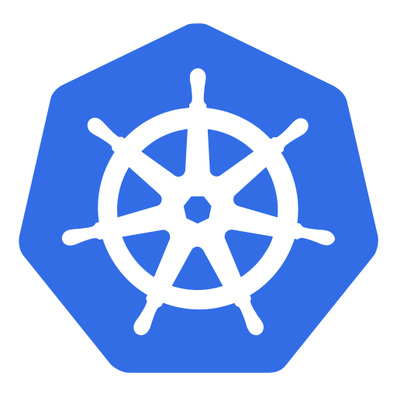
NodeGoat
NodeJS Web Application
Notes:
NodeGoat (Sprint 4)
- Vulnerable NodeJS Web Application
This use case contains the full devops process including build test and finally deploy.
Using this project to demonstrate dast, dependency scanning, license scanning and lastly deployment of web application to kubernetes service.
Dynamic application security testing (DAST) is a black box testing method that examines an application as it’s running to find vulnerabilities that an attacker could exploit.
The Dependency Scanning feature can automatically find security vulnerabilities in your dependencies
License Scanning or License Compliance searches your project’s dependencies for their licenses. You can then decide whether to allow or deny the use of each license. For example, if your application uses an external (open source) library whose license is incompatible with yours, then you can deny the use of that license.
Container Scanning - > using Alphine Image (Show Docker File)
Alphine Image : A minimal Docker image based on Alpine Linux with a complete package index and only 5 MB in size!
The application and the mongodb used by the application is being to deployed to AKS and it is accessible to the public through load balancer created.
Demonstrate seamlessly deploy updates
GitLab offers powerful integration with Prometheus for monitoring key metrics of your apps, directly in GitLab although it is getting deprecated soon and unclear on what are the replacement gitlab going to use.

Slide 20
NodeGoat
NodeJS Web Application
Pipeline Stages
Build
Test
Dast
Deploy to Azure Kubernetes Service
GitLab Security Features
Static Application Security Testing
Code Quality
Secret Detection
Container Scanning
Dependency Scanning
License Scanning
Dynamic Application Security Testing (OWASP ZAP)

Slide 21
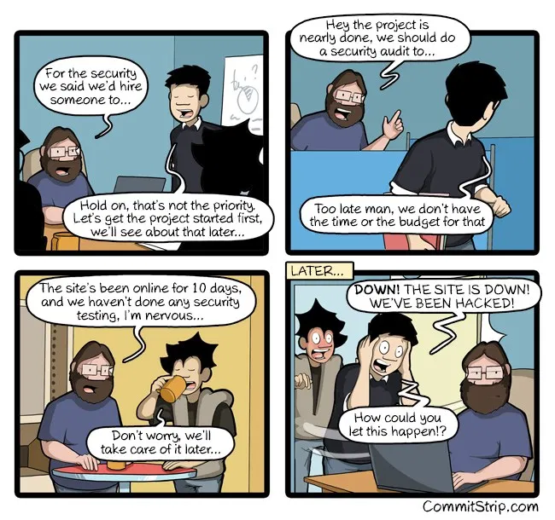
Conclusion and Key Takeaway
Technical Skills
Script writing
DevSecOps workflow
Understanding on the new technology trend

Slide 22
THANKS

