Slide 1






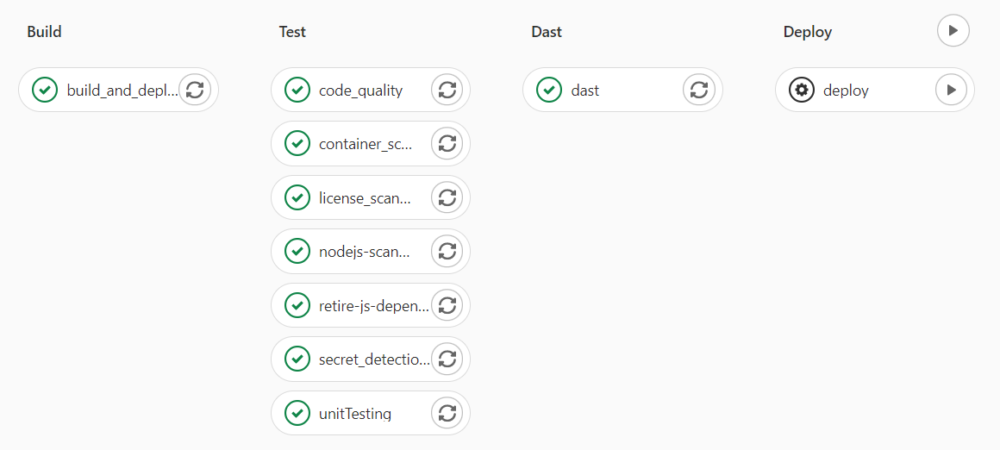
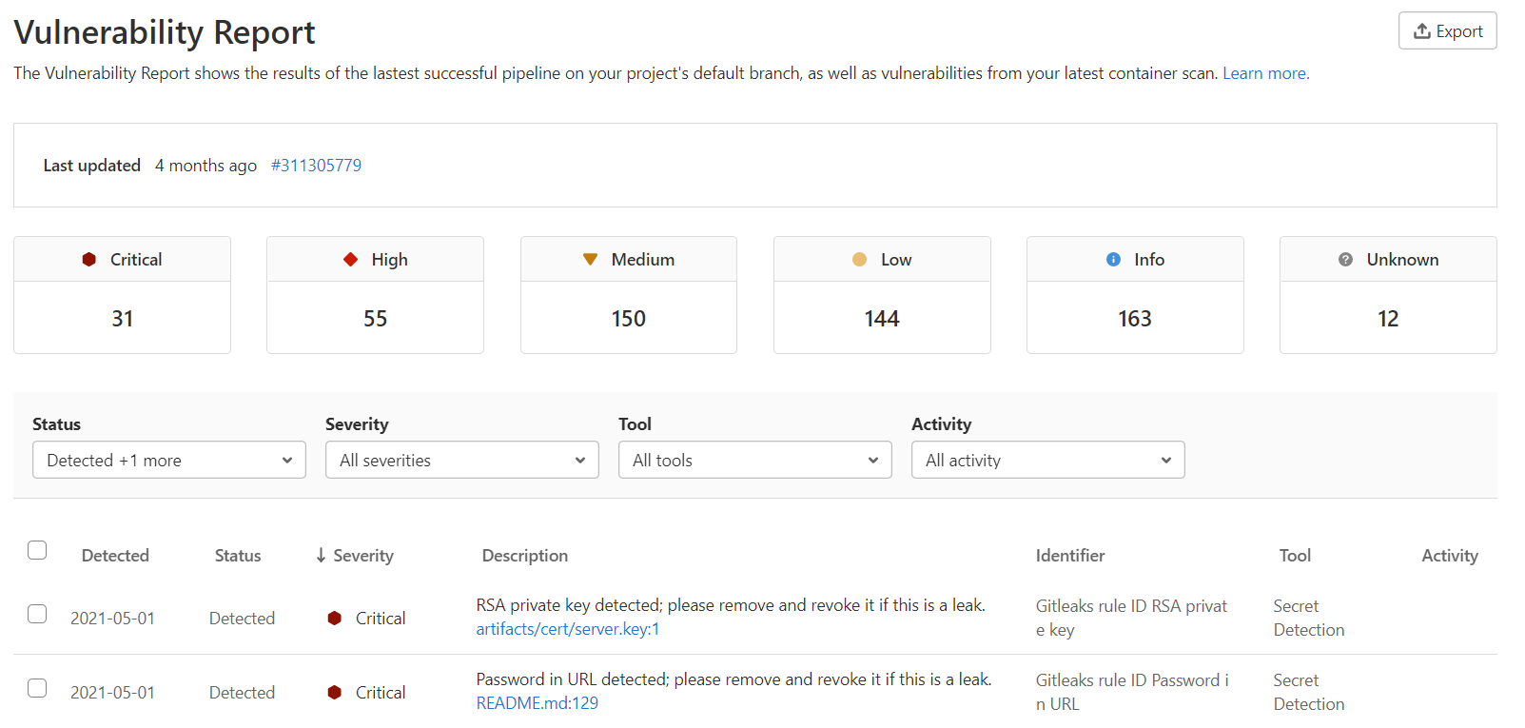
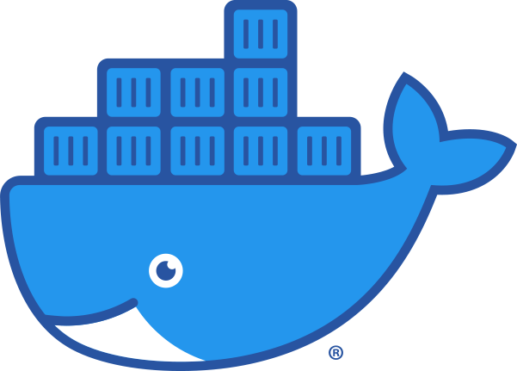
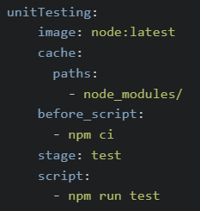
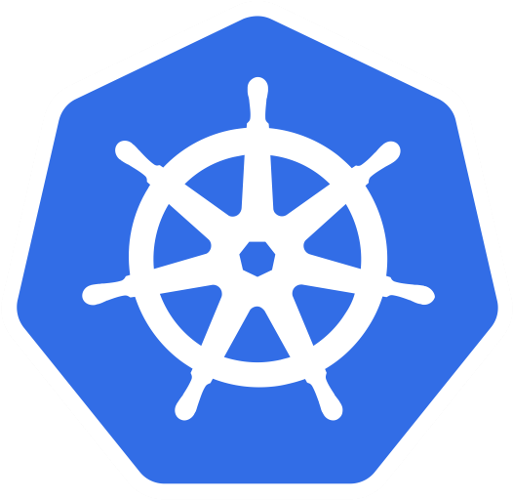
DevSecOps with GitLab (v13.2)
What is GitLab?
Use Case Implementation
Use Cases
Security Features Implemented
Open source deliberately vulnerable application is forked to GitLab repository for use case demonstration.
Ensure GitLab runner availability, create and configure .gitlab-ci.yml file to run necessary jobs based on different scenario through GitLab CI/CD pipeline.
Use cases to demonstrate GitLab features in different scenarios
1. AndroGoat
Kotlin Android Mobile Application
2. WebGoat.NET
.NET Web Application
3. VAMPI
Python Web API
4. NodeGoat
NodeJS Web Application with MongoDB
Static Application Security Testing (SAST)
Dynamic Application Security Testing (DAST)
Fuzz Testing
Dependency List/Scanning
Secret Detection
Container Scanning
API Fuzzing
Complete
DevOps Platform
Delivered as a Single
Application
Other Features Implemented
Container Registry
Kubernetes Management
Secret Management
Git Repository
Runner
.gitlab-ci.yml
GitLab CI/CD Pipeline Configuration
GitLab Sample Pipeline
Other Technologies Implemented
To use GitLab CI/CD pipeline, you need:
GitLab runner
Application code in a Git repository
.gitlab-ci.yml file that contains CI/CD configuration
Create, deploy, and run application by using containers easily.
Package up an application with all of the parts nit needs and deploy it as one package
In the .gitlab-ci.yml file, you can define scripts, templates to include and others using keywords.
Notes: Those highlighted in blue are the keywords
Docker
Here is one of the pipeline I did for NodeGoat.
Whenever there is a new changes in the repository, the pipeline will run.
There are 4 stages:
Build : Build the docker image and deploy to the GitLab container registry
Test : Unit testing and security testing
DAST : Dynamic Application Security Testing with the use of GitLab service as testing environment
Deploy : Manually deploy the application to Azure Kubernetes cluster
You can view Vulnerability Report which shows the results of the latest successful pipeline on your project's default branch, as well as vulnerabilities from your latest container scan.
By default, the GitLab CI/CD executor pulls images from Docker Hub to run the jobs.
As of sample above, it pull the node:latest image from Docker Hub.
Notes: Do go through all the keywords. It will assist you when configuring your pipeline.
Container-orchestration system
Azure Kubernetes Service (AKS)
Kubernetes

