Slide 1







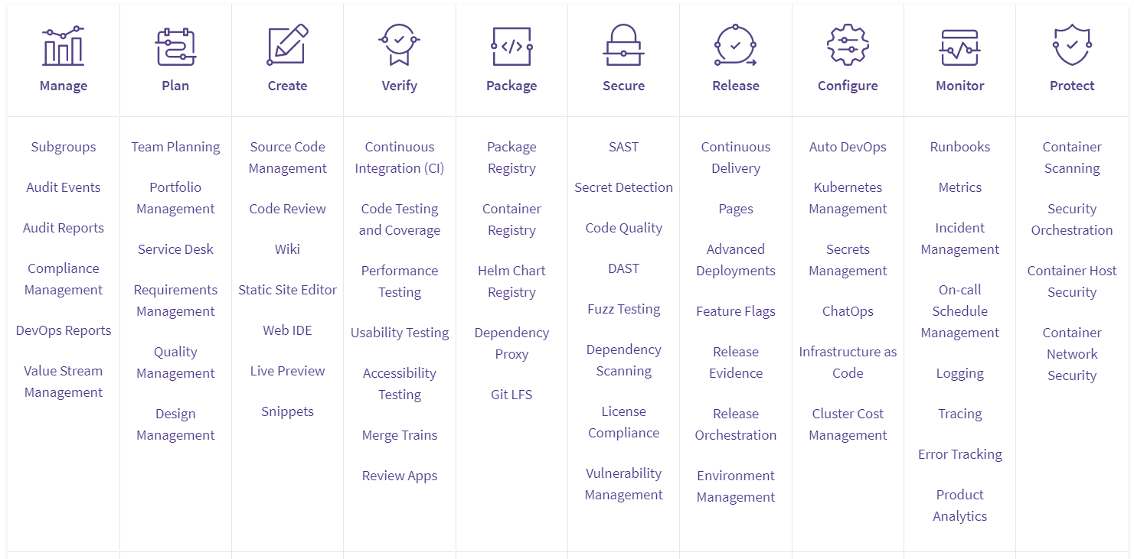
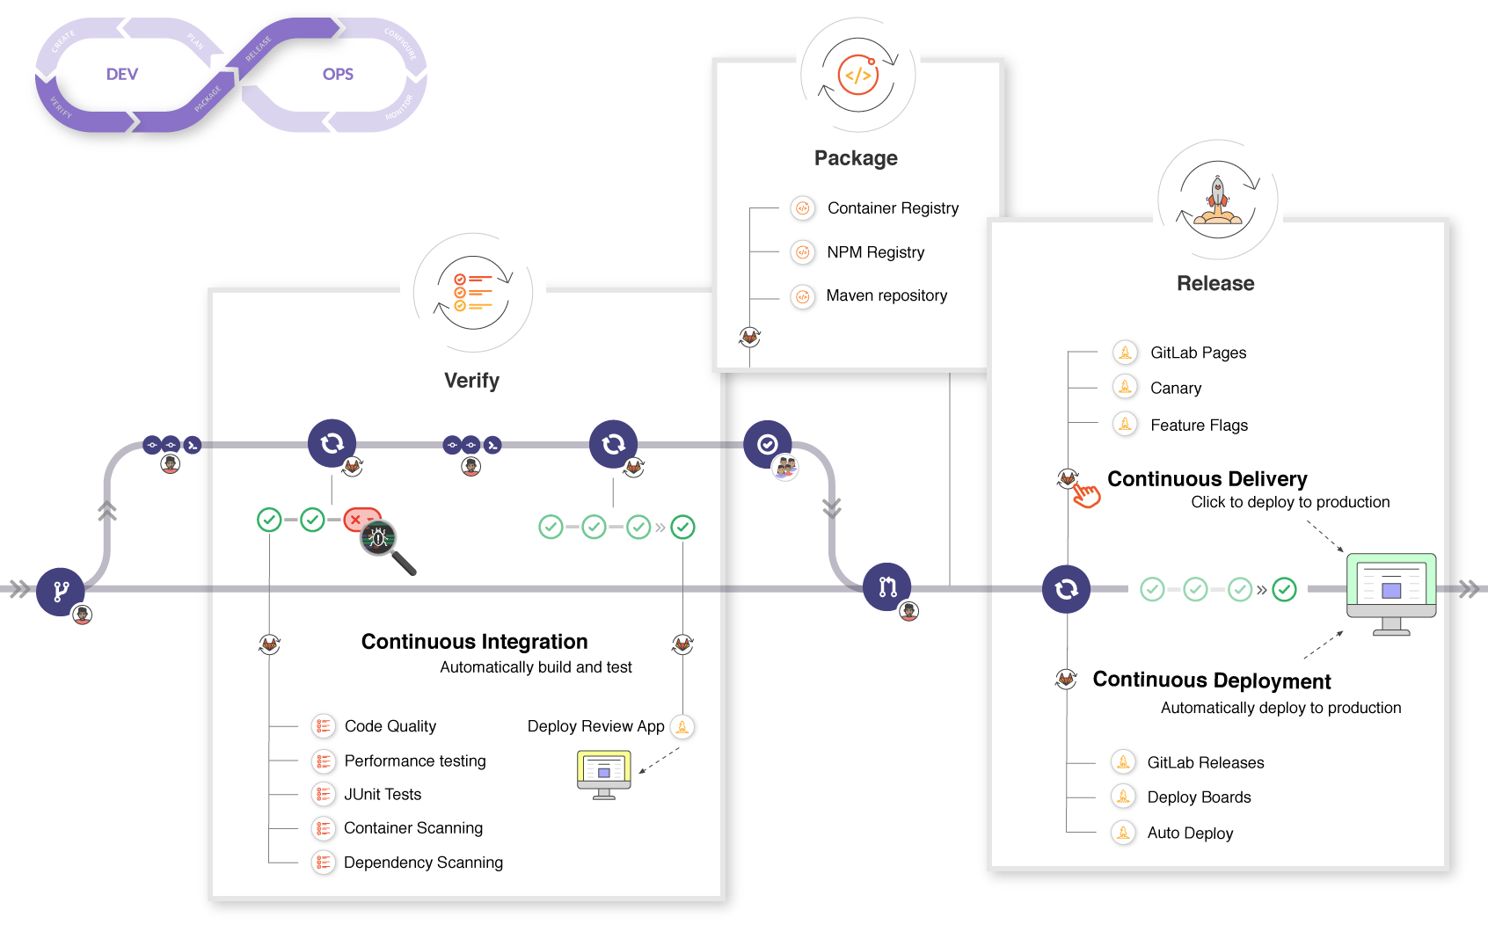
DevSecOps with GitLab (v14.4)
What is GitLab?
Benefits of GitLab
Constantly Updating
Complete
DevOps Platform
Delivered as a Single
Application
Work more efficiently
Deliver better software faster
Reduce
risk and cost
14.4
New features every month
GitLab Toolchain
GitLab CI/CD

Slide 2
DevSecOps with GitLab

