Slide 1
Energy Consumption Prediction-Assignment 3
Dylan Nico Ambrosi
Code: https://github.com/Dylan-Nico/MidtermsISPR.git

Slide 2
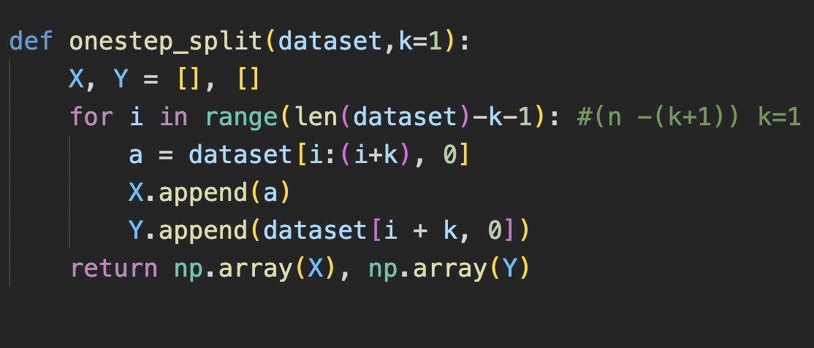
Data Preprocessing
The data is scaled with MaxMinScaler().
TR, VL and TS partition are created.
The one-step-ahead is performed by the onestep_split() function, which takes as parameter: the data and the step (looks back k steps).

Slide 3
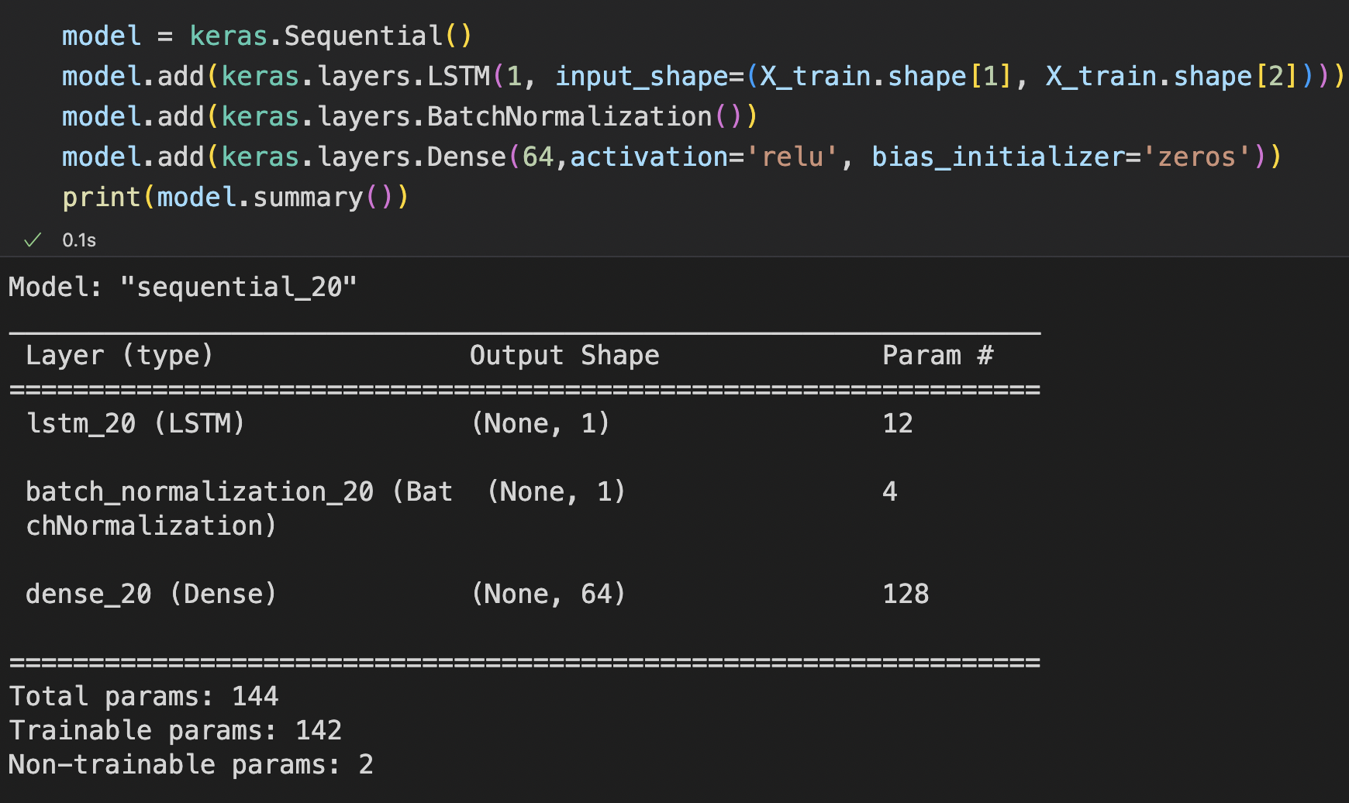
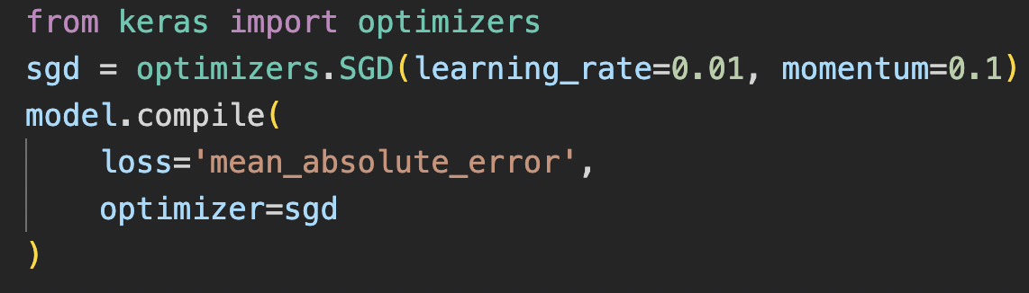
LSTM
The NN is composed by: the LSTM layer, a BatchNormalization layer and a Dense layer with relu activation function. Also, as a small grid search suggested, the weights of the Dense layer are initialized to zeros.
The optimizer used is the SGD.
The loss used is the Mean Absolute Error Loss.
Learning_rate=0.01
Momentum=0.1

Slide 4
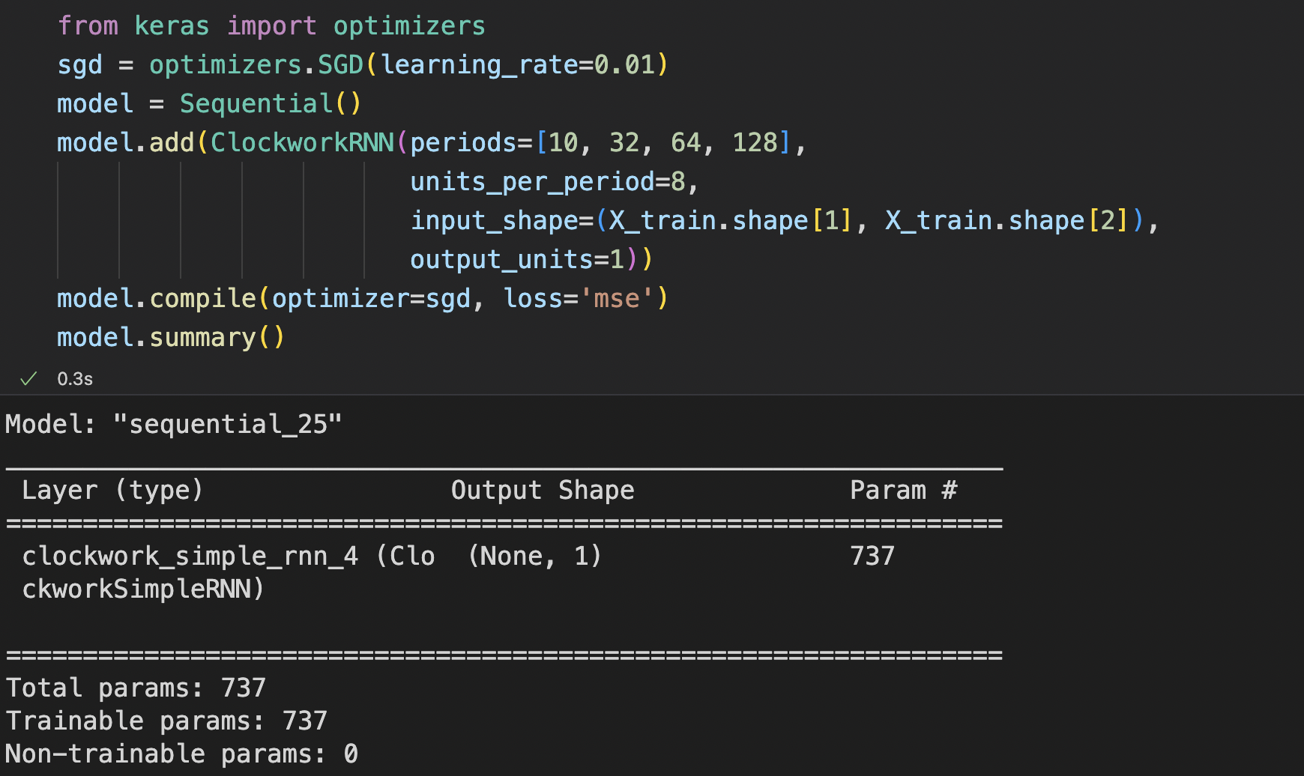
CWRNN
The clockwork RNN is implemented using [1] Reference, which lean on the Keras implementation of Sequential().
The internal layers are SimpleRNN, also from Keras. The recurrent units are set to 8, with different frequencies (period parameter).
Loss is the Mean Squared Error. The optimizer is the SGD.
Learning_rate= 0.01

Slide 5
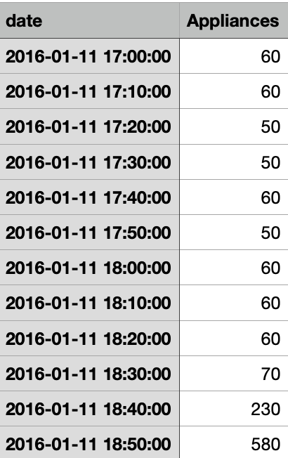
Period Parameter
Small values allow to see changes in longer periods of time (i.e, months).
In this case, high values are preferred, since the measurements are taken in a timestep of 10 minutes.

Slide 6
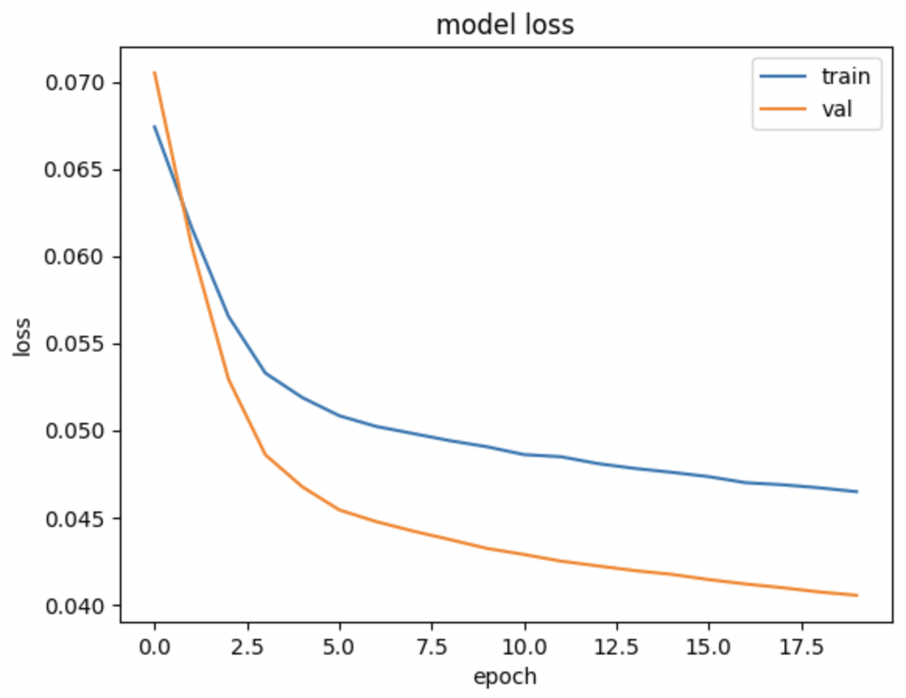
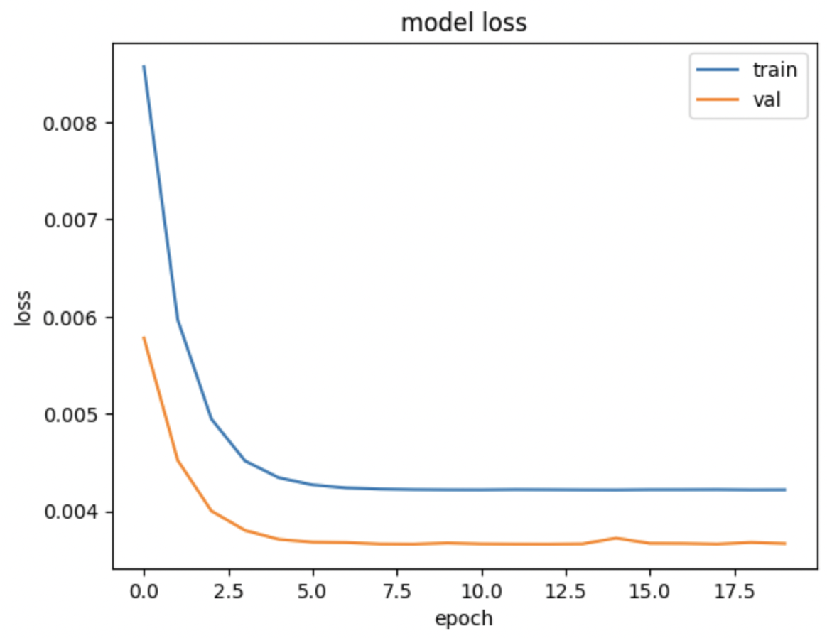
Losses
Clockwork loss has a faster convergence.
Both losses are not optimal but CWRNN performance is slightly better.
LSTM
CWRNN

Slide 7
Testing: RMSE
Models are tested and Root Mean Square Error is computed between the gound truth and the predicted labels.
LSTM shows a RMSE = 72.89
CWRNN shows a RMSE = 61.77
Execution time: The LSTM runs approximately within 3 minutes. Whereas the CWRNN takes about 5-6 minutes.

Slide 8
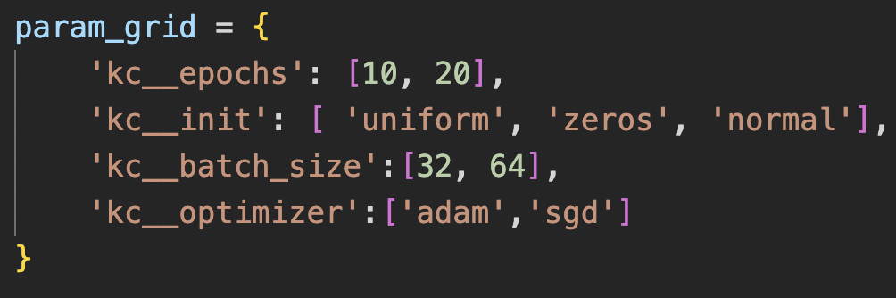
Small GridSearch
A small grid search is performed on the LSTM model to have an hint of the best hyperparameters to be chosen.
The best estimator is obtained using: {'kc__batch_size': 64, 'kc__epochs': 20, 'kc__init': 'zeros', 'kc__optimizer': 'sgd’}.
The max number of epochs are set to 20, since higher values showed no improvement for the validation loss.

Slide 9
Comments
It was very difficult to find good hyperparameter values and obtain such losses. The models were often in underfitting, especially the LSTM.
GridSearch gave some hints, but also it takes a lot of time for few hyperparams.
Some proper model validation is certainly required to improve the performance.

Slide 10
Bibliography
[1] https://github.com/flandolfi/clockwork-rnn
[2] https://pythonalgos.com/long-short-term-memory-lstm-in-keras/
[3] A Clockwork RNN, Jan Koutník et al. https://arxiv.org/abs/1402.3511

