Slide 1

ECE 263 Project Proposal
Oliver’s Underlings
Dylan Umino Oliver Hoffman Hussain Alramadhan
October 26th 2026

Slide 2
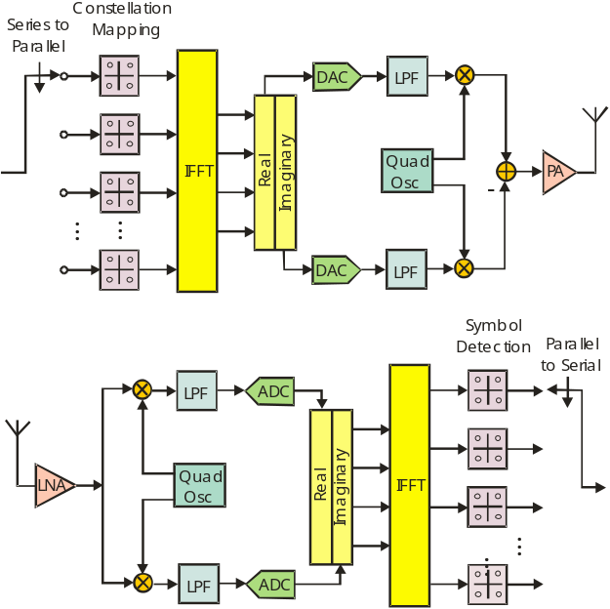
Why do we need this Converter?
In a low power integrated RF 802.11 OFDM Transceiver, we need dense digital logic for Digital Signal Processing of Baseband signals, as well as various analog blocks
A high efficiency is needed to support heavy signal processing
such as FFTs, Channel Inversion, and Beamsteering
A buck converter to drop the battery voltage efficiently for
lower switching power in the digital blocks.
The transceiver is designed on this TSMC 65nm process which
supports transistors with salicide, and a buck converter can
be easily integrated onto the same Die.

Slide 3
Specifications
Specifications | Target
Input Voltage | 1.6V-2V 1.8V Nominal
Output Voltage | 0.6V-1.2V 0.8V Nominal
Load Current | 0.2A-2A 1A Nominal
Output Voltage Ripple | < 50mV 30mV Nominal
Droop at Vout in load transient | < 50 mV For a current transient of 0.5A in 0.5us
Droop at Vout in line transient | < 50 mV For a Vin transient of 1.7V to 1.9V in 1us
Efficiency | > 80% Nominal
FOM | < 0.5 W*mm^2
Our transistors can generally handle ~2V before breakdown, so this is an intermediate stage in conversion
Output voltage is 0.8V, as that is the nominal rail voltage of our digital logic
Load current and transients are required, as the digital logic has Dynamic Voltage and Frequency Scaling (DVFS), as different uplink and downlink situations require different throughput.
For battery life and thermal management, >80% efficiency, and low loss is needed for our design

Slide 4
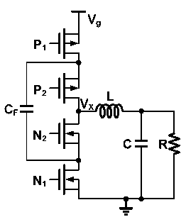
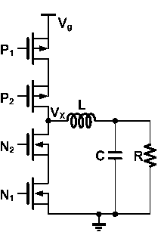
Topology Selection
Two candidate topologies are the classic Buck Converter and the 3 Level Buck Converter
For simplicity and to decrease the time to market, we selected the Buck Converter although the 3 Level is attractive for its higher efficiency.
Buck
3-Level Buck

Slide 5
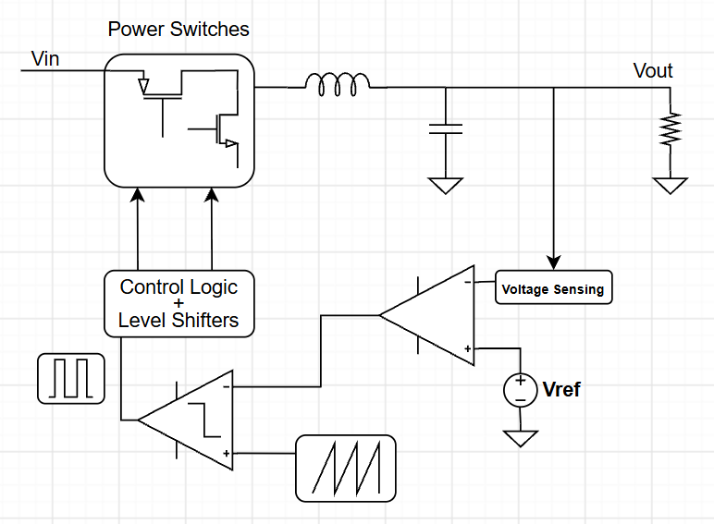
Block Diagram of Buck Converter
Several sub-blocks with considerations needed to regulate the buck converter
Error Amplifier
  Unity Gain Bandwidth
  Input/Output Common Mode
Control Logic
  Timing Switch On/Off times
PWM Generation
  Comparator
  Ramp Generation

Slide 6
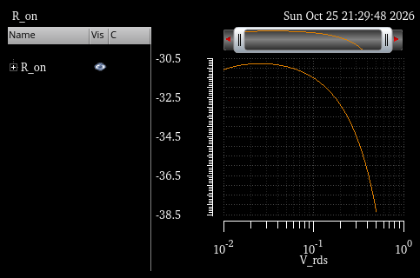
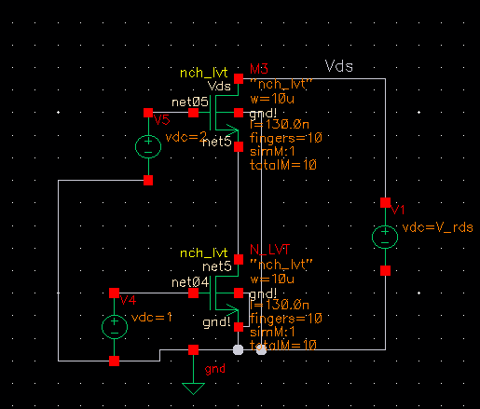
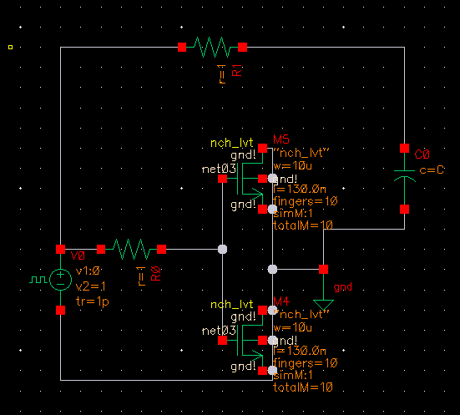
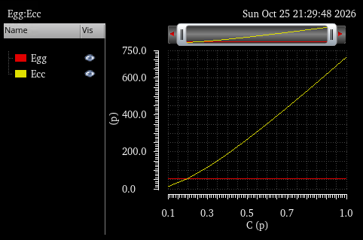
Optimization – Switches
Transistor Selection
  We explored multiple types of MOSFET devices to decide which would be best suited to our purposes (nch, nch_25, nch_lvt, and nch_na25). We selected the nch_lvt device for its low on resistance, which will allow for a smaller size and lower capacitance

Slide 7
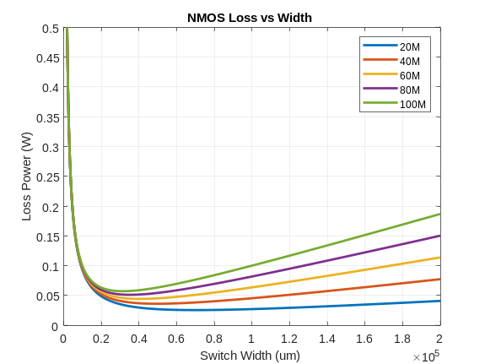
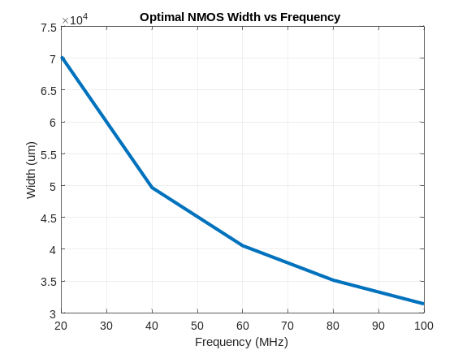
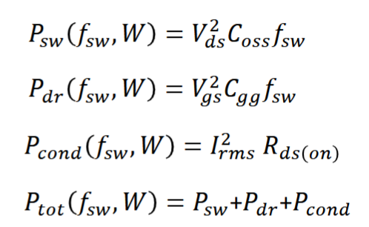
Optimization – Switches
Loss Analysis: Transistor Sizing
  Using Cadence simulation results we calculated total loss (switching + driving + conduction) for various widths to choose the lowest loss.
  For our preliminary sizing we simply chose the lowest loss option, which we may revise later to afford more area to components such as the inductor.

Slide 8
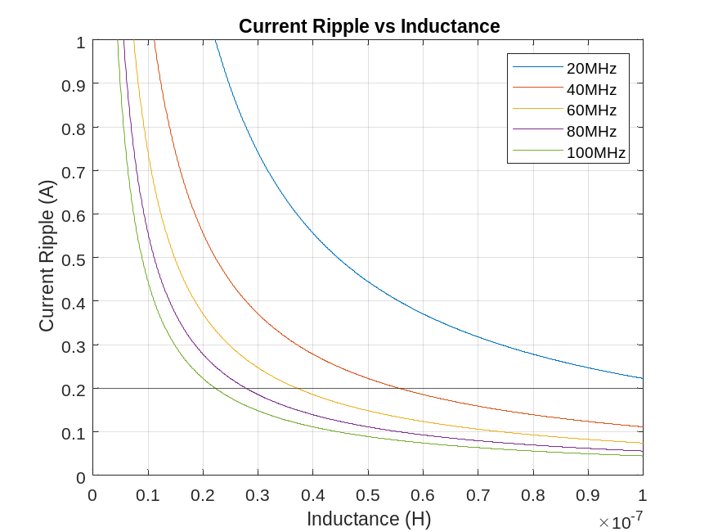
Optimization – Passives
Inductor Modeling
  We plotted current ripple vs inductance at various frequencies and chose a limit that guarantees that the converter stays in CCM.
Frequency Selection
  We found that a higher switching frequency is generally better for the inductor size as well as optimal switch size. We chose to start by assuming a tentative but fast switching frequency of 80MHZ.
We chose a preliminary inductor size of 14nH

Slide 9
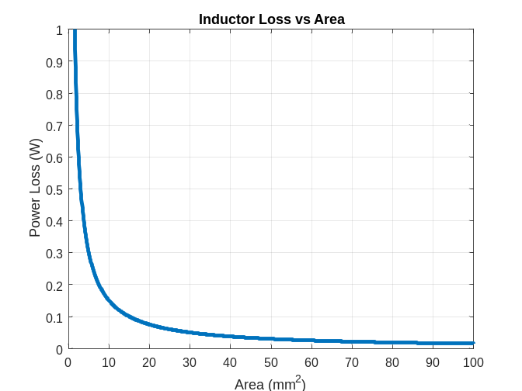
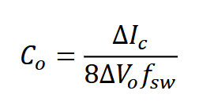
Macro Model of Circuit
Inductor area
  We plotted the inductor loss vs area to estimate our losses to inductor resistance and approximate the size required.
Capacitor sizing
  The capacitor size is determined primarily by the output voltage ripple requirement.
  We used our determined inductor current, output ripple specification, and our chosen switching frequency to determine our preliminary capacitor size to be 20nF

Slide 10
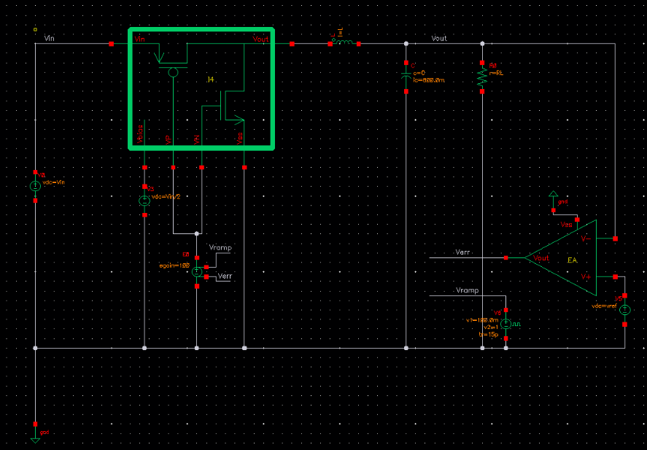
Macro Model of Circuit
Switches with Ron of ~46mOhms
Inductor with DCR ~100mOhms
Single Pole Operational Amplifier
Ideal Gate Driver + Ramp
Generation

Slide 11
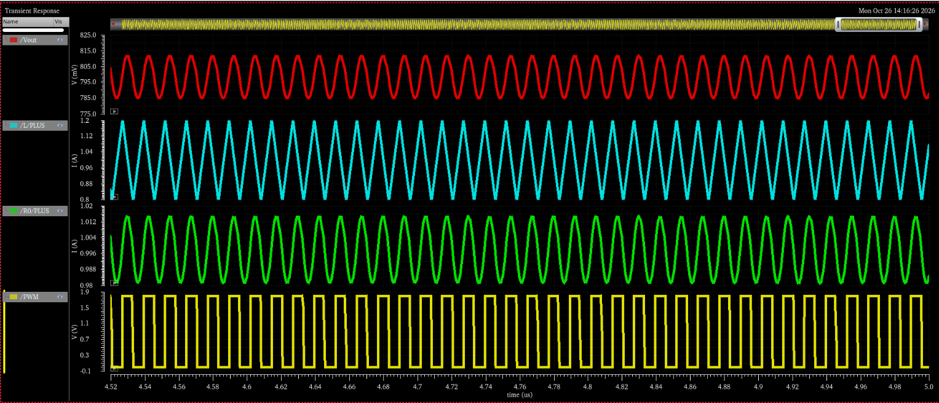
Macro Model of Circuit
Output Voltage
Inductor Current
Output Current
Switch Voltage
Average Output Voltage: 800mV
Average Output Current: 1A
Efficiency: 86.7%
Output Voltage Ripple: 26mV
Inductor Current Ripple: 0.4A
Output Current Ripple: 0.2A
Under nominal 1A output current

Slide 12
Backup Slides Macro Models Details
Parameter | Value
Op Amp Gain | 1000 V/V (60dB)
Op Amp Output Resistance | 100kOhms
Op Amp Output Capacitance | 10pF
Switch On Resistance | 46 mOhms
Inductor | 13.75 nH
Inductor DCR | 60 mOhms
Capacitor | 24nH
Performance Metric | Value
Input Voltage | 1.8V
Output Voltage | 0.8V
Output Voltage Ripple | 26mV
Switching Frequency | 80 MHz
Efficiency | 86.7%
FOM | 0.78

Slide 13
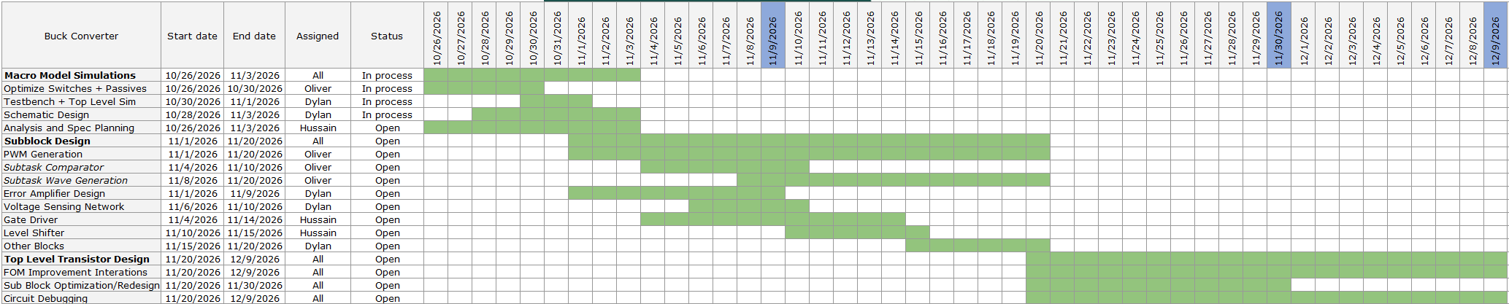
Timeline
Top Level Transistor Design Assignments Unclear for Now
Currently Focusing on Macro Model Simulations with Real Power Switches and Passives
Full Loop Macro Model will inform specs for error amplifier and gate drivers

