Slide 1
Yilin Wang Aug 2026
Learning to Route for Sensing Coverage
A neural amortized solver trained on Gurobi labels — methodology

Slide 2
Agenda
• Problem: fleet sensing-coverage routing on a fixed network
• Pipeline: offline label farm → supervised training → millisecond inference
• Network & instance definition (bidirectional 4×4, 8 gates, 56 ODs)
• Model architecture & the feasibility mask
• Training recipe: data generation + teacher forcing
• Evidence so far (3×3 / 4×4) · extension-1 evaluation design [results pending]
202608

Slide 3
Methodology
Problem
• One case (an 'operating day'): congestion δ ∈ {0,1}^80 per directed link · V vehicles · per-vehicle task (origin gate, destination gate, departure t0)
• Vehicles run SIMULTANEOUSLY on one timeline; entering link i at time t occupies cells (i, t … t+c−1), travel time c(i,t) = (base(i)+t)//4 + 1 + δᵢ (street-symmetric base)
• Objective (identical to the Gurobi MILP): min [ α₁·total_cost − α₂·fleet_coverage ] / (V·H), α = 0.3 / 0.7
• coverage = |union of occupied (link, time) cells| — overlap counts once; horizon H = 338 is the per-vehicle budget
• Taxonomy: team-orienteering-type (selective, max-utility, budget) — NOT visit-all min-cost CVRP

Slide 4
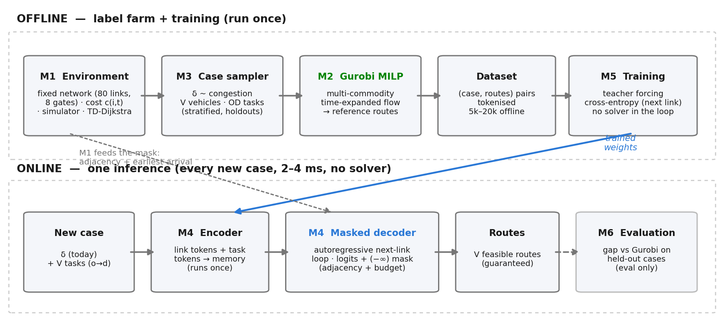
Methodology
Pipeline
• Gurobi = the only solution source (offline labels); the trained model replaces per-case solving at deployment — 2–4 ms, no solver calls

Slide 5
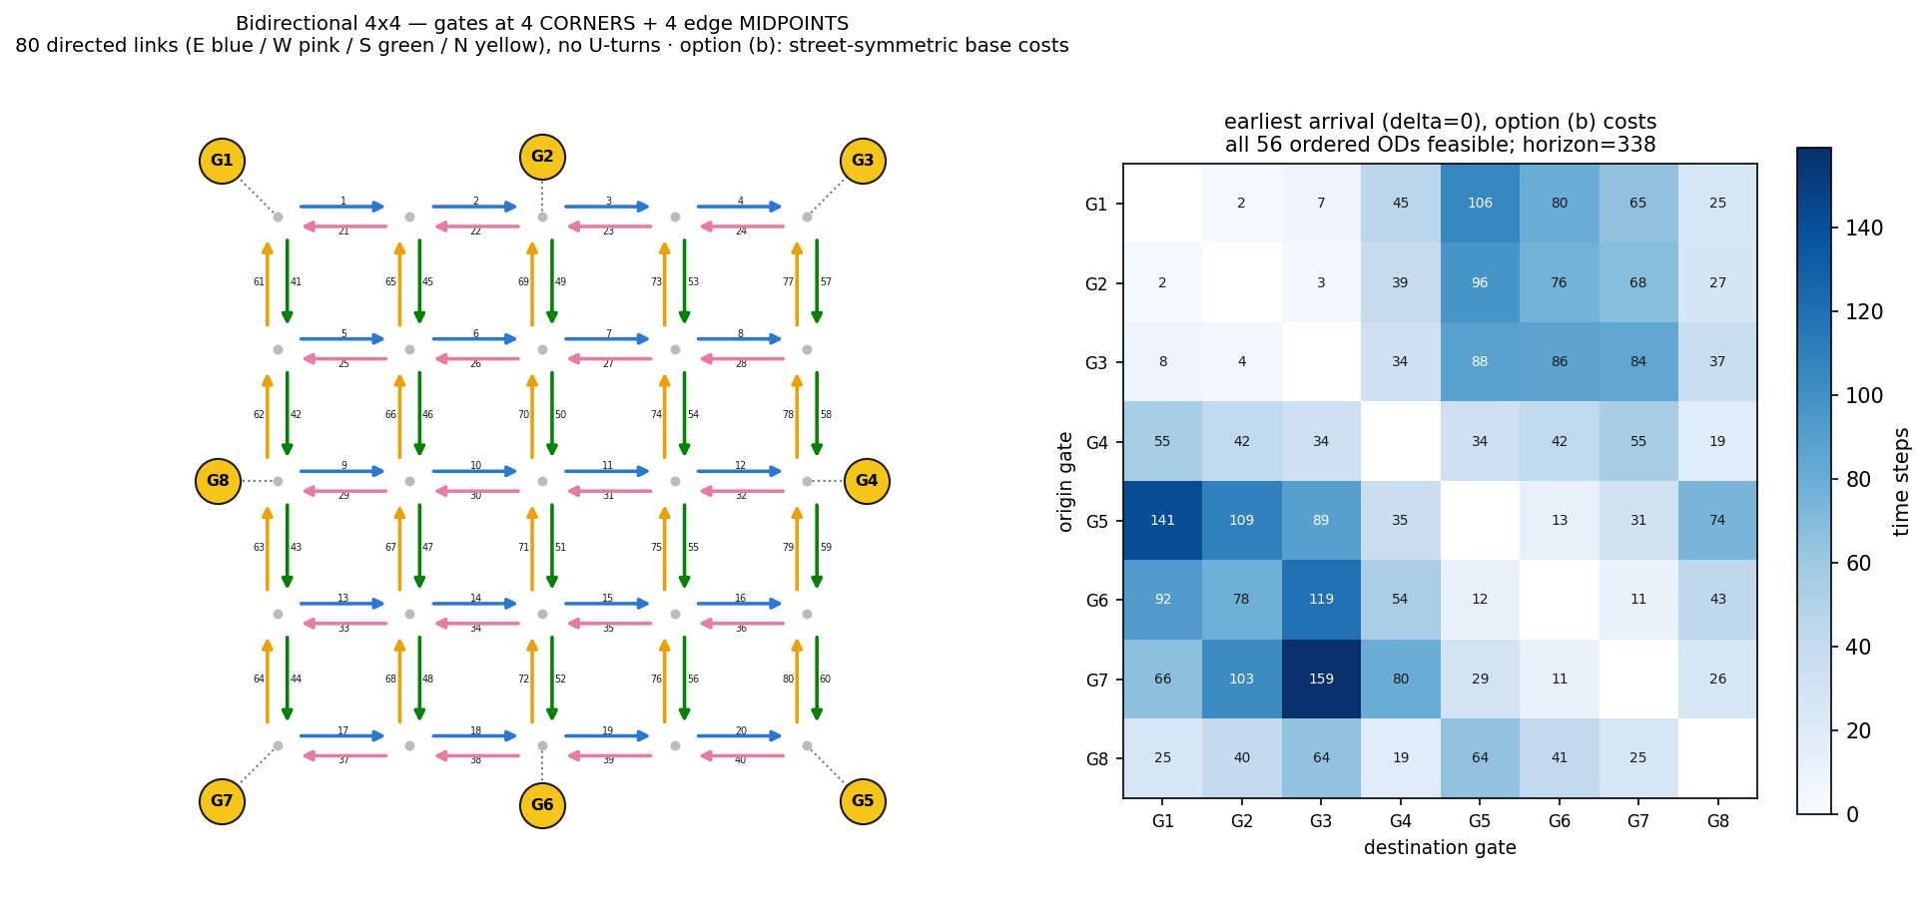
Methodology
Network
• Bidirectional 4×4: 80 directed links, no U-turns · 8 gates (4 corners + 4 midpoints) · all 56 ordered ODs feasible (heatmap) · horizon 338

Slide 6
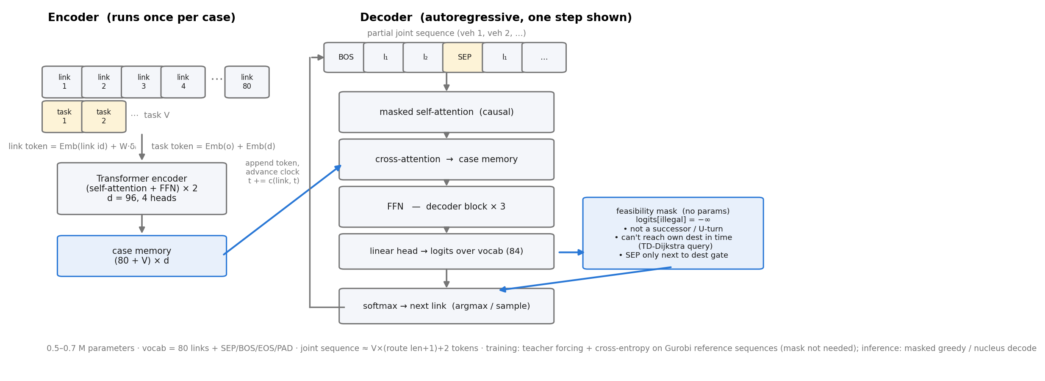
Methodology
Model

Slide 7
Methodology
Feasibility mask
• Three lines between logits and softmax: logits[illegal] = −∞ → illegal probability is EXACTLY zero (grammar-constrained decoding)
– not a successor of the current link / U-turn (road topology)
– cannot reach THIS vehicle's destination gate within the horizon (time-dependent Dijkstra query)
– SEP only when adjacent to own destination; EOS only after V SEPs
• No parameters — rules guarantee feasibility; the network only ranks legal moves (learned from Gurobi)
• Standard in the literature: Kool AM §3 (u=−∞; OP budget rule) · MTPOMO Eq.10 · FM-MCVRP §4.2 (softmax(G·Wo+M)) · TOP-Former Eq.18
• Measured necessity: adjacency-only mask → 10/200 horizon-infeasible decodes; + budget mask → 200/200 feasible

Slide 8
Methodology
Training
• Data (offline label farm, resumable + watchdog-supervised):
– δ ~ iid{0,1}^80 · V ∈ {2,3,4,6} · OD stratified by difficulty terciles (earliest-arrival matrix) · t0 ∈ {0..5}
– labels: multi-commodity time-expanded flow MILP (Gurobi, MIPGap 2%, 60 s cap) — validated vs min-time bound, decomposition-consistent
– 5000 train + 500 test + 300 OD-zero-shot (4 held-out ODs) + 300 fleet-extrapolation (V ∈ {5,8})
• Objective design note: coverage normalized by V·H with α 0.3/0.7 — otherwise optima collapse to min-time routes (no sensing behavior to learn)
• Training: teacher forcing, next-link cross-entropy (PAD ignored); no solver and no generation inside the training loop; AdamW, batch 64
• Model selection: per-epoch MASKED GREEDY generation on validation cases — select on true objective gap, not on CE loss
• Data-volume policy: nested 1k/2k/5k slope experiment; extend the resumable farm only if the curve is still steep

Slide 9
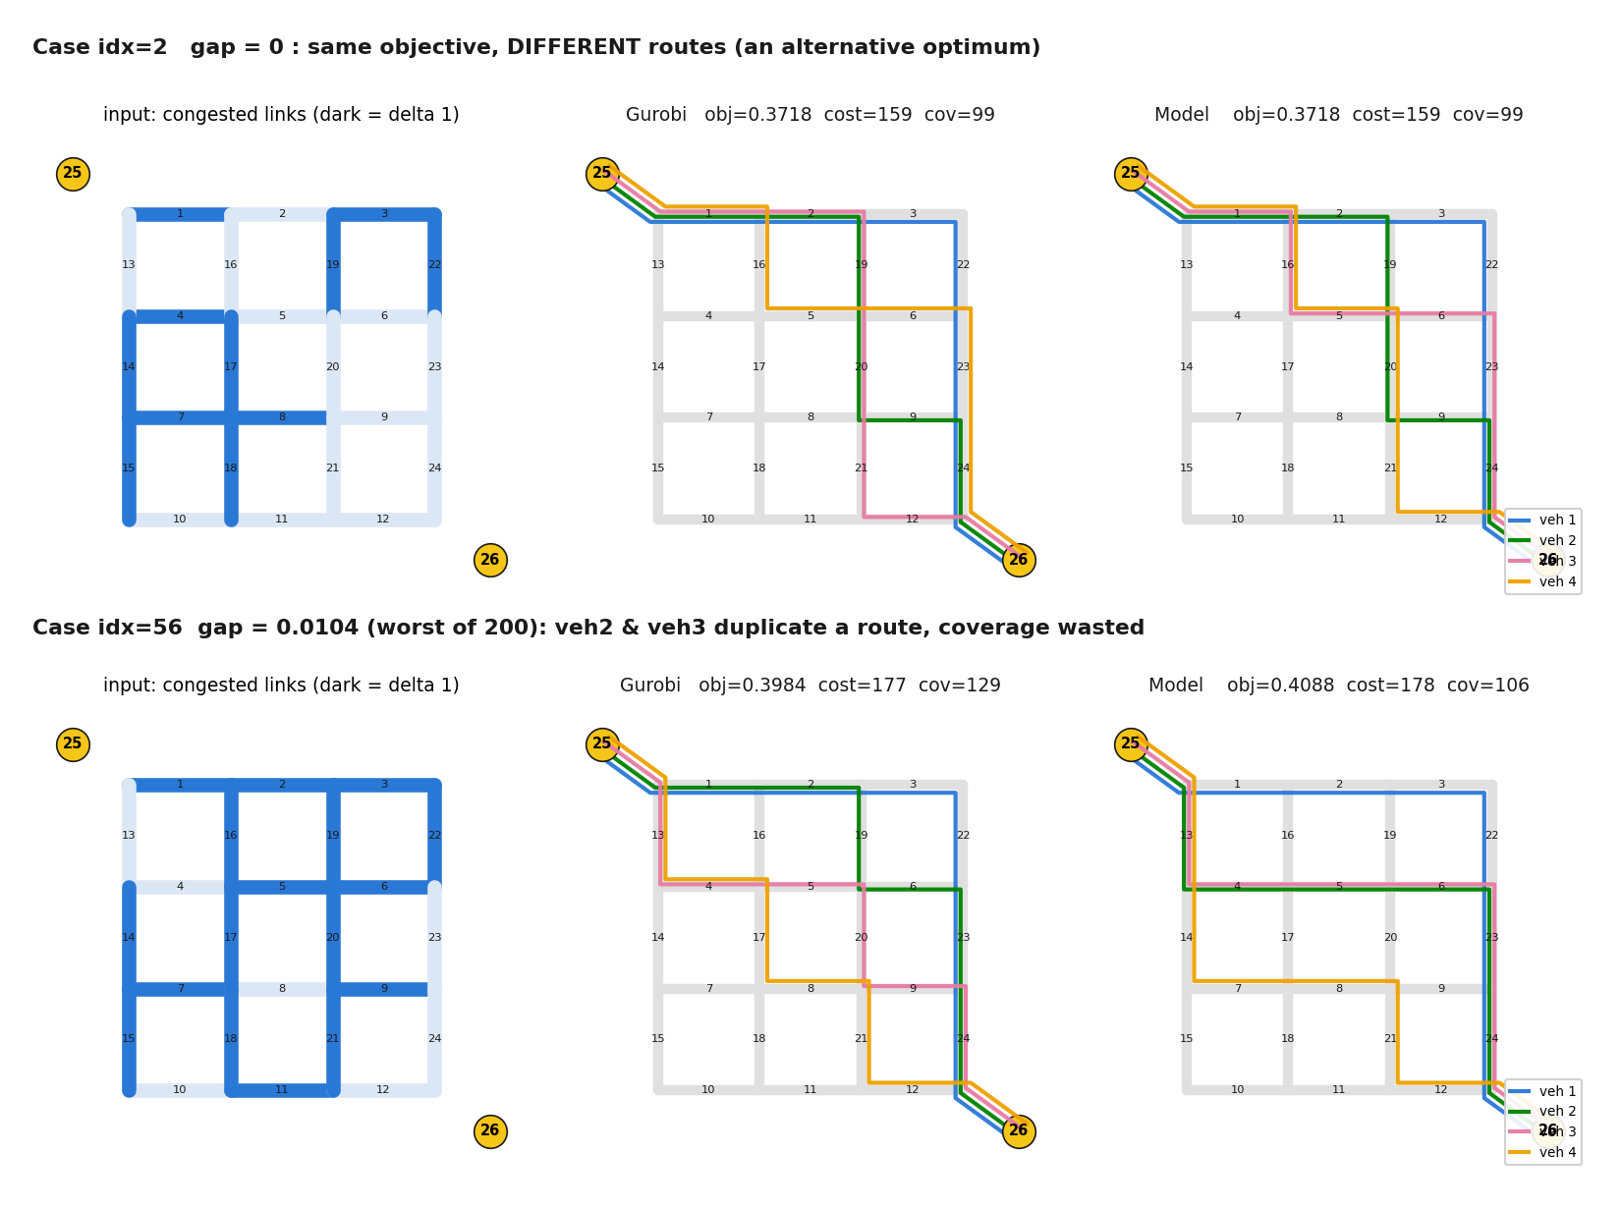
Evidence (toy)
Learned coordination
• Decoder writes the fleet as ONE token sequence — later vehicles attend to earlier routes
• Same prefix, different context: veh-2 flips 3:1.00 → 19:0.85 after seeing veh-1 occupy the 3-22-23-24 corridor (real trace)
• 'Don't duplicate coverage' is learned from joint-optimal labels, not hard-coded

Slide 10
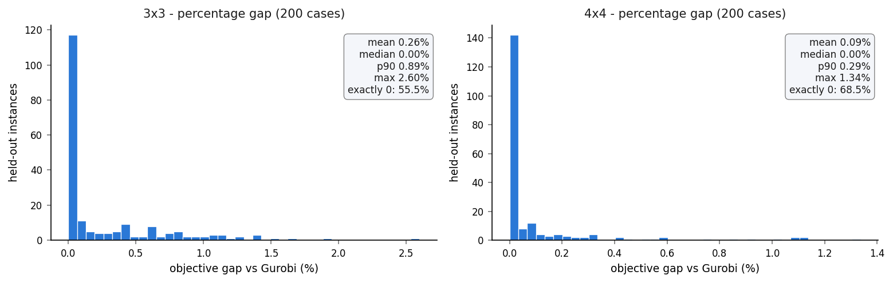
Evidence (toy)
vs Gurobi
• 3×3: 55.5% exact-match, mean 0.26% · 4×4: 68.5%, mean 0.09% · 200/200 feasible · 2–4 ms/case (Gurobi: seconds) · 0.5 M params, <150 MB VRAM

Slide 11
Extension 1
Evaluation
• Three-layer exam for the multi-OD / multi-fleet / staggered-departure model:
– L1 same-distribution: 500 unseen cases (trained ODs, new δ / task mixes)
– L2 OD ZERO-SHOT: 4 OD pairs never seen in training (G1→G5, G6→G2, G4→G8, G7→G3)
– L3 fleet extrapolation: V ∈ {5, 8} (trained on {2,3,4,6})
• Metrics: feasibility rate · % matching Gurobi · absolute + percentage objective gap · per-case CSV + route visualisations
• [ RESULTS PENDING — label farm running (5000 train, ~3 h ETA at deck build time); slides to be filled after training ]

Slide 12
Extension 2
The weight α is not a dial
• Objective: min [ α₁·Σcost − α₂·Σ y(i,τ) ] / (V·H), both terms verified in (0,1] before α (max exactly 1.000 across all 6 100 labels — normalization is NOT the issue)
• Marginal argument: one extra step through a fresh cell costs ΔC = 1 and buys ΔK ≤ 1, so
Δobj = (α₁ − α₂) / (V·H) → sign flips at α₂/α₁ = 1, independent of any normalizer
• α₂ > α₁ ⇒ EVERY detour is profitable ⇒ the optimum roams until the horizon stops it; α₂ < α₁ ⇒ no detour is ever bought (coverage survives only as a tie-break)
• So the real limit on coverage is the HORIZON H, not α. α selects one of two regimes; it cannot set a position between them
• Consequence for learning: conditioning a neural solver on α would teach it a switch, not a continuous semantics — not worth new labels

Slide 13
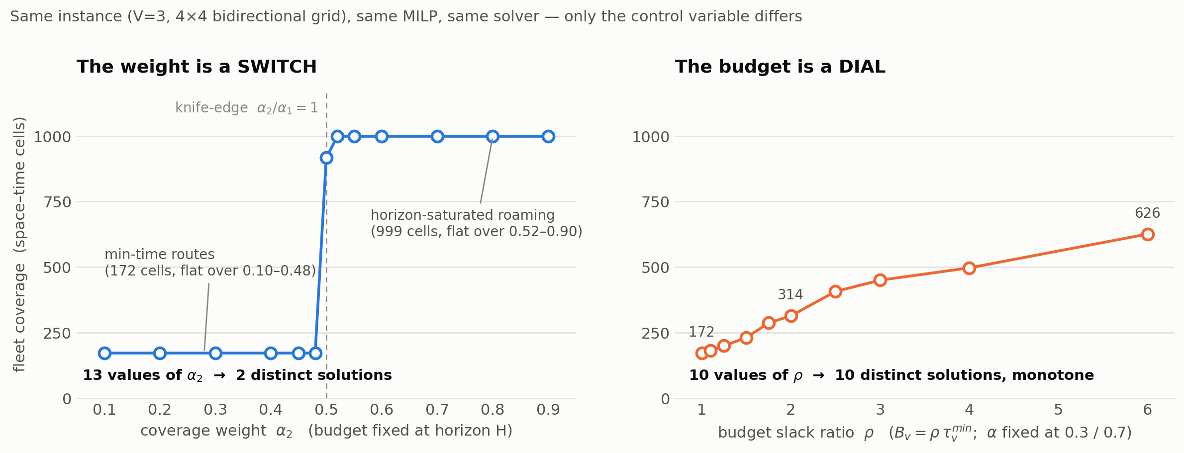
Extension 2
Switch vs dial — measured
• One fixed instance, one MILP, one solver, MIPGap 0.5%. LEFT: 13 values of α₂, budget fixed at H → 2 distinct solutions (α₂ = 0.10–0.48 identical link-for-link). RIGHT: α frozen at 0.3/0.7, budget swept → 10 distinct monotone solutions

Slide 14
Extension 2
The fix: a per-vehicle budget
• Every vehicle carries its own budget Bᵥ (= shift length / remaining energy — a PHYSICAL parameter, not a tuning weight); hard deadline t0ᵥ + Bᵥ. The objective is unchanged:
min [ α₁·Σcost − α₂·Σ y(i,τ) ] / Σᵥ Bᵥ s.t. vehicle v reaches dᵥ by t0ᵥ + Bᵥ
• Parameterised as a SLACK RATIO: Bᵥ = ⌈ρᵥ · τᵐⁱⁿ(oᵥ,dᵥ,t0ᵥ)⌉ — an absolute budget is not comparable across ODs (vacuous for near pairs, infeasible for far ones). ρ is the scalar the model is conditioned on, and the x-axis of every plot that follows
• Bounds preserved: cov ≤ cost ≤ Σᵥ Bᵥ, so both terms stay in (0,1] before α
• MILP deltas: commodity key (o,d,t0) → (o,d,t0,B); time-expanded DAG pruned at min(H, t0+B); coverage grid still on [0,H)
• Verified reduction: at Bᵥ ≥ H the budget MILP returns the previous full-horizon solution link-for-link — a strict generalisation, not a different problem
• Bonus: tight budgets prune the DAG, so labelling is ~30× FASTER (0.9 s vs 26 s mean per case)
• Taxonomy: budget is the defining constraint of Orienteering / Team-Orienteering — this moves the benchmark into the family the routing foundation models actually transfer to

Slide 15
Extension 2
Pipeline changes
• ① Label farm — every vehicle draws ρᵥ; fleets are heterogeneous (65%) or homogeneous (35%)
– trained ρ anchors {1.0, 1.5, 2.0, 3.0} · held out for the exam: {1.25, 1.75} and {4.0}
– 10 780 labels, 0 errors, 0 hit the 60 s cap (previous farm: 5.1% capped) · ~17 min on 15 workers
• ② Encoder task token gains the budget attribute (RouteFinder-style attribute embedding):
Emb_o(o) + Emb_d(d) + Proj(t0) → … + Proj([ρᵥ , Bᵥ/H]) (+0.3 k params)
• ③ Decoder feasibility mask switches threshold — the one change that makes budgets GENERALISE:
min_finish(j, t, d) ≤ H → min_finish(j, t, d) ≤ t0ᵥ + Bᵥ
– the budget enters through a HARD mechanical channel, not only as a soft preference in the labels ⇒ an unseen budget still yields a feasible route by construction
• ④ Exam gains layer L4 = budgets never seen in training (interpolation + extrapolation), plus a coverage-vs-ρ response curve against Gurobi
• Unchanged: teacher forcing on next-link CE, model selection on masked-greedy objective gap, no solver in the training loop

Slide 16
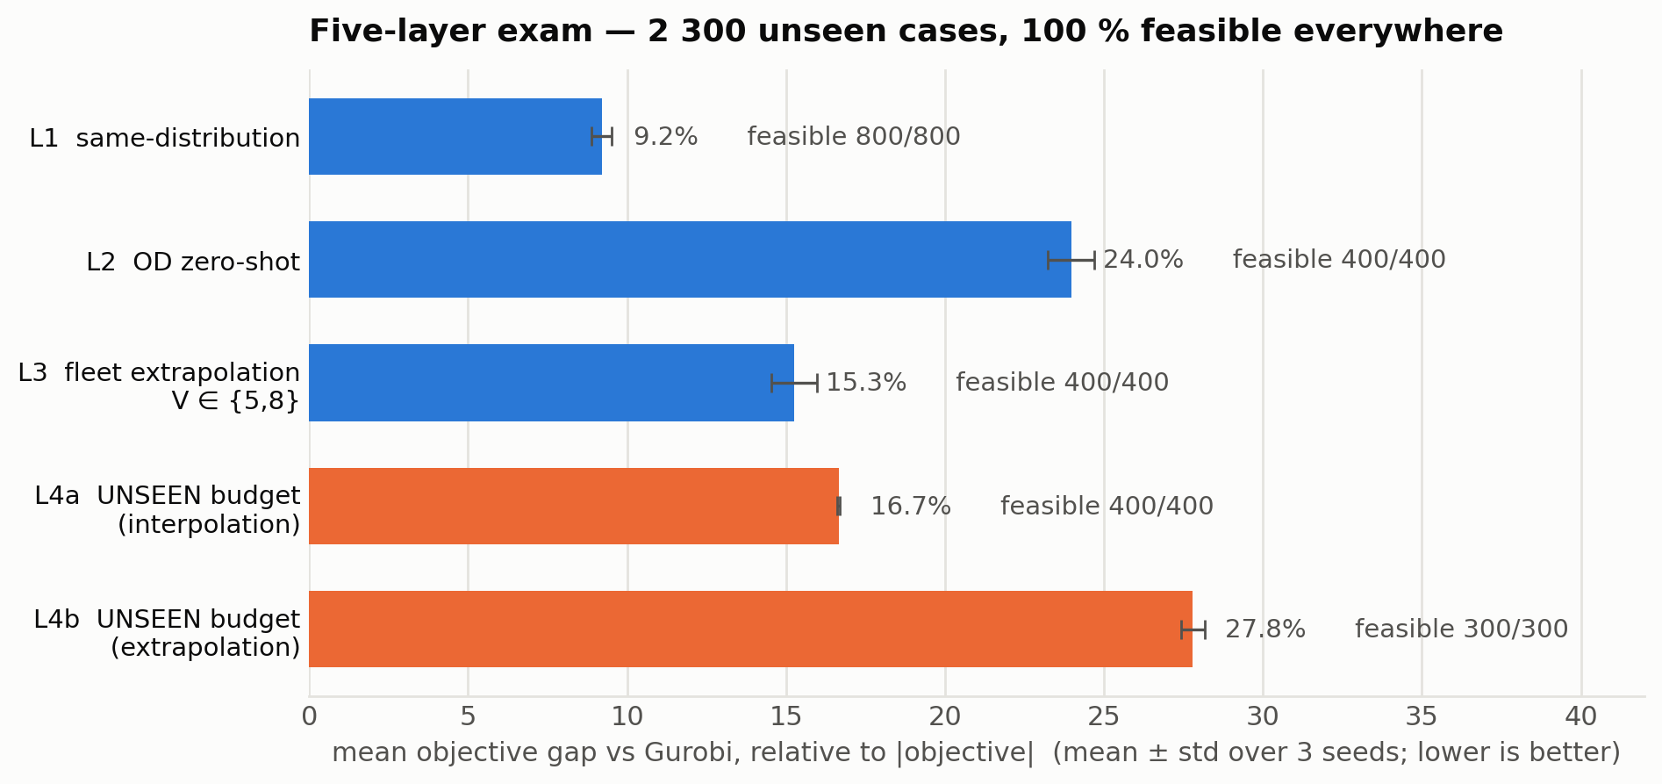
Extension 2
Results — five-layer exam
• 3 seeds × 60 epochs (1.04 M params, ~4 min/seed, one RTX 3090) · 6–9 ms per case · 274/800 of L1 match or beat Gurobi
• NOT comparable with the extension-1 numbers: different denominator (Σ Bᵥ vs V·H) and a different label set — a new baseline, not an improvement claim

Slide 17
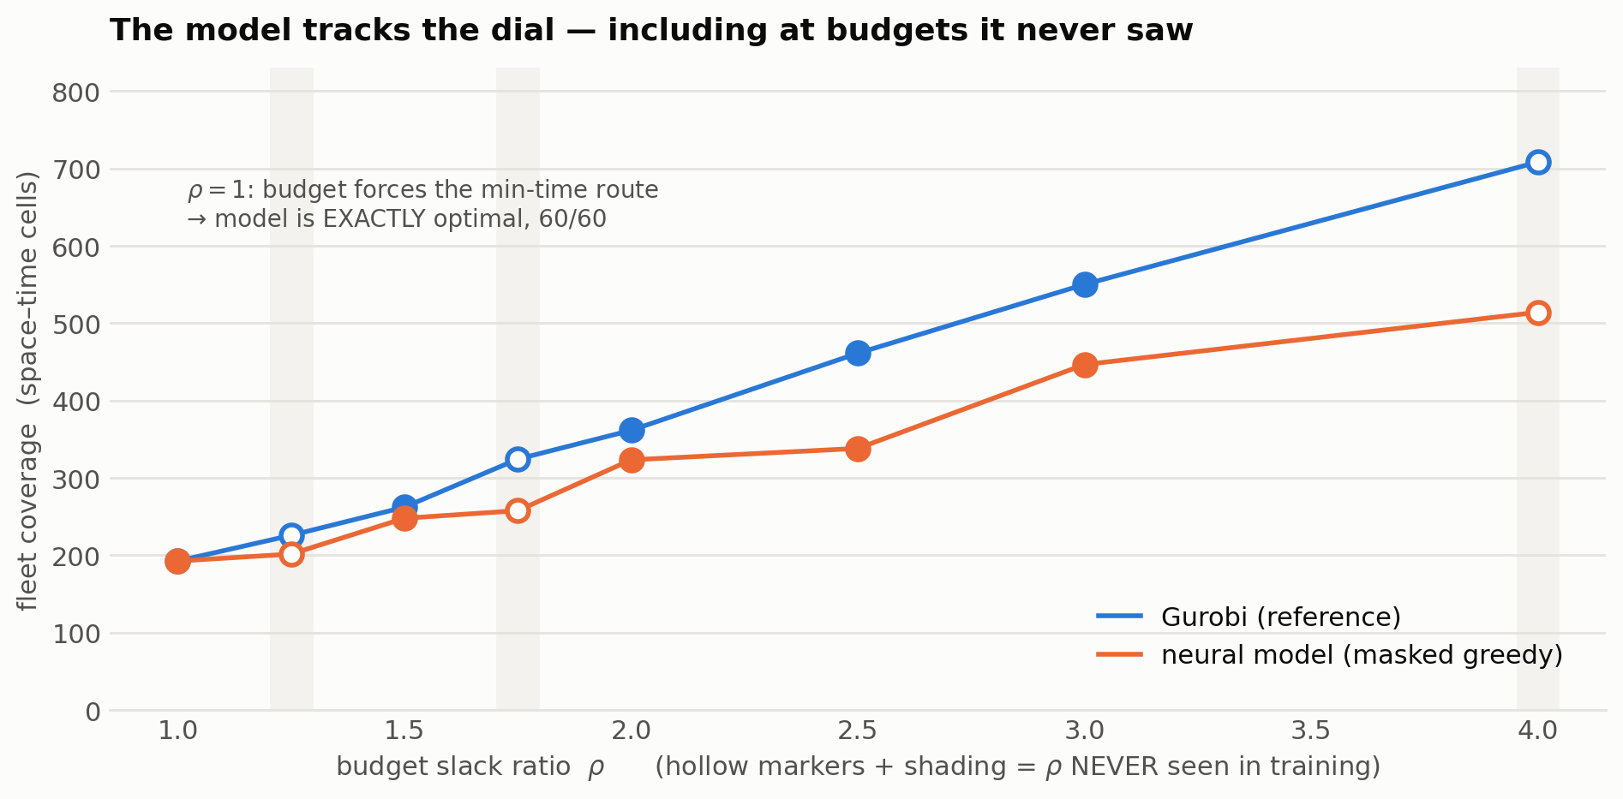
Extension 2
Results — the dial generalises
• Monotone response reproduced — including at ρ = 1.25 / 1.75 / 4.0, absent from every training label. At ρ = 1 the model is EXACTLY optimal (60/60); tracking degrades as slack grows (ρ = 4: 514 vs 708 cells)

Slide 18
Summary
Where this leaves us
• One recipe, now with a physically meaningful control: Gurobi labels offline → small Transformer → guaranteed-feasible millisecond inference, conditioned on per-vehicle budget
• The α analysis is a result in its own right: a normalized weight can still be a switch when the two objective terms are marginally 1:1 coupled — worth a paragraph in the paper
• Known degeneracy, deliberately left open: with uniform cell utility, overlap = 0 in 92% of labels ⇒ coverage ≈ cost. The budget controls HOW MUCH to roam; WHICH cells to prefer needs heterogeneous utility wᵢ (deferred by decision — the α₂/α₁ ratio becomes a real threshold then)
• Next levers, in order: multi-sample (non-greedy) decoding · data-volume slope · wider ρ range to repair L4b extrapolation · then the 5×5 real network

